Slide 1
Chinese Tire imports (tariff) “President obama imposed punitive duties of up to 35%....”

Slide 2
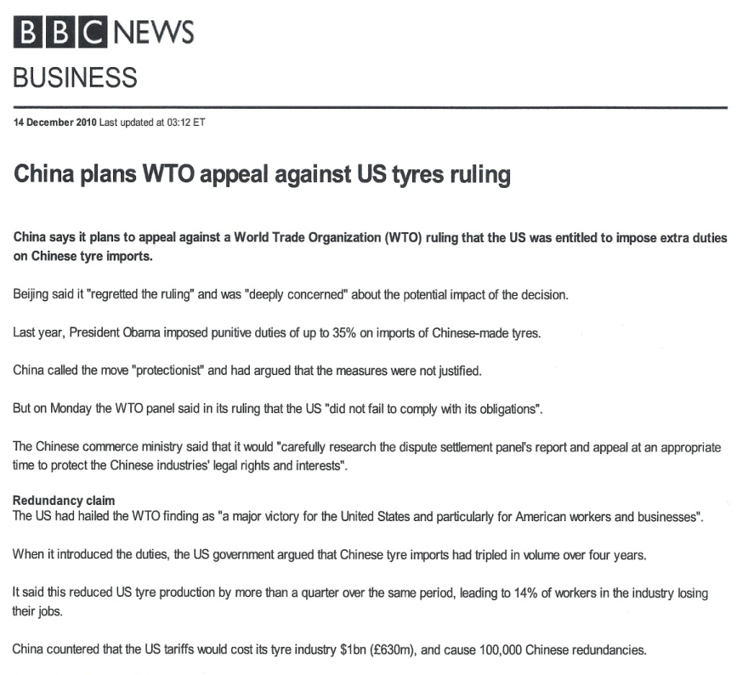
U.S. said Chinese tire imports had tripled in volume over four years.
Reduced U.S. tire production by more than a quarter.
Led to 14% job loss in the industry.
President imposed tariff on Chinese tires.

Slide 3
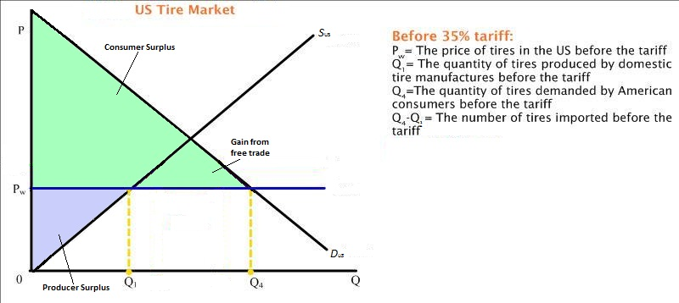

Slide 4
