Slide 1
“State Tax Costs Given” Tax exemption for airplane engine-repair parts…Expire
ECON2106(Micro): Section B

Slide 2
The Augusta Chronicle
“One due to expire in June is the sales tax exemption for airplane engine-repair parts, which was worth $7 million last year…companies including Gulfstream Aerospace…argues that jobs would be lost if airplane customers took their business to states that don’t charge the tax.”

Slide 3
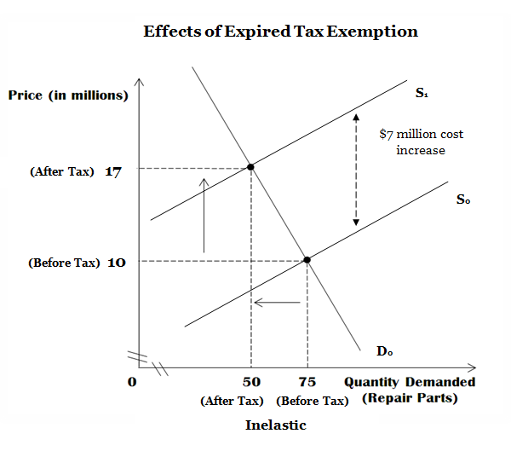
% Δ in QTY Demanded: 50-75 is 0.333…which is a 33% decrease in the quantity demanded. 75
% Δ in Price: 17-10 is 0.7 which is a 70% cost increase.
10
Midpoint % Δ in Price: 17-10 is 0.51 which is 51%.
((17+10)/2)
The large % increase in price only slightly effected the quantity demanded which makes it inelastic. (% Δ in QTY Demanded < % Δ in Price). –Price Elasticity of Demand: 0.47 < 1.

Slide 4
Conclusions
Increase in cost will lower quantity demanded.
However, I believe the graph being inelastic shows:
-Majority of customers will not leave, but in fact stay and accept the higher costs.

