Slide 1
Online Education

Slide 2
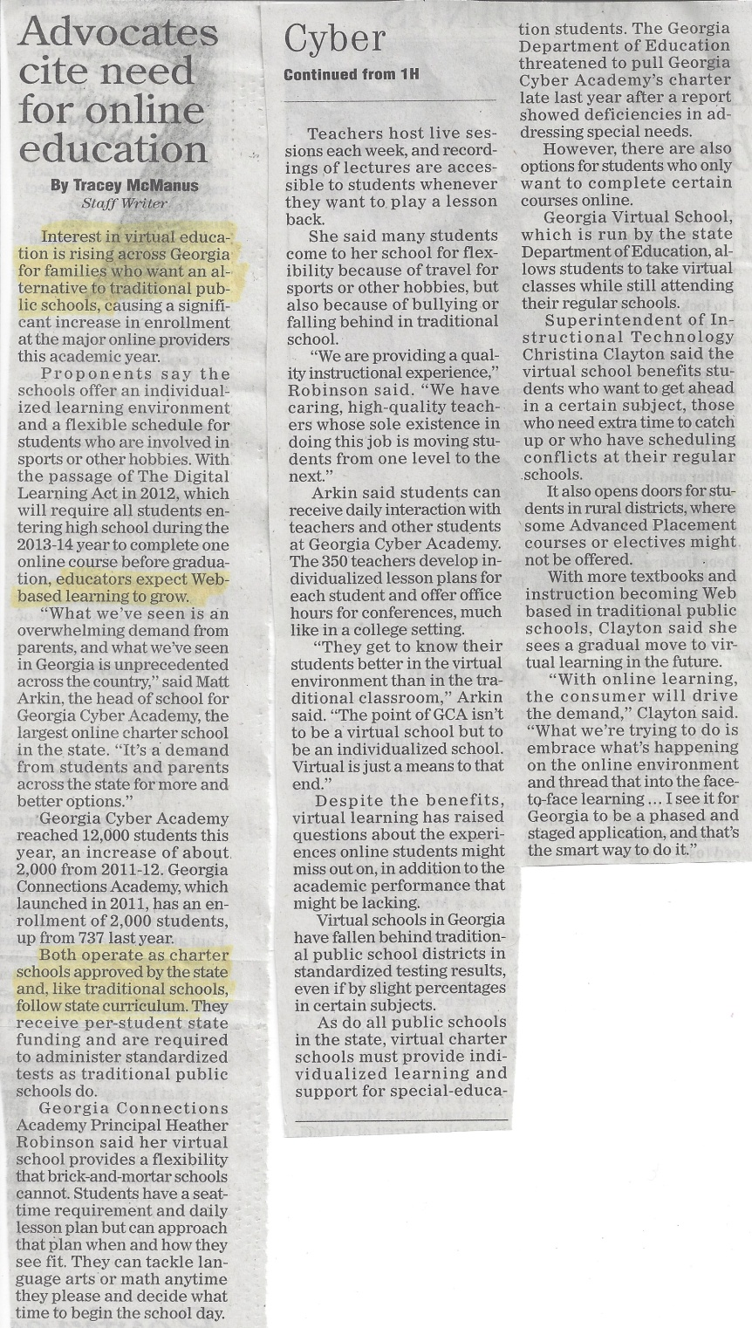
Interest in virtual education is rising
Schools offer individualized learning and a flexible schedule
Enrollment continuing to increase

Slide 3
Charter Schools
Online schools become more popular
The price of online schools, a substitute for charter schools, falls
Demand for charter schools decreases
Positive cross elasticity of demand
Price (hundreds of dollars per student)
15
10
Cross Elasticity of Demand:
-5 percent/ -10 percent= 0.5
5
D0
D1
2
4
6
Quantity (thousands of students)

Slide 4
Online Schools
As the price of online schools declines, the quantity demanded increases
There is a movement along the demand curve for online schools
Price (hundreds of dollars per student)
15
1
10
2
D1
5
D0
2
4
6
Quantity (thousands of students)

