Slide 1
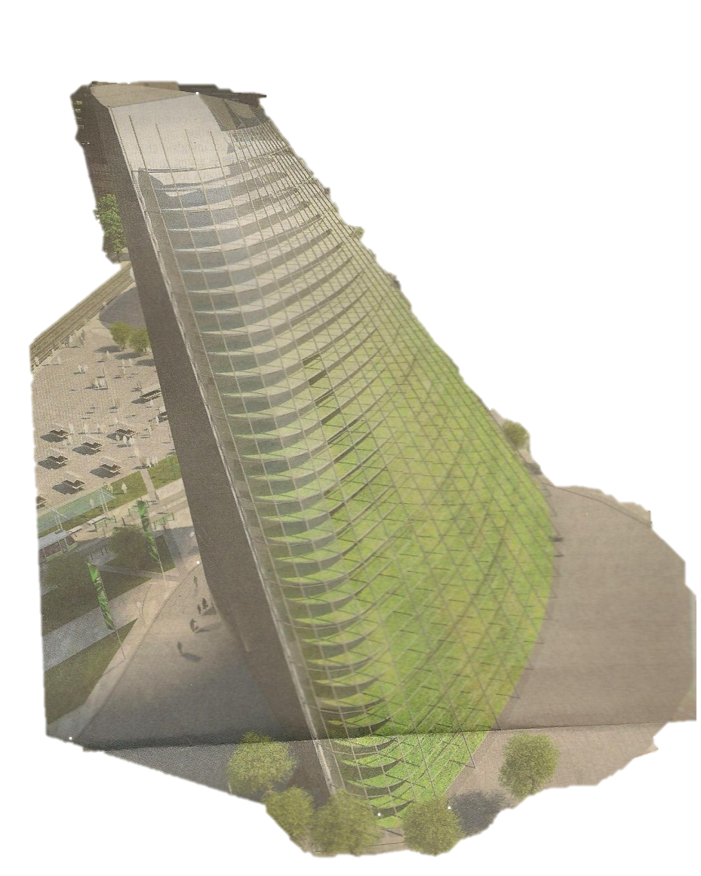
Cost

Slide 2

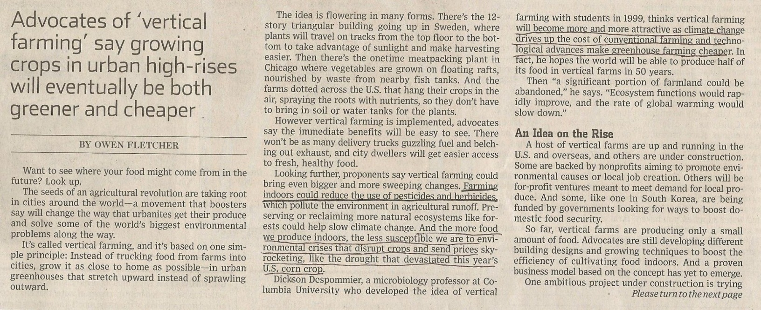
“Farming indoors could reduce the use of pesticides and herbicides”

Slide 3
CROPS
MC₀
MC₁
ATC₀
Advances in technology reduce the cost of production
Due to the environmental controls involved in vertical farming, there is a reduced need for pesticides and herbicides, thus lowering average variable cost and therefore average total cost as well
ATC₁
AVC₀
Dollars per plant
AVC₁
AFC₀
Number of Plants Produced

