Slide 1
Natural Gas Hits Decade Low
Macroeconomics 2105
Graph S/D (Decrease Gas Usage)
WSJ
Jan 20, 2012
Student name

Slide 2
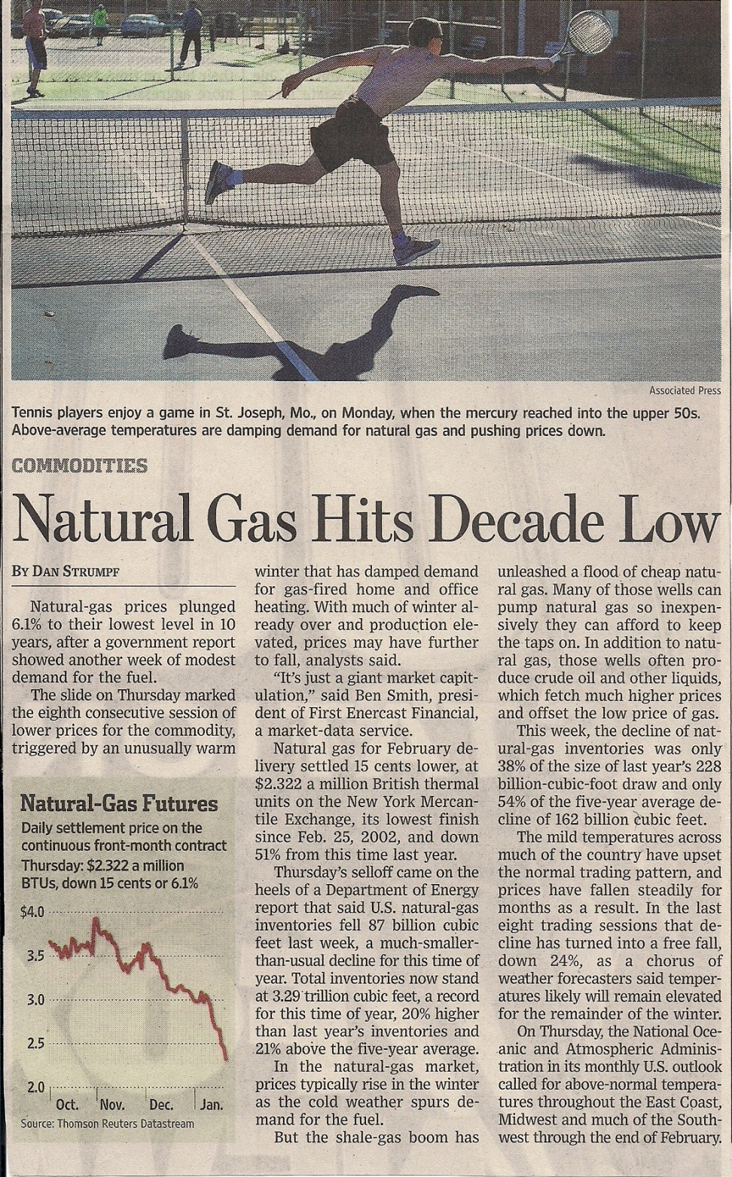
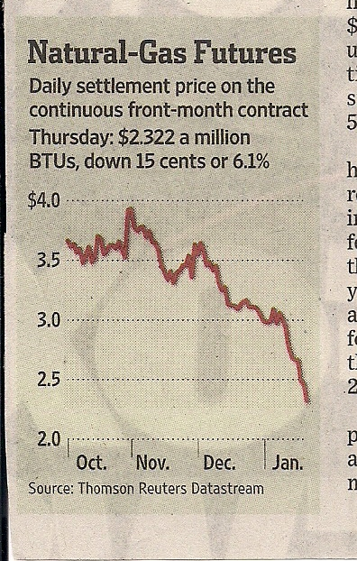

Slide 3
Natural Gas
Unusually warm winter results in decreased usage of natural gas for heating
S
P
Price Per Cubic Feet
1
P
D
2
1
D
0
Q
Q
2
1
Quantity in Cubic Feet
Edwin Harvey

