Slide 1

Supply & Demand
Student name
ECON 2106
8.25.2011

Slide 2
“Brewer’s Outlook Is Weak As Industry’s Woes Mount.”
-The Wall Street Journal, Augusta 24, 2011.
“Heineken’s net profit fell €605 million, compared with €700 million a year earlier.”

Slide 3
Last Year’s Beer Market
Supply
Price of Beer
EP1
D1
EQ1
Quantity of Beer

Slide 4
Current Beer Market
Supply
Price of Beer
EP2
EP1
D1
D2
EQ2
EQ1
Quantity of Beer

Slide 5

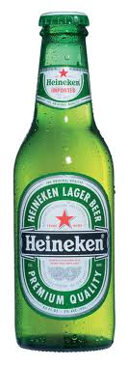
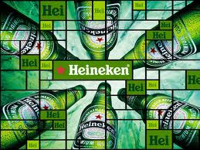
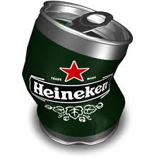
Why the big change?
Demand
of a normal good
Income

