Slide 1
Loanable Funds Curve
March 22, 2010
ECON 2105-B

Slide 2
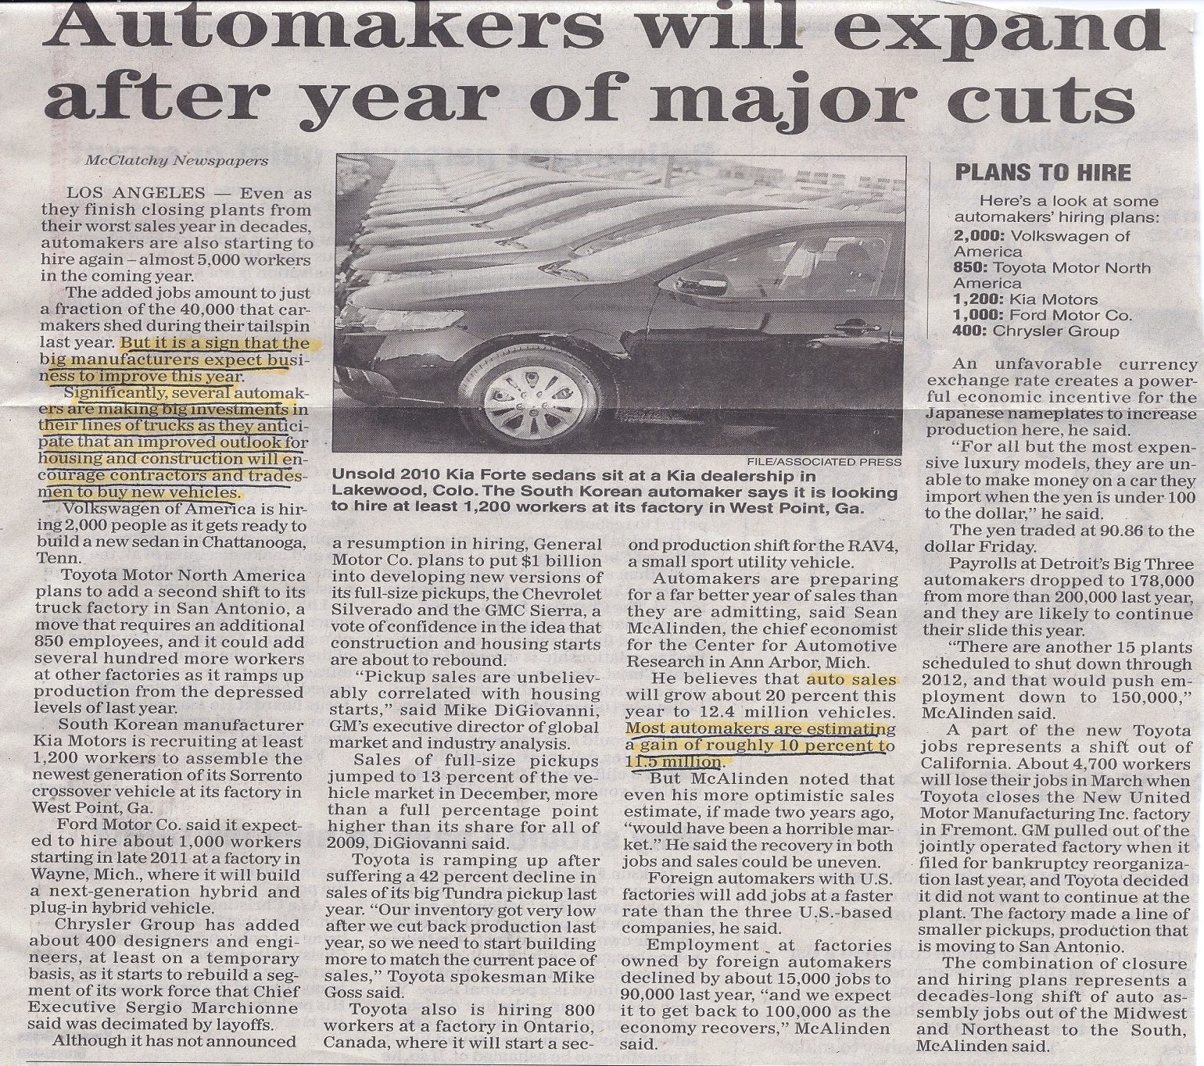

Slide 3
Change in Expected Profit Outlook For Automobile Industry
Real
Interest
Rate
SLF₀
Eq₁
Eq₀
DLF₁
DLF₀
Eq₀
Eq₁
Loanable Funds
Increase in Expected Profits= Increase in Demand

