Slide 1
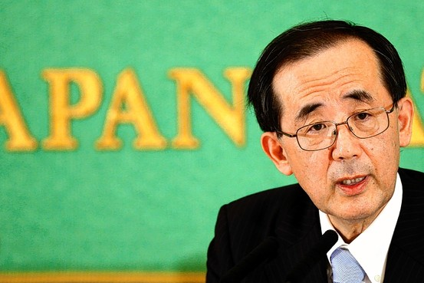
Demand & Supply of Loanable Funds
“Japan’s Bond Buys Are Seen Pressuring Debt” –Yuka Hayashi, Wall Street Journal
Econ 2105
3/14/2012
Bank of Japan’s Masaaki Shirakawa

Slide 2
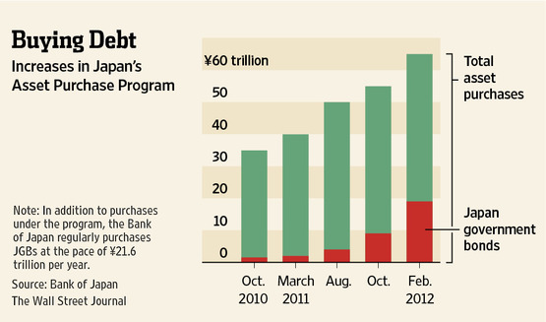
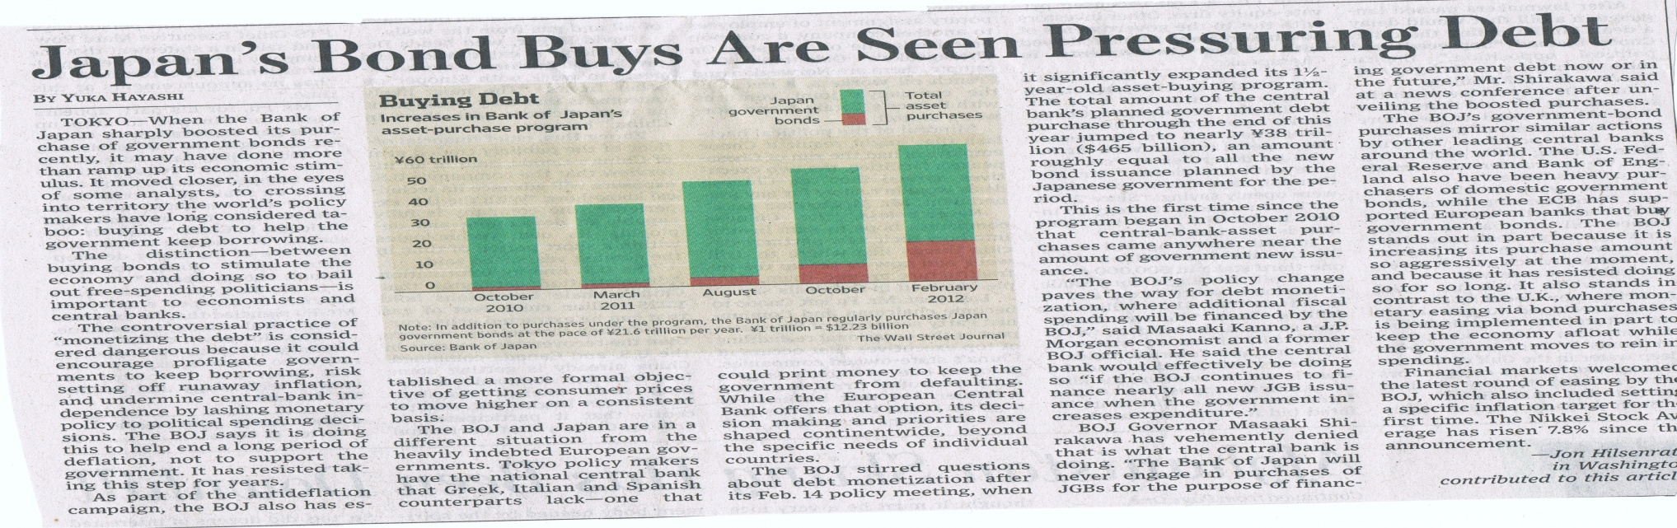
“Bank of Japan boosted its purchase of Gov. Bonds ” by Yuka Hayashi from the Wall Street Journal (March 5, 2012)

Slide 3
Demand & Supply For Loanable Funds In Japan, 2012
Real Interest Rate
(percent per year)
SLF 0
Equilibrium
Interest Rate
DLF
Equilibrium funds
Loanable funds
(dollars)

Slide 4
Bank of Japan Supplying Loanable Funds.
Supply & Demand of Loanable funds in Japan, 2012
Expected Future = Supply of
Income Loanable Funds
Real Interest Rate
(percent per year)
SLF 0
SLF 1
Equilibrium
Interest Rate
DLF
Equilibrium funds
Loanable funds
(dollars)
“Bank of Japan buys government bonds to help end deflation, could encourage government borrowing.”

