Slide 1
THE DEMAND FOR LOANABLE FUNDS
Econ 2105-C ,10/20/09

Slide 2
The New York Times
Eastman Machine
Family owned tool company
Buffalo, New York
Have been making cutting tools for the textile industry for 120 years

Slide 3
Robert Stevenson
President and CEO of Eastman Machine
Last year had to lay off a dozen workers due to financial decline
However, the dollar’s near 20% decline since March has made Eastman Machine’s goods more competitive

Slide 4
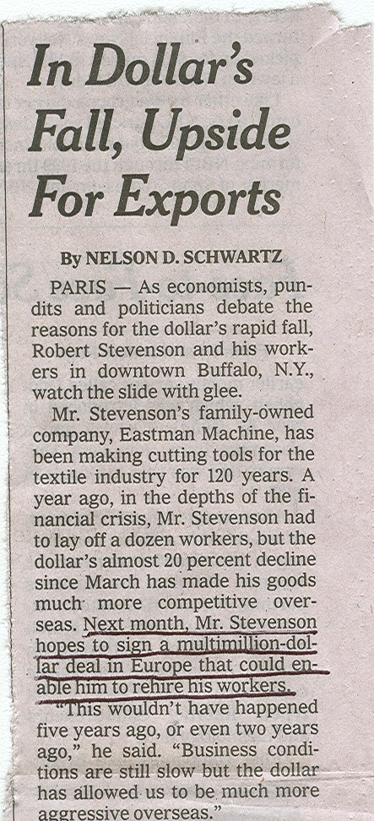
Increase in Expected Profit!!!
Mr. Stevenson and Eastman Machine are expecting a substantial increase in profit!!

Slide 5
INCREASE IN EXPECTED PROFIT
“Other things remaining the same, the greater the expected profit from new capital, the greater is the amount of investment and the greater is the demand for loanable funds.”
-- Textbook
Hence, Demand for Loanable Funds Curve shifts rightward

Slide 6
Real Interest Rate (% per year)
SLF
DLF0
Loanable Funds
(trillions of 2000 dollars)

Slide 7
Real Interest Rate (% per year)
SLF
DLF1
DLF0
Loanable Funds
(trillions of 2000 dollars)

