Slide 1
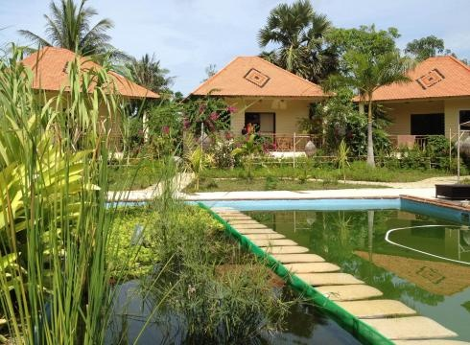
“Swimming pools starting to go au naturel”
“clients like the fact that it’s a green product”
ECON 2106B

Slide 2
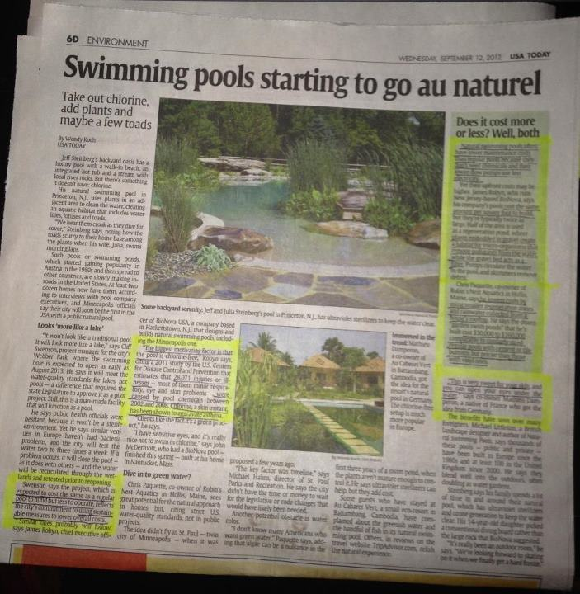
By Wendy Koch
USA TODAY
Wednesday, September 12, 2012

Slide 3
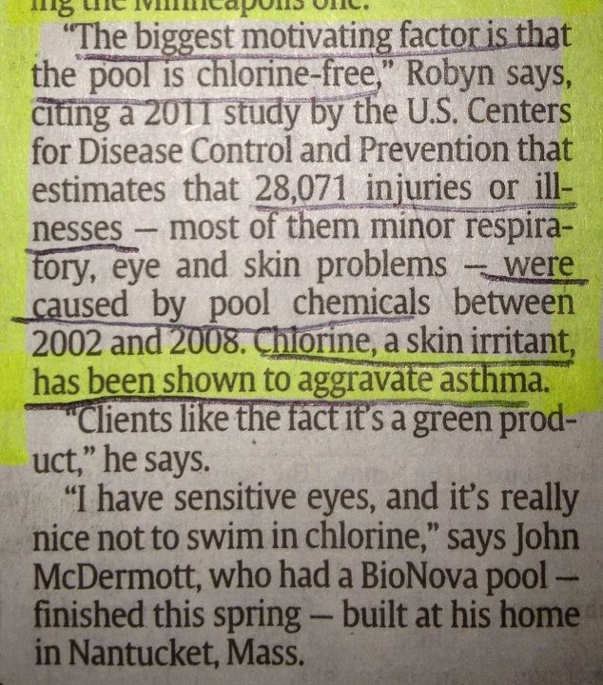
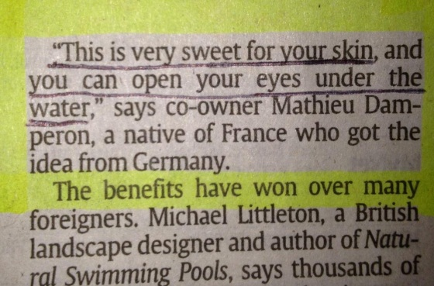
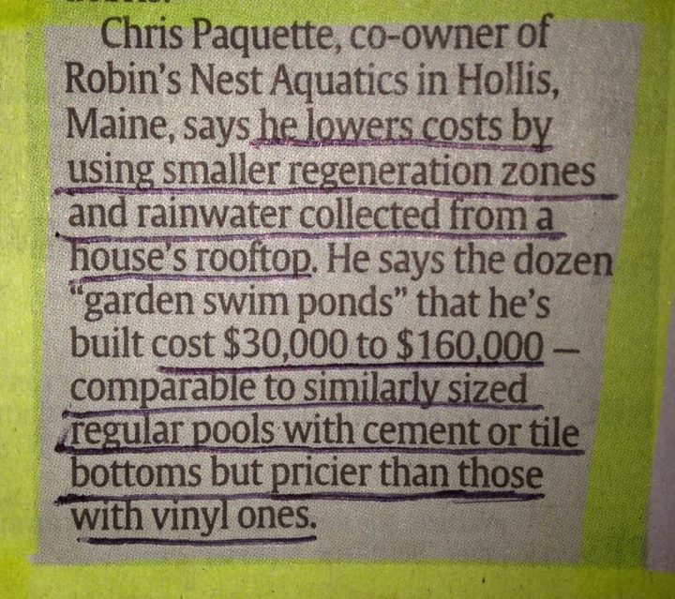
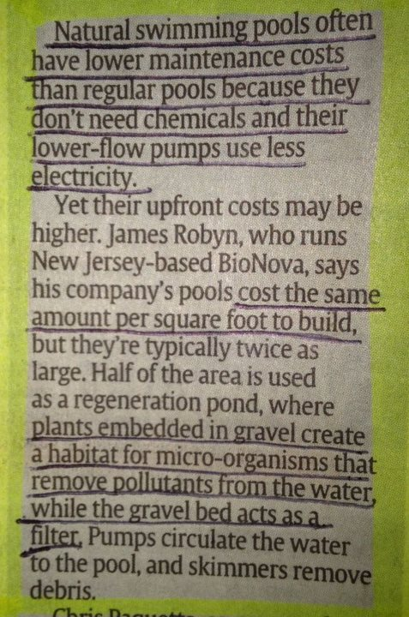
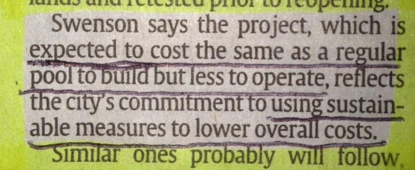
Natural pools are BETTER than the alternative (chlorine pools) because…
natural pools are eco-friendly and aesthetically pleasing
natural pools are chlorine free, and chlorine is an irritant to skin, asthma, eyes, etc.
go green!
go green!
go green!
natural pools will be cheaper to maintain, and cost about the same amount to build as similar sized chlorine pools
go green!

Slide 4
A change in preference will shift the DEMAND curve…
“Tastes or preferences, as economists call them, influence demand. When preferences change, the demand for one item increases and the demand for another item (or items) decreases.” Pearson Custom Business Resources
Chlorinated Pool Market
P
S
EP1
2
4
EP2
1
Since the population seeking a new pool now has information telling them that a better type of pool is available, the demand for the inferior product will decrease.
D1
D2
EQ2
EQ1
Q
3
1
Demand curve shifts leftward (decrease in demand)
2
Price falls
3
Quantity supplied decreases
4
Equilibrium quantity decreases

