Slide 1



The Movie Market 2009-2010
Article: Movie ticket prices reach new milestone
(The Augusta Chronicle)
Notes:
The Intro

Slide 2
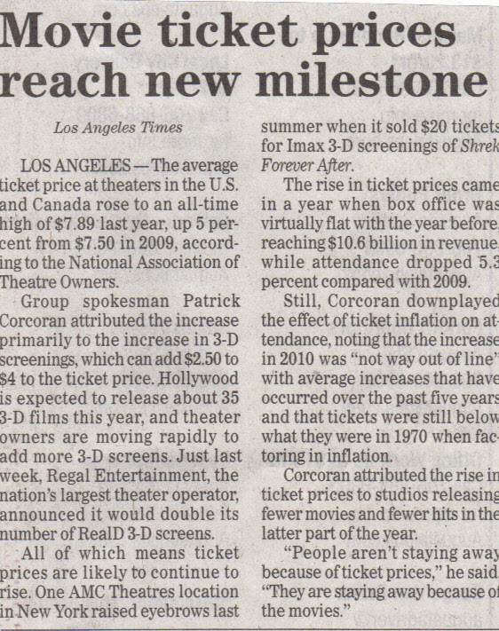


The Newspaper Article
Notes:
The Newspaper Article

Slide 3
Economic reasons for the changes in the movie market
The average income has been affected by the unemployment. (inferior good –> income decrease & demand increase)
# of buyers has affected the movie market, because more people seek alternative choices for high movie ticket prices.
Consumers have preferences on cheaper alternatives instead of expensive theaters, ex. RedBox.
The prices of movie tickets has increased, therefore there is increased quantity of supplied movies, but quantity demanded for movie theater experiences has decreased.(graphed)
Law of Demand:
Price = Quantity Demanded
Market for movie theater experiences
P
surplus*
S
1.
3.
2.
D
Q
* surplus means more empty seats at the theaters, as consumers go elsewhere
Notes:
The graph of the increased movie ticket prices (1.), and the results of increased quantity supplied (2.), and a decreased quantity demanded (3.).

Slide 4

The Alternative Movie Market from 2009 to 2010
price
supply
The quantity demanded of movie theater experiences has decreased as the prices of movie tickets have sky-rocketed. As a result, consumers find alternative choices for movie entertainment, such as the RedBox. Therefore, the demand has increased for this cheaper substitute good, and more RedBoxes are supplied for the consumers’ convenience.
demand1
demand0
quantity
Notes:
The supply and demand graph, where the demand curve has been shifted to the right as demand for the substitute good (RedBox) has increased.

