Slide 1
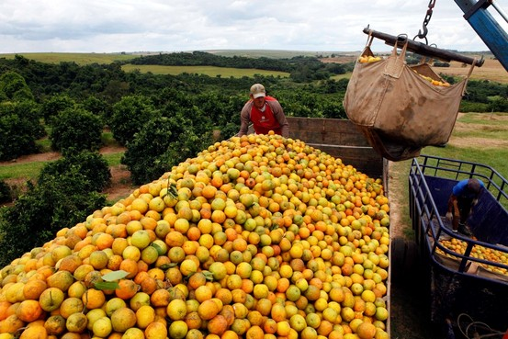
Supply & Demand
“Fungus Fears Push Orange Juice Up”
Econ 2105
1/30/2012

Slide 2
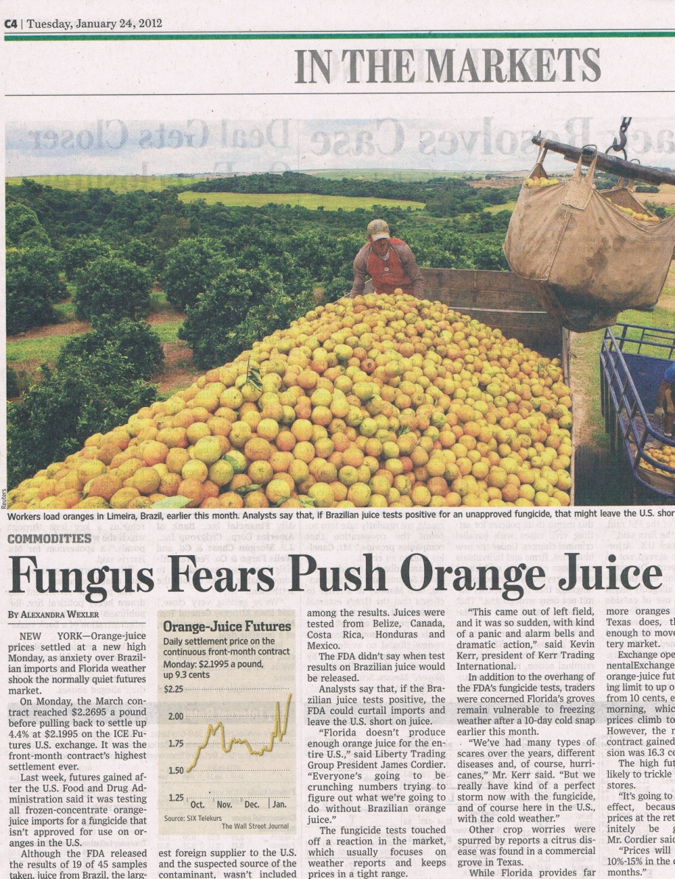
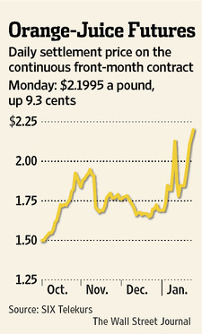
“Fungus Fears Push Orange Juice UP” by Alexander Wexler from the Wall Street Journal (Tuesday, January 24, 2012)

Slide 3
Increase in Demand due to expected future shortage/price increase.
Orange Juice Market
Price
Dollars per pound.
S1
EP
D2
D
EQ
Quantity
Pounds of oranges

Slide 4
Or you could have …. Decrease in Demand due to consumer preference – not to consume fungus infected orange juice
Orange Juice Market
Price
Dollars per pound.
S1
EP
D2
D
EQ
Quantity
Pounds of oranges

Slide 5
Are likely to also have…. Decrease in supply as a result of infected imports.
Orange Juice Market
Price
Dollars per pound.
S2
S1
EP
D
EQ
Quantity
Pounds of oranges
In four months oranges rises from $1.50 to $2.19 per pound.
“FDA could curtail imports in Brazilian juice test positive and leave the US short of juice.”

