Slide 1
“Many Manufacturers beg for workers”
Student Name

Slide 2
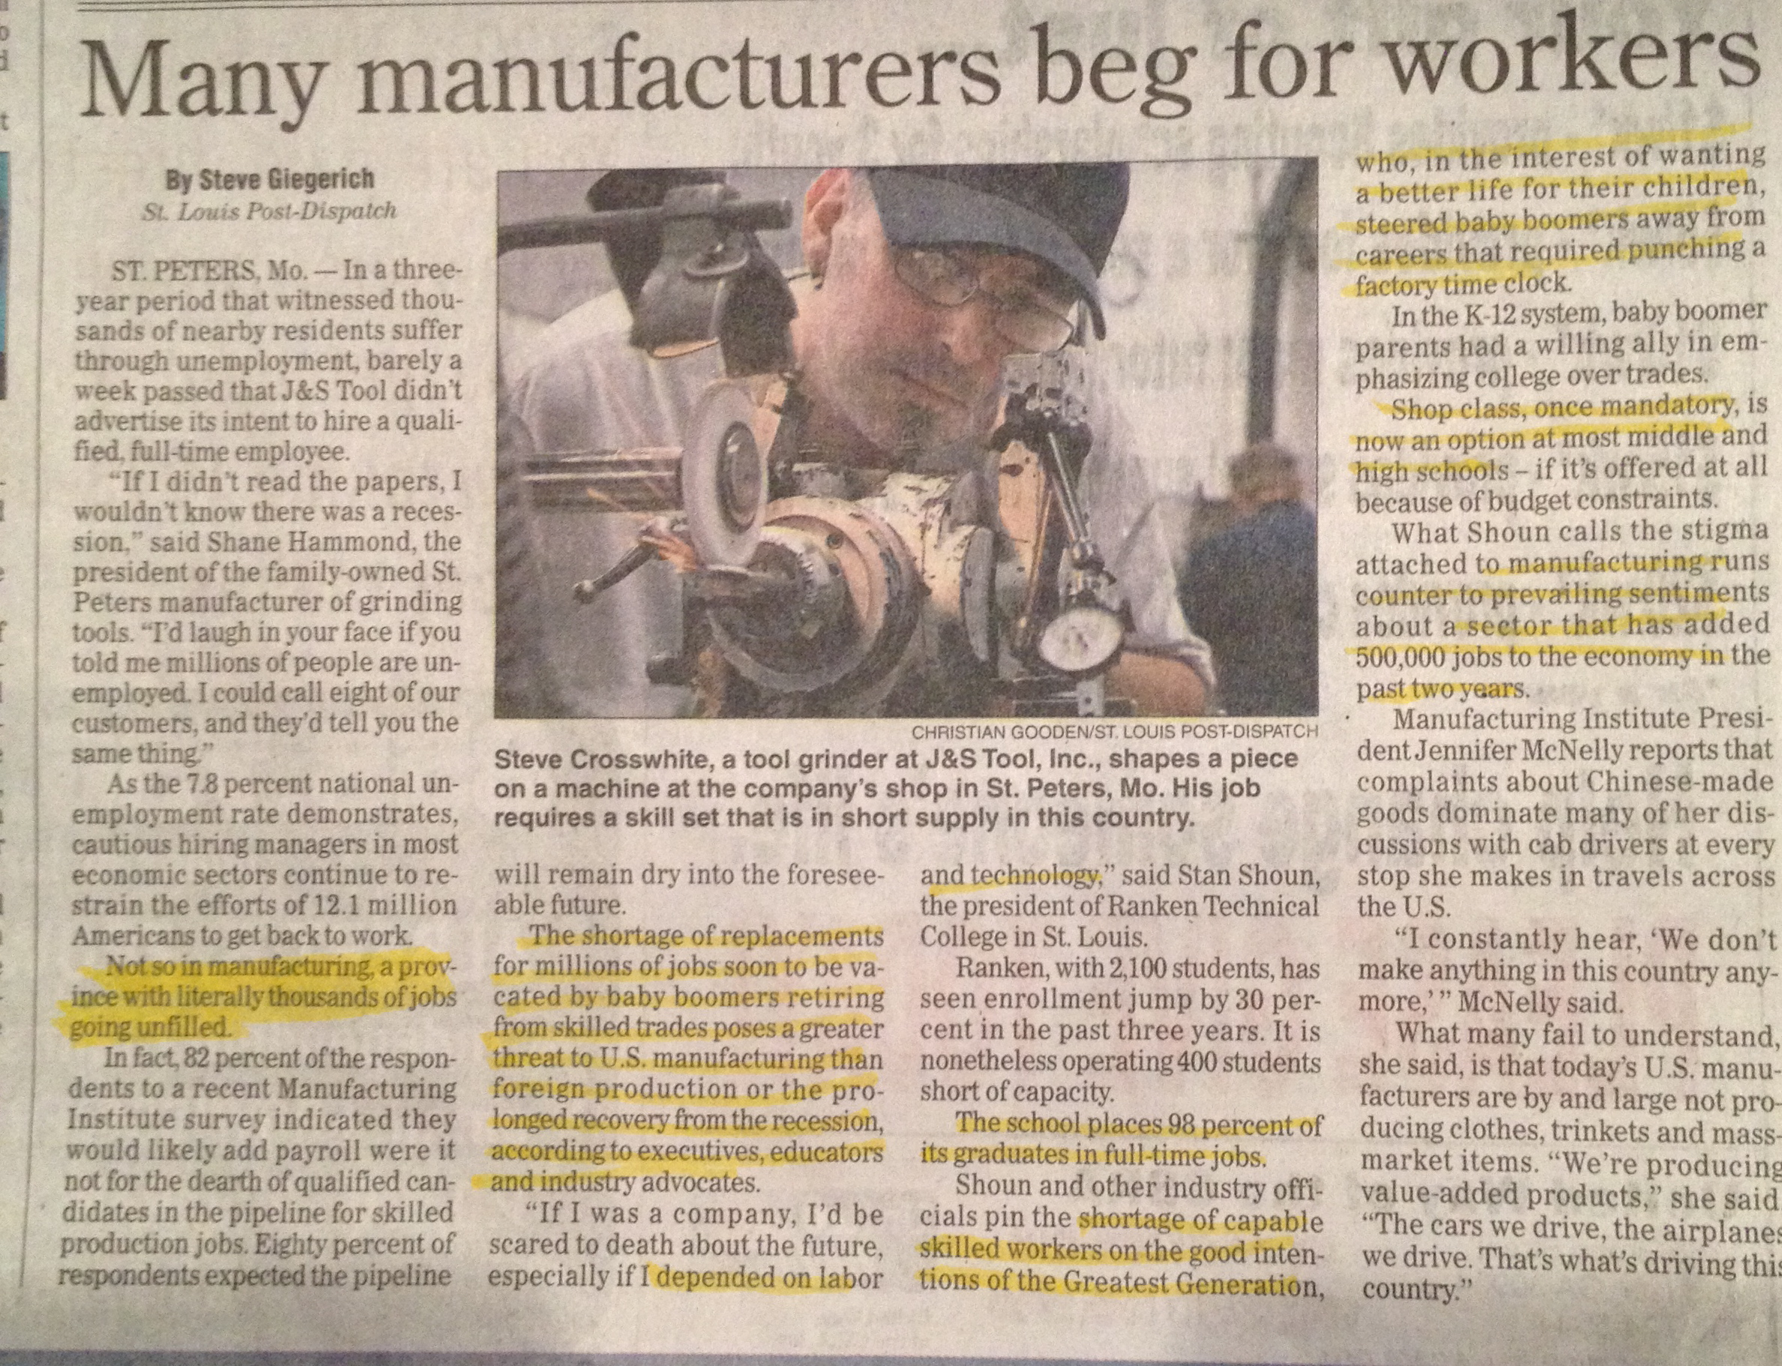
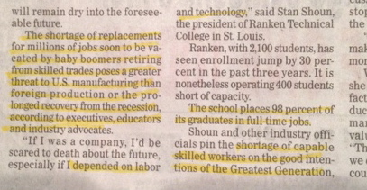
“Many Manufacturers beg for workers”
Thousand of manufacturing jobs are going unfilled
“The shortage of replacements for millions of jobs soon to be vacated by baby boomers retiring from skilled trades”
There has been a shortage of skilled workers because of parents who want better lives for their children than working in manufacturing

Slide 3
Manufacturing Labor
Real
Wage
Rate
LS2
LS1
LD
Labor

