Slide 1
China’s Labor Supply
ECON 2105 C

Slide 2
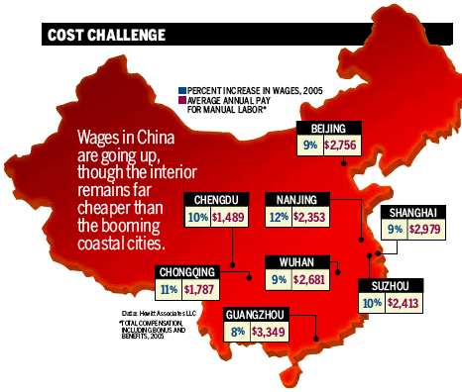
China Faces Dwindling Labor Supply
By Bloomberg News - Aug 30, 2011

Slide 3
China Faces Dwindling Labor Supply
China’s 30yr old one-child policy has caused a decrease in population
A decrease in labor force has caused the real wage rate to increase
Chinese companies are forced to upgrade to higher quality / technological products / higher value products
Japan had to do the same thing in the 1960’s and 70’s and look where they are now
It might be a good time to invest in Chinese technological and machine industry companies

Slide 4
China’s Labor Supply
RWR
LS2
LS1
LD
LABOR
CURVE SHIFT:
$ LS = $population

