Slide 1
Peanut Product Recalls
Student name

Slide 2
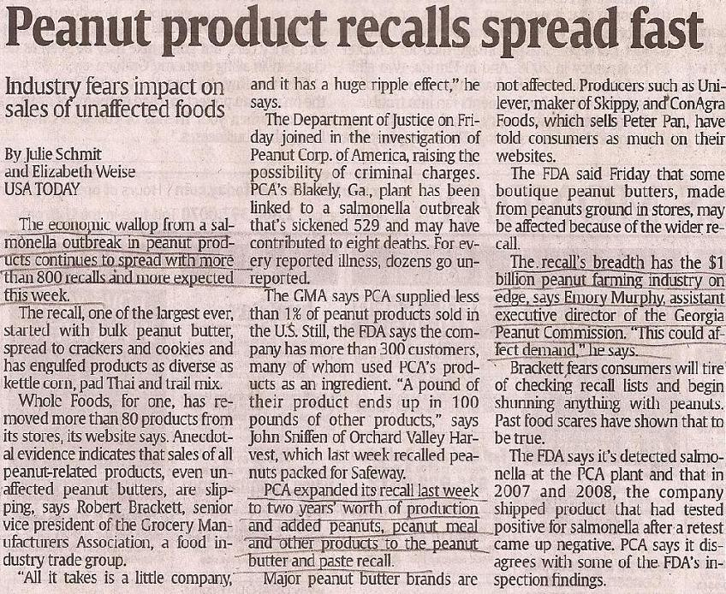

Slide 3
Key Points For Demand
Industry fears impact on sales of unaffected foods.
Consumers may tire of checking recall lists and begin shunning anything with peanuts. Past scares show this to be true.

Slide 4
Result on Demand
The result is a decrease in the aggregate demand due to the decrease in the demand for peanuts and all peanut products.

Slide 5
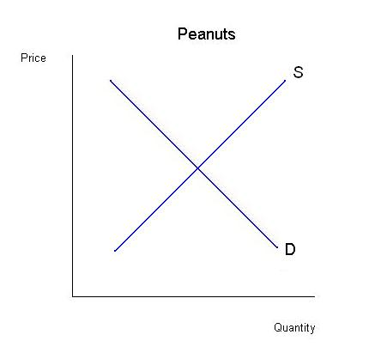
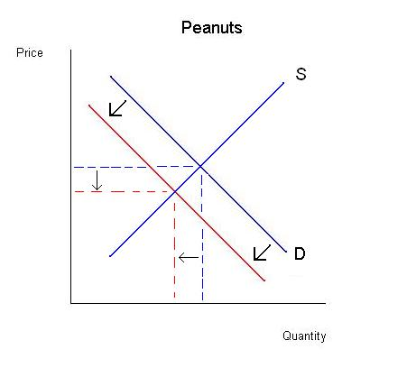
Change in Aggregate Market

Slide 6
Article Reference
Schmit, J. (2009, February 1). Peanut product recalls spread fast. USA Today

