Slide 1
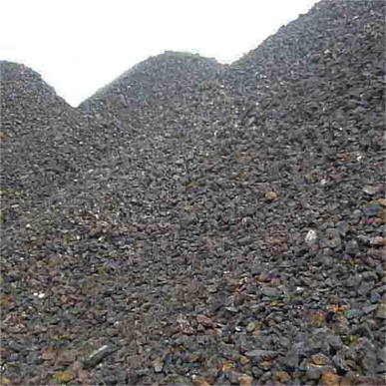
Aggregate Market
“Steelmakers Face Hard Winter”
The Wall Street Journal
ECON 2105
11/18/2010

Slide 2
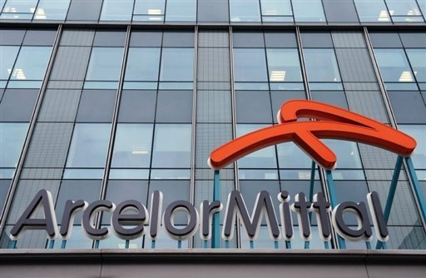
Iron Ore and Coal Prices Increased
Production must Decrease

Slide 3
Aggregate Market
Price level
AS₂
AS₁
E₂
E₁
AD
E₂
E₁
Real GDP

