Slide 1
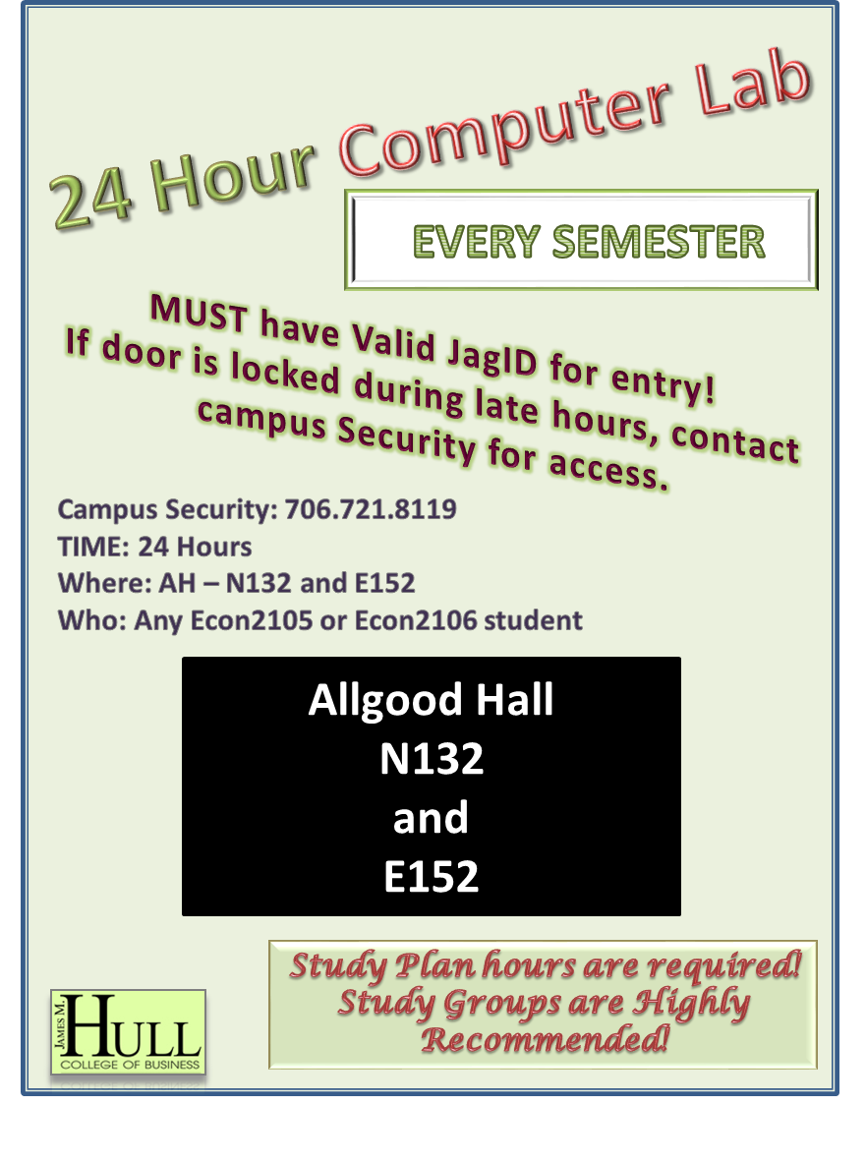

Slide 2

24 Hour Computer Lab
EVERY SEMESTER
MUST have Valid JagID for entry!
If door is locked during late hours, contact campus Security for access.
Campus Security: 706.721.8119
TIME: 24 Hours
Where: AH – N132 and E152
Who: Any Econ2105 or Econ2106 student
Allgood Hall
N132
and
E152
Study Plan hours are required!
Study Groups are Highly Recommended!

