Slide 1
Building High Performance Classrooms

Slide 2

AGENDA
Why are we here?
The Current State of the Classroom
How Does One Break Down the Issue?
Issues
Instructor Perspective/Concerns
Student Perspective/Concerns
What Makes the Difference?
Traditional Setting
Redesigned Setting
Quantitative and Qualitative Results
Where Does One Go Next?
Technology
Students vs Instructor
Who? YOU, When? NOW
Notes:
Introduce Self & University
Enrollment, Location
ECON enrollment in classroom and online

Slide 3


CURRENT STATE
OF THE CLASSROOM
SUCCESSFUL KNOWLEDGE TRANSFER
WHY Are We Here ?

Slide 4
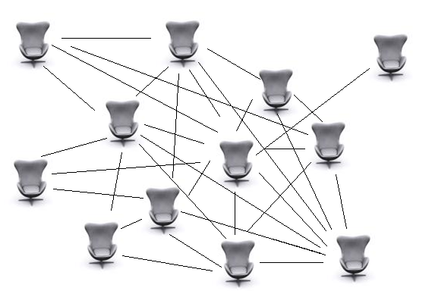
Current State of the Classroom
Why are we here?
DOES THIS DESCRIBE YOUR CLASSROOM CONVERSATION ?
Notes:
Trainer Note:
Add Activity Details
Include Methodology
Time Taken etc
Note: Glossary is linked to a word document

Slide 5

Current State of the Classroom
Why are we here?
What is YOUR Reality?
Notes:
Trainer Note:
Add Activity Details
Include Methodology
Time Taken etc
Note: Glossary is linked to a word document

Slide 6
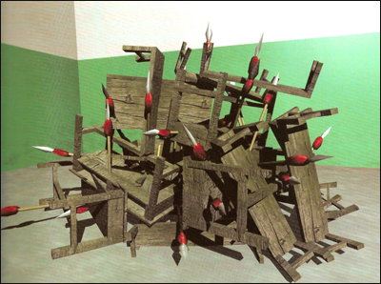
Current State of the Classroom
Why are we here?
Some Days . . .
Notes:
Trainer Note:
Add Activity Details
Include Methodology
Time Taken etc
Note: Glossary is linked to a word document

Slide 7
PROBLEMS / ISSUES
SUCCESSFUL KNOWLEDGE TRANSFER
So HOW Does One Break Down the Issues?

Slide 8
PROBLEMS / ISSUES / CONCERNS
How Does One Break Down the Issue?
Low Averages
Difficulty with Calculations
Inability to Apply to Real Life
Students are Detached / Lost
Students do not Seek Help
Course Changes do not have Desired Effect
Difficulty with Graphs
WHOSE Concerns Are These? Instructors? Students?

Slide 9
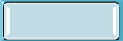
PROBLEMS / ISSUES / CONCERNS
How Does One Break Down the Issue?
Low Averages
Difficulty with Calculations
Inability to Apply to Real Life
Students are Detached / Lost
Students do not Seek Help
Course Changes do not have Desired Effect
Difficulty with Graphs
Perspective Matters!
Notes:
Students had several issues – but only these were considered to need addressing.

Slide 10
TRADITIONAL vs. REDESIGNED COURSE SETTING
SUCCESSFUL KNOWLEDGE TRANSFER
So, WHAT Can You Do to Make A Difference ?
Notes:
Now that we know the issues….let’s look at our course design and see what can be done to address the issues.

Slide 11
TRADITIONAL
COURSE DESIGN
What Makes the Difference?
TRADITIONAL - Classroom
TRADITIONAL - Online
Original Grade Allocation
Original Grade Allocation
Chapter Homework | 20%
Exams (5 including Final) | 50%
Journals | 20%
Participation | 10%
Homework | 35%
Chapter Quizzes | 35%
Midterm Exam | 15%
Final Exam | 15%
Online:
Implemented MANDATORY orientation
and Stressed contacting me!
Appear to be Plenty of Application and Anxiety Resistant Opportunities . . .
Yet, All of the Problems / Issues Existed !
Notes:
Trainer Note:
Add Activity Details
Include Methodology
Time Taken etc
Note: Glossary is linked to a word document

Slide 12
PROBLEM / ISSUE REVIEW
What Makes the Difference?
TRADITIONAL - Classroom
TRADITIONAL - Online
Original Grade Allocation
Original Grade Allocation
ISSUES - Classroom
ISSUES - Online
Chapter Homework | 20%
Exams (5 including Final) | 50%
Journal | 20%
Participation | 10%
Homework | 35%
Chapter Quizzes | 35%
Midterm Exam | 15%
Final Exam | 15%
Low Averages
Difficulty with Graphs
Difficulty with Calculations
Inability to Apply Concepts to One’s Real Life
All of the Classroom Issues PLUS
Students Feel Detached / Lost
Students Do Not Seek Assistance or Do So When it is Too Late
Course Changes Do Not Have the Desired Effect
So WHAT Can One Do – SPECIFICALLY ?
Notes:
One must allocate the issues – online/classroom – in order to redesign.

Slide 13
TRADITIONAL vs. REDESIGNED CLASSROOM SETTING
What Makes the Difference?
ISSUES ADDRESSED
#1. Low Averages #3. Difficulty with Calculations
#2. Difficulty with Graphs
Classroom
STUDY PLAN Provides Individualized Remediation
Demonstrate in Class
HOMEWORK
Electronically graded = more prep time for lectures and in class exercises
Rewards those that utilize course tools
Use it
Online
STUDY PLAN Provides Individualized Remediation
Require its Use
F2F SEMINARS
Scheduled Face2Face Seminars around due dates of difficult concept areas. Placed worked problems online for non-attendees
Chose concept areas by viewing PERFORMANCE BY CHAPTER percentages
Perspective Matters!

Slide 14

TRADITIONAL vs. REDESIGNED CLASSROOM SETTING
What Makes the Difference?
ISSUES ADDRESSED
#4. Inability to Apply to Real Life
Classroom
ORIGINALLY I required ‘Course Journals’ where students read newspapers/journals and wrote economic statements or drew graphs based on the articles.
REDESIGNED with
ECONOMICS IN THE NEWS
I reduced the requirements from 18 articles (mostly statements) to 10 articles (mostly graphs) and added a Course Debate.
REQUIRES Real Life Application and ALLOWS group prep time.
Online
ORIGINALLY No assignment that led to Real Life Applications
REDESIGNED with DISCUSSION BOARD
Conversational postings to Discussion Board in small groups on assigned articles or graphs. REQUIRES open minded view of various perspectives. ENCOURAGES application to STUDENTS LIFE.
Require its Use
DISCUSSION BOARD
I created an Open Forum on Discussion Board for Students to Talk about Chapter Concepts and Current Events. I might start a conversation but rarely interject my opinion.
Their culture is not ours – they do not read newspapers for fun or to obtain news
Perspective Matters!

Slide 15
TRADITIONAL vs. REDESIGNED CLASSROOM SETTING
ACTUAL EMAIL received 8/29/09:
Thank you for the praise. Seriously, I'm not sucking up, but I really enjoy economics. It's pretty fun....hard to understand sometimes, but fun. -Navid
What Makes the Difference?
ISSUES ADDRESSED
#5. Students Felt Detached/Lost
#6. Students Do Not Seek Help/ or Seek Help Too Late
Online
HOMEWORK
Created ‘Extra Problems’ homework from test bank and publisher questions and Omitted scores
An Idea: Allows greater remediation without instructor contact
ANNOUNCEMENTS/EMAILS
Posted ‘Announcements’ and sent Emails frequently PRAISING those ahead in their work, performing well, or showing improvement.
Research shows students perform at the level the teacher expects.
Performance is never higher than the bar is set.
F2F SEMINARS
Scheduled Face2Face Seminars around due dates of difficult concept areas. Placed worked problems online for non-attendees
Provides Opportunity for Instructor Contact and Instructor led Step by Step Processes Examples
*Security/Difficulty
Perspective Matters!
Notes:
F2F seminars is the only redesign that is duplicated but it has a different purpose here.

Slide 16
TRADITIONAL vs. REDESIGNED CLASSROOM SETTING
What Makes the Difference?
ISSUES ADDRESSED
#5. Students Felt Detached/Lost #7. Second Quiz Attempt Did Not Improve Scores
Online
DISCUSSION BOARD
I created an Open Forum on Discussion Board for Students to Talk about Chapter Concepts and Current Events without subject to being graded. I might start a conversation but rarely interject my opinion.
Provides another resource for insight and support to online students
COLLABORATE– STEP by STEP STUDY GUIDE
Reassessed the purpose behind the 2nd attempt on a quiz. Developed and included in the syllabus and orientation a Step by Step guide as to how to utilize the 2nd attempt.
Students do not read our minds and are not as intuitive as we desire - So lay it out for them.
Also, explained parameters around the quiz settings and the tools available to me for tracking their time spent online and performance.
Technologically savvy teachers:
* Earn the respect of their students
* Students are less likely to dishonestly earn a grade.
Perspective Matters!
Notes:
MEL still leaves some to be desired, but are working on updates every day. Plus, it’s all about what your students believe!

Slide 17
REDESIGNED COURSE
What Makes the Difference?
TRADITIONAL - Classroom
TRADITIONAL - Online
Original Grade Allocation
Redesigned Grade Allocation
Original Grade Allocation
Redesigned Grade Allocation
Chapter Homework | 20%
Exams (5 including Final) | 50%
Journals | 20%
Participation | 10%
Homework | 35%
Chapter Quizzes | 35%
Midterm Exam | 15%
Final Exam | 15%
Chapter Quizzes | 15%
Exams (5 including Final) | 30%
Course Journal | 14%
Graph Presentations (3 total) | 21%
Debate (1 total) | 10%
Participation | 10%
Homework | 25%
Chapter Quizzes | 25%
Midterm Exam | 10%
Final Exam | 10%
Discussion Board | 20%
Participation | 10%
So WHAT made a Difference ?
Notes:
So what does my Grade Allocation look like now… Homeworks became quizzes online, participation is still attendance based but

Slide 18
QUANTITATIVE vs. QUALITATIVE RESULTS
SUCCESSFUL KNOWLEDGE TRANSFER
So, WHAT Kind of and HOW Much of a Difference Can You Make ?

Slide 19
QUALITATIVE RESULTS
What Makes the Difference?
Classroom & Online
Student feedback expresses excitement about the online tools and positive Pearson tutoring experiences
Classroom
Debates were implemented this semester
Classroom & Online
Students will engage each other around topics of interest when given the opportunity
Classroom
Time to modify lecture or in class exercise to fit needs of current students (Time to differentiate learning)
Online
Online students LOVE the addition of discussion boards.
Online
Face 2 Face Seminars and Grade Omitted Homework assignments with extra problems are new this semester
Students that come to my office have a specific problem that they can not work and are functioning at a higher level of thought
Students are more engaged during class, and show signs of moving from knowledge and comprehension to application quicker
Students are already showing less concern over finding articles and more interest in drawing graphs based on articles
Students come to class with a better understanding of the concepts and a desire to discuss their forum in class
I can track student progress online and pull up their assignment to go over with them - Ultimately, there are fewer frustrated students.
More students (even online students) are forming and finding value in study groups – Function as electronic study groups!
They are easy to perform well on and provide the classroom conversation that online students miss
I have received so many comments on this assignment that I have started posting them to my website.
Several students have already expressed excitement about the planned seminars after completing the sibling course without the option. Some new students expressed relief that they had a scheduled appointment with me during the semester.
Study Plan
HW in MyEconLab
Economic in the News
Open Forum
Discussion Board
v
Discussion Board
F2F Seminars
& Extra Homework
Online Assignments = Larger Classroom Capacity
So WHERE does on go now ?
Notes:
So what does my Grade Allocation look like now… Homeworks became quizzes online, participation is still attendance based but

Slide 20
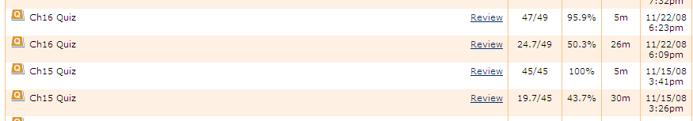
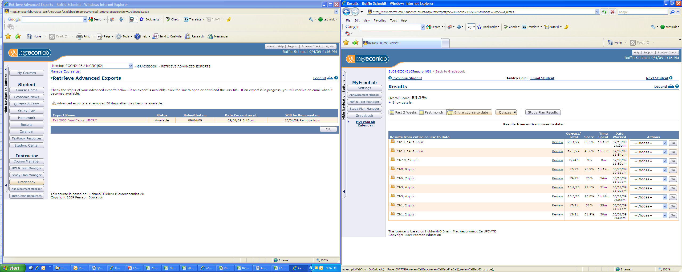
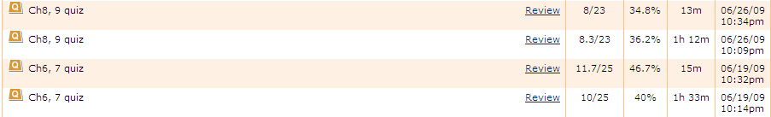
QUANTITATIVE RESULTS
What Makes the Difference?
 |  | A | B | C | D | F
MACRO | Fall 08 | 12% | 40% | 33% | 10% | 5%
 | Spr 09 | 3% | 27% | 19% | 28% | 23%
 | Sum 09 | 9% | 29% | 34% | 13% | 15%
MICRO | Fall 08 | 5% | 43% | 35% | 8% | 8%
 | Spr 09 | 0% | 22% | 18% | 30% | 30%
 | Sum 09 | 9% | 26% | 35% | 14% | 16%
FA08: No parameters on quizzes SP09: Parameters [% earning C or better: 49% & 40%]; SU09: Parameters and Step by Step guidelines [C or better: 72% & 70%]
Fall 08
FA08: No parameters on quizzes
Spring 09
Grade Allocation
FALL 2008 | DB | Homework | QUIZZES | Exams | Participation
 | 0% | 35% | 35% | 30% | 0%
SPRING 2009 | DB | Homework | QUIZZES | Exams | Participation
 | 15% | 20% | 25% | 30% | 10%
SUMMER 2009 | DB | Homework | QUIZZES | Exams | Participation
 | 25% | 25% | 20% | 20% | 10%
SP09: Parameters Only
Summer 09
SU09: Parameters and Step by Step guidelines
So WHERE does on go now ?
Notes:
So what does my Grade Allocation look like now… Homeworks became quizzes online, participation is still attendance based but

Slide 21
TECHNOLOGY
STUDENT verse INSTRUCTOR
SUCCESSFUL KNOWLEDGE TRANSFER
WHERE Does One Go Next ?

Slide 22
SOCIAL MEDIA STATISTICS
Where Does One Go Next ?
By 2010 Gen Y will outnumber Baby Boomers….96% of them have joined a social network
Social Media has overtaken porn as the #1 activity on the Web
1 out of 8 couples married in the U.S. last year met via social media
Years to Reach 50 millions Users: Radio (38 Years), TV (13 Years), Internet (4 Years), iPod (3 Years)…Facebook added 100 million users in less than 9 months…iPhone applications hit 1 billion in 9 months.
If Facebook were a country it would be the world’s 4th largest between the United States and Indonesia
2009 US Department of Education study revealed that on average, online students out performed those receiving face-to-face instruction
1 in 6 higher education students are enrolled in online curriculum
80% of companies using LinkedIn as a primary tool to find employees
Generation Y and Z consider e-mail passé…In 2009 Boston College stopped distributing e-mail addresses to incoming freshmen
80% of Twitter usage is on mobile devices…people update anywhere, anytime…imagine what that means for bad customer experiences?
THINK YOU CAN’T DO IT?-The fastest growing segment on Facebook is 55-65 year-old females
BETTER FIGURE IT OUT! - Facebook USERS translated the site from English to Spanish via a Wiki in less than 4 weeks and cost Facebook $0
Ashton Kutcher and Ellen Degeneres have more Twitter followers than the entire populations of Ireland, Norway and Panama
24 of the 25 largest newspapers are experiencing record declines in circulation because we no longer search for the news, the news finds us.
YES ,YOU CAN !
Notes:
So what does my Grade Allocation look like now… Homeworks became quizzes online, participation is still attendance based but

Slide 23


KNOWLEDGE CHECK / QUESTIONS
Problems
Solutions
Any Questions ?
Problem Allocation
Grade Allocation
Results

Slide 24
Resource Slide: Content Slide obstructed in presentation
PROBLEM / ISSUE REVIEW
What Makes the Difference?
ISSUES - Classroom
ISSUES - Online
Low Averages
Difficulty with Graphs
Difficulty with Calculations
Inability to Apply Concepts to One’s Real Life
All of the Classroom Issues PLUS
Students Feel Detached / Lost
Students Do Not Seek Assistance or Do So When it is Too Late
Course Changes Do Not Have the Desired Effect
Appear to be Plenty of Application and Anxiety Resistant Opportunities . . .
Yet, All of the Problems / Issues Existed !
Notes:
Trainer Note:
Add Activity Details
Include Methodology
Time Taken etc
Note: Glossary is linked to a word document

Slide 25
Resource Slide: Syllabus is referred to several times
Course Syllabi and Social Statistic Website
http://hull.aug.edu/bschmidt
http://socialnomics.net/2009/08/11/statistics-show-social-media-is-bigger-than-you-think/
Bloom’s Taxonomy
Notes:
Trainer Note:
Add Activity Details
Include Methodology
Time Taken etc
Note: Glossary is linked to a word document

Slide 26
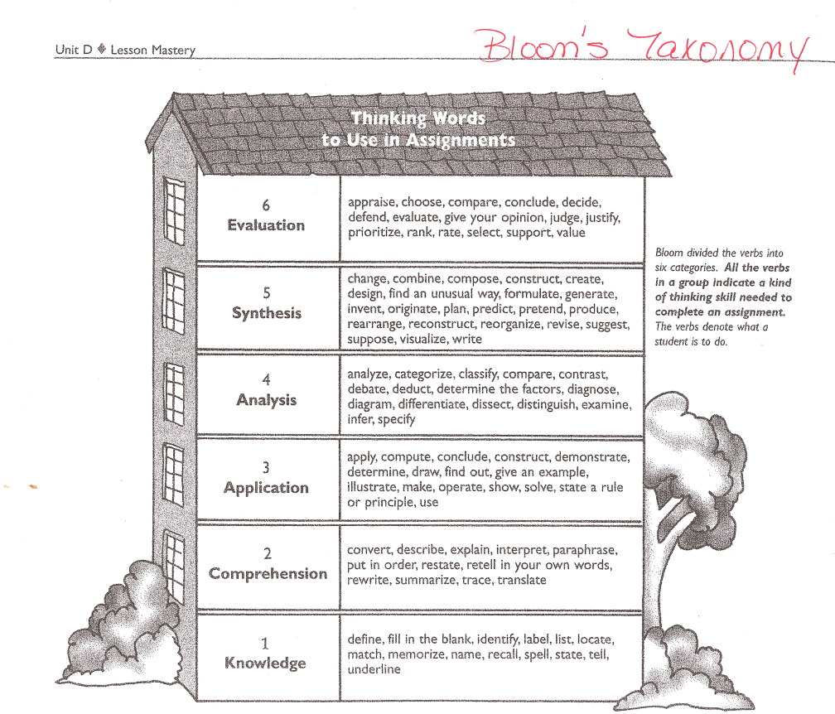
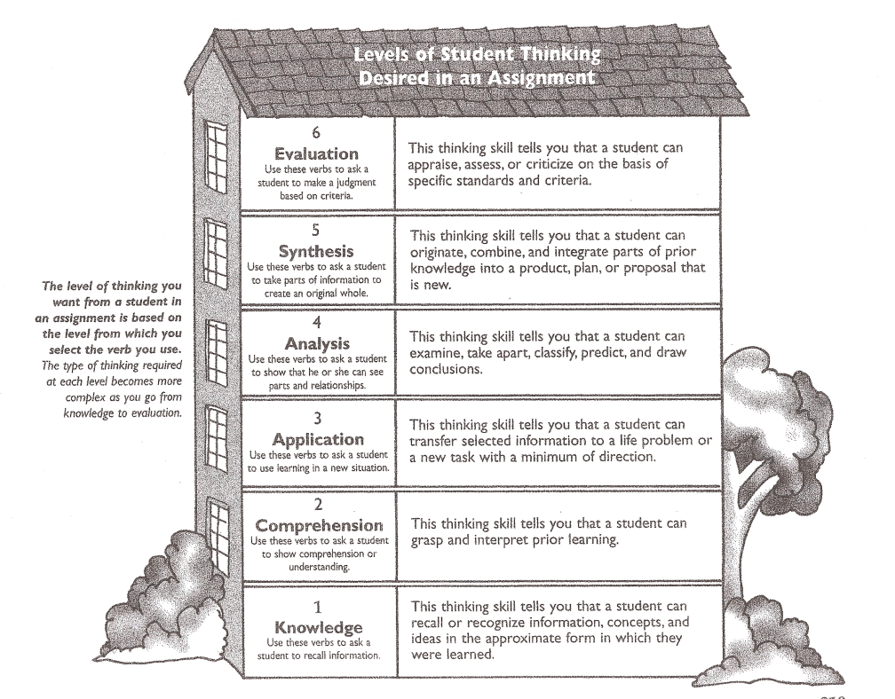
Resource Slide: Blooms Taxonomy
How to improve your Quiz grades
o Complete chapter homework with the best score you can obtain
o Review main concepts from chapters covered
o Take quiz – noting topics and concepts covered in your course notebook
o Study the concepts that you jotted down as you took the quiz
o Utilize the second attempt at the quiz
Recommended study plan listed below.
o Read each assigned chapter
o Do all online Study Plan exercises (the system helps you with each step)
o Complete in-chapter and end-of-chapter exercises
o Work in study groups
o Complete the assigned homework [this item is graded]
o Work in study groups, utilize extra problems homework, and/or contact professor for assistance/clarification
o Complete the assigned chapter Quiz [this item is graded]
o Review material and prepare for the next chapter

