Slide 1
MACROECONOMICS
B. Schmidt
Hull College of Business
Augusta State University

Slide 2
How I BEGIN Class
Try to make it REAL and PERSONAL to the student
Discuss current events
Try to make it FUN
Encourage opinions
Try to increase COMPREHENSION and RETENTION
Demand participation

Slide 3
FIRST things FIRST:
DETERMINE what they know
Correctly Draw and Label the following graphs: S/D, LS/LD, SLF/DLF, AS/AD, MS/MD, PPF, PF

Slide 4
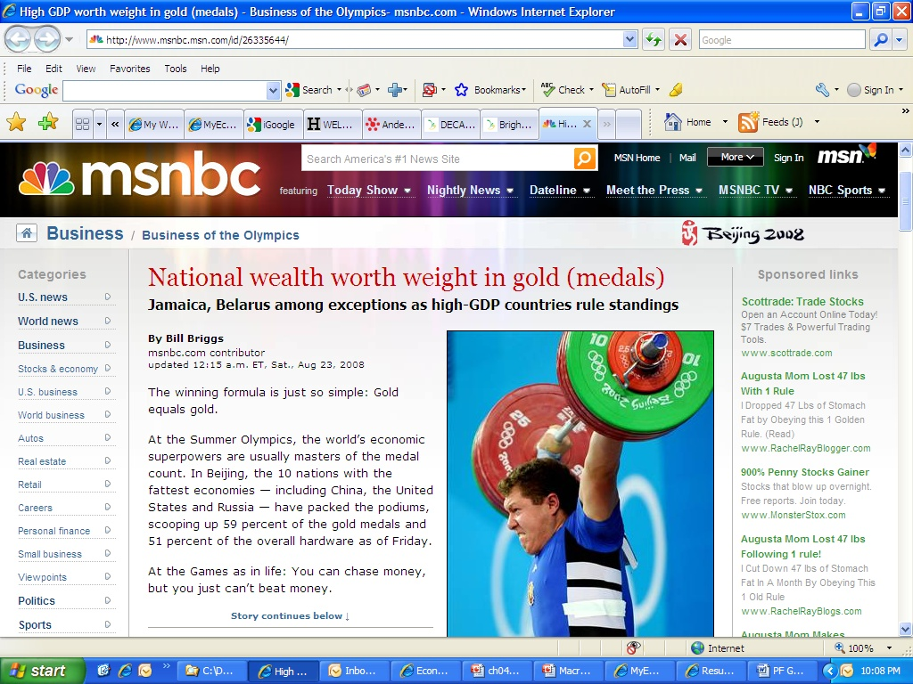
What is the immediate short-term result of the following statement

Slide 5
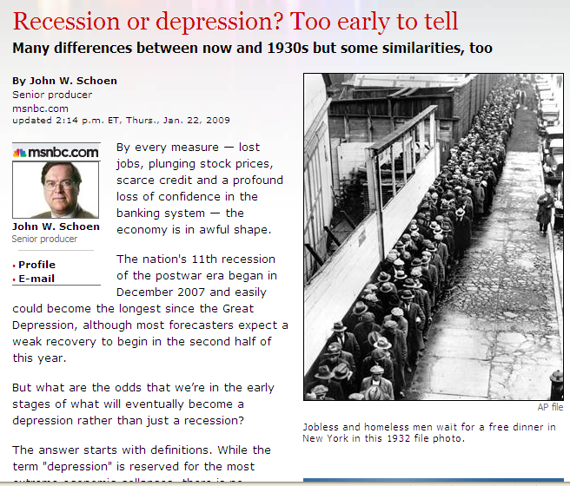
And this one…

Slide 6
Various Graphs
NIR
MS
PL
AS
Good x
RGDP
PPF
PF
MD
AD
Good y
QM
RGDP
MC
RWR
LS
MB
LD
Labor
Goods & Services
Labor
Loanable Funds
P
S
RWR
LS
RIR
SLF
Surplus Market effecting Price Floor
shortage, Market effecting Price Ceiling
D
LD
DLF
Q
Labor
LF
Deficit
DurpluD
RIR
SLF
RIR
PSLF
RIR
PSLF
SLF
DLF
DLF
LF
LF

Slide 7
PPF & PF
Good
x
RGDP
Attainable, efficient
PF
Unattainable
Unattainable
Attainable, inefficient
Attainable
PPF
GOOD
y
Labor

Slide 8
S
P
P
S1
S2
S2
S1
D
D
Q
Q
CURVE SHIFTS:
$ S = #price of Substitute in production
$ S = $price of compliment
$ S = $resource price or other input price
$ S = #price of the good is expected to rise
$ S = $number of sellers
$ S = $productivity

Slide 9
D
P
P
S
S
D2
D1
D1
D2
Q
Q
CURVE SHIFTS:
$ D = $price of substitute in consumption
$ D = #price of compliment
$ D = $price of good is expected to fall
$ D = #price of the good is expected to rise
$ D = $number of sellers
$ D = $productivity

Slide 10
LS
WAGE
WAGE
LS1
LS2
LS2
LS1
LD
LD
LABOR
LABOR
CURVE SHIFTS:
$ LS = #taxes
$ LS = #unemployment
$ LS = $population

Slide 11
LD
WAGE
WAGE
LS
LS
LD2
LD1
LD1
LD2
LABOR
LABOR

Slide 12
MS
NIR
MS1
MS2
NIR
MS2
MS1
MD
MD
QM
QM
CURVE SHIFTS:
$ MS = #RRR
$ MS = #Disc rate
$ MS = Selling Securities

Slide 13
MD
NIR
MS
NIR
MS
MD2
MD1
MD1
MD2
QM
QM
CURVE SHIFTS:
# MD = #PL
# MD = #RGDP
Financial Technology
# MD = #ATMs
$ MD = #Credit Cards

Slide 14
AS
PL
PL
AS1
AS2
AS2
AS1
AD
AD
RGDP
RGDP
CURVE SHIFTS:
# AS = #Pot. GDP
# AS = $MWR
# AS = $Money price of other resource

Slide 15
AD
PL
PL
AS
AS
AD2
AD1
AD1
AD2
RGDP
RGDP
CURVE SHIFTS:
# AD = #Exp. Future income, inflation, profits
# AD = #Govt. Expenditure
# AD = #Global economy (expands)
# AD = #qty money
# AD = $Exchange rate
# AD = $taxes
# AD = $Interest rate

Slide 16
SLF
RIR
RIR
SLF1
SLF2
SLF2
SLF1
DLF
DLF
LF
LF
CURVE SHIFTS:
# SLF = #Disp. income
# SLF = $Wealth
# SLF = $Exp. Future income

Slide 17
DLF
RIR
RIR
SLF
SLF
DLF2
DLF1
DLF1
DLF2
LF
LF
CURVE SHIFTS:
# DLF = #Exp. profit
Bus. Cycle expansion
Technology, successful new products
# Population

Slide 18
SURPLUS
WAGE
P
LS
S
LABOR SURPLUS
SURPLUS
LD
D
LABOR
Q

Slide 19
SHORTAGE
WAGE
P
LS
S
LABOR SHORTAGE
SHORTAGE
LD
D
LABOR
Q

Slide 20
The Real World is ONE BIG RIPPLE . . .
#PL
#MD
#NIR
#RIR
#PL
#PL
#RIR

Slide 21
What is the immediate short-term result of the following statement

Slide 22
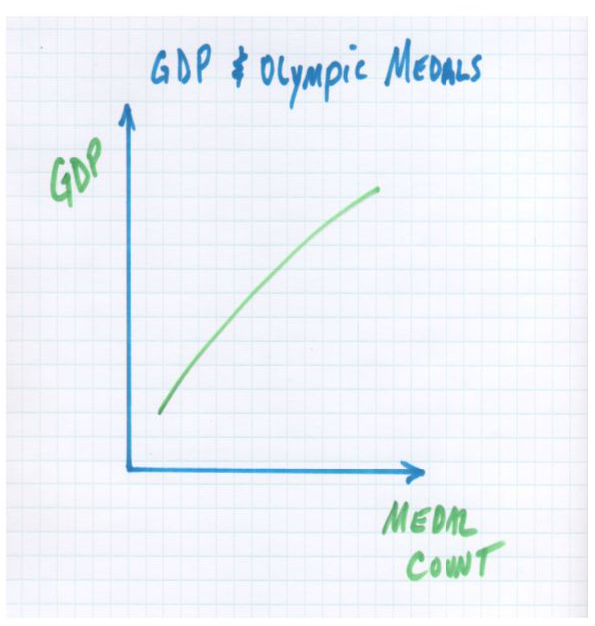
Analyzing the News
The article points out that there are anomalies such as Belarus and Jamaica where low GDP countries have won a lot of hardware. In the case of Belarus they also point out that its success could be due to the fact that it was a former Soviet bloc country where the Olympics were a substantial focus.

Slide 23
And this one…

Slide 24
Summary: Key Points in the Article
A depression is defined as a severe recession. But what constitutes severe? Since the Great Depression of the 1930s we have had short-lived and relatively shallow downturns in economic activity. But many forecasters and pundits are throwing the term 'depression' around this time. While economic conditions do appear to be dire they are not yet of the same magnitude as the Great Depression.
GDP fell 27 percent between 1929 and 1933. In the current downturn we are only down 2.5 to 3 percent. The stock market lost 90 percent of its value in the Great Depression and we are only down 35 to 40 percent now. One third of all banks failed in the Great Depression. And, while the current bank failures are large, they are numbered in the dozens.
By any metric we are not in a depression. However, the period leading up to the Great Depression has some similarities that are alarming. A period of prosperity in the 1920s led to asset price bubbles and a faltering banking system. However, the current belief is that we learned from our policy mistakes of the 1930s. The Fed has been aggressive in addressing the liquidity crisis. In addition the government appears to be near additional massive fiscal stimulus. Only time will tell whether we have better tools today to keep this downturn classified as a recession.

Slide 25
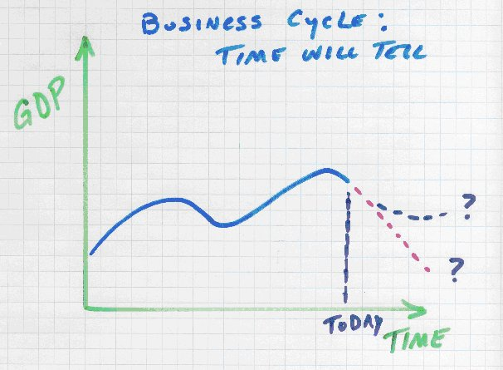
Analyzing the News
Where are we on the business cycle? Unfortunately we won't know until later. Did the aggressive monetary and fiscal stimulus work? I'll let you know in a few years but until then we will all be speculating. Was it enough? Was it too much? Will it get better or worse? It appears we have not been able to prevent downturns nor predict their magnitude. Economic intervention is still more art than science.

Slide 26
PPF

Slide 27
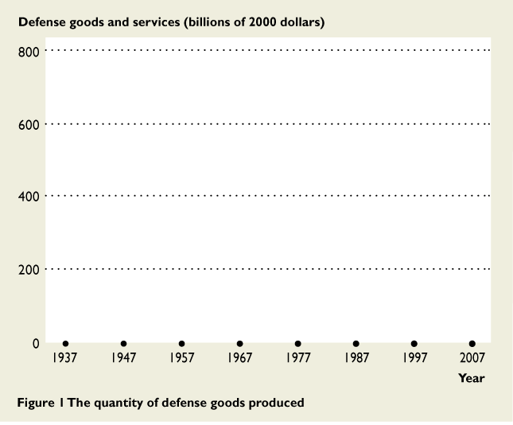
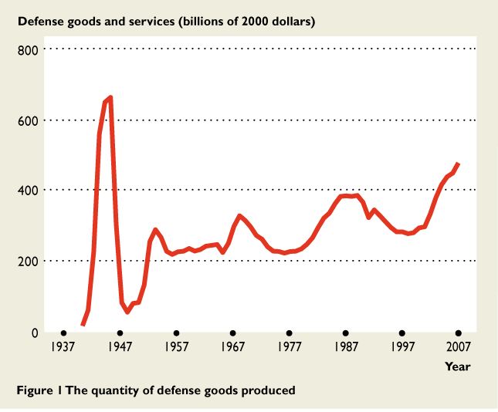
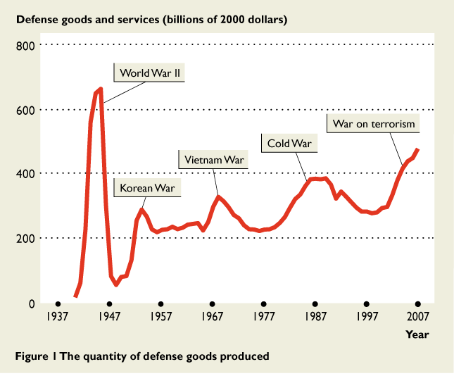
Guns Versus Butter
The figure shows the change in the quantity of defense goods and services produced.
It increases in times of war and decreases in times of peace.

Slide 28
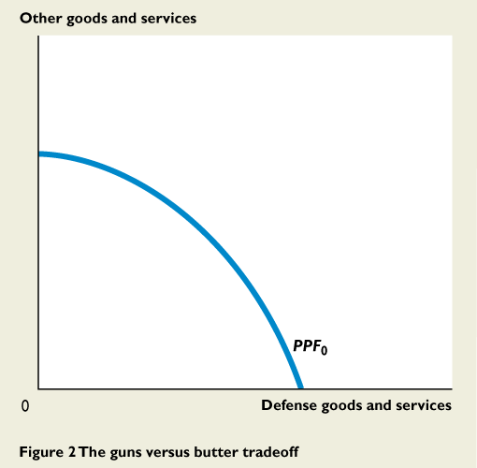
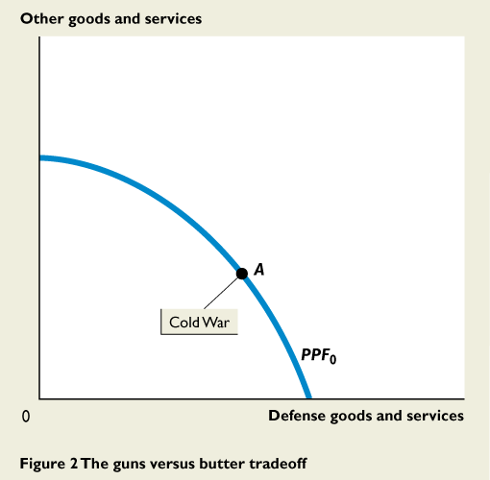
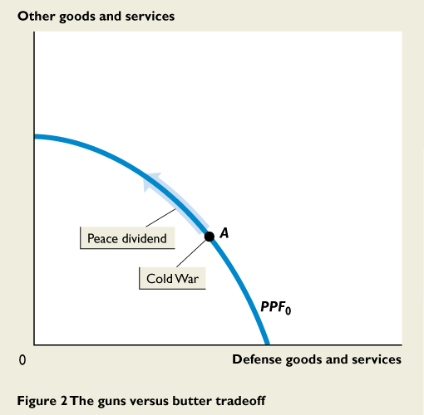
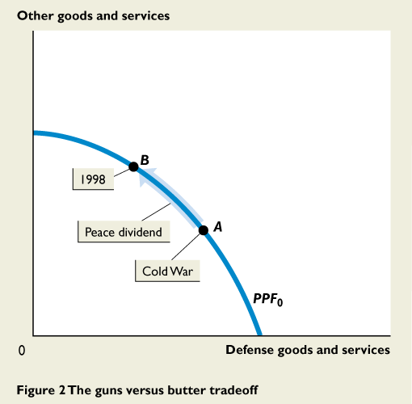
Guns Versus Butter
During the 1990s, U.S. production possibilities were shown by PPF₀.
President Reagan raised the stakes in the Cold War and the United States was producing at point A.
By mid-1990s, the United States enjoyed a peace dividend and production moved to point B.

Slide 29
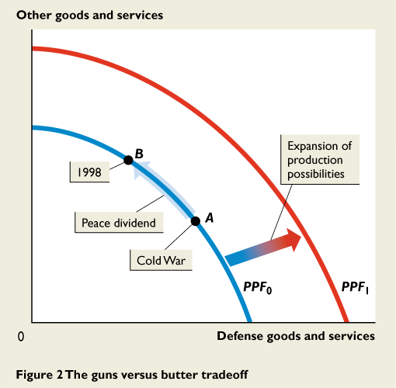
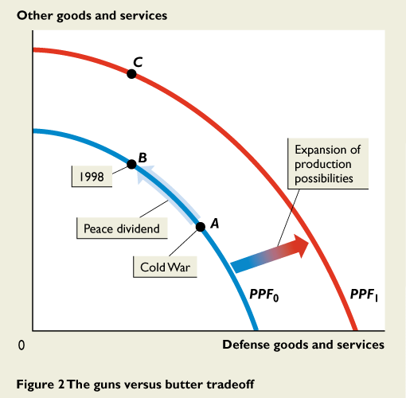
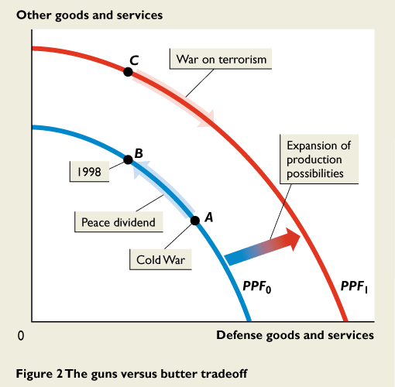
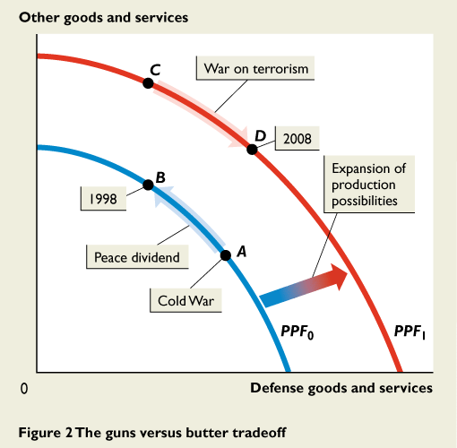
Guns Versus Butter
During the next decade, production possibilities expanded to PPF₁.
The United States could have kept defense production constant and moved to point C.
But after 9/11, defense production increased and the United States moved to point D.

Slide 30
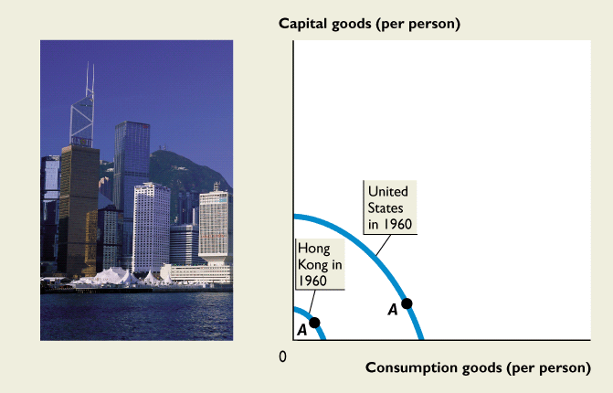
Hong Kong’s Rapid Economic Growth
In 1960, Hong Kong’s production possibilities were 25 percent of those in the United States.
In 1960, the United States and Hong Kong produced at point A on their respective PPFs.

Slide 31
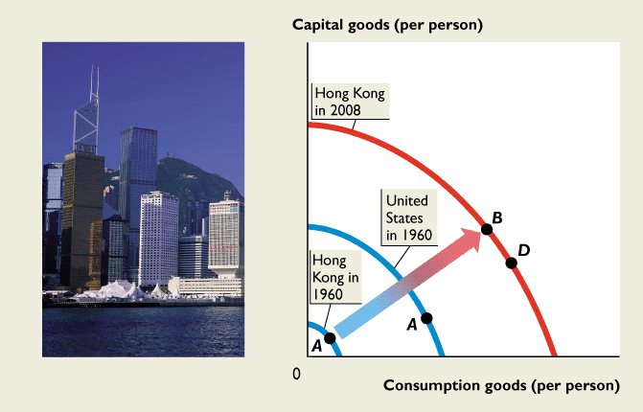
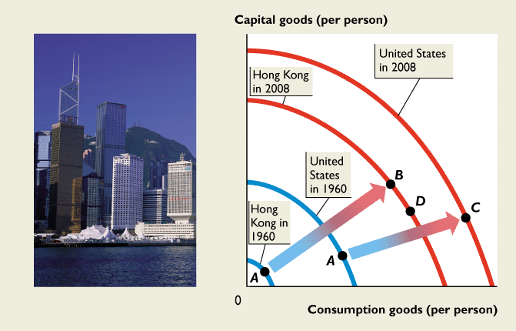
Hong Kong’s Rapid Economic Growth
Hong Kong allocated more resources to producing capital goods than the United States did.
And by 2008, Hong Kong’s PPF was 80 percent of U.S. PPF.

Slide 32
Hong Kong’s Rapid Economic Growth
If Hong Kong continues to produce at a point like B, allocating more resources to producing capital goods, it will grow more rapidly than the United States.

Slide 33
Hong Kong’s Rapid Economic Growth
But if Hong Kong produces at a point like D, its economic growth rate will slow.

Slide 34
Business cycle
What cycle are we currently in?

Slide 35
13.1 BUSINESS-CYCLE DEFINITIONS AND FACTS
U.S. Business-Cycle History
The NBER has identified 33 complete cycles starting from a trough in December 1854.
Over all 33 complete cycles:
The average length of an expansion is 35 months and the average length of a recession is 18 months.
The average time from trough to trough is 53 months.

Slide 36
13.1 BUSINESS-CYCLE DEFINITIONS AND FACTS
So over the 152 years since 1854, the U.S. economy has been in:
Recession for about one third of the time
Expansion for about two thirds of the time.
The 152-year averages hide significant changes that have occurred in the length of a cycle and the relative length of the recession and expansion phases.

Slide 37
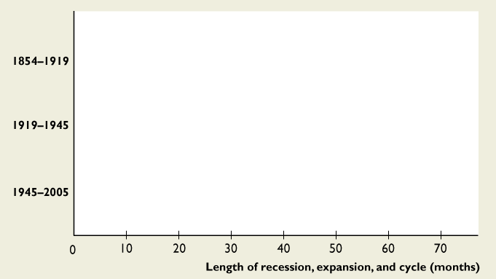
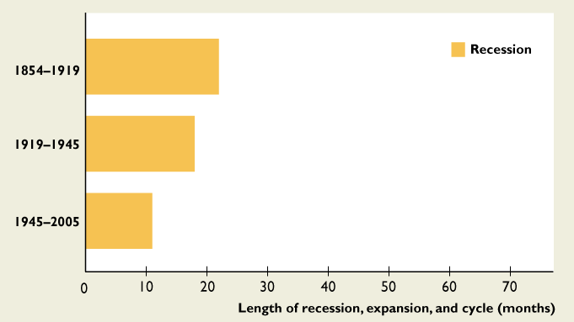
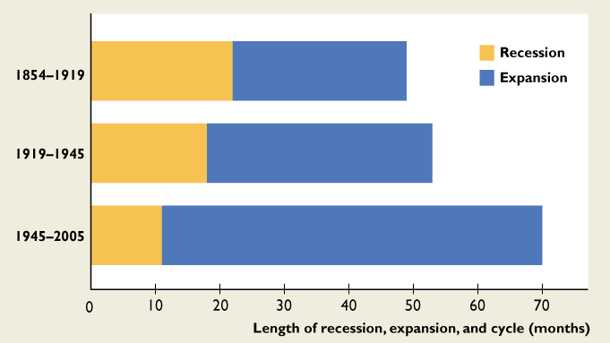
13.1 BUSINESS-CYCLE DEFINITIONS AND FACTS
Figure 13.1 summarizes U.S. recession, expansion, and cycle length since 1854.
Recessions have shortened.
Expansions have lengthened, and complete cycles have lengthened.

Slide 38
The National Bureau Calls a Recession
The NBER’s Business Cycle Dating Committee announced in November 2001 that a peak in business activity has occurred in the U.S. economy in March 2001.
To identify the date of the cycle peak, the NBER committee looked at industrial production, employment, real income, and wholesale and retail sales.
The figure on the next slide shows employment.

Slide 39
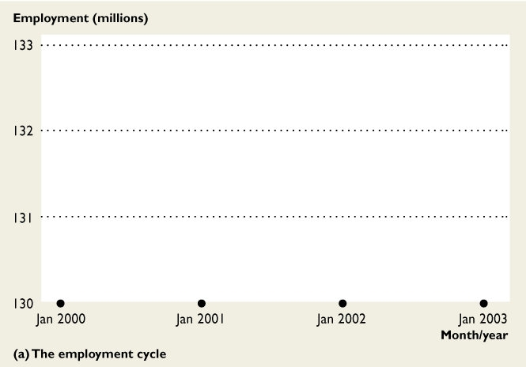
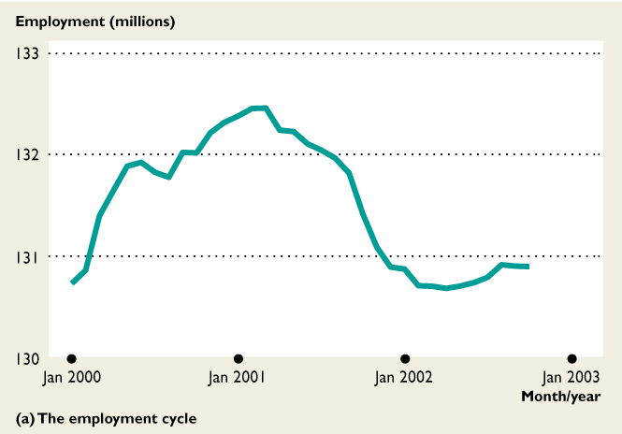
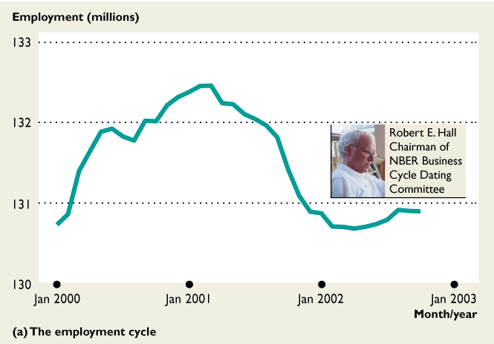
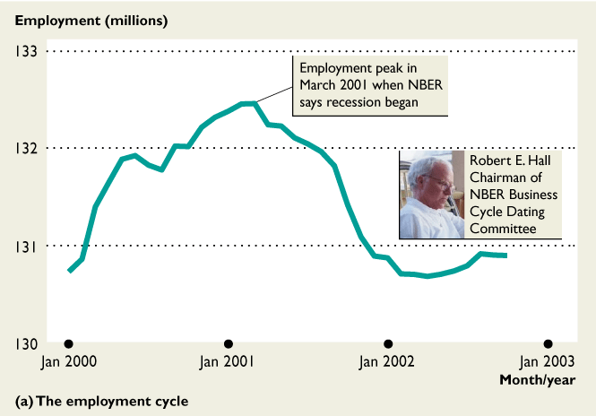
The National Bureau Calls a Recession
Employment peaked in March 2001.
Other factors considered by the committee did not peak but didn't contradict the employment numbers.
So the committee was clear that March was the peak month.

Slide 40
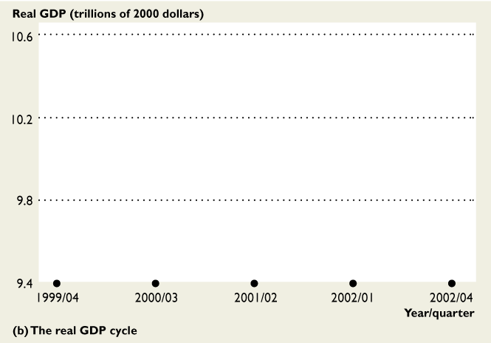
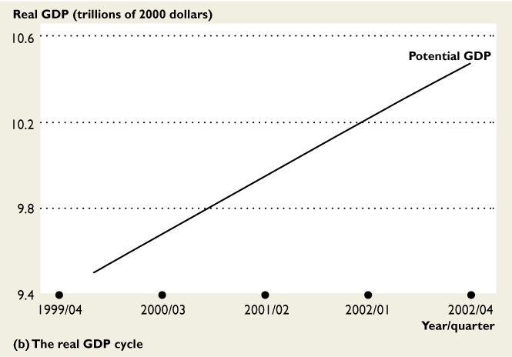
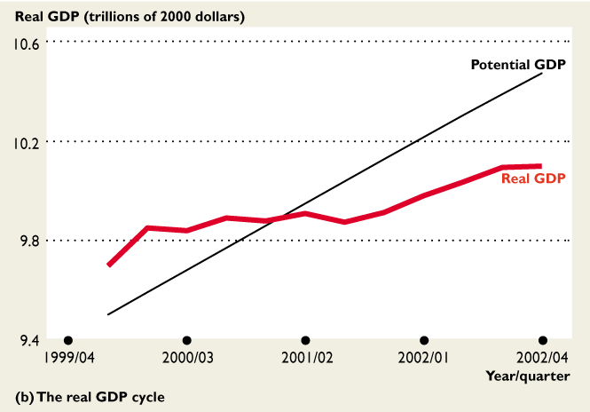
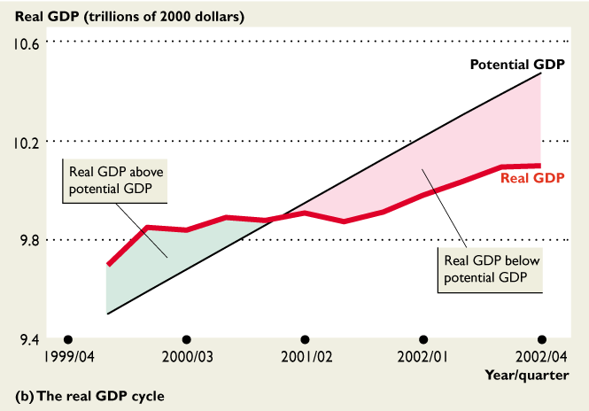
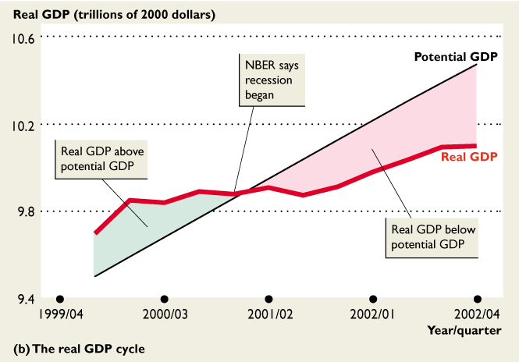
The National Bureau Calls a Recession
The NBER committee gives relatively little weight to real GDP.
The figure shows that through 2000, real GDP exceeded potential GDP.
Real GDP was shrinking during the first quarter of 2001, before the NBER says the recession began.

Slide 41
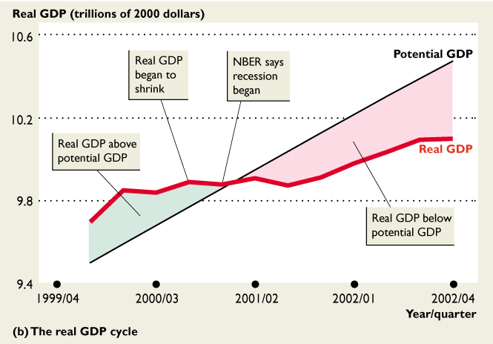
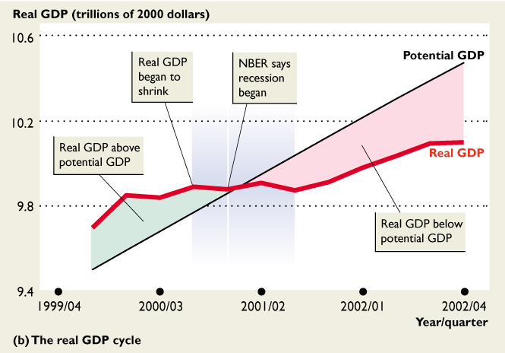
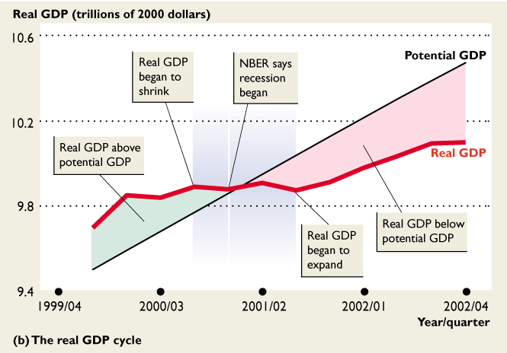
The National Bureau Calls a Recession
In July 2003, the NBER committee announced that a new expansion had begun in November 2001.
The figure shows that this timing lined up better with real GDP than with employment.

Slide 42
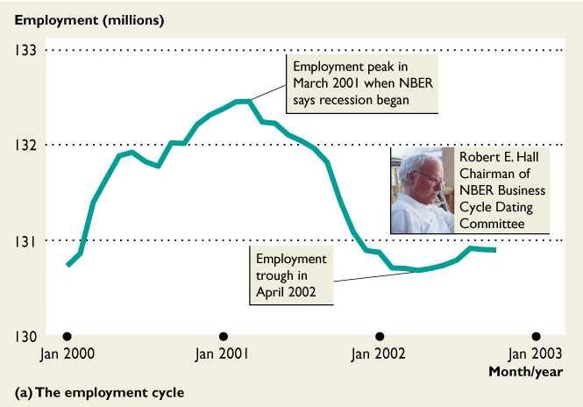
The National Bureau Calls a Recession
The employment trough didn’t occur until April 2002.
This lagging of employment behind real GDP is normal and occurs in all expansions.

Slide 43
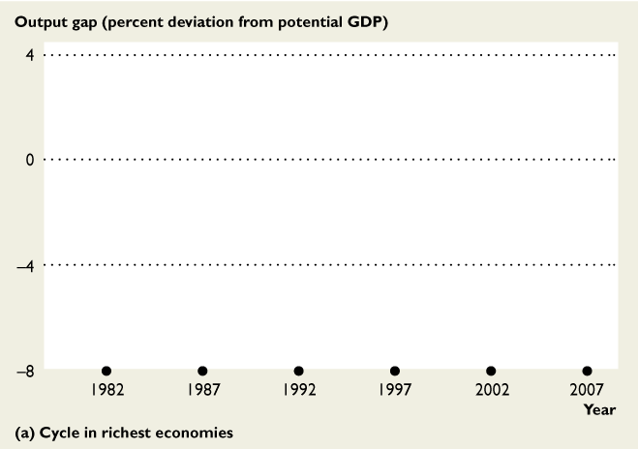
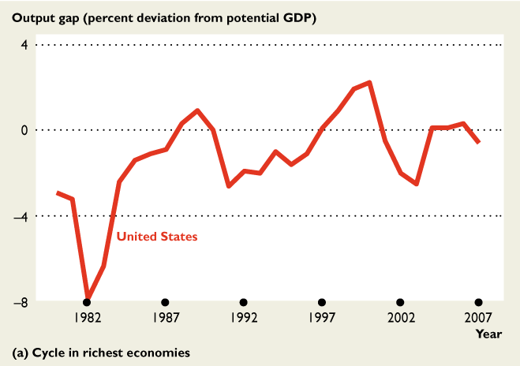
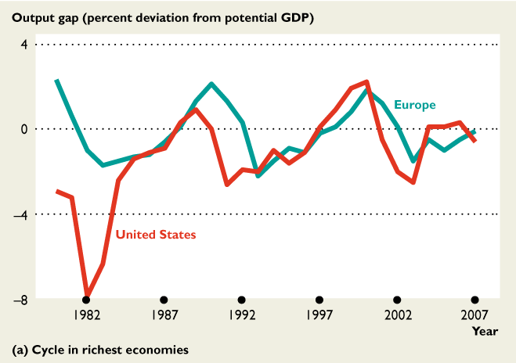
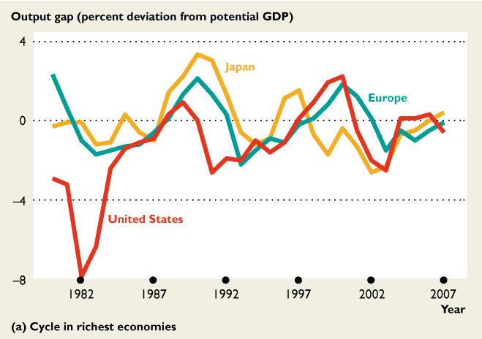
The Global Business Cycle
Every economy has a business cycle, but they differ in severity and timing.
The U.S. cycle in the early 1908s was the most severe.
The U.S. cycle leads the cycle in Europe and Japan.
Japan’s cycle has taken a downward trend since early 1990s.

Slide 44
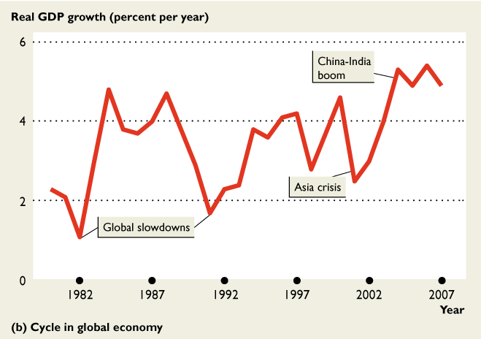
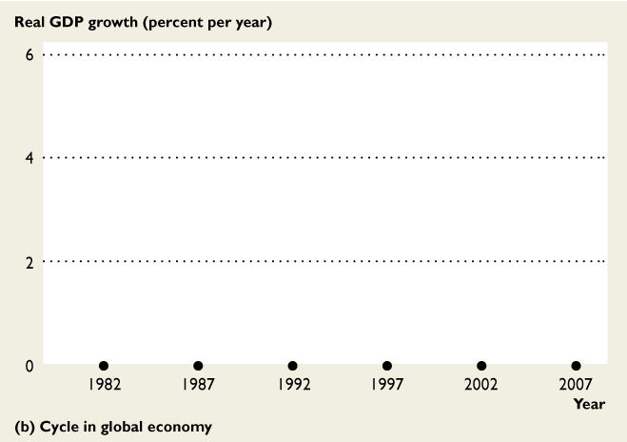
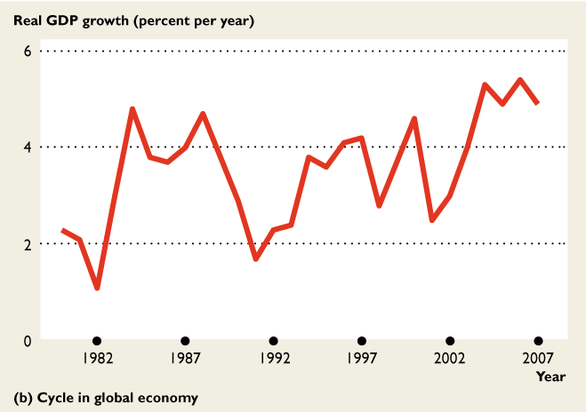
The Global Business Cycle
The figure shows the business cycle in the world economy.
The figure shows no recession in the world as a whole since 1980.
and that the Asian economies are driving the world economy.

Slide 45
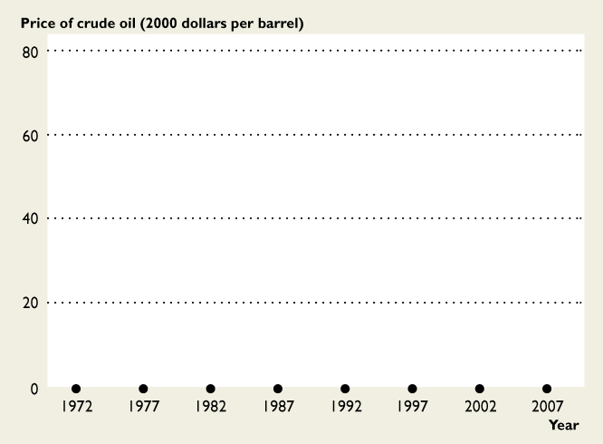
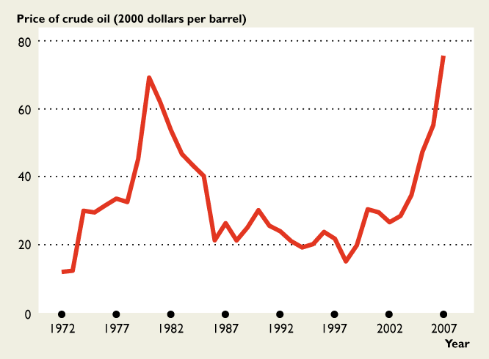
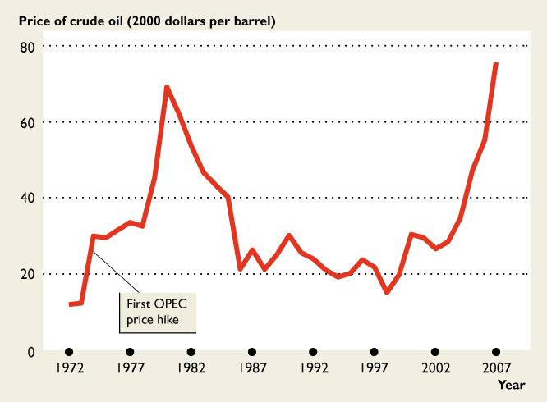
Oil Price Cycles in the U.S. and Global Economies
In September 1973, OPEC cut production and raised the price of crude oil to $10 a barrel—$30 in 2000 dollars.
In United States, Europe, Japan and developed nations went into recession.

Slide 46
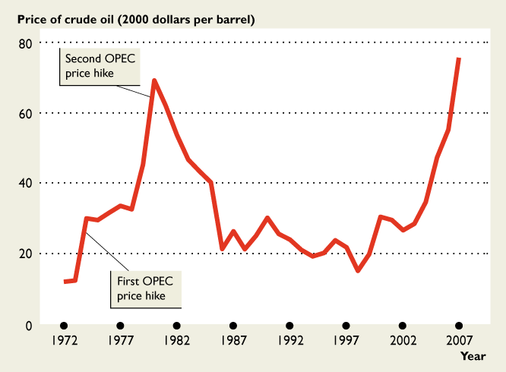
Oil Price Cycles in the U.S. and Global Economies
In 1980, OPEC again cut production and raised the price to $37 a barrel—almost $70 in 2000 dollars.
The global economy experienced recession, but more severe than the mid-1970 one because the Fed’s monetary policy cut aggregate demand.

Slide 47
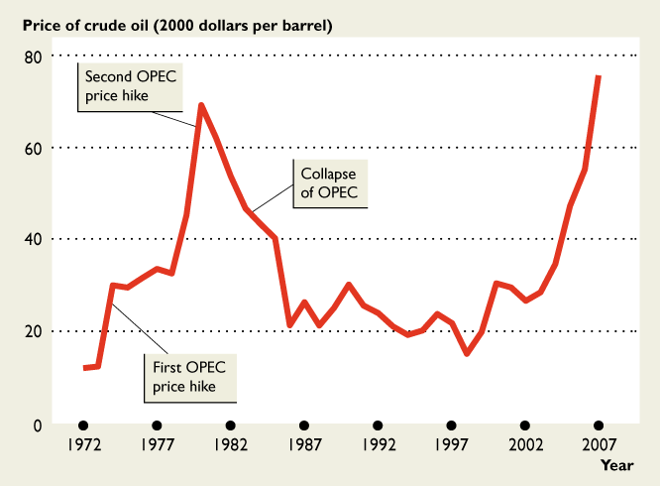
Oil Price Cycles in the U.S. and Global Economies
With the price of crude oil so high, Canada and the United States increased production.
Britain and Norway developed North Sea oil and Mexico stepped up production.
The price tumbled.

Slide 48
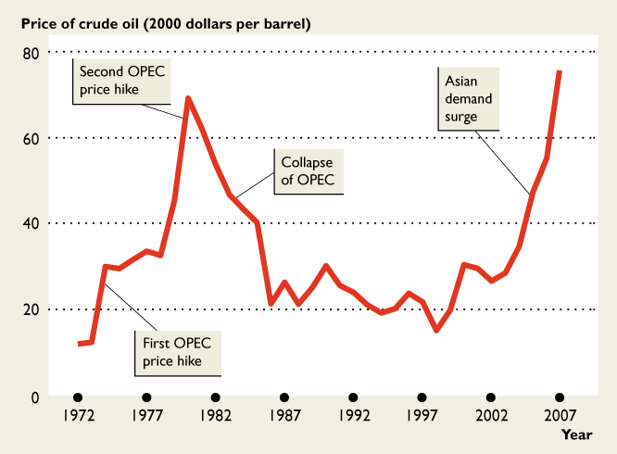
Oil Price Cycles in the U.S. and Global Economies
Strong Asian demand for oil increased its price in the 2000s.
By 2007, the price has surged to almost $60 a barrel.
By the summer of 2008, the price was $145 a barrel.

Slide 49
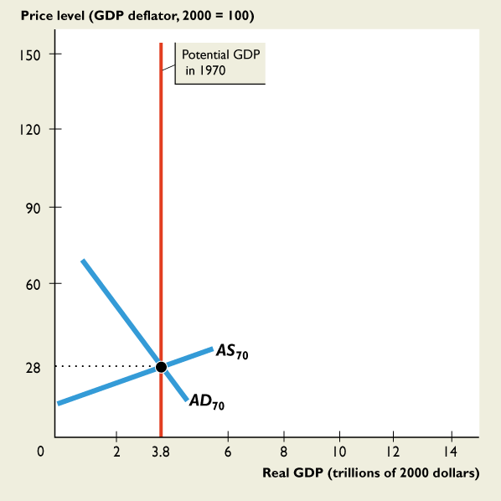
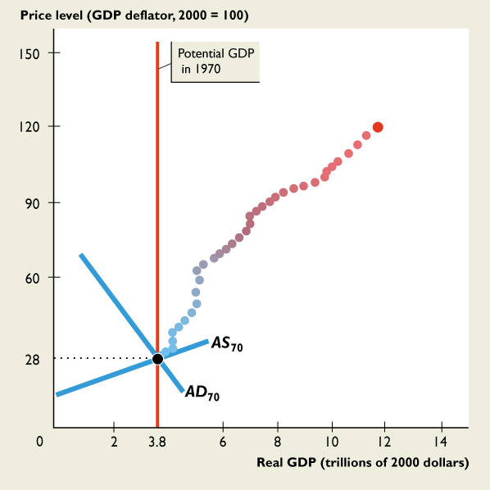
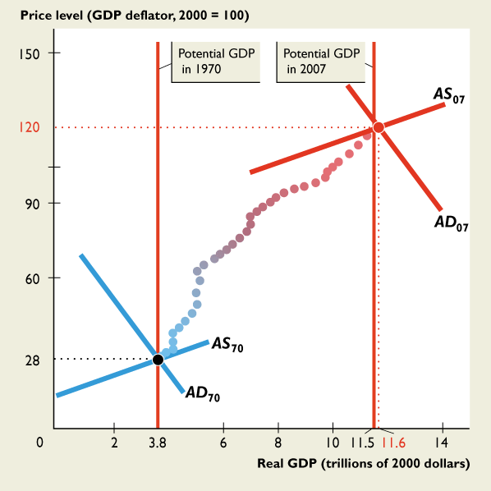


Real GDP Growth, Inflation, and the Business Cycle
Each dot represents a year between 1970 and 2007.
Dots move rightward, which shows economic growth.
Dots move upward, which shows inflation.

Slide 50



Real GDP Growth, Inflation, and the Business Cycle
The dots move in waves, which show the business cycle and the recessions.
Sometimes the economy is at full employment as it was in 1970.
Sometimes there is an output gap as in 2007.

Slide 51
GDP /
HDI

Slide 52











MEASURING U.S. GDP
The relationship between GDP, GNP, and disposable personal income.

Slide 53




THE USE AND LIMITATIONS OF REAL GDP
The shaded periods show the recessions—periods of falling production that lasts for at least six months.

Slide 54
Making GDP Personal
Making Sense of the Numbers
To use the GDP numbers in a news report, you must first check whether the reporter is referring to nominal GDP or real GDP.
Using U.S. real GDP per person, check how your income compares with the average income in the United States.
When you see GDP numbers for other countries, compare your income with that of a person in France, or Canada, or China.

Slide 55
GDP, Population and Per Capita GDP, Selected Nations Reported by the World Bank, 2007
Country | Nominal GDP (millions, US $ | Population | Nominal GDP Per capita
United States | $13,811,200 | 301,621 | $46,040
United Kingdom | $2,727,802 | 61,034 | $42,740
Germany | $3,297,233 | 82,268 | $38,860
Japan | $4,387,705 | 127,771 | $37,670
China | $3,280,053 | 1,319,983 | $2,360
Word Total | $54,347,038 | 6,612,040 | $7,958
Source: World Bank, http://web.worldbank.org/WBSITE/EXTERNAL/DATASTATISTICS/0,,contentMDK:20399244~menuPK:1504474~pagePK:64133150~piPK:64133175~theSitePK:239419,00.html#ranking

Slide 56
U.S. GDP Second Quarter 2008 (Current Dollars, Annual Rate)
+C | (Consumption) | $10,138.5 (billions)
+I | (Investment) | $2,000.9
+G | (Government) | $2,873.7
+X | (Exports) | $1,923.2
-M | (Imports) | $2,641.4
 | (Net) | (-718.2)
= | GDP | $14,294.5*
Source: BEA, www.bea.gov/national.nipaweb/TableView.asp?SelectedTable=5&Freq=Qtr&FirstYear=2006&LastYear=2008

Slide 57





The Human Development Index
The figure shows the relationship between real GDP per person and the Human Development Index (HDI).
Each dot represents a country.
The small Africa country of Sierra Leone has the lowest HDI and the second lowest real GDP per person.

Slide 58
The Human Development Index
The United States has the third highest real GDP per person but has the eighth highest HDI.
Why is the United States not ranked higher on the HDI?
Because the people who live in seven countries live longer, have better access to health care and education than do Americans.

Slide 59



How Fast Has Real GDP per Person Grown?
This figure shows the estimates of 1 million years of real GDP per person (in 2000 U.S. dollars) .

Slide 60
How Fast Has Real GDP per Person Grown?
Real GDP per person hovered around $100 per year from 1,000,000 B.C. until 1350!

Slide 61
How Fast Has Real GDP per Person Grown?
Around 1750, the Industrial Revolution began and by 1850, real GDP per person was twice its 1650 level.

Slide 62
How Fast Has Real GDP per Person Grown?
By 1950, real GDP per person was more than five times its 1850 level. And by 2000, it was four times its 1950 level.

Slide 63


How Fast Has Real GDP per Person Grown?
These figures give you a close-up view of U.S. real GDP per person over the past 100 years.
In 2005, real GDP per person was almost eight times its level in 1905—an average growth rate of 2 percent a year.

Slide 64

How Fast Has Real GDP per Person Grown?
But growth has been uneven: The 1930s saw no growth and the 1940s saw the fastest growth.
Measured decade by decade, growth has slowed since the 1960s.
But if we divide the 1990s into before and after the Internet, growth has picked up since 1994.

Slide 65





9.2 THE SOURCES OF ECONOMIC GROWTH
Labor productivity growth depends on
Physical capital growth
Human capital growth
Technological advances

Slide 66



U.S. Labor Productivity Growth Since 1960
The 1960s were years of rapid human capital growth and technological change .

Slide 67
U.S. Labor Productivity Growth Since 1960
The contribution of human capital growth and technological change slowed during the 1970s.
Why?

Slide 68
U.S. Labor Productivity Growth Since 1960
Three reasons:
1. Oil price hikes in 1973−1974 and in 1979−1980 diverted technological change toward saving energy rather than increasing labor productivity.
2. Taxes and government regulation increased during the late 1960s and 1970s, which weakened incentives and labor productivity growth slowed.
3. Rapid inflation distorted saving and investment decisions and shortened the time horizon over which firms made their borrowing and lending plans.

Slide 69
U.S. Labor Productivity Growth Since 1960
The contribution of human capital and technological change remained low until the new economy era of the 1990s, when…
Computer and information technologies kicked in to bring faster labor productivity growth again.

Slide 70
How You Influence and Are Influenced by Economic Growth
Many of the choices that you make affect your personal economic growth rate—the pace of expansion of your own standard of living.
These same choices, in combination with similar choices made by millions of other people, have a profound effect on the economic growth of the nation and the world.
The most important of these choices right now is your choice to increase your human capital.

Slide 71
How You Influence and Are Influenced by Economic Growth
A choice that will become increasingly important later in your life is to accumulate a pension fund.
This choice provides a source of income for you when you eventually retire.
But it also provides financial resources that firms can use to finance the expansion of physical capital.
Not only do your choices influence economic growth; economic growth also has a big influence on you—on how you earn your income and on the standard of living that your income makes possible.

Slide 72
How You Influence and Are Influenced by Economic Growth
Because of economic growth, the jobs available today are more interesting and less dangerous and strenuous than those of 100 years ago.
And today’s jobs are hugely better paid.
But for many of us, economic growth means that we must accept change and be ready to learn new skills and get new jobs.

Slide 73
Human Capital
Jobs destroyed/created

Slide 74




Changes in What We Produce
Over the past 65 years, the number of people who work on farms and who produce goods have decreased.
While the number of people who produce services has expanded.

Slide 75





Changes in Human Captical
Over the past 90 years, the amount of education people receive has increased.
The importance of education has become known and more people are making sacrifices to achieve educational goals

Slide 76

Changes in How We Produce in the New Economy
The new economy consists of the jobs and businesses that produce and use computers and equipment powered by computer chips.
In each pair of photos, the new technology enables capital to replace labor.

Slide 77
Changes in How We Produce in the New Economy
In the top pair of images, illustrates how the ATM (capital) is replacing many bank tellers (labor).
In the bottom pair of images illustrates how a flight check-in machine (capital) is replacing many check-in clerks (labor).

Slide 78
Changes in How We Produce in the New Economy
The number of bank teller and airline check-in clerk jobs is shrinking.
But new technologies are creating a range of new jobs for people who make, program, install, and repair these new machines.

Slide 79



Growing Government
A 100 years ago, the federal government spent 2 cents out of each dollar earned.
Government grew during two world wars and in the 1960s and 1970s social programs expanded.
During the 1980s and 1990s, government shrunk.
After 9/11, government started to grow again.

Slide 80
The U.S. and Global Economies in Your Life
How can you use the facts and trends about what, how, and for whom goods and services are produced in the U.S. and global economies?
As you think about your future career, you know that a job in manufacturing is likely to be tough. A job in services is more likely to lead to success.
What sort of job will you take?
As you think about the stand you will take on the political question of protecting U.S. jobs, you are better informed.
But how will you vote?

Slide 81
unemployment

Slide 82


Labor Market in the Great Depression
The Great Depression lasted from 1929 until the end of the 1930s.

Slide 83
Labor Market in the Great Depression
1933 was the worst year—real GDP fell 30 percent and one in four people could not find work.

Slide 84








7.1 LABOR MARKET INDICATORS
Figure 7.1 shows population labor force categories.
The figure shows the data for August 2007.

Slide 85




7.2 LABOR TRENDS AND FLUCTUATIONS
The unemployment rate increases in recessions and decreases in expansions.

Slide 86




7.2 LABOR TRENDS AND FLUCTUATIONS
The labor force participation rate of men has decreased.
The average participation rate of both sexes has
increased.
Notes:
Students are interested in the different behavior of the male labor force participation rate and the female labor force participation rate. Students will probably believe that the reason for the increasing female participation rate is social, not economic. They will identify changing social attitudes toward women as the major source and probably see the women’s liberation movement as the driving force for this change. While not to deny the importance of attitudes, this area is a good one in which to get students to explore the economic forces that lie behind social attitudes and change. Get them to think about the technological advances that have contributed to more women being in the labor force. Many goods that were previously produced in the household are now mass‐produced and available for purchase— most items of prepared food, for example. New appliances have increased productivity in the home enabling household production in less time—laundry, kitchen, and cleaning equipment for example. The market provides new goods and services that households want but can’t readily make at home—home entertainment equipment (TV, CD, DVD, etc) for example. These changes lead to many families deciding to have two income earners rather than the older tradition of one. It is interesting to let students discuss what they think will happen to the labor force participation rates in the future and whether or not they think they will ever be equal—or unequal in the opposite direction!

Slide 87




7.2 LABOR TRENDS AND FLUCTUATIONS
The figure also shows involuntary part-time workers.
Involuntary part-time work increases in recessions and decreases in expansions.

Slide 88





7.3 SOURCES AND TYPES OF UNEMPLOYMENT
Figure 7.6 shows unemployment by reasons.
Job leavers are the smallest group, and their number fluctuates little.
Job losers are the biggest group, and their number fluctuates most.
Notes:
Now ask: do the same ideas apply to unemployed people. (Be sure to be compassionate about the misery that unemployment can bring. You are not claiming that it is not costly. You’re trying to identify the benefits, if any.) You’ll quickly get your students to see that imagining an economy without any unemployment is nearly impossible. If consumers are free to change their decisions about what they want to buy, some goods and services must fall out of favor when others come into favor. The firms making the unfavored products fall on hard times and often their workers are fired or laid off.
Sure, these laid off workers could start work right away, cleaning shoes, selling flowers at intersections. But they are better off (in their own opinion) being frictionally unemployed and searching for new jobs. To eliminate this source of unemployment we would need to forbid consumers from changing their buying plans or insist that no one remain idle and get on with doing any job even if it doesn’t earn a wage. Note that if this is how we ran our economy we’d still be using coal-fired stoves and the pony express, and we’d be wearing coonskin caps. There would be no McDonald’s, Federal Express, or Nike shoes.

Slide 89


7.3 SOURCES AND TYPES OF UNEMPLOYMENT
Duration and Demographics of Unemployment
On the average from 1997 to 2007, blacks experienced more than twice the unemployment rate of whites.

Slide 90





7.3 SOURCES AND TYPES OF UNEMPLOYMENT
Figure 7.8(a)shows the U.S. unemployment rate from 1977 to 2007.
As the unemployment rate fluctuates around the natural rate unemployment, …
Cyclical unemployment is negative (shaded red) and positive (shaded blue).

Slide 91





7.3 SOURCES AND TYPES OF UNEMPLOYMENT
Figure 7.8 shows the relationship between unemployment and real GDP.
As the unemployment rate fluctuates around the natural rate unemployment in part (a), real GDP fluctuates around potential GDP in part (b).

Slide 92







Unemployment Around the World
The U.S. unemployment rate lies in the middle of the range experienced by other countries.

Slide 93
Unemployment Around the World
Canada, the United Kingdom, and the Eurozone have higher unemployment rates than the United States and Japan.

Slide 94
Unemployment Around the World
The newly industrializing countries of Asia have lower unemployment rates.

Slide 95
Unemployment Around the World
The differences in unemployment rate were much greater during the 1980s and 1990s than in the 2000s.

Slide 96
Unemployment Around the World
All of the countries with higher unemployment rates than the U.S. rate also have higher unemployment benefits and more regulated labor markets.

Slide 97



Unemployment Benefits and the
Natural Unemployment Rate
Before 1980, unemploy-ment rates in the United States and Canada were similar.

Slide 98
Unemployment Benefits and the
Natural Unemployment Rate
The key change in the 1980s was an increase in Canadian unemploy-ment benefits.

Slide 99
Unemployment Benefits and the
Natural Unemployment Rate
Almost 100 percent of Canada’s unemployed people receive benefits compared to 38 percent in the United States.

Slide 100


Unemployment Benefits and the
Natural Unemployment Rate
The level of unemployed benefits appear to have a large effect on the natural unemploy-ment rate.

Slide 101


Women in the Labor Force
The labor force participation rates of women in most advanced countries has increased since the 1960s, but the level of participation varies a great deal.

Slide 102
Women in the Labor Force
Cultural factors play a role in determining national differences in women’s choices, but economic factors such as education will ultimate dominate cultural ones.

Slide 103
UNEMPLOYMENT <> BAD Natural Unemployment <> Everyone Employed
You will go through several seasons of life
Each bringing a season of employment and career
Not in labor force
Voluntarily part-time
Job seeking
Employed
Employment Situation Life Reason
Career change
College education
Family events / life styles
Illness
Monetary needs
RECOGNIZE, RELAX, ENJOY, AND MOVE FORWARD

Slide 104

WHY ARE YOU HERE
PLU’s
Stipend
Have to do something
Inspiration
Collaboration
Encouragement

Slide 105



Slide 106



Slide 107


Slide 108


Slide 109


Slide 110


Slide 111
INSPIRE
ENCOURAGE
EXPECT

Slide 112
Govt spending

Slide 113


What We Produce

Slide 114


Income Distribution

Slide 115


Federal Government
Revenue
Expenditures

Slide 116


State and Local Government
Revenue
Expenditures

Slide 117

Value of Production

Slide 118



Energy Sources
OIL
Natural
Gas
Coal

Slide 119

Income Per Day

Slide 120
Inflation,
NWR/RWR,
CPI

Slide 121




Slide 122

Analyzing the News
The Fed will enter the market and buy U.S. Treasury securities with cash. This open market operation injects new money into the economy and pushes interest rates lower as shown in the previous graph.

Slide 123


700 Years of Inflation and Deflation
These data show that inflation became a persistent problem only after 1900.
During the preceding 600 years, inflation was almost unknown.

Slide 124

700 Years of Inflation and Deflation
There was a burst of inflation during the sixteenth century after Europeans discovered gold in America, but this inflation was less than 2 percent a year.
Inflation eventually subsided.

Slide 125


700 Years of Inflation and Deflation
The Industrial Revolution was a temporary burst of inflation.
The graph provides dramatic evidence that inflation took off during the last century.

Slide 126


The Nominal and Real Price of a First-Class Letter
The figure shows the cost of a first-class letter since 1907.
The green line is the nominal price—the actual price of a stamp in the dollars (cents) of the year in question.

Slide 127

The Nominal and Real Price of a First-Class Letter
The red line is the real price—the price in terms of
the 2007 dollar.
The nominal price has gradually increased, but the real price has fluctuated—sometimes rising and sometimes falling.

Slide 128
The Nominal and Real Price of a First-Class Letter
The highest real price, 45 cents, occurred in 1933 and the lowest real price, 19 cents, occurred in 1920.

Slide 129


The Nominal and Real Wage Rates of
Presidents of the United States
Who earned more, George W. Bush in 2005 or George Washington in 1789?
George Washington was paid $25,000 in 1789.
George W. Bush was paid $400,000 in 2005.

Slide 130


The Nominal and Real Wage Rates of
Presidents of the United States
The real wage rate (the red line) has followed a remarkable course.
Expressed in 2005 dollars, George Washington earned $251,000 a year—more than George W. Bush’s $400,000.

Slide 131
The Nominal and Real Wage Rates of
Presidents of the United States
The White House is more comfortable today, and presidential travel arrangements are a breeze compared to earlier times.
So adding in the perks of the job, George W. Bush doesn’t get such a raw deal.

Slide 132



6.3 NOMINAL AND REAL VALUES
Figure 6.4 shows nominal and real wage rates: 1982–2006.
The nominal wage rate has increased every year since 1982.
The real wage rate decreased slightly from 1982 through the mid-1990s, after which increased slightly.

Slide 133
Using the CPI
Suppose you have a student loan of $80,000.
Suppose that the CPI rises by 3 percent a year each year from now (2008) through 2028.
Also suppose that the nominal interest rate on your loan is fixed at 5 percent a year.
How much will a $100 repayment cost you in 2008 dollars, when you start to pay off your loan in 2018?
How much will a $100 repayment cost you in 2008 dollars, when you make your final payment in 2028?
What is the real interest rate that you will have paid?

Slide 134
Using the CPI
You can answer all these questions.
Set the CPI in 2008 equal to 100.
With the CPI rising at a rate of 3 percent per year, the CPI in 2018 will be 134.
A $100 payment in 2018 is equivalent to a $74 payment in 2008. ($100 ÷ 134) x 100 = $74.
The CPI in 2028 will be 181.
So a payment of $100 in 2028 is equivalent to a payment of $55 in 2008.

Slide 135
Using the CPI
The further in the future a payment is made, the less is your $100 payment in today’s dollars.
Your real interest rate is the 5 percent a year nominal interest rate minus the 3 percent a year inflation rate.
Your real interest rate is 2 percent per year.

Slide 136
investment,
Saving,
Rir

Slide 137






Investment and
Capital: 1976-2006
Part (a) shows gross investment and depreciation.
The gap between gross investment and depreciation is net investment.
Part (b) shows net investment.
Part (c) shows the capital stock.

Slide 138

Investment and
Capital: 1976-2006
Gross investment increases in most years and increased rapidly during the booming 1990s, but it decreases in recession years—see part (a) of the figure.
Recession years are highlighted in red.

Slide 139
Investment and
Capital: 1976-2006
Depreciation increases in most years.
Like gross investment, net investment increased rapidly during the 1990s expansion.
Because net investment is always positive, the quantity of capital increases each year despite huge swings in net investment because the quantity of capital is large in comparison to net investment.

Slide 140



6.3 NOMINAL AND REAL VALUES
Figure 6.5 shows real and nominal interest rates: 1967–2007.
During the 1970s, the real interest rate became negative.
The nominal interest rate increased during the high-inflation 1980s.

Slide 141
Interest Rate Puzzle
The real interest rate paid by big corporations fell from 5.5 percent a year in 2001 to 2.5 percent a year in 2005.
Alan Greenspan said he was puzzled that the real interest rate was falling when the U.S. government budget deficit was growing.
Why did the real interest rate fall?
The answer lies in the global loanable funds market.

Slide 142



Interest Rate Puzzle
Global saving increased and the supply of loanable funds increased from SLF₀₁ in 2001 to SLF₀₅ in 2005.
U.S. saving decreased and U.S. borrowing from the rest of the world increased strongly during these years.
The Chinese, Japanese, and Germans all have much higher saving rates than do Americans.

Slide 143
Your Saving, Investment, and Loanable Funds Market
Think about the amount of saving that you do.
How much of your disposable income do you save? Is it a positive amount or a negative amount?
If you save a positive amount, what do you do with your savings?
Do you put them in a bank, in the stock market, in bonds, or just keep money at home?
What is the interest rate you earn on your savings?

Slide 144
Your Saving, Investment, and Loanable Funds Market
If you save a negative amount, just what does that mean?
It means that you have a deficit (like a government deficit). You’re spending more than your disposable income.
In this case, how do you finance your deficit? Do you get a student loan? Do you run up an outstanding credit card balance?
How much do you pay to finance your negative saving (your dissaving)?
How do you think your saving will change when you graduate and get a better-paying job?
CURVE SHIFTS:
# SLF = #Disp. income
# SLF = $Wealth
# SLF = $Exp. Future income

Slide 145
Your Saving, Investment, and Loanable Funds Market
Also think about the amount of investment that you do.
You are investing in your human capital by being in school. What is this investment costing you? How are you financing this investment?
When you graduate, you will need to decide whether to invest in an apartment or a house or to rent your home.
How would you make a decision whether to buy or rent a home?
Would it be smart to borrow $300,000 to finance the purchase of a home? How would the interest rate influence your decision?

Slide 146
Banks,
Money Abroad,
Credit Cards,
Fed watching,
Hyper inflation

Slide 147














11.3 THE FEDERAL RESERVE SYSTEM
Figure 11.4 shows the 12 Federal Reserve districts.
Each Federal
Reserve district has its own
Federal Reserve Bank.
The Board of Governors of the Federal Reserve System is
located in Washington, D.C.

Slide 148



11.2 THE BANKING SYSTEM
Figure 11.2 shows the institutions of the banking system.
The Federal Reserve regulates and influences the activities of the commercial banks, thrift institutions, and money market funds, whose deposits make up the nation’s money.

Slide 149
Big Banks
Before 1997, U.S. banks were not permitted to operate in more than one state.
In 1997, this restriction was lifted.
Since 1997, bank mergers and failures have decreased the number of banks from 13,000 to 7,400.

Slide 150


Big Banks
The largest U.S. banks are huge.
Three of them, Citigroup, JP Morgan Chase, and bank of America made the world’s top 10 list in 2006.

Slide 151







11.1 WHAT IS MONEY?
M2
M1
Savings deposits
Small time deposits
Money market funds and other deposits

Slide 152






The U.S. Dollar Abroad
The figure shows the growth of U.S. dollars held in the United States
Edition 3
and held abroad
The total quantity of dollar bills in circulation at the end of 2004 was $700 billion.

Slide 153
The U.S. Dollar Abroad
Edition 3
At the end of 2004, perhaps as many as was $300 billion was circulating abroad.
Many U.S. dollar bills that go abroad get there as payments for illegal goods, especially drugs and weapons.

Slide 154
The U.S. Dollar Abroad
Edition 3
Counterfeit U.S. dollar bills are also in use but newly designed bills that are hard to forge have cut this illegal activity.

Slide 155
Credit Cards and Money
Today, 80 percent of U.S. households own a credit card, and most of us use a credit card as a substitute for money.
Each month, most of us pay off some of the outstanding balance but not all of it.
In 2005, 57 percent of credit card holders had an outstanding balance after making their most recent payment, and the average card balance exceeded $5,000.
In 1970, only 20 percent of U.S. households had a credit card.
How has the spread of credit cards affected the amount of money that people hold?

Slide 156





Credit Cards and Money
1. As more people use a credit card,
2. The quantity of M1 as a percentage of GDP has decreased.

Slide 157



Credit Cards and Money
The expansion of credit card ownership is a change in financial technology that has lead to a steady decrease in the demand for money.

Slide 158
Fed Watching
http://www.federalreserve.gov/fomc/beigebook/2008/
2008
January 16 Report | February | March 5 HTML 286 KB PDF | April 16 HTML 182 KB PDF | May | June 11 HTML 144 KB PDF
July 23 HTML 261 KB PDF | August | September 3 HTML 164 KB PDF | October 15 HTML 135 KB PDF | November | December 3 HTML 150 KB PDF

Slide 159
Hyperinflation in Germany in the 1920s
An international treaty signed in 1991 required Germany to pay large amounts as compensation for war damage to other countries in Europe.
To meet its obligations, Germany printed money.
The quantity of money in Germany increased by 24 percent in 1921, by 220 percent in 1922, and by 43 billion percent in 1923!
Not surprisingly, the price level increased rapidly.
The figure on the next slide shows how rapidly.

Slide 160



Hyperinflation in Germany in the 1920s

Slide 161
Hyperinflation in Germany in the 1920s
In November 1923, when the hyperinflation reached its peak, the price level was more than doubling every day. Wages were paid twice a day, and people spent their morning’s wages at lunchtime to avoid the loss in the value of money that the afternoon would bring.

Slide 162
Hyperinflation in Germany in the 1920s
In 1923, bank notes were more valuable as fire kindling than as money, and the sight of people burning Reichmarks was a common one.

Slide 163
Ch9
Ch 9 international trade
Andex Charts
Cross relational ECON standards
Web page

