Slide 1
Andex charts
Web page
Handouts
Cross relatioal econ standards

Slide 2
INTERNATIONAL
B. Schmidt
Hull College of Business
Augusta State University

Slide 3
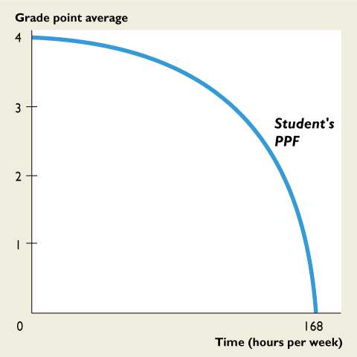
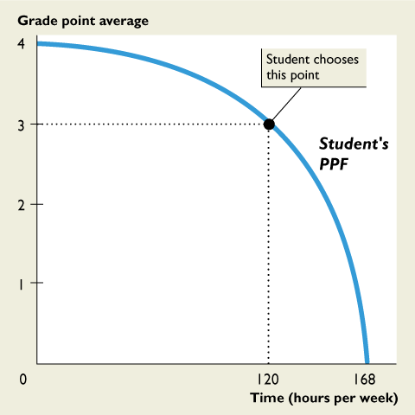
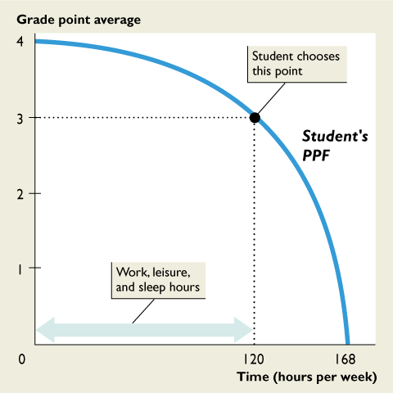
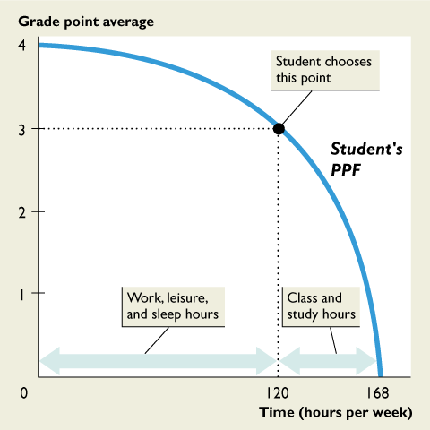
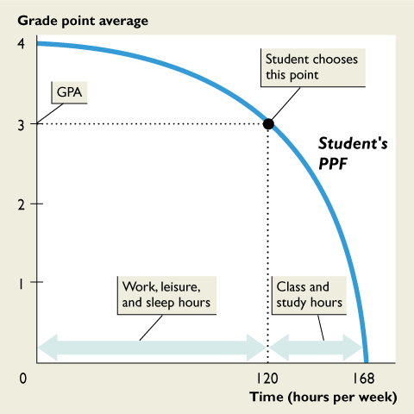

Slide 4
OPPORTUNITY COST
The Opportunity Cost of a Cell Phone
The opportunity cost of a cell phone is the decrease in the quantity of DVDs divided by the increase in the number of cell phones as we move along the PPF.
Figure 3.4 illustrates the calculation of the opportunity cost of a cell phone.
Notes:
Students almost instinctively relate costs to monetary costs. To help them grasp the idea of opportunity cost while moving along the PPF, it is important to get students to realize very early on that thinking only of monetary costs is a narrow view and that it ignores the most important cost of all—opportunity cost. Demonstrate the fact that that opportunity cost does not necessarily involve money by launching your lecture with an example that hits close to home. Ask your students to take a minute to write down a list of things that qualify as the opportunity cost to them of attending your economics class. Expect a fairly wide range of answers from the downright silly to the very thoughtful. Stress that the true opportunity cost of any endeavor is only the one next best alternative forgone. The reason is because you can only perform one other activity in place of whatever it is you are doing at present. In other words, you will need to convince your students that even though they have come up with a fairly long list of items, the opportunity cost of attending your economics class can only be one of them. This one is the one that will rank above the others as the next best available alternative. Here might be some possible answers: by taking economics your students cannot take biology, physics or chemistry; they might have to give up overtime at work (if they are taking a night class); or the cost could be the forgone extra sleep they could have enjoyed if they are taking an 8:00 a.m. class!

Slide 5
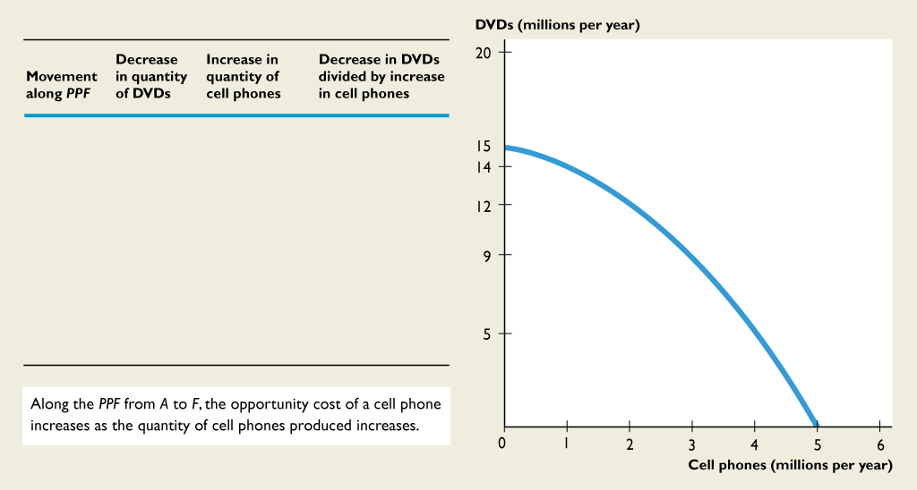
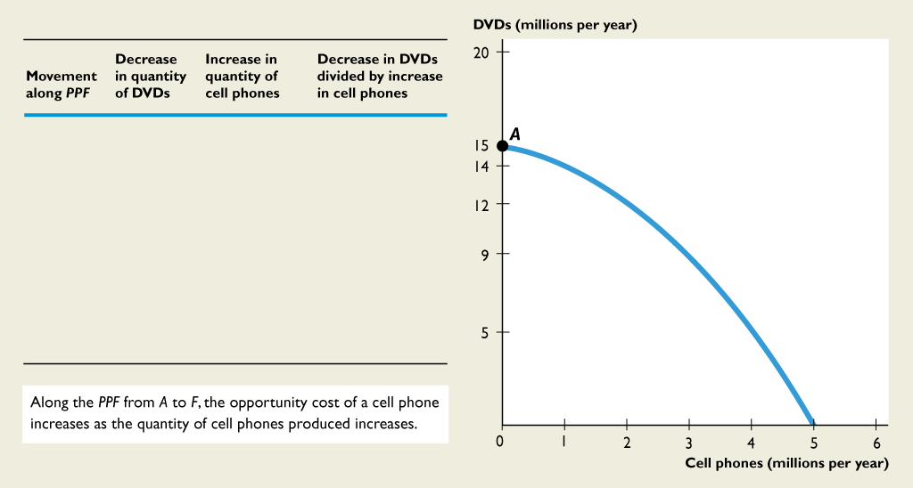
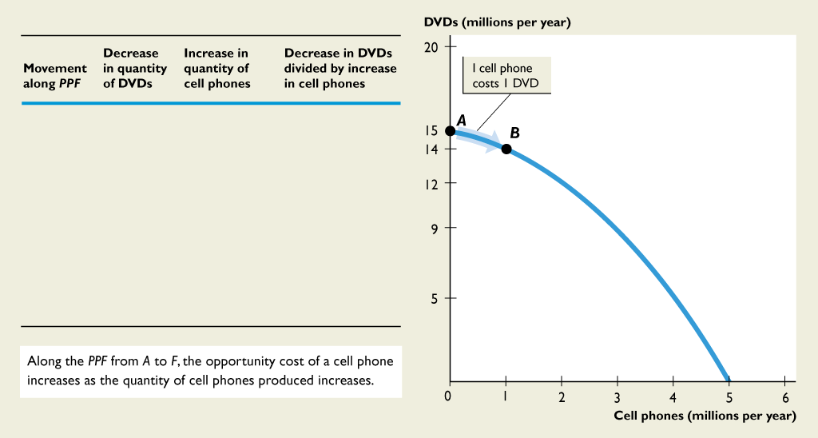

OPPORTUNITY COST
Moving from A to B, 1 cell phone costs 1 DVD.

Slide 6
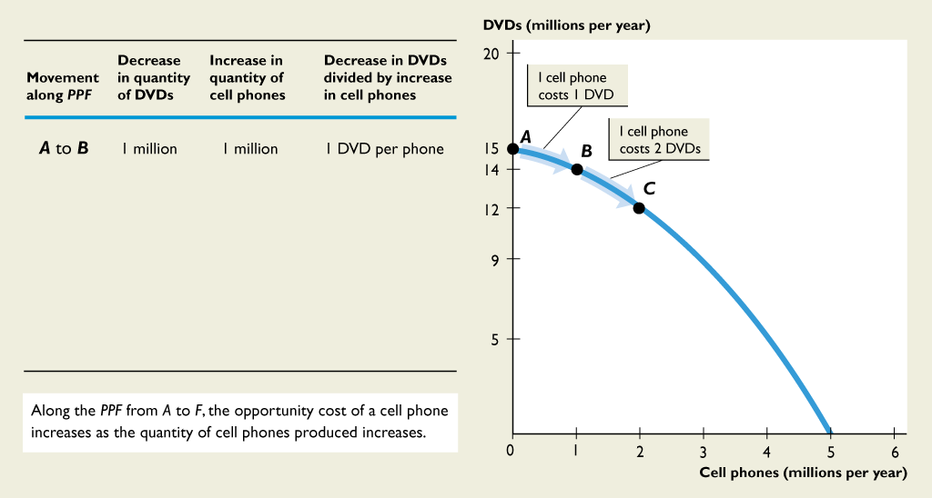
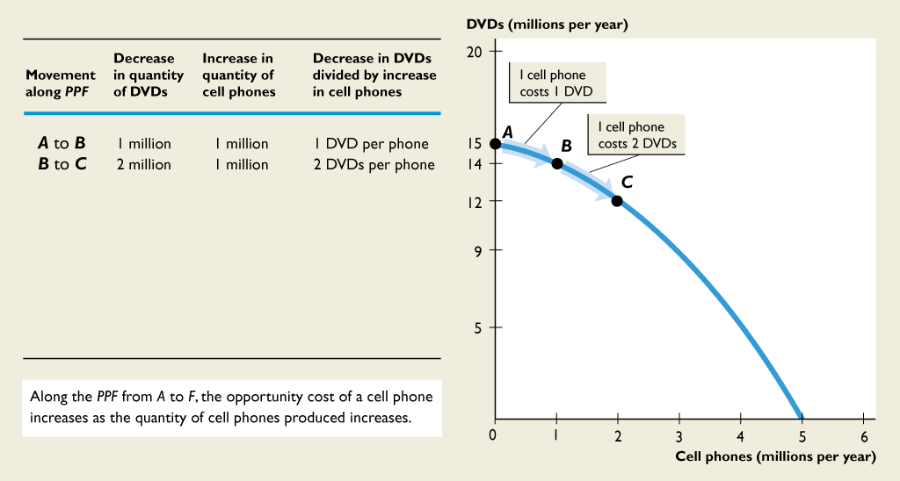
OPPORTUNITY COST
Moving from B to C, 1 cell phone costs 2 DVDs.

Slide 7
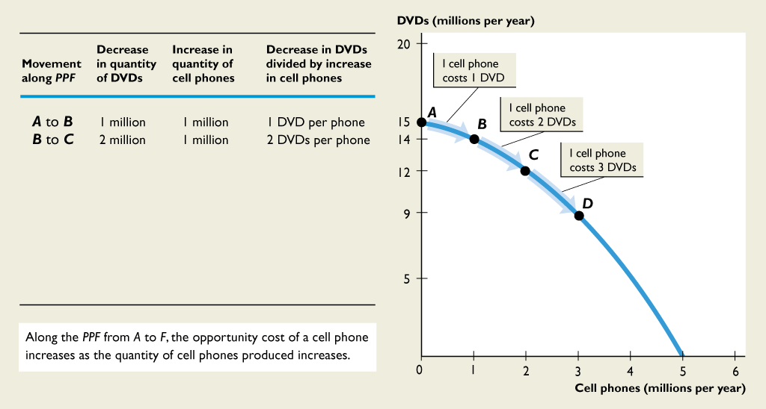
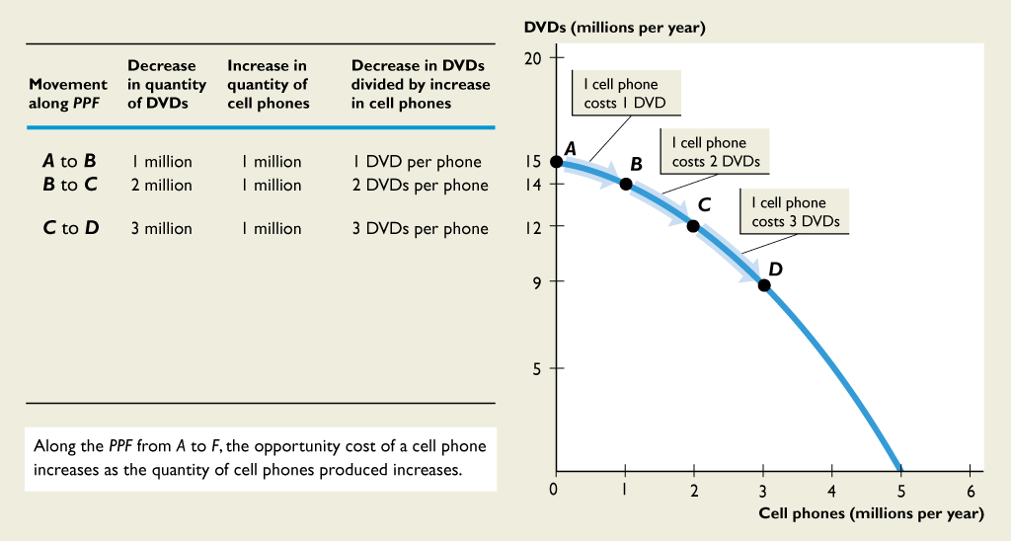
OPPORTUNITY COST
Moving from C to D, 1 cell phone costs 3 DVDs.

Slide 8
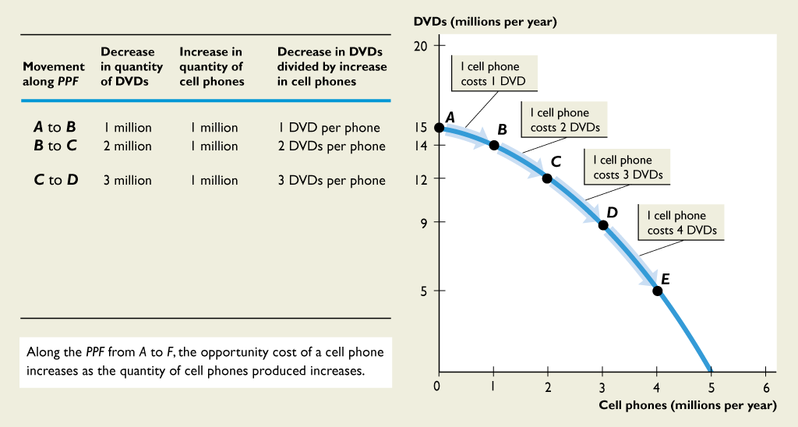
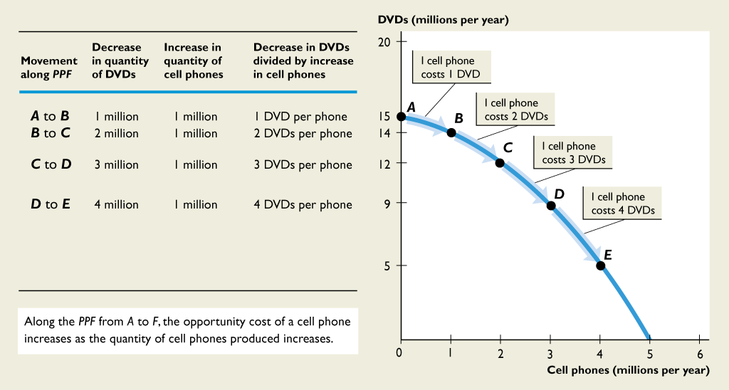
OPPORTUNITY COST
Moving from D to E, 1 cell phone costs 4 DVDs.

Slide 9
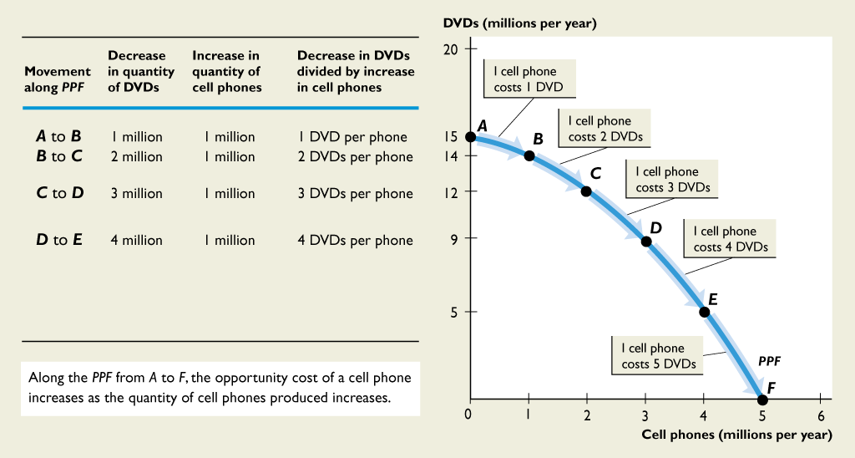

OPPORTUNITY COST
Moving from E to F, 1 cell phone costs 5 DVDs.

Slide 10
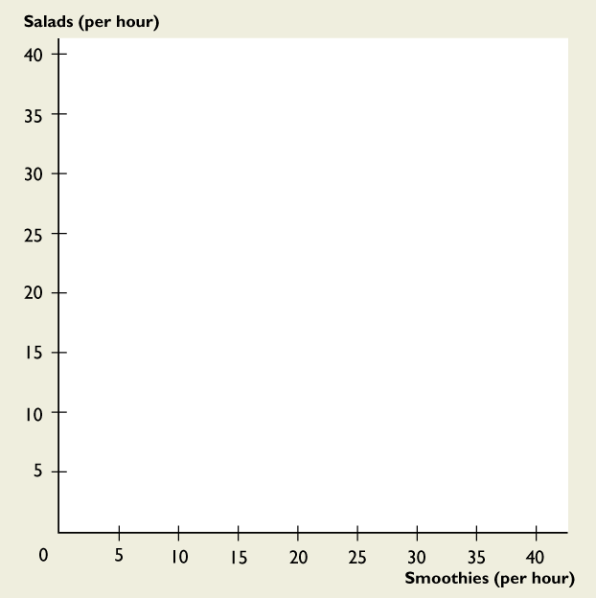
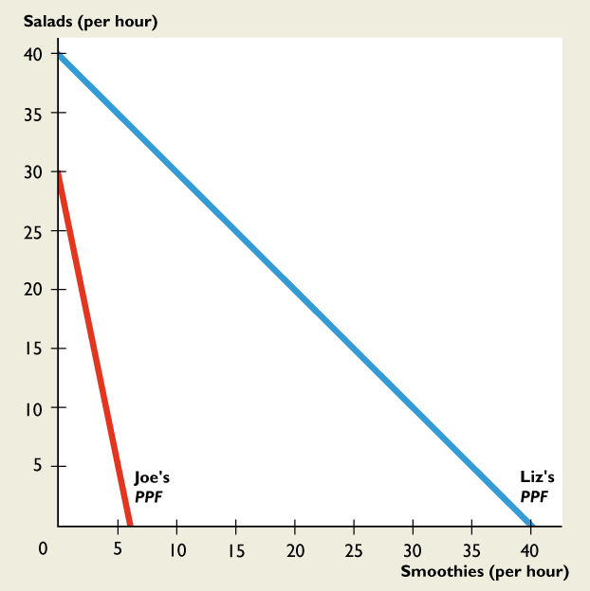
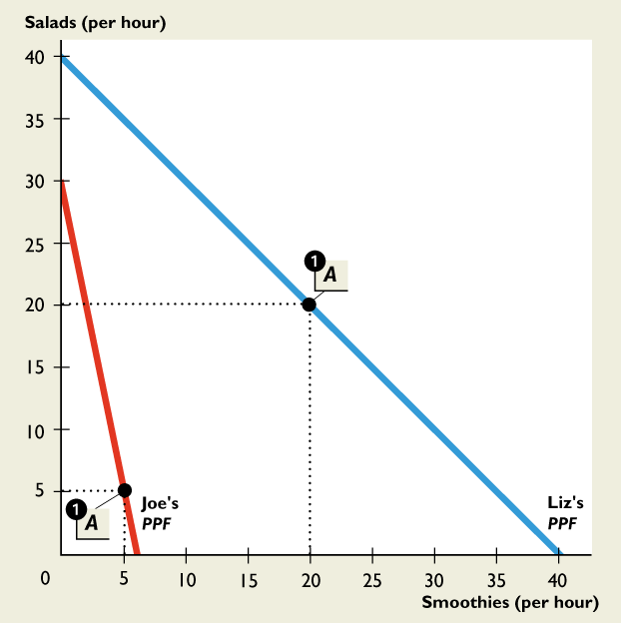
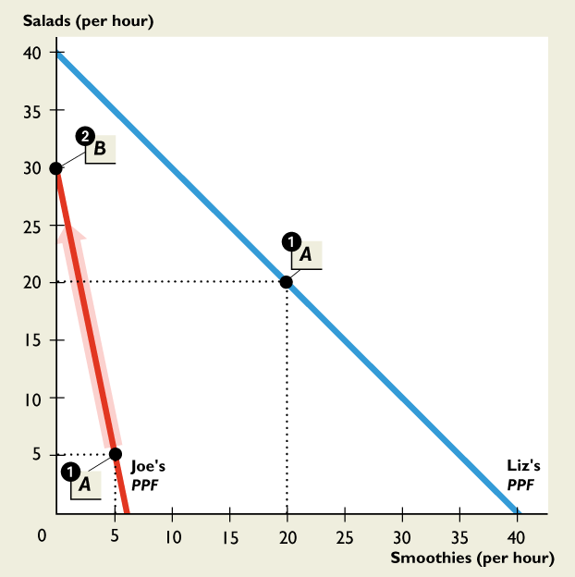
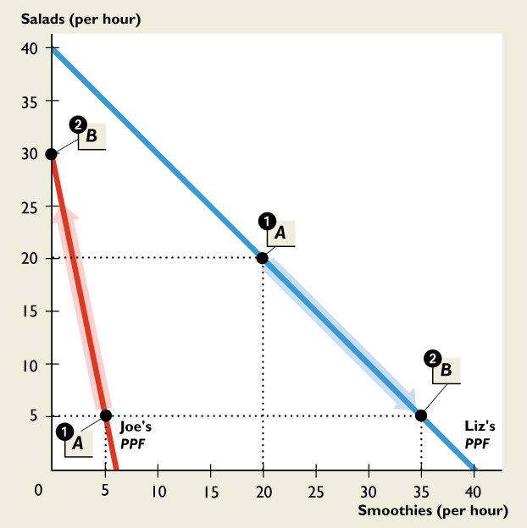
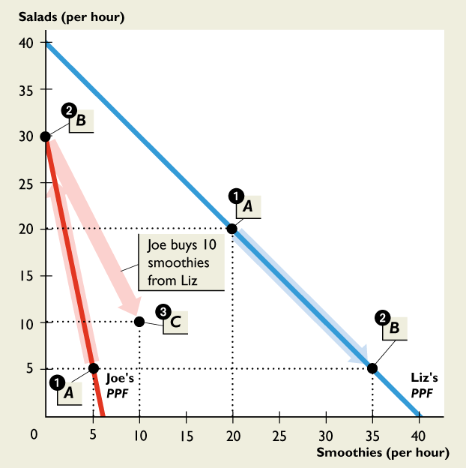
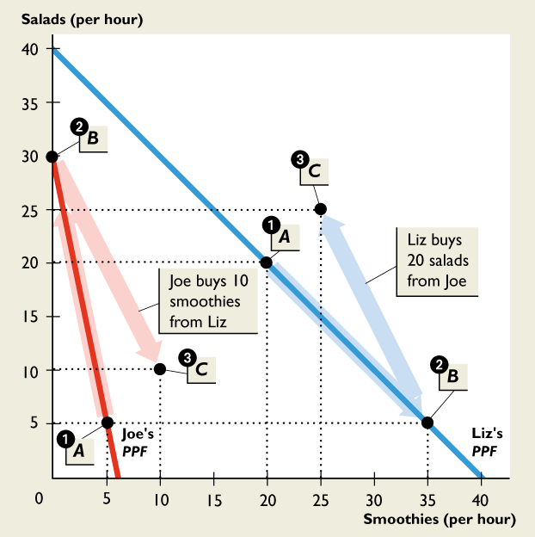

Slide 11
OPPORTUNITY COST (increasing)
Slope of the PPF and Opportunity Cost
The magnitude of the slope of the PPF measures opportunity cost.
The slope of the PPF in Figure 3.4 measures the opportunity cost of a cell phone.
The PPF is bowed outward, as more water is produced, the PPF becomes steeper and the opportunity cost of a cell phone increases.

Slide 12
OPPORTUNITY COST
Opportunity Cost Is a Ratio
The opportunity cost of a cell phone is the quantity of DVDs forgone divided by the increase in the quantity of cell phones.
The opportunity cost of a DVD is the quantity of cell phones forgone divided by the increase in the quantity of DVDs.
When the opportunity cost of a cell phone is x DVDs, the opportunity cost of a DVD is 1/x cell phones.

Slide 13
OPPORTUNITY COST
Increasing Opportunity Costs Are Everywhere
Just about every activity that you can think of is one with an increasing opportunity cost.

Slide 14
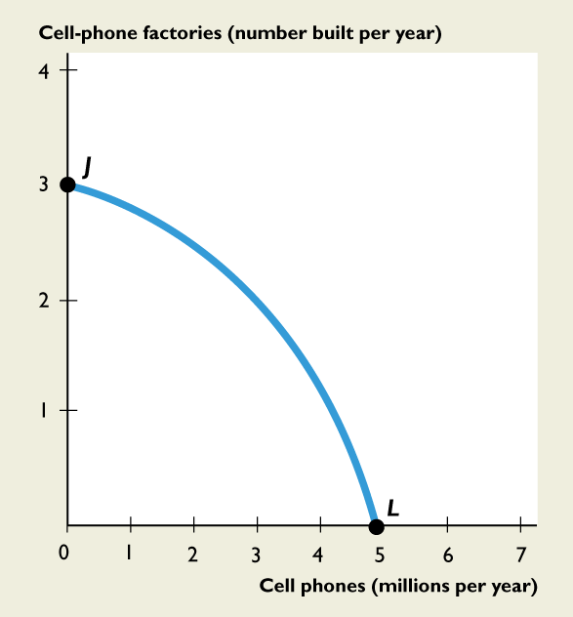
ECONOMIC GROWTH
If we produce at point J, we produce only cell-phone factories and no cell phones.
If we produce at point L, we produce cell phones and no cell-phone factories.
And every year, consumption remains at 5 million cell phones.

Slide 15
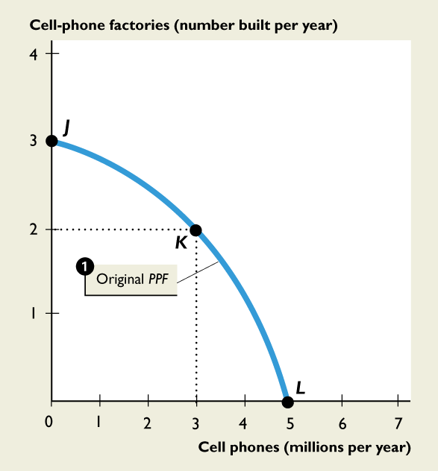
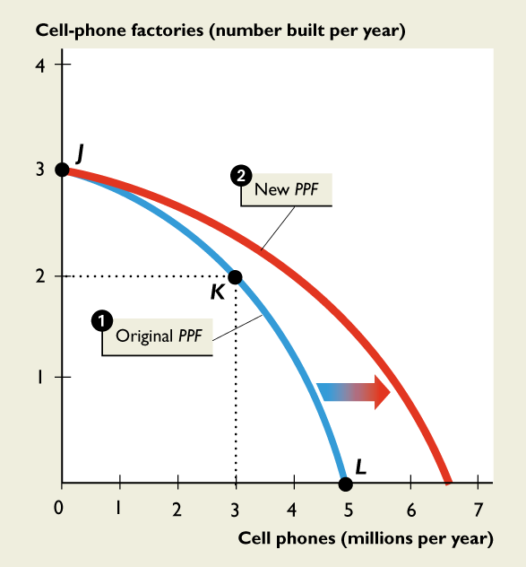
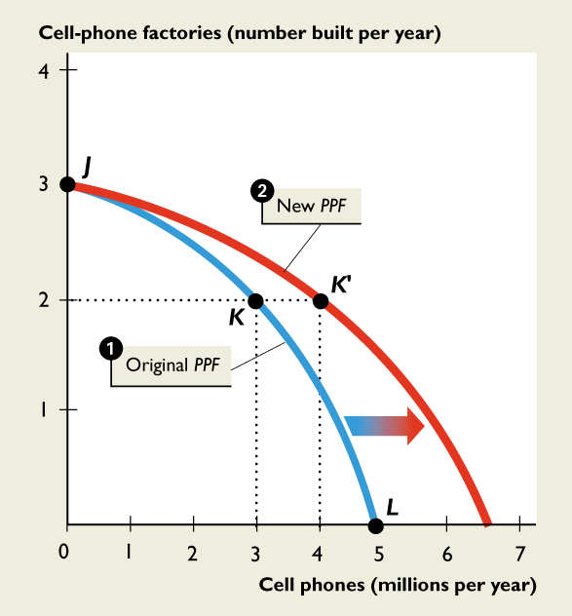
ECONOMIC GROWTH
But if we cut production of cell phones to 3 million this year, we can produce 2 cell-phone factories at point K.
Then next year, our PPF shifts outward because we have more capital.
We can consume at a point outside our original PPF, such as K'.

Slide 16
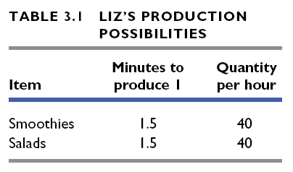

Slide 17
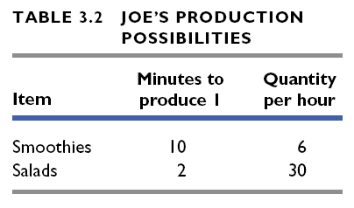

Slide 18
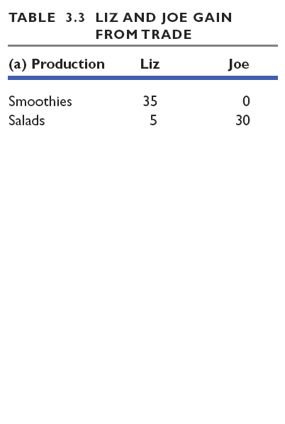
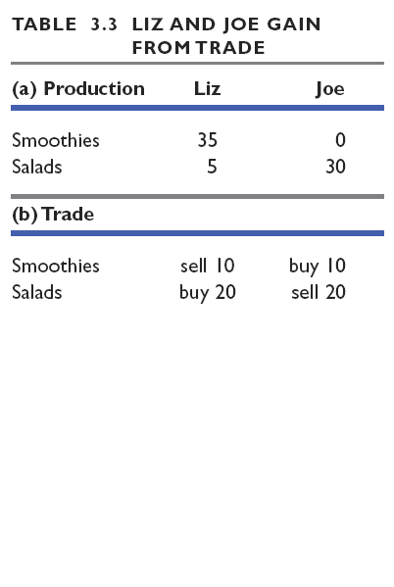
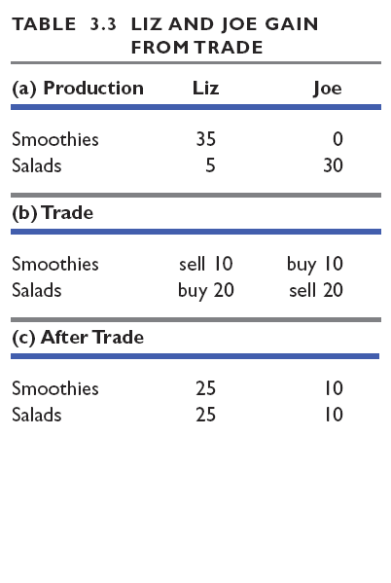
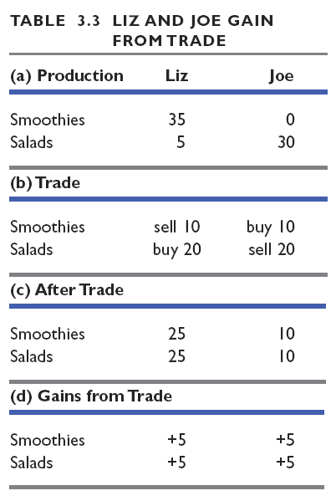

Slide 19
SPECIALIZATION AND TRADE
Comparative Advantage
Comparative advantage is the ability of a person to perform an activity or produce a good or service at a lower opportunity cost than someone else.
Joe and Liz operate smoothie bars and produce smoothies and salads.
Notes:
Comparative advantage and absolute advantage are concepts that give students trouble. It flies in the face of intuition to say that even though someone has the ability to produce something using fewer resources than someone else, nonetheless, it still pays for the two to trade. It is an especially difficult concept to grasp when you up the ante by saying that the same would still be true even if that person enjoyed an absolute advantage in everything over their trading partner! This might be a good opportunity to use a very concrete example that students should be able to compute right in the classroom. Lay out the following scenario: Assume Suzie, a computer consultant, is very good at repairing computers and also happens to be a very good house painter. In fact, she is so good that it turns out she is more productive at both things than her neighbor, Bob, who happens to paint houses for a living. To the right is a table that shows the amount of time it takes for Suzie and Bob to perform each of the two activities. In addition, let’s assume that Suzie and Bob earn $100 per computer repaired and Bob and Suzie earn $960 per house painted. Ask the students to compute the opportunity cost for Suzie and Bob repairing a computer and painting a house. The new table to the right contains the opportu54 nity costs. (To calculate these numbers, take Suzie’s opportunity cost of painting a house. In the 30 hours it takes her to paint a house, she could have repaired 15 computers, so the opportunity cost is 15 computers times $100 each.) It reveals that Suzie has the lower opportunity cost of repairing computers and Bob has the lower opportunity cost of painting houses. What this example demonstrates so powerfully is that a person can have an absolute disadvantage in everything, as is the case for Bob, but still manage to have a comparative advantage in an activity. Point out to students that this logic applies between individuals and also across cities, states, and nations

Slide 20
SPECIALIZATION AND TRADE
Liz's Smoothie Bar
In an hour, Liz can produce either 40 smoothies or 40 salads.
Liz's opportunity cost of
producing 1 smoothie is 1 salad.
Liz's opportunity cost of producing 1 salad is 1 smoothie.
Each hour, Liz produces 20 smoothies and 20 salads.

Slide 21
SPECIALIZATION AND TRADE
Joe's Smoothie Bar
In an hour, Joe can produce either 6 smoothies or 30 salads.
Joe's opportunity cost of
producing 1 smoothie is 5 salads.
Joe's opportunity cost of producing 1 salad is 1/5 smoothie.
Each hour, Joe's produces 5 smoothies and 20 salads.

Slide 22
SPECIALIZATION AND TRADE
Liz’s Absolute Advantage
Absolute advantage is a situation in which one person is more productive than another person in several or even all activities.
Liz is four times as productive as Joe—Liz can produce 20 smoothies and 20 salads an hour and Joe can produce only 5 smoothies and 5 salads an hour.

Slide 23
SPECIALIZATION AND TRADE
Liz’s Comparative Advantage
Liz’s opportunity cost of a smoothie is 1 salad.
Joe’s opportunity cost of a smoothie is 5 salads.
Liz’s opportunity cost of a smoothie is less than Joe’s, so Liz has a comparative advantage in producing smoothies.

Slide 24
SPECIALIZATION AND TRADE
Joe’s Comparative Advantage
Joe’s opportunity cost of a salad is 1/5 smoothie.
Liz’s opportunity cost of a salad is 1 smoothie.
Joe’s opportunity cost of a salad is less than Liz’s, so Joe has a comparative advantage in producing salads.

Slide 25
SPECIALIZATION AND TRADE
Achieving Gains from Trade
Liz and Joe produce more of the good in which they have a comparative advantage:
Liz produces 35 smoothies and 5 salads.
Joe produces 30 salads.

Slide 26
SPECIALIZATION AND TRADE
Liz and Joe trade:
Liz sells Joe 10 smoothies and buys 20 salads.
Joe sells Liz 20 salads and buys 10 smoothies.
After trade:
Liz has 25 smoothies and 10 salads.
Joe has 25 smoothies and 10 salads.

Slide 27
SPECIALIZATION AND TRADE
Gains from trade:
Liz gains 5 smoothies and 5 salads an hour—she originally produced 20 smoothies and 20 salads.
Joe gains 5 smoothies and 5 salads an hour—he originally produced 5 smoothies and 5 salads.
Figure 3.10 on the next slide illustrates the gains from trade.

Slide 28
Gains From Trade (step by step)

Slide 29
SPECIALIZATION AND TRADE
1. Joe and Liz each produce at point A on their PPFs.
Joe has a comparative advantage in producing salads.
Liz has a comparative advantage in producing smoothies.

Slide 30
SPECIALIZATION AND TRADE
Joe and Liz produce more of the good in which they have a comparative advantage.
2. Joe produces 30 salads at point B on his PPF.
2. Liz produces 35 smoothies and 5 salads at point B on her PPF.

Slide 31
SPECIALIZATION AND TRADE
Joe and Liz trade salads and smoothies at a price of 2 salads per smoothie.
Joe sells 20 salads and buys 10 smoothies from Liz.
Liz sells 10 smoothies and buys 5 salads from Joe.
3. Both consume at point C, which is outside their PPFs.

Slide 32
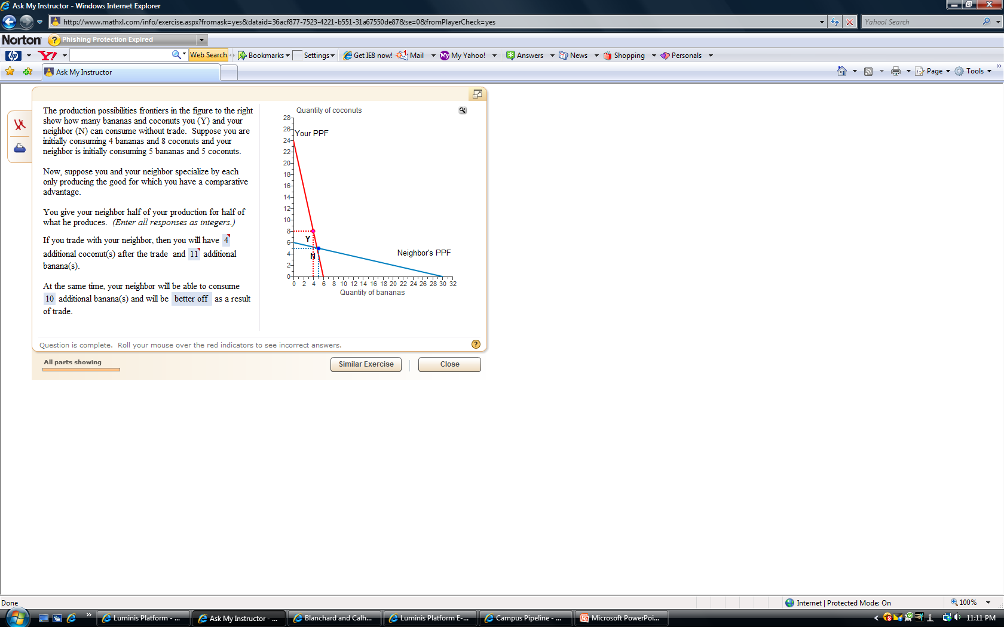
Gain from Trade EXAMPLE 2

Slide 33
Gain from Trade EXAMPLE 2
Production Before Specialization or Trade
 | You | Neighbor
Bananas | 4 | 5
Coconuts | 8 | 5

Slide 34
Gain from Trade EXAMPLE 2
MUST Calculate Opportunity Cost to determine Comparative Advantage

Slide 35
Gain from Trade EXAMPLE 2
Production Before Specialization or Trade
 | You | Neighbor
Bananas | 4 | 5
Coconuts | 8 | 5
Opp Cost bananas = loss in coconuts / gain in bananas
You: OC B = 24/6 → 4
Neighbor: OC B = 6/30 → 1/5
Opp Cost coconuts= loss in bananas / gain in coconuts
You: OC C = 6/24 → 1/4
Neighbor: OC C = 30/6 → 5
Lowest Opportunity Cost
Determines good used for Specialization

Slide 36
Gain from Trade EXAMPLE 2
Production with Specialization
 | You | Neighbor
Bananas | 0 | 30
Coconuts | 24 | 0
Opp Cost bananas = loss in coconuts / gain in bananas
You: OC B = 24/6 → 4
Neighbor: OC B = 6/30 → 1/5
Opp Cost coconuts= loss in bananas / gain in coconuts
You: OC C = 6/24 → 1/4
Neighbor: OC C = 30/6 → 5
Lowest Opportunity Cost Determines good used for Specialization

Slide 37
Gain from Trade EXAMPLE 2
Trade Agreement: ½ production for ½ production
 | You | Neighbor
Bananas | 30/2 | 30/2
Coconuts | 24/2 | 24/2
Production With Trade Agreement
 | You | Neighbor
Bananas | 15 | 15
Coconuts | 12 | 12

Slide 38
Gain from Trade EXAMPLE 2
Production GAINS Calculation
 | You | Neighbor
Bananas | 15-4 | 15-5
Coconuts | 12-8 | 12-5
Production GAINS From Trade
 | You | Neighbor
Bananas | 11 | 10
Coconuts | 4 | 7
So Both of you are
better off with Trade

Slide 39
So, Trade is Good…
What about
International Trade

Slide 40
International Trade
If You Want to Increase Economic Growth
You Must:
Create incentive mechanisms
Encourage savings
Encourage research development
Improve the quality of education
Encourage international trade
Free International Trade STIMULATES economic growth by
EXTRACTING gains from specialization and trade
Today’s fastest growing economies are those with the fastest growing exports/imports
NAFTA and the EU are successful examples of governments taking steps to stimulate economic growth through trade

Slide 41
Price Level and Real GDP
Price Level
When U.S. price level rises and other things remain the same, prices in other countries do not.
Thus, U.S. goods become more expensive and Americans IMPORT more
Real GDP
Increase in RGDP = Increase in Income
Increase in Income = Increase in expenditures on goods and services
60% of goods and services are imported
Increase in RGDP = Increase in Imports
This relationship is shown by:
Marginal propensity to import = Change in Imports
Change in RGDP

Slide 42
Trade in Goods
Exports
70% of U.S. Exports in 2006 were in goods
55% Manufactured Goods
2% Minerals and Fuels
5% Agricultural
Imports
80% of U.S. Imports in 2006 were in goods
70% Manufactured Goods
12% Minerals and Fuels
3% Agricultural\
Rest of U.S. International trade was in Services
Hotel, Food, and Transportation services bought by American tourists abroad = U.S. import services
Vacation in U.S. by foreign tourists = U.S. export of services to France
This is also true for insurance, and banking services

Slide 43
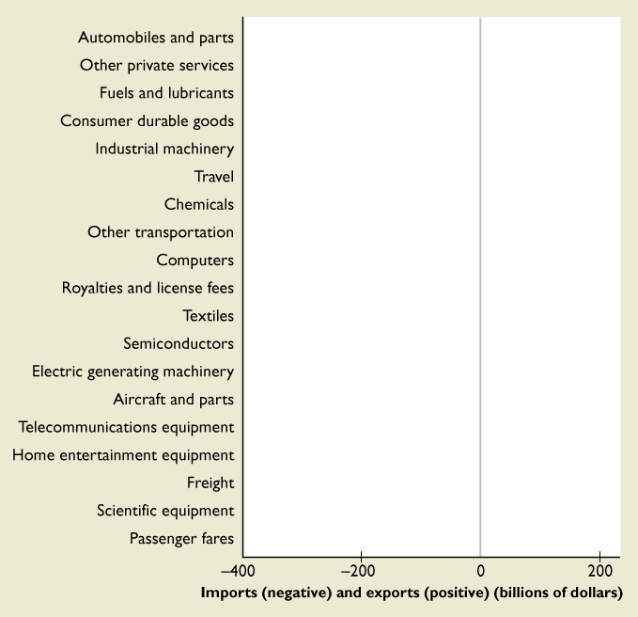
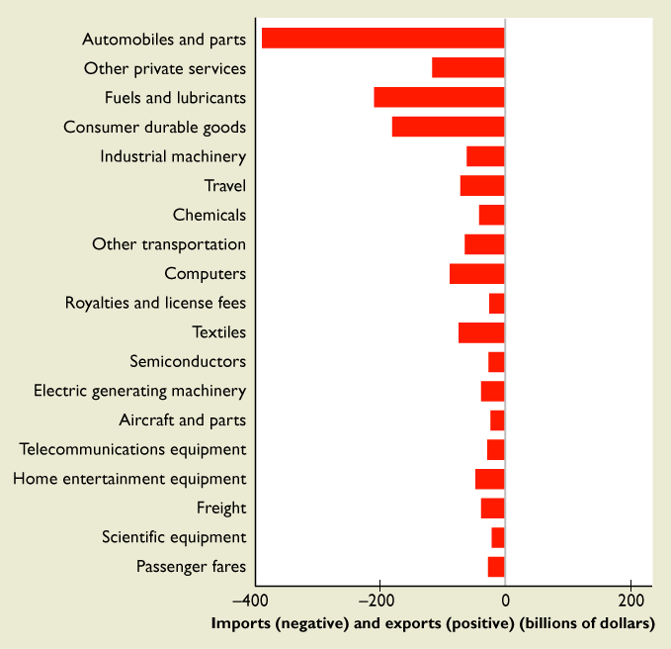
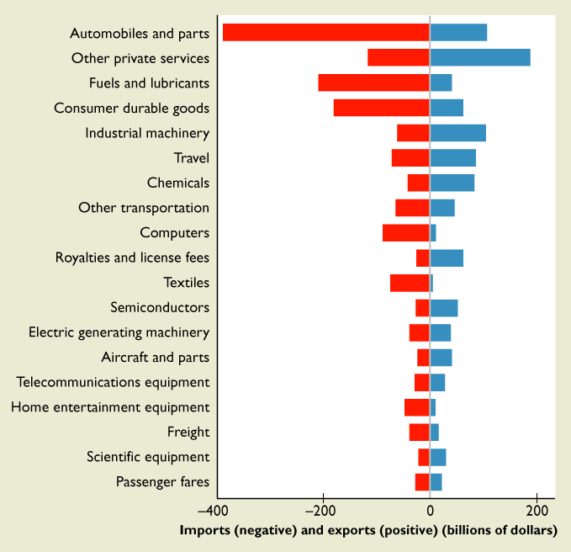
The Major Items That We Trade with Other Nations
The figure shows the U.S. volume and balance of trade for the most traded items in 2006.
The red bars show U.S imports.
The blue bars show U.S exports.
If a bar has more red than blue, the United States has a trade deficit in that item.

Slide 44
TRADE PATTERNS AND TRENDS
The Outsourcing Trend
In 1960, the United States
Exported 5 percent of total output.
Imported 4 percent of the goods and services bought.
By 2007, the United States
Exported 12 percent of total output.
Imported 17 percent of the goods and services bought.
Some of the increase arises from OFFSHORE outsourcing—buying a good or service from a low-cost overseas supplier and NEARSHORE outsourcing.

Slide 45
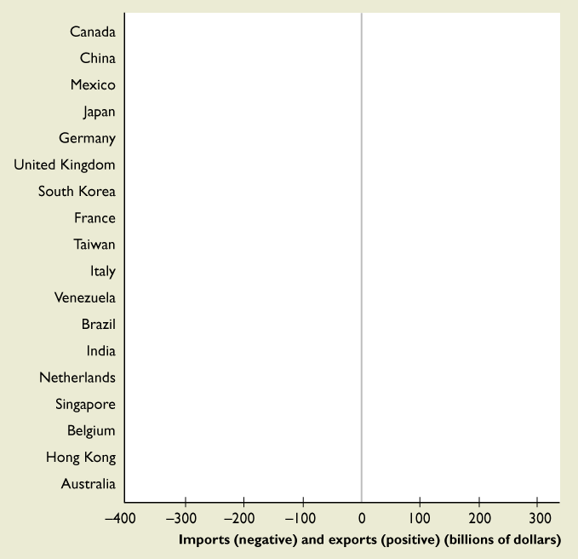
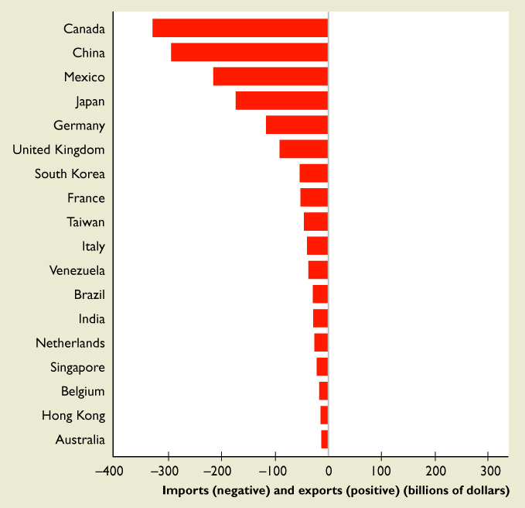
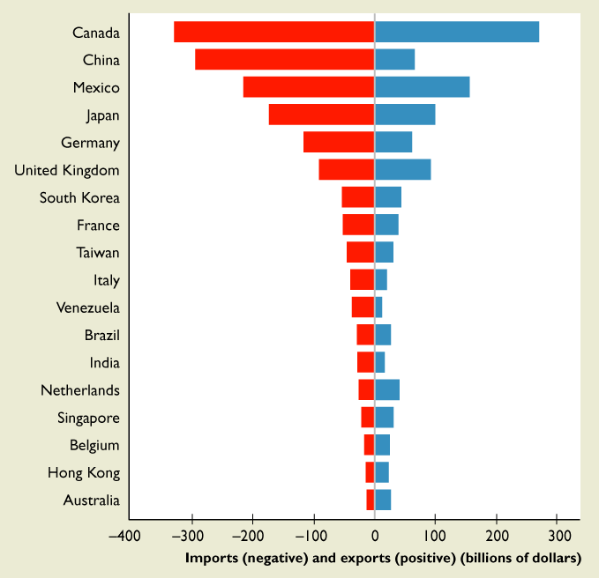
The Major U.S. Trading Partners and Volumes of Trade
The figure shows the U.S. volume of trade and balance of trade with its 18 largest trading partners in 2006.
The red bars show U.S imports.
The blue bars show U.S exports.
If a bar has more red than blue, the United States has a trade deficit with that country.

Slide 46
U.S. Trade Agreements
Member of WTO (world trade organization) an organization that seeks to promote FREE international trade
Trade Agreements = Treaties
Purpose:
Promote greater trade
Economic cooperation
Promote political or social goals
Bilateral agreements (between two countries)
U.S. and Australia, Bahrain, Chile, Israel, Jordon, Morocco, Oman,
Singapore, Thailand
Multilateral agreements (between a number of countries)
NAFTA North American Free Trade Agreement
CAFTA Central American Free Trade Agreements
APEC Asia-Pacific Economic Cooperation
*FTAA Free Trade of the Americas (not yet active)

Slide 47
MULTILATERAL AGREEMENTS
NAFTA
1994: United States, Canada, and Mexico
To make trade among them easier and freer.
Trade among these three countries has grown rapidly since the enactment of NAFTA
CAFTA
United States, Costa Rica, the Dominican Republic, El Salvador, Guatemala, Honduras, and Nicaragua.
Both trade and political goals, the latter to promote freedom and democracy in Central America

Slide 48
MULTILATERAL AGREEMENTS
APEC
1989: 21 nations that border the Pacific Ocean.
Includes the United States, China, Japan, Australia, Canada, Indonesia, and the dynamic Asian countries.
Promotes freer trade and cooperation among members.
APEC nations conduct 50 percent of world trade.
FTAA (not yet active, excludes Cuba)
The governments of 34 democracies in the Americas have begun the process to enact FTAA
Objective is to achieve free international trade among all countries in the Americas.

Slide 49
Balance of Trade
EXPORTS – IMPORTS = BALANCE OF TRADE
U.S. imports more than it exports = Trade Deficit
When a country has a trade deficit, it pays for the deficit by borrowing from other countries or by selling some of its assets.
When a country has a trade surplus, it lends to other countries or buys more foreign assets so that other countries can pay their trade deficits.
COMPARATIVE ADVANTAGE is the force that generates international trade
The U.S. has a comparative advantage in the production of Airplanes
China has a comparative advantage in the production of clothes

Slide 50
THE GAINS FROM TRADE
Why the United States Exports Airplanes
The United States has a comparative advantage in the production of airplanes
because
the opportunity cost of producing an airplane is lower in the United States than in most other countries.
Notes:
There is an enormously rich heritage of stories, parables, fables, and satires that you can use to enliven your classes on this topic. The following fable, inspired by James Ingram, International Economic Problems, John Wiley, 1970, is a powerful way to begin. Make up your own version with local flavor and embellishment.
Adam Blackbox announces that he has discovered an amazing way to produce low-price, high-quality automobiles. He sets up a plant on a large tract of land along the coast of Massachusetts; hires 10,000 employees, swears them to secrecy, and begins delivering his low‐price, high‐quality autos to the nation’s showrooms. Adam Blackbox is hailed as an American industrial hero. Blackbox Enterprises floats stock and Wall Street booms. Consumers love Adam Blackbox.
[Continued on next slide]

Slide 51
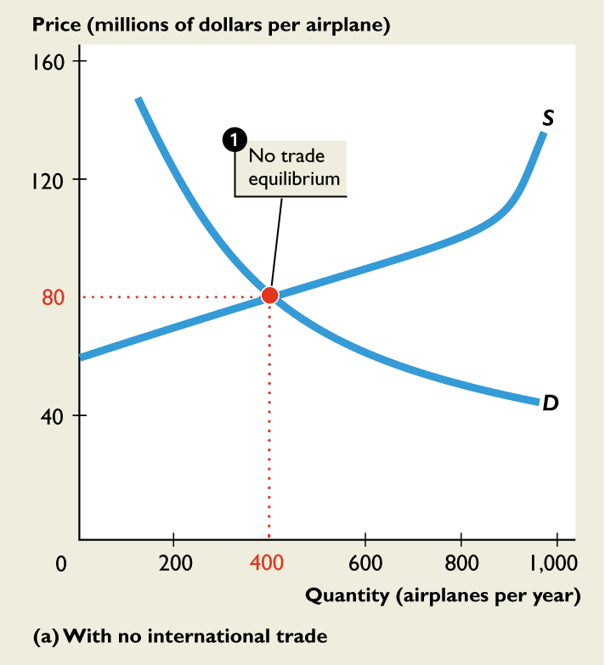
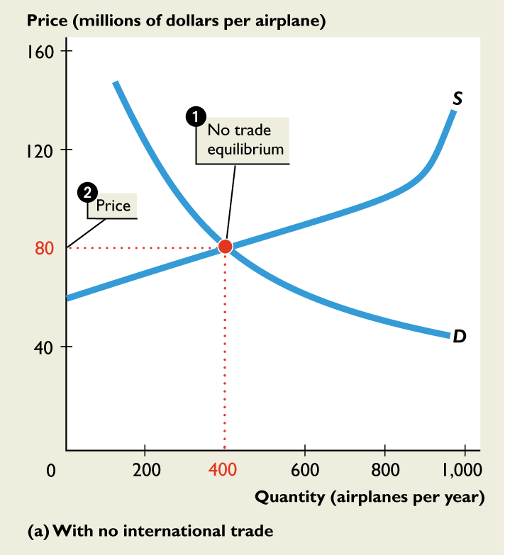
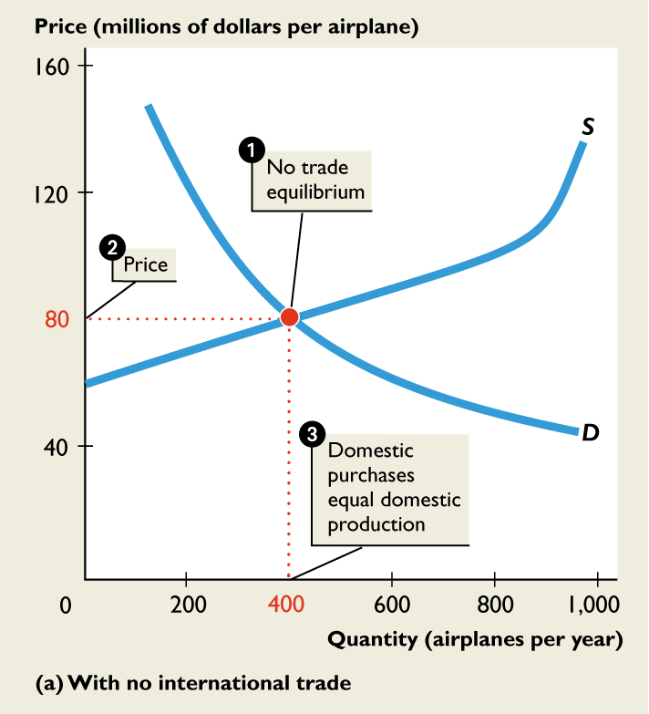
THE GAINS FROM TRADE
No Trade
1. With no international trade, domestic purchases equal domestic production.
2.The U.S. price of an airplane is $80 million.
3. U.S. aircraft makers produce 400 airplanes a year.
Notes:
His automobiles are better and cheaper than those they could buy before he came along. Automakers hate him, but their attempts to pass laws to restrict his operations fail. The President and congressional leaders explain that economic adjustment is an inevitable consequence of technological advance. And Adam Blackbox’s new technology for delivering low-price, high-quality automobiles is clearly part of the process of achieving greater prosperity for all. The press becomes increasingly curious about what is going on in the giant New England auto plant. Investigative journalists create endless hours of speculative television programming on the amazing new technology. Then a tabloid journalist with a big checkbook finds a worker who is willing to talk.
[Continued on next slide]

Slide 52
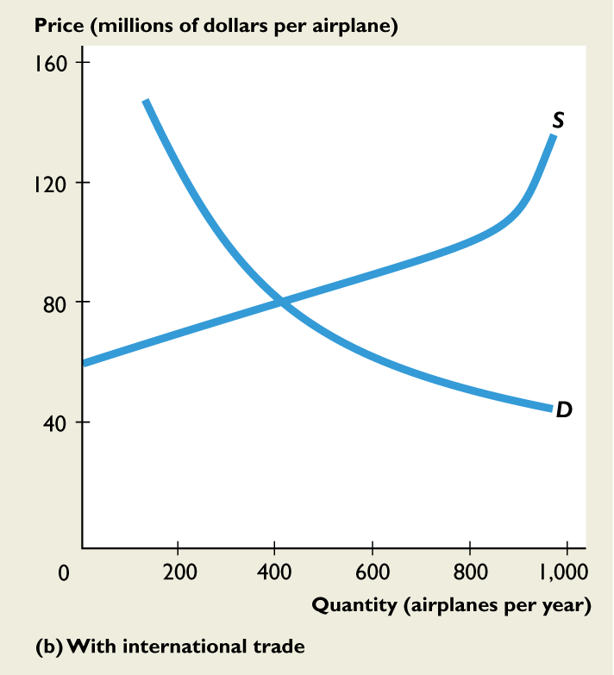
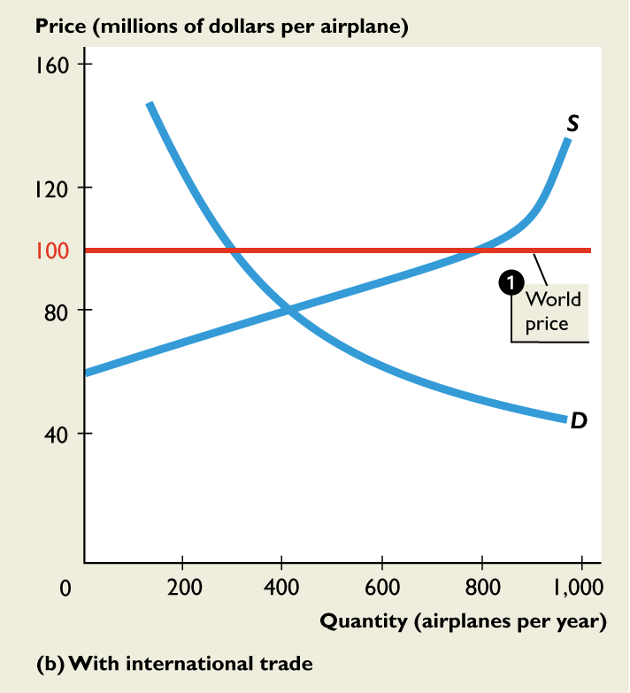
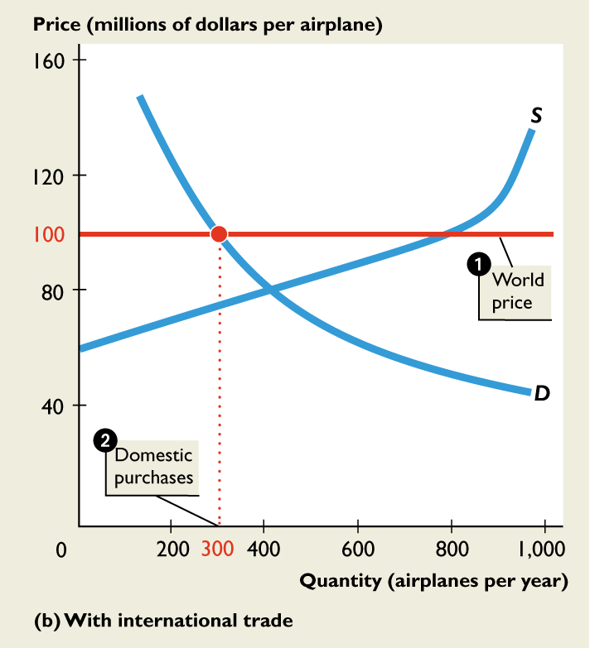
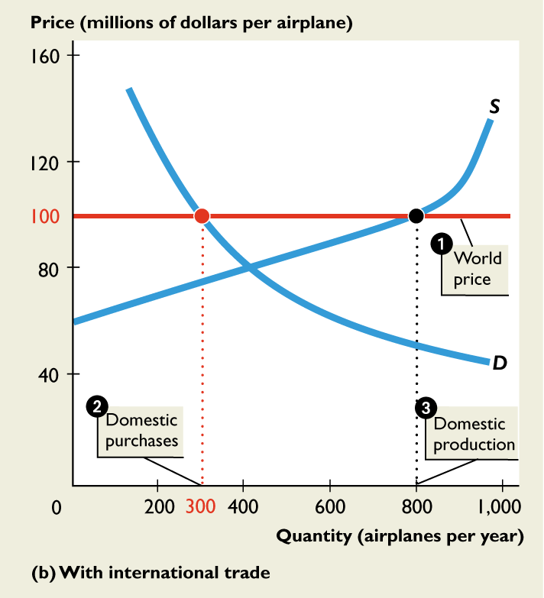
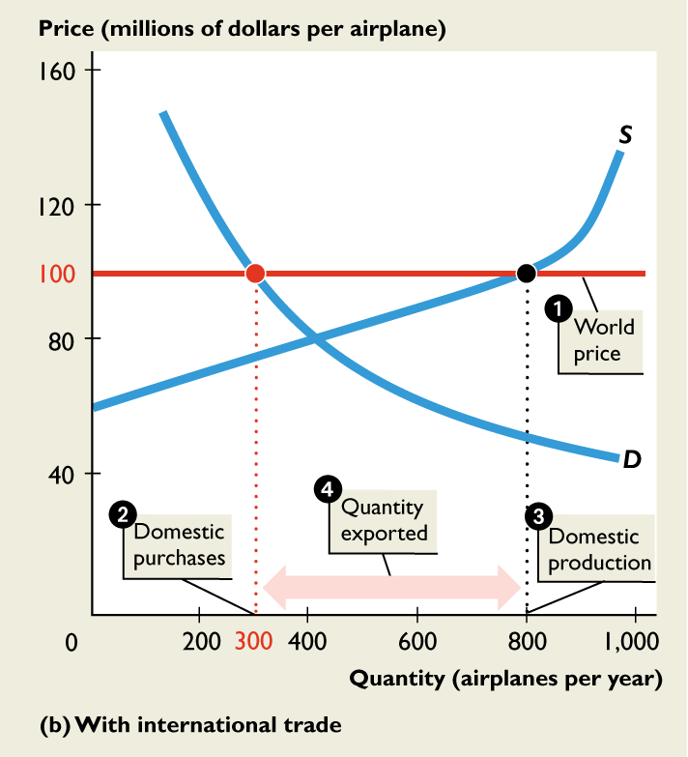
THE GAINS FROM TRADE
Trade
With international trade, the world market determines
1. The world price of a plane at $100 million.
2. Domestic purchases decrease to 300 airplanes.
3. Domestic production increases to 800 airplanes.
4. 500 airplanes are exported.

Slide 53
U.S. Trade Partners

Slide 54
THE GAINS FROM TRADE
Comparative Advantage
The U.S. aircraft makers have a comparative advantage in producing airplanes:
The world price line tells us that the world opportunity cost of producing an airplane is $100 million.
The U.S. supply curve shows that the U.S. opportunity cost of producing a airplane is less than $100 million for all airplanes up to the 800th one.

Slide 55
THE GAINS FROM TRADE
Why the United States Imports T-shirts
More than half the clothing we buy is manufactured in other countries and imported into the United States.
Why?
The rest of the world (mainly Asia) has a comparative advantage in the production of clothes because the opportunity cost of producing a T-shirt in Asia is less than in the United States.

Slide 56
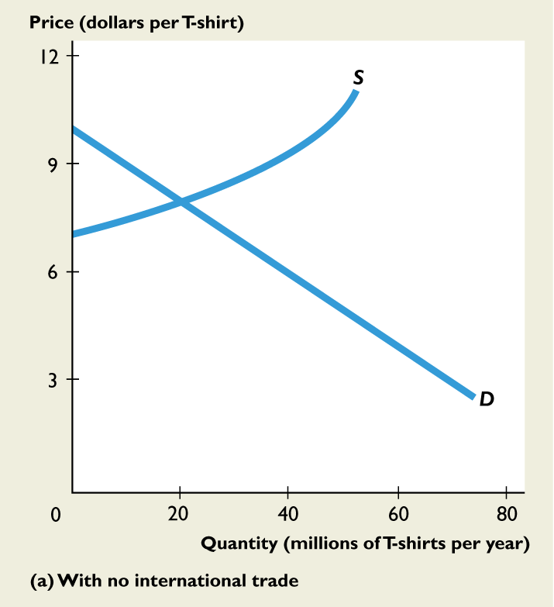
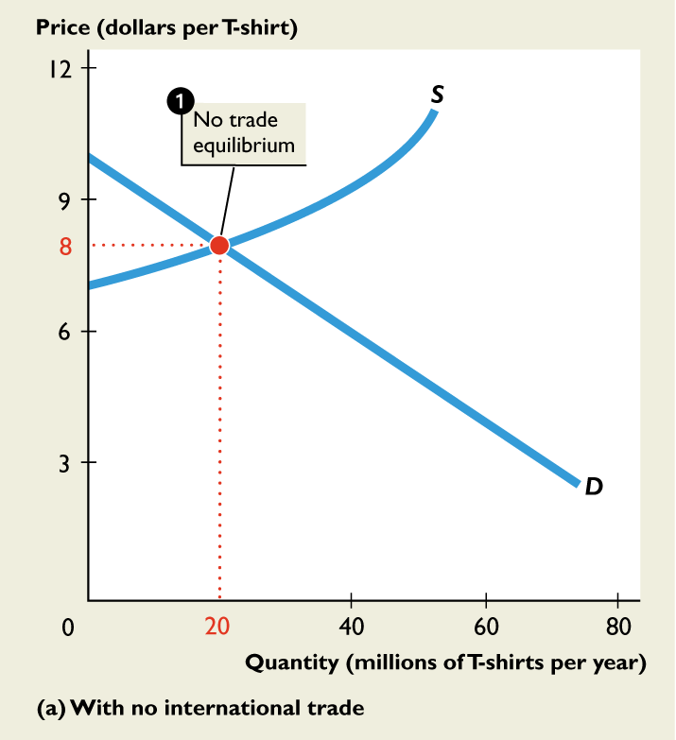
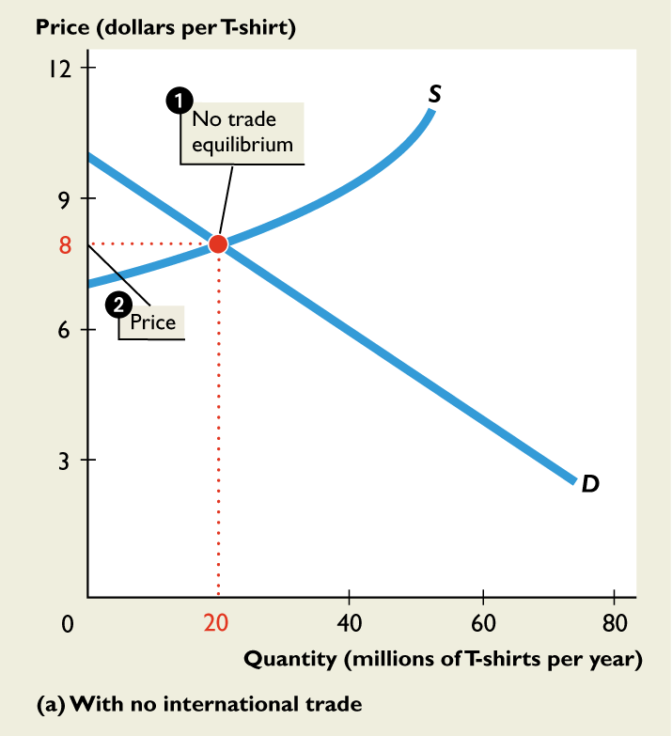

THE GAINS FROM TRADE
No Trade
1. With no international trade, domestic purchases equal domestic production.
2. The price of a T-shirt is $8.
3. U.S. T-shirt makers produce 20 million T-shirts a year.

Slide 57





THE GAINS FROM TRADE
Trade
With international trade, the world market determines
1. The world price at $5 a T-shirt.
2. Domestic purchases increase to 50 million T-shirts.
3. Domestic production decreases to zero.
4. 50 million T-shirts are imported.

Slide 59
THE GAINS FROM TRADE
Comparative Advantage
Asian garment makers have a comparative advantage in producing T-shirts:
The world price line tells us that the world opportunity cost of producing a T-shirt is $5.
The U.S. supply curve shows that no U.S. garment maker has such a low opportunity cost, not even at smaller output.

Slide 60
Another
Comparative Advantage
Example

Slide 61
18.2 THE GAINS FROM TRADE
Gains from Trade and the PPF
We can use the PPF to show the gains from international trade.
Production Possibilities in the United States and China
Suppose that the United States produces only two goods: airplanes and T-shirts
Suppose that China produces these same goods.

Slide 62
18.2 THE GAINS FROM TRADE
If the United States uses all of its resources to produce airplanes, its output is 10 airplanes a year and no T-shirts.
If ithe United States uses all of its resources to produce T-shirts, its output is 100 million T-shirts and no airplanes.
Assume, that the U.S. opportunity cost of producing a airplane is constant.
The U.S. opportunity cost of producing 1 airplane is 10 million T-shirts.

Slide 63
18.2 THE GAINS FROM TRADE
If China uses all of its resources to make airplanes, China can produce 2 airplanes a year and no T-shirts.
If China uses all of its resources to produce T-shirts, China can produce 100 million T-shirts and no airplanes.
Assume, China’s opportunity cost of producing a airplane is constant.
China’s opportunity cost of producing 1 airplane is 50 million T-shirts.

Slide 64




18.2 THE GAINS FROM TRADE
Figure 18.3(a) shows the U.S. PPF.
1. With no international trade, the United States produces at point A.
Along the U.S. PPF, the opportunity cost of producing an airplane is constant.
2. The opportunity cost of producing an airplane in the United States is 10 million T-shirts.

Slide 65




18.2 THE GAINS FROM TRADE
Figure 18.3(b) shows China’s PPF.
3. With no international trade, the China produces at point B.
4. The opportunity cost of producing an airplane in China is 50 million T-shirts.

Slide 66
18.2 THE GAINS FROM TRADE
No Trade
With no international trade:
The United States produces 5 airplanes and 50 million T-shirts at point A on its PPF.
China produces 2 airplanes and no T-shirts at point B on its PPF.
With no trade, total production is 7 airplanes and 50 million T-shirts.

Slide 67
18.2 THE GAINS FROM TRADE
Comparative Advantage
China has the comparative advantage in producing T-shirts.
China’s opportunity cost of a T-shirt is 1/50,000,000 of a airplane.
The U.S. opportunity cost of T-shirt is 1/10,000,000 of a airplane.
China’s opportunity cost of a T-shirt is less than the U.S. opportunity cost of a T-shirt, so China has a comparative advantage in producing T-shirts.

Slide 68
18.2 THE GAINS FROM TRADE
The United States has a comparative advantage in producing airplanes.
The U.S. opportunity cost of producing a airplane is 10 million T-shirts.
China’s opportunity cost of producing a airplane is 50 million T-shirts.
The U.S. opportunity cost of a airplane is less than China’s opportunity cost of a airplane, so the United States has a comparative advantage in producing airplanes.

Slide 69
18.2 THE GAINS FROM TRADE
The Gains Available from Trade
If the United States, which has a comparative advantage in producing airplanes, allocates all its resources to producing airplanes, it can produce 10 airplanes a year.
If China, which has a comparative advantage in producing T-shirts, allocates all its resources to producing T-shirts, China can produce 100 million T-shirts a year.

Slide 70
18.2 THE GAINS FROM TRADE
With no trade, total production is 7 airplanes and 50 million T-shirts.
By specializing in production, total production is 10 airplanes and 100 million T-shirts.
Total production increases by 3 airplanes and 50 million T-shirts a year.
This increase in production is the gains available from trade. But to reap these gains the United States and China must trade.

Slide 71
18.2 THE GAINS FROM TRADE
Achieving the Gains from Trade
The United States and China will reap the gains from international trade, if each country specializes in producing the good in which it has a comparative advantage and then the two countries trade with each other.

Slide 72



18.2 THE GAINS FROM TRADE
Figure 18.4 shows the gains from trade.
1. The United States specializes by producing 10 airplanes at point P on its PPF.
2.China specializes by producing 100 million T-shirts at point Q on its PPF.

Slide 73



18.2 THE GAINS FROM TRADE
If T-shirts and airplanes are traded at 20 million T-shirts per airplane,
China can consume at points B’ and
the United States consumes at points A’.
3. Both countries consume outside their PPFs—both countries gain from trade.

Slide 74
International Trade
So What is the
Verdict
On International Trade

Slide 75
Winners and Losers
Economists generally agree that there are more winners than losers from globalization and that the gains vastly outweigh the losses.
But there are both winners and losers.
Americans on the average gain from offshoring, but some lose.
The losers are those who have invested in human capital to do a specific job that has now gone offshore.

Slide 76

Winners and Losers
U.S. (and European) textile worker or furniture maker is one of the big losers.
Jobs have disappeared and many people have struggled to find new jobs even when they’ve been willing to take a pay cut.
But one of the biggest losers is the African farmer.
Blocked from global food markets by trade restrictions and subsidies in the United States and Europe, globalization is leaving much of Africa on the sidelines.

Slide 77
International Trade
International trade plays an extraordinarily large role in your life in three broad ways. It affects you as a
Consumer
Producer
Voter
As a consumer, you benefit from the availability of low cost, high-quality goods and services that are produced in other countries.
Where was your computer made? Where were your shirt and your shoes made? Where is the coffee that you buy grown?
The answers are most likely Asia, Mexico, or South America.

Slide 78
International Trade
As a producer (or as a potential producer if you don’t yet have a job) you benefit from huge global markets for U.S. products.
Your job prospects would be much dimmer if the firm for which you work didn’t have global markets in which to sell its products.
People who work in the aircraft industry, for example, benefit from the huge global market for large passenger jets.
Airlines from Canada to China are buying Boeing 777 aircraft as fast as they can be pushed out of the production line.

Slide 79
International Trade
As a voter, you have a big stake in the politics of free trade versus protection.
As a buyer, your self-interest is hurt by tariffs and quotas on imported goods. Each time you buy a $20 sweater, you contribute $5 to the government in tariff revenue.
But as a worker, your self-interest might be hurt by offshoring and by freer access to U.S. markets for foreign producers.
So as you decide how to vote, you must figure out what trade policy serves your self-interest and what best serves the social interest.

Slide 80
TRADE RESTRICTIONS
Governments restrict trade to protect industries from foreign competition by using two main tools:
Tariffs
Nontariff barriers
A tariff is a tax on a good that is imposed by the importing country when an imported good crosses its international border.
A nontariff barrier is any action other than a tariff that restricts international trade. For example, a quota.
Notes:
Give your students the words of the master, Adam Smith. In The Wealth of Nations, he got right to the heart of the matter. “It is the maximum of every prudent master of a family never to make at home what it will cost him more to make than to buy . . . If a foreign country can supply us with a commodity cheaper than we ourselves can make it, better buy it of them.”
Presenting this Adam Smith quotation in class is valuable for a couple of reasons.
First, it forces students to understand that trade is not some abstract principle that only applies to people who make national economic policy. It applies to the household, the business leader, and each one of us.
Scond, it allows us to focus on the orginal meaning of the word economics. The word economics comes from the Greek word economicus, which means the affairs of the household.
If the economizing nature of one leading a household is virtuous then by logical extension it should apply to neighborhoods, states, nations, and regions.
Free international trade benefits a nation just like it benefits an individual.

Slide 81



The History of the U.S. Tariff
The figure shows the average tariff rate—total tariffs as a percentage of total imports.
The United States is member of the WTO and GATT, and party to many trade agreements with individual countries or regions.
U.S. tariffs today are modest in comparison with their historical levels.

Slide 82





TRADE RESTRICTIONS - TARIFF
1.The world price of a T-shirt is $5.
2. With free international trade, Americans buy 50 million T-shirts a year.
3. The United States produces no T-shirts, so 50 million shirts are imported.
Suppose that the United States put a tariff on imported T-shirts.

Slide 83



TRADE RESTRICTIONS-TARIFF
With a tariff,
1. The domestic price equals
2. The world price plus
3. The tariff.
So with a 50 percent tariff on T-shirts, the price in the United States rises from $5 to $7.50.

Slide 84



TRADE RESTRICTIONS - TARIFF
4. Americans buy 25 million T-shirts a year.
5. U.S. garment makers produce 10 million T-shirts a year
6. Imports shrink to 15 million T-shirts a year and the government collects tariff revenue (purple area).

Slide 85
TRADE RESTRICTIONS - TARIFF
Rise in Price of a T-shirt
The price of a T-shirt rises by 50 percent from $5 to $7.50 a shirt.
Decrease in Purchases
The quantity bought decreases from 50 million to 25 million T-shirts a year.
Increase in Domestic Production
The higher price stimulates domestic production, which increases from zero to 10 million T-shirts a year.

Slide 86
TRADE RESTRICTIONS - TARIFF
Decrease in Imports
The quantity imported from 50 million to 15 million T-shirts a year—a decrease of 35 million T-shirts.
Tariff Revenue
The government collects tariff revenue of $2.50 per
T-shirt on the 15 million T-shirts imported, a tariff revenue of $37.5 million a year.

Slide 87
TRADE RESTRICTIONS - TARIFF
U.S. Consumers Lose
The opportunity cost of T-shirt is $5.
But Americans pay $7.50 for a T-shirt—
$2.50 more than the opportunity cost of a T-shirt.
U.S. consumers are willing to buy 50 million T-shirts a year at the opportunity cost.
So the tariff deprives people of T-shirts that they are willing to buy at a price equal to its opportunity cost.

Slide 88
TRADE RESTRICTIONS - QUOTA
Nontariff Barriers
Quota is a specified maximum amount of a good that may be imported in a given period of time.
How a Quota Works
With free trade, Americans pay $5 a T-shirt and import 50 million T-shirts a year.
Suppose the U.S. government sets a quota on imported T-shirts at 15 million a year.

Slide 89




TRADE RESTRICTIONS - QUOTA
Figure 18.6 shows the effects of a quota.
1. With free trade, the domestic price equals the world price, there is no domestic production, and imports are 50 million shirts a year.
2. With a quota, domestic supply become S + quota.

Slide 90







TRADE RESTRICTIONS - QUOTA
3. The price Americans pay is determined in the U.S. market and it rises to $7.50 a T-shirt.
4. Americans buy 25 million T-shirts a year.
5. With the higher price, U.S garment makers increase production to 10 million T-shirts a year.

Slide 91

TRADE RESTRICTIONS - QUOTA
6. U.S. imports decrease from 50 million to 15 million T-shirts, which equals the quota.

Slide 92
TRADE RESTRICTIONS - OTHER
Health, Safety, and Other Nontariff Barriers
Thousands of detailed health, safety, and other regulations restrict international trade.
Some examples are
Food imports into the United States must meet Food and Drug Administration’s standards.
Europe bans imports of genetically modified foods such as U.S. soybean and Canadian granola.
Australia bans imports of Californian grapes to protect its grapes from a virus in California.

Slide 93
THE CASE AGAINST PROTECTION
Three Traditional Arguments for Protection
The national security argument
The infant-industry argument
The dumping argument
Notes:
Have students try to find a current news article that ignores or uses incorrectly the ideas behind comparative advantage. Examples abound of misguided reports regarding offshore outsourcing, and trying to convince people to “buy domestic.” One possibility is to ask students to bring the articles to class for discussion or have them email you the articles ahead of time. Then pick a couple and talk about the issues underlying the article. Alternatively, have students write a one to two sentence summary of how the article ignores the potential gains from trade. This can help students solidify for themselves the idea that trade provides benefits, although these benefits may accrue unevenly. Don’t be afraid to spend more time on this issue as the benefits from trade is a key idea for students to grasp. Alternatively, pick a current trade argument in the news as the focus of discussion. Put the keys facts on the board or overhead and give students a chance to figure out who benefits and who loses from the restriction in trade. You might want to divide students into groups and ask some groups to come up with the benefits and others to come up with the costs. Then allow the students to present their arguments. Depending on where your school is, you may get strong arguments regarding protecting family farms or protecting manufacturing jobs. Be sensitive and take your students arguments seriously as some will have been affected directly by offshore outsourcing. Try to get the students to convince each other of the benefits from trade outweighing the costs. But also recognize that redistribution rarely compensates the losers, so there is a real distribution of costs and benefits issue.

Slide 94
THE CASE AGAINST PROTECTION
The National Security Argument
For:
A country must protect industries that produce equipment and armaments and those on which the defense industries rely for their raw materials.
Against:
In a time of war, all industries contribute to national defense.
To increase the output of a strategic industry, it is more efficient to use a subsidy rather than a tariff or quota.

Slide 95
THE CASE AGAINST PROTECTION
The Infant-Industry Argument
For:
It is necessary to protect a new industry to enable it to grow into a more mature industry that can compete in world markets.
Against:
Valid only if the benefits of learning-by-doing not only accrue to the owners and workers of the firms in the infant industry but also spill over to other industries and parts of the economy.

Slide 96
THE CASE AGAINST PROTECTION
The Dumping Argument
For:
Dumping occurs when a foreign firm sells its exports at a lower price than its cost of production.
A firm that wants to become a global monopoly might try to eliminate its foreign competitors by dumping. Once it has a global monopoly, it will raise its price.
Against:
It is virtually impossible to detect dumping because it is hard to determine a firm’s cost. Faulty detection methods.
Natural global monopolies are hard to find, so alternative products from competitive markets are likely to be found.
The best way to deal with an actual natural global monopoly would be by regulation – as we do with domestic monopolies

Slide 97
THE CASE AGAINST PROTECTION
Five New Arguments for Protection
Saves Jobs
The argument is that protection saves jobs because when we buy shoes from Brazil or shirts from Taiwan, U.S. workers lose their jobs.
Allows Us to Compete with Cheap Foreign Labor
The argument is that with the removal of protective tariffs in U.S. trade with Mexico jobs rushing to Mexico would make a “giant sucking sound.”

Slide 98
THE CASE AGAINST PROTECTION
Brings Diversity and Stability
The argument is that protection brings a diversified economy—an economy that fluctuates less than one that produces only a few goods and services.
Penalizes Lax Environmental Standards
The argument is that many poor countries, such as Mexico, do not have the same environmental standards as the United States, so we cannot compete without tariffs.

Slide 99
THE CASE AGAINST PROTECTION
Protects National Culture
The argument that is commonly heard in Canada and Europe is that free trade in books, magazines, movies, and television programs means U.S. domination and the end of local culture.
None of these five common arguments provides overwhelming support for protection.

Slide 100
THE CASE AGAINST PROTECTION
SO →Why Is International Trade Restricted?
Two key reasons:
Tariff revenue
Rent seeking
Tariff Revenue
In some developing countries, governments cannot use income taxes and sales taxes because financial record-keeping is poor.
In these countries, international trade transactions are well recorded, so governments use tariffs on imports to raise revenue.
Rent Seeking
Rent seeking is lobbying and other political activity that seeks to capture the gains from trade.

Slide 101
THE CASE AGAINST PROTECTION
FREE TRADE
Free trade increases consumption possibilities on the average, but not everyone shares in the gains.
Free trade brings benefits to some and costs to others.
The uneven distribution of benefits and costs is the principle source of impediment to freer international trade.

Slide 102
THE CASE AGAINST PROTECTION
Compensating Losers
In total, the gains from free international trade exceed the losses, so why don’t the people who gain from free trade compensate the losers?
To a degree, losers are compensated: When Congress approved the NAFTA deal with Canada and Mexico, it set up a $56 million fund to support and retrain workers who lost their jobs because of the free trade agreement.
During the first six months of NAFTA, only 5,000 workers applied for benefits under the scheme.
It is difficult to identity and compensate the losers from free international trade. But if we don’t make a better effort, protectionism will remain a popular and permanent feature of our national economic and political life.

Slide 103
Exchange Rates

Slide 104
THE EXCHANGE RATE
Foreign exchange market is the market in which the currency of one country is exchanged for the currency of another.
The foreign exchange market that is made up of importers and exporters, banks, and specialist dealers who buy and sell currencies.
Notes:
A lot of silly ideas about the exchange rate find their way into the popular media. The most notable one is that the strength of a nation’s currency on the foreign exchange market is somehow a sign of the nation’s overall strength. Explain that the exchange rate is just a price. And it is the relative price of two currencies that ultimately depends on the price levels in two countries. A downward trend in an exchange rate means that a country is experiencing more rapid inflation that another country. That is all. The exchange rate trend tells us nothing—absolutely nothing—about productivity and real income growth in the two countries.

Slide 105
THE EXCHANGE RATE
Foreign exchange rate is the price at which one currency exchanges for another.
For example, in October 2007, one U.S. dollar bought 70 euro cents. The exchange rate was 70 euro cents per U.S. dollar.
This exchange rate can be expressed in terms of dollars (or cents) per euro. In October 2007, the exchange rate was $1.42 per euro.

Slide 106
THE EXCHANGE RATE
Currency appreciation is the rise in the value of one currency in terms of another currency.
For example, when the dollar rose from 86 euro cents in 1999 to 1.18 euros in 2001, the dollar appreciated by 37 percent.
Currency depreciation is the fall in the value of one currency in terms of another currency.
For example, when the dollar fell from 1.18 euros in 2001 to 0.70 euros in 2007, the dollar depreciated by 40 percent.

Slide 107
THE EXCHANGE RATE
The value of the foreign exchange rate fluctuates.
Sometimes the U.S. dollar depreciates and sometimes it appreciates. Why?
The foreign exchange rate is a price and like all prices, and demand and supply in the foreign exchange market determine its value.

Slide 108
THE EXCHANGE RATE
Demand in the Foreign Exchange Market
The quantity of dollars demanded in the foreign exchange market is the amount that traders plan to buy during a given period at a given exchange rate.
The quantity of dollars demanded depends on
The exchange rate
Interest rates in the United States and other countries
The expected future exchange rate

Slide 109
THE EXCHANGE RATE
The Law of Demand for Foreign Exchange
Other things remaining the same, the higher the exchange rate, the smaller is the quantity of dollars demanded.
The exchange rate influences the quantity of dollars demanded for two reasons:
Exports effect
Expected profit effect

Slide 110
THE EXCHANGE RATE
Exports Effect
The larger the value of U.S. exports, the larger is the quantity of dollars demanded on the foreign exchange market.
The lower the exchange rate, the cheaper are U.S.-made goods and services to people in the rest of the world, the more the United States exports, and the greater is the quantity of U.S. dollars demanded to pay for them.

Slide 111
THE EXCHANGE RATE
Expected Profit Effect
The larger the expected profit from holding dollars, the greater is the quantity of dollars demanded in the foreign exchange market.
But the expected profit depends on the exchange rate.
The lower the exchange rate, other things remaining the same, the larger is the expected profit from holding dollars and the greater is the quantity of dollars demanded.

Slide 112




THE EXCHANGE RATE
Figure 19.1 shows the demand for dollars.
1. If the exchange rate rises, the quantity of dollars demanded decreases along the demand curve for dollars.
2. If the exchange rate falls, the quantity of dollars demanded increases along the demand curve for dollars.

Slide 114
THE EXCHANGE RATE
Changes in the Demand for Dollars
A change in any influence (other than the exchange rate) on the quantity of U.S. dollars that people plan to buy in the foreign exchange market changes the demand for U.S. dollars and shifts the demand curve for dollars.
These influences are
Interest rates in the United States and other countries
Expected future exchange rate

Slide 115
THE EXCHANGE RATE
Interest Rates in the United States and Other Countries
U.S. interest rate differential is the U.S. interest rate minus the foreign interest rate.
Other things remaining the same, the larger the U.S. interest rate differential, the greater is the demand for U.S. assets and the greater is the demand for dollars on the foreign exchange market.

Slide 116
THE EXCHANGE RATE
The Expected Future Exchange Rate
Other things remaining the same, the higher the expected future exchange rate, the greater is the demand for dollars.
The higher the expected future exchange rate, the larger is the expected profit from holding dollars, so the larger is the quantity of dollars that people plan to buy on the foreign exchange market.

Slide 117





THE EXCHANGE RATE
Figure 19.2 shows changes in the demand for dollars.
1. An increase in the demand for dollars
2. A decrease in the demand for dollars.

Slide 119
THE EXCHANGE RATE
Supply in the Foreign Exchange Market
The quantity of U.S dollars supplied in the foreign exchange market is the amount that traders plan to sell during a given time period at a given exchange rate.
The quantity of U.S. dollars supplied depends on many factors, but the main ones are
The exchange rate
Interest rates in the United States and other countries
The expected future exchange rate

Slide 120
THE EXCHANGE RATE
The Law of Supply of Foreign Exchange
Traders supply U.S. dollars in the foreign exchange market when they buy other currencies.
Other things remaining the same, the higher the exchange rate, the greater is the quantity of U.S. dollars supplied in the foreign exchange market.
The exchange rate influences the quantity of dollars supplied for two reasons:
Imports effect
Expected profit effect

Slide 121
THE EXCHANGE RATE
Imports Effect
The larger the value of U.S. imports, the larger is the quantity of foreign currency demanded to pay for these imports.
When people buy foreign currency, they supply dollars.
Other things remaining the same, the higher the exchange rate, the cheaper are foreign-made goods and services to Americans. So the more the United States imports, the greater is the quantity of U.S. dollars supplied on the foreign exchange market.

Slide 122
THE EXCHANGE RATE
Expected Profit Effect
The larger the expected profit from holding a foreign currency, the greater is the quantity of that currency demanded and so the greater is the quantity of dollars supplied in the foreign exchange market.
The expected profit depends on the exchange rate.
Other things remaining the same, the higher the exchange rate, the larger is the expected profit from selling dollars and the greater is the quantity of dollars supplied in the foreign exchange market.

Slide 123




THE EXCHANGE RATE
Figure 19.3 shows the supply of dollars.
1. If the exchange rate rises, the quantity of dollars supplied increases along the supply curve for dollars.
2. If the exchange rate falls, the quantity of dollars supplied decreases along the supply curve for dollars.

Slide 124
THE EXCHANGE RATE
Changes in the Supply of Dollars
A change in any influence (other than the current exchange rate) on the quantity of U.S. dollars that people plan to sell in the foreign exchange market changes the supply of U.S. dollars and shifts the supply curve for dollars.
These influences are
Interest rates in the United States and other countries
Expected future exchange rate

Slide 125
THE EXCHANGE RATE
Interest Rates in the United States and Other Countries
The larger the U.S. interest rate differential, the smaller is the demand for foreign assets, so the smaller is the supply of U.S. dollars on the foreign exchange market.

Slide 126
THE EXCHANGE RATE
The Expected Future Exchange Rate
Other things remaining the same, the higher the expected future exchange rate, the smaller is the expected profit from selling U.S. dollars today, so the smaller is the supply of dollars today.

Slide 127





THE EXCHANGE RATE
Figure 19.4 shows changes in the supply of dollars.
1. An increase in the supply of dollars.
2. A decrease in the supply of dollars.

Slide 128
THE EXCHANGE RATE
Market Equilibrium
Demand and supply in the foreign exchange market determines the exchange rate.
If the exchange rate is too low, there is a shortage of dollars.
If the exchange rate is too high, there is a surplus of dollars.
At the equilibrium exchange rate, there is neither a shortage nor a surplus of dollars.

Slide 129



THE EXCHANGE RATE
Figure 19.5 shows the equilibrium exchange rate.
1. If the exchange rate is 0.90 euros per dollar, there is a surplus of dollars and the exchange rate falls.
2. If the exchange rate is 0.70 euros per dollar, there is a shortage of dollars and the exchange rate rises.

Slide 130

THE EXCHANGE RATE
3. If the exchange rate is 0.80 euros per dollar, there is neither a shortage nor a surplus of dollars and the exchange rate remains constant. The market is in equilibrium.

Slide 131
THE EXCHANGE RATE
Changes in the Exchange Rate
The predictions about the effects of changes in the demand for and supply of dollars are exactly the same as for any other market.
An increase in the demand for dollars with no change in supply raises the exchange rate.
A increase in the supply of dollars with no change in demand lowers the exchange rate.

Slide 132
THE EXCHANGE RATE
An Appreciating Dollar: 1999–2001
Between 1999 and 2001, the dollar appreciated against the euro. The exchange rate rose from 0.86 euros to 1.18 euros per dollar.
A Depreciating Dollar: 2001–2007
Between 2001 and 2007, the dollar depreciated against the euro. The exchange rate fell from 1.18 euros to 0.70 euros per dollar.

Slide 133



THE EXCHANGE RATE
Figure 19.6(a) shows why the dollar appreciated between 1999 and 2001.
1.Traders expected the dollar to appreciate— the demand for U.S. dollars increased and the supply of U.S. dollars decreased.
2. The dollar appreciated.

Slide 134



THE EXCHANGE RATE
Figure 19.6(b) shows why the dollar depreciated between 2001 and 2007.
1.Traders expected the dollar to depreciate— the demand for U.S. dollars decreased and the supply of U.S. dollars increased.
2. The dollar depreciated.

Slide 135
THE EXCHANGE RATE
Why the Exchange Rate Is Volatile
Sometimes the dollar appreciates and sometimes it depreciates, but the quantity of dollars traded each day barely changes.
Why?
The main reason is that demand and supply are not independent in the foreign exchange market.

Slide 136
THE EXCHANGE RATE
Exchange Rate Expectations
Why do exchange rate expectations change?
There are two forces:
Purchasing power parity
Interest rate parity
Purchasing power parity means equal value of money—a situation in which money buys the same amount of goods and services in different currencies.
Notes:
Use the Big Mac PPP to explain further the forces of purchasing power parity and deviations from purchasing power parity (PPP). Each year, The Economist calculates a Big Mac PPP exchange rate for a number of developed and developing economies. The Economist uses this to show which currencies are “overvalued” and which are “undervalued.” You can also use this, however, to show deviations from PPP in Big Mac prices. You may want to hand out the table or use it as an overhead in class to show the different prices of Big Macs across the globe. This can be a useful way to get the students to explain PPP before giving a formal economic definition. Describe how an individual can arbitrage away the Big Mac price difference by trading a Big Mac across countries (by buying a Big Mac in a low-price country and selling it in a high-price country). Students will immediately see that the Big Mac is not a tradable good…at least, it is likely none of them will want to eat a Big Mac that has spent hours if not days in transit! Now ask them to think about the components of the Big Mac. Will PPP hold for the tradable components such as onions, beef, buns, and pickles that make up the Big Mac? What about the other non-tradable components such as the labor and the rent on the building? This exercise can help to solidify the basic idea of PPP while allowing students to see why PPP will not hold at all times.

Slide 137
THE EXCHANGE RATE
Suppose that a Big Mac costs $4 (Canadian) in Toronto and $3 (U.S.) in New York.
If the exchange rate is $1.33 Canadian per U.S. dollar, then the two monies have the same value—you can buy a Big Mac in Toronto or New York for either $4 (Canadian) or $3 (U.S.).
But if a Big Mac in New York rises to $4 and the exchange rate remains at $1.33 Canadian per U.S. dollar, then money buys more in Canada than in the United States.
Money does not have equal value.

Slide 138
THE EXCHANGE RATE
The value of money is determined by the price level.
If prices in the United States rise faster than those of other countries, people will generally expect the foreign exchange value of the U.S. dollar to fall.
Demand for U.S. dollars will decrease, and supply of U.S. dollars will increase.
The U.S. dollar exchange rate will fall.
The U.S. dollar depreciates.

Slide 139
THE EXCHANGE RATE
If prices in the United States rise more slowly than those of other countries, people will generally expect the foreign exchange value of the U.S. dollar to rise.
Demand for U.S. dollars will increase, and supply of U.S. dollars will decrease.
The U.S. dollar exchange rate will rise.
The U.S. dollar appreciates.

Slide 140
THE EXCHANGE RATE
Interest Rate Parity
Interest rate parity means equal interest rates—a situation in which the interest rate in one currency equals the interest rate in another currency when exchange rate changes are taken into account.
Notes:
Be sure that your students appreciate interest rate parity. There are many horror stories of people losing their shirts by misunderstanding interest rate parity. One story concerns the once wealthy Catholic Church of Australia that decided to borrow in Japan at a low interest rate and lend the proceeds of its borrowing in Australia at a higher interest rate. When the Australian dollar nosedived against the Japanese yen, the church struggled to repay its loans. Interest rate parity always holds. Interest rates might look unequal, but the market expectation of the change in the exchange rate equals the gap between interest rates. It is a foolish person or organization that acts as if it can beat the market.

Slide 141
THE EXCHANGE RATE
Suppose a Canadian dollar deposit in a Toronto bank earns 5 percent a year and the U.S. dollar deposit in New York earns 3 percent a year.
If people expect the Canadian dollar to depreciate by 2 percent in a year, then the expected fall in the value of the Canadian dollar must be subtracted to calculate the net return on the Canadian dollar deposit.
The net return on the Canadian dollar deposit is 3 percent (5 percent minus 2 percent) a year. Interest rate parity holds.

Slide 142
THE EXCHANGE RATE
Adjusted for risk, interest rate parity always holds.
Traders in the foreign exchange market move their funds into the currencies that earn the highest return.
This action of buying and selling currencies brings about interest rate parity.

Slide 143
THE EXCHANGE RATE
Monetary Policy and the Exchange Rate
Monetary policy influence the U.S. interest rate, so the Fed’s actions influence the U.S. dollar exchange rate.
If the U.S. interest rate rises relative to those in other countries, the value of the U.S. dollar rises on the foreign exchange market.
If foreign interest rate rises relative to U.S. interest rate, the value of the U.S. dollar falls on the foreign exchange market.
So the exchange rate responds to monetary policy.

Slide 144
THE EXCHANGE RATE
Pegging the Exchange Rate
But the Fed can intervene directly in the foreign exchange market to influence the exchange rate.
The Fed can try to smooth out fluctuations in the exchange rate by changing the supply of U.S. dollars.
The Fed changes the supply of U.S. dollars on the foreign exchange market by buying or selling U.S. dollars.

Slide 145





THE EXCHANGE RATE
Figure 19.7 shows foreign market intervention.
Suppose that the Fed’s target exchange rate is 0.80 euros per dollar.
1. If demand increases from D₀ to D₁, the Fed sells U.S. dollars to increase the supply of dollars.

Slide 146


THE EXCHANGE RATE
2. If demand decreases from D₀ to D₂, the Fed buys U.S. dollars to decrease the supply of dollars.
Persistent intervention on one side of the market cannot be sustained.

Slide 147


THE EXCHANGE RATE
People’s Bank of China in the Foreign Exchange Market
The People’s Bank of China has been piling up reserves of U.S. dollars since 2000.
Notes:
The China situation will always provide a source of news for lively classroom discussion.

Slide 148



THE EXCHANGE RATE
Figure 19.8(b) shows the market for U.S. dollars in terms of the Chinese yuan.
1. The equilibrium exchange rate is 5 yuan per U.S. dollar.
2. The People’s Bank has a target exchange rate of 7.50 yuan per U.S. dollar.

Slide 149

THE EXCHANGE RATE
At the target exchange rate, the yuan is undervalued.
3. To keep the exchange rate pegged at its target, the People's Bank of China must buy U.S. dollars in exchange for yuan.
China’s reserves of U.S. dollars piles up.
Only by allowing the yuan to appreciate can China stop piling up U.S. dollars

Slide 150


The U.S. Balance of Payments
A large current account deficit emerged during the 1980s but declined from 1987 to 1991.
Throughout the 1990s and 2000s, the current account deficit increased.

Slide 151


The U.S. Balance of Payments
The capital account balance mirrors the current account balance.
The official settlements account is very small in comparison.

Slide 152


Current Account Balances Around the World
The U.S. current account deficit in 2004 is the major international payments deficit.
No other country has a deficit remotely similar to that of the United States.

Slide 153

Current Account Balances Around the World
For every current account deficit there must be a current account surplus.
The U.S. deficit is reflected in a large number of small surpluses spread around the world.
Notice China’s small surplus.

Slide 154




The Dollar and the Euro Since 1999
The figure shows the exchange rate of the U.S. dollar in terms of the euro.
From 1999 to 2001, the U.S. dollar appreciated against the euro.
From 2002 to 20078, the U.S. dollar depreciated against the euro.

Slide 155
The Dollar and the Euro Since 1999
The U.S. dollar’s depreciation was rapid during 2003, but it slowed during 2004 and for a few months it appreciated again.
But the dollar’s slide resumed in 2006 and by the end of 2007, it was hitting new lows against the euro almost daily.

Slide 156


Purchasing Power Parity
Purchasing power parity (PPP) holds in the long run, but in the short run, large deviations from PPP can occur.
In November 2007, the Danish krone was the most overvalued currency.
According to PPP, an overvalued currency, will depreciate in the future.

Slide 157

Purchasing Power Parity
The most undervalued currency in November 2007, the Mexician peso.
According to PPP, an undervalued currency will appreciate in the future.
But PPP does not predict when the appreciation or depreciation will occur.

Slide 158


The Fixed Yuan
The Chinese Central Bank, the People’s Bank of China, has pegged the value of the yuan in terms of the U.S. dollar for more than 10 years.

Slide 159



The Fixed Yuan
The yuan was devalued in January 1994.
The yuan appreciated a bit in 1995, but it was then pegged at 8.28 yuan to the U.S. dollar for more than 10 years.
In July 2005, the yuan began a managed float.

Slide 160
Your Foreign Exchange Transactions
If you plan to go to Europe for a vacation next summer, you will need some euros.
What is the best way to get euros?
One way is to just take your cash card (your debit card or credit card) and use an ATM in Europe.
You’ll get euros from the cash machine, and your bank account in the United States will get charged for the cash you obtain.
When you get euros, the number of euros you request is multiplied by the exchange rate to determine how many dollars to take from your bank account.

Slide 161
Your Foreign Exchange Transactions
You have just made a transaction in the foreign exchange market. You have exchanged dollars for euros.
The exchange rate that you paid was probably costly.
Your bank took a commission for helping you get euros. Some banks charge as much as 5 percent.
Check in advance. It might be better to buy euros from your bank before you leave on your trip.

Slide 162
Your Foreign Exchange Transactions
Another question has possibly occurred to you:
How many euros will your budget buy next summer?
Should you get the euros now at a price that is certain or would it be better to wait until closer to your travel date and take a chance on the value of the dollar then?
No one can answer this question.
But you can buy euros today for delivery at a later date and at a fixed price today. (This transaction is made in a market called the forward exchange market.)
Again, you’ll end up paying a big commission for the service.

Slide 163
Crossing Standard Lines
WILL I EVER
USE THIS AGAIN ?
Yes, even now!

Slide 164


Slide 165
GA Performance Standards Mentioning’s of Economics
ACCT
GOP
AG AGRICULTURE
ASB
PSB Plant Science Biology
FS Forest science
NL Nursery and landscape
AML
BAS Basic agricultural science and technology
BCS BUSINESS AND COMPUTER SCIENCE
BE Business essentials
BI Banking and Investing
EV
IRM INSURANCE and RISK MANAGEMENT
EDU EDUCATION
CIE Contemporary issues in education
ENGR ENGINEERING AND TECHNOLOGY
AAE Appropriate and alternative energy technologies
EA
STEM
SSUSH US history
NLRL Native language reading literacy
FCS FAMILY and CONSUMER SERVICES
CA Consumer Awareness
CS Consumer Services
AGL
CF
CLS
USF
HS HEALTHCARE SCIENCE
ABT
HIS Introduction to healthcare science
MKT MARKETING, SALES and SERVICE
AM
ASEM
FM INTRO TO FASHION MARKETING
MP MARKETING PRINCIPLES
SEM
AFM ADVANCED FASHION MARKETING
HTM
IT
PSP Professional sales and promotion
SEV
SNS SPANISH FOR NATIVE SPEAKERS
SSEF
SSWG WORLD GOVT
SSWH WORLD HISTORY
SSCG CIVIC GOVERNMENT

Slide 166
ENTOMOLOGY
SEN3. Students will investigate the impact of insects on the production of food and other products.
d. Analyze the economic impact that insects can have on livestock and pets (e.g., dog heartworm is transmitted by mosquitoes, and fleas are irritating pests).
SEN5. Students will evaluate methods for the management of insect populations for the benefit of humans.
a. Discuss the economic benefits of controlling insect population.

Slide 167
GOVERNMENT
SSCG20 The student will describe the tools used to carry out United States foreign policy (diplomacy, economic, military and, humanitarian aid, treaties, sanctions, and military intervention).
International, technology,, global village, human rights, United nations, civil and political rights, social and economic rights

Slide 168
MULTICULTURAL and WORLD LITERATURE
ELAMLRL3 The student deepens understanding of a work of multicultural literature by relating it to its historical and/or contemporary context, as well as to works from other cultures.
As a group students research the historical event, familiarizing themselves with the social, political, and economic contexts.

