Slide 1
Part 3
Using IS for Competitive Advantage
Notes:
The previous six chapters provided a foundation of IS fundamentals. In Chapters 7–12, those fundamentals are applied to learn ways organizations use information systems to gain a competitive advantage and otherwise achieve their strategies. Part 3, Chapters 7–9, focuses on application of IS.

Slide 2
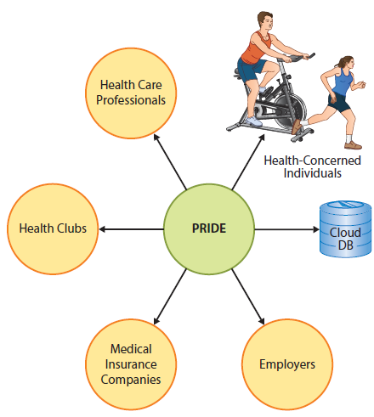
Performance Recording, Integration, Delivery, and Evaluation (PRIDE)
Notes:
Chapters 7–12 begin with a scenario using a hypothetical cloud-based, mobile application for the health care industry. These are the major actors involved in the PRIDE system.

Slide 3
Performance Recording, Integration, Delivery, and Evaluation ( cont'd)
Future business professionals need to be able to assess, evaluate, and apply emerging information technology to business.
PRIDE system will allow you to practice that key skill.

Slide 4


