Slide 1
Chapter 12
Information
Security Management

Slide 2
“We Have to Design It for Privacy and Security.”
Tension between Maggie and Ajit regarding terminology to use with Dr. Flores
Common problem for techies when talking with business professionals
Use too much technical language
Notes:
GOALS
Illustrate the meaning of design for security.
Illustrate a use for knowledge of relationship cardinality.
Set up a class discussion about how much technical language to use in management/IS professional meetings.

Slide 3
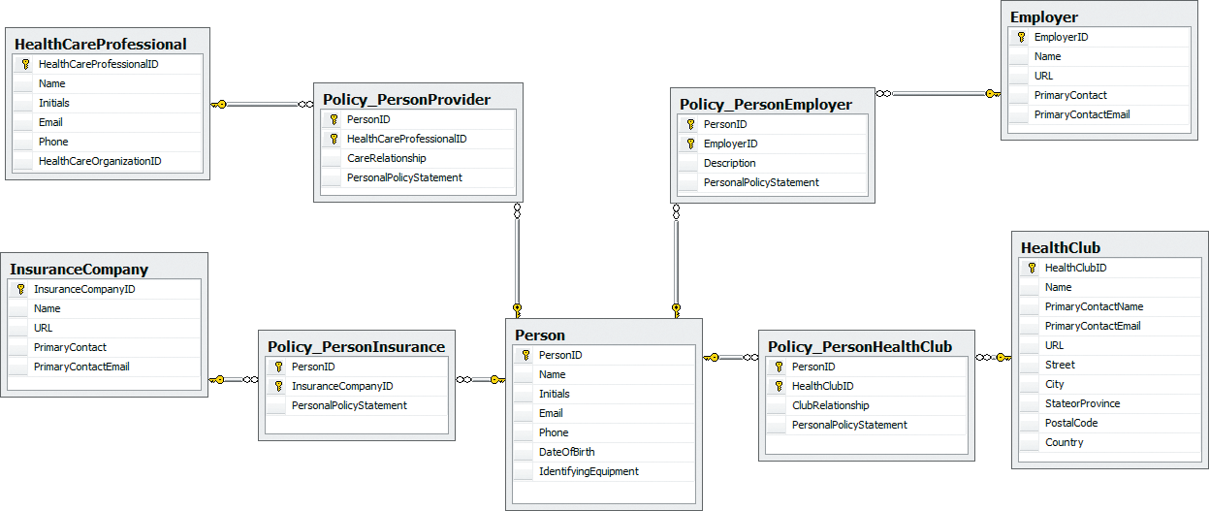
PRIDE Design for Security
Notes:
M:N tables with Person as intersecting security table.

Slide 4
Study Questions
Q1: What is the goal of information systems security?
Q2: How big is the computer security problem?
Q3: How should you respond to security threats?
Q4: How should organizations respond to security threats?
Q5: How can technical safeguards protect against security threats?
Q6: How can data safeguards protect against security threats?
Q7: How can human safeguards protect against security threats?
Q8: How should organizations respond to security incidents?

Slide 5
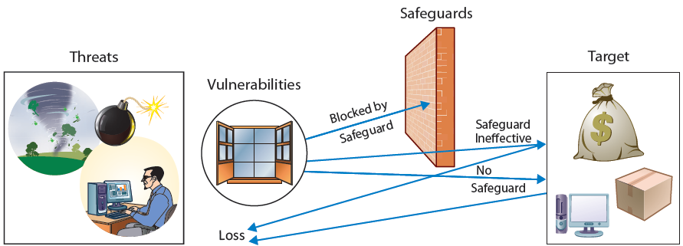
Q1: What Is the Goal of Information Systems Security?
Notes:
Major elements of IS security
Threat – person or organization seeks to obtain data or other assets illegally, without owner’s permission and often without owner’s knowledge
Vulnerability – opportunity for threats to gain access to individual or organizational assets; for example, when you buy online, you provide your credit card data, and as data is transmitted over Internet, it is vulnerable to threats
Safeguard – measure individuals or organizations take to block threat from obtaining an asset; not always effective, some threats achieve their goal in spite of safeguards
Target – asset desired by threat

Slide 6
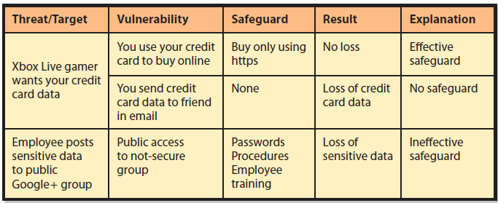
Examples of Threat/Loss

Slide 7
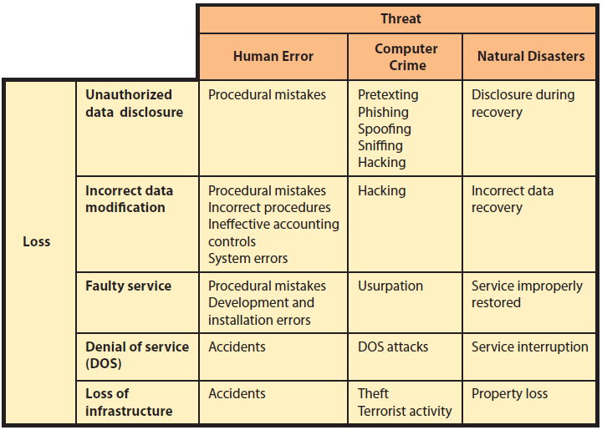
What Are the Sources of Threats?
Notes:
Sources of security threats:
Human error examples: (1) employee misunderstands operating procedures and accidentally deletes customer records; (2) employee inadvertently installs an old database on top of current one while doing backing up; (3) physical accidents, such as driving a forklift through wall of a computer room
Computer crime – intentional destruction or theft of data or other system components
Natural disasters – fires, floods, hurricanes, earthquakes, tsunamis, avalanches, other acts of nature; includes initial loss of capability and service, and losses recovery costs

Slide 8
What Types of Security Loss Exists?
Unauthorized Data Disclosure
Pretexting
Phishing
Spoofing
IP spoofing
Email spoofing
Drive-by sniffers
Hacking
Natural disasters
Notes:
These are common threats associated with unauthorized data disclosure.

Slide 9
Incorrect Data Modification
Procedures not followed or incorrectly designed procedures
Increasing a customer’s discount or incorrectly modifying employee’s salary
Placing incorrect data on company Web site
Improper internal controls on systems
System errors
Faulty recovery actions after a disaster

Slide 10
Faulty Service
Incorrect data modification
Systems working incorrectly
Procedural mistakes
Programming errors
IT installation errors
Usurpation
Denial of service (unintentional)
Denial-of-service attacks (intentional)
Notes:
Faulty service – problems caused by incorrect system operation
Usurpation – occurs when computer criminals invade a computer system and replace legitimate programs with their own unauthorized ones that shut down legitimate application and substitute their own processing to spy, steal and manipulate data, or other purposes
Denial of service – humans inadvertently shut down a Web server or corporate gateway router by starting a computationally intensive application
Denial-of-service attacks – (1) malicious hacker intentionally floods a Web server with millions of bogus service requests; (2) user unintentionally shuts down Web server or corporate gateway router by starting computationally intensive application

Slide 11
Loss of Infrastructure
Human accidents
Theft and terrorist events
Disgruntled or terminated employee
Natural disasters
Advanced Persistent Threat (APT) or cyberwarfare
Notes:
Examples – bulldozer cutting a conduit of fiber-optic cables or floor buffer crashing into a rack of Web servers
APT – sophisticated, possibly long-running, computer hack perpetrated by large, well funded organizations like governments
Cyberwarfare examples – Stuxnet and Flame. Stuxnet reputed to have been used to set back Iranian nuclear program by causing Iranian centrifuges to malfunction. Flame is a large and complex computer program reputed to have hacked into computers and operate as a cyber spy, capturing screen images, email and text messages, and searching nearby smartphones using Bluetooth communication.

Slide 12
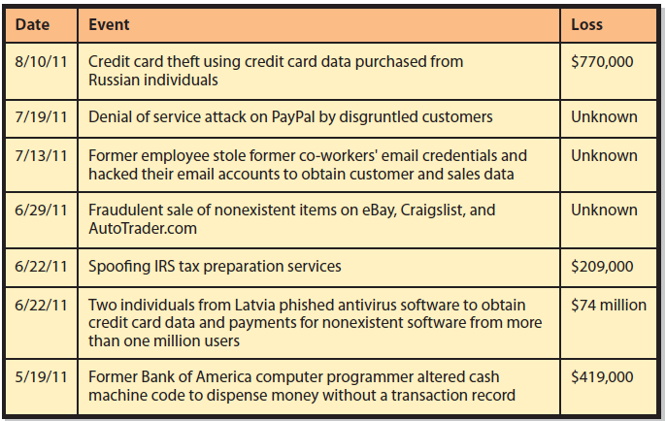
Q2: How Big Is the Computer Security Problem?
Notes:
Full extent of losses due to computer security threats not known. 2011 report, CSI stated that it had no estimate of the total loss to computer crime experienced by its survey respondents. Only 144 of the 522 responding organizations provided cost data on losses to computer crime.
Figure shows some of the major arrests, charges, and convictions for a 3-month period in 2011.
US Department of Justice publishes a list of computer crime news on its site at http://www.justice.gov/criminal/cybercrime/cc.html.

Slide 13
Verizon–Secret Service Findings 2011
Number of data-loss security incidents reached all-time high, but number of data records lost fell dramatically for second year in a row
Data theft most successful at small and medium-sized businesses
Notes:
In 2011, Verizon reported number of data-loss security incidents reached an all-time high, but number of data records lost fell dramatically for second straight year.
Large data sites have implemented effective controls, while smaller ones have not. Data theft was most successful at small and medium-sized businesses.

Slide 14
Verizon–Secret Service Findings 2011 (cont'd)
Four most frequent computer crimes
Criminal activity against servers
Viruses
Code insertion
Data loss on user computer

Slide 15
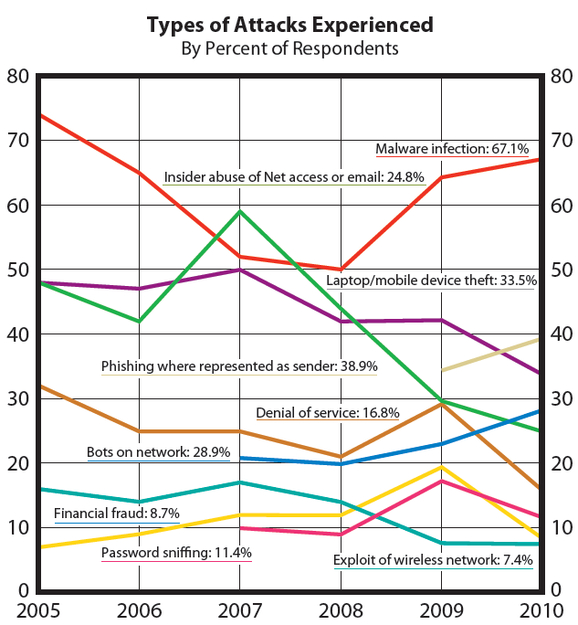
Types of Attacks Experienced
Notes:
September 2011, Norton, maker of Symantec, claimed total computer crime losses in 24 countries during prior 12 months exceeded $388 billion. Estimated $114 billion was direct cash losses and $274 billion costs associated with time victims invested in recovering from crime incidents.

Slide 16
Intrusion Detection System (IDS)
Computer program that senses when another computer is attempting to scan disk or otherwise access a computer
“When I run an IDS on a computer on the public Internet,... I get more than 1,000 attempts, mostly from foreign countries. There is nothing you can do about it except use reasonable safeguards.”

Slide 17
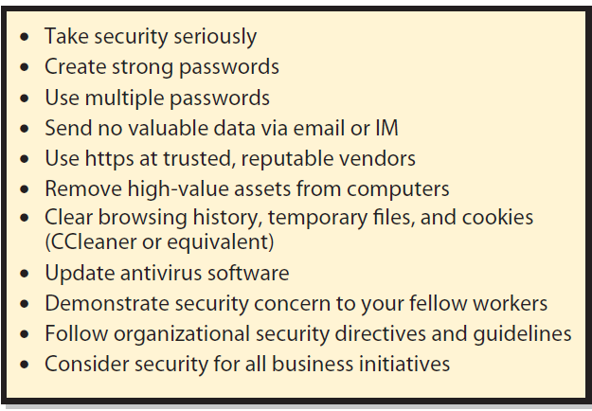
Q3: How Should You Respond to Security Threats?
Notes:
Personal security safeguards

Slide 18
Q4: How Should Organizations Respond to Security Threats?
Establish a company-wide security policy
What sensitive data to store
How it will process that data
Will data be shared with other organizations
How employees and others can obtain copies of data stored about them

Slide 19
Q4: How Should Organizations Respond to Security Threats? (cont'd)
How employees and others can request changes to inaccurate data
What employees can do with their own mobile devices at work
What non-organizational activities employees can take with employee-owned equipment

Slide 20
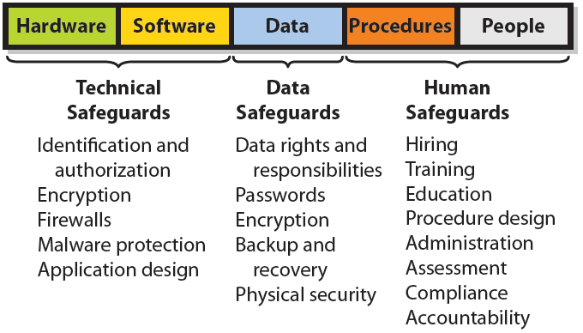
Security Safeguards as They Relate to the Five IS Components

Slide 21
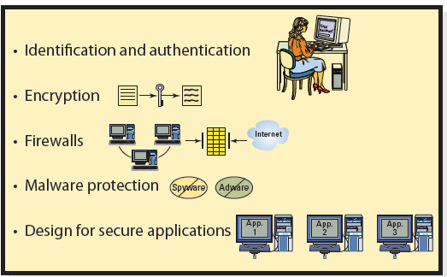
Q5: How Can Technical Safeguards Protect Against Security Threats?
Notes:
Technical safeguards involve the hardware and software components of an information system.

Slide 22
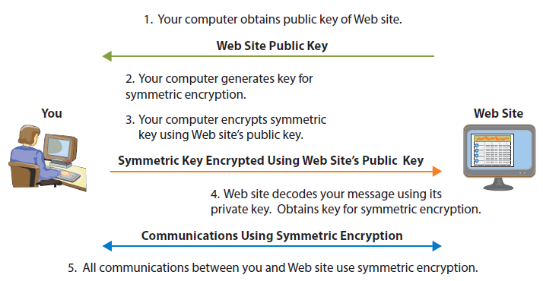
Essence of HTTPS (SSL or TLS)
Notes:
Summary of how SSL/TLS works when you communicate securely with a Web site:
1. Your computer obtains public key of Web site to which it will connect.
2. Your computer generates a key for symmetric encryption.
3. Your computer encodes key using Web site’s public key, then sends encrypted symmetric key to Web site.
4. Web site decodes symmetric key using its private key.
5. Now, your computer and Web site communicate using symmetric encryption.

Slide 23
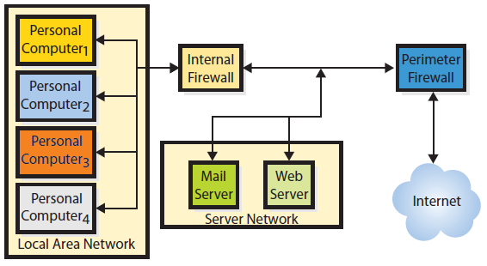
Firewalls
Notes:
Organizations normally use multiple firewalls. A perimeter firewall sits outside the organizational network; it is first device that Internet traffic encounters.
Packet-filtering firewall examines each part of a message and determines whether to let that part pass. To make this decision, it examines the source address, destination address(es), and other data. Packet-filtering firewalls can prohibit outsiders from starting a session with any user behind firewall, prohibit traffic from legitimate, but unwanted, addresses, such as competitors’ computers, and filter outbound traffic.

Slide 24
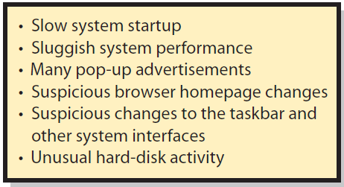
Malware Types and Spyware and Adware Symptoms
Viruses
Payload
Trojan horses
Worms
Beacons
Spyware & Adware Symptoms
Notes:
Payload is the program code that causes unwanted activity. It can delete programs or data, or modify data in undetected ways.
Beacons are tiny files that gather demographic information, use a single code to identify users by age, gender, location, likely income, and online activity. A beacon code can contain your favorite movies, whether you read online news, your shopping habits, your online dating habits, and what type of research you conduct on computer.

Slide 25
Malware Safeguards
Antivirus and antispyware programs
Scan frequently
Update malware definitions
Open email attachments only from known sources
Install software updates
Browse only reputable Internet neighborhoods

Slide 26
Design for Secure Applications
SQL injection attack
Occurs when user enters SQL statement into a form instead of a name or other data
Accepted code becomes part of database commands issued
Improper data disclosure, data damage and loss possible
Well designed applications make injections ineffective

Slide 27
InClass Exercise 12: Phishing for Credit Cards, Identifying Numbers, Bank Accounts
In this exercise, you and a group of your fellow students will investigate phishing attacks.
Search the Web for phishing, be aware that your search may bring the attention of an active phisher.
Therefore, do not give any data to any site that you visit as part of this exercise!
Notes:
Goal:
To learn the fundamentals of phishing.
To learn some precautionary measures you can take in an attempt to reduce the potential of being conned by phishing scams.
Lessons
Never click on hyperlinks within email messages
Use anti-spam filter software
Use anti-virus software
Use a personal firewall
Keep software updated (especially operating systems and browsers)

Slide 28
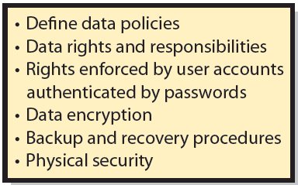
Q6: How Can Data Safeguards Protect Against Security Threats?
Notes:
When organizations store databases in the cloud, all of the safeguards should be part of the service contract.

Slide 29
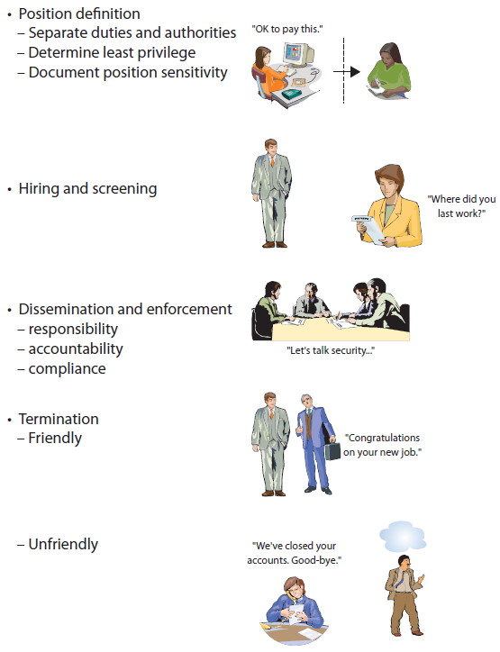
Q7: How can Human Safeguards Protect Against Security Threats?
Notes:
Development of human safeguards for employees

Slide 30
Account Administration
Account Management
Standards for new user accounts, modification of account permissions, removal of unneeded accounts
Password Management
Users should change passwords frequently
Help Desk Policies
Notes:
Account management
Create new user accounts, modify existing account permissions, remove unneeded accounts. Improve your relationship with IS personnel by providing early and timely notification of needed account changes.
Password management
Users should change passwords every 3 months or less.
Help desk management
Set policy for means of authenticating a user.

Slide 31
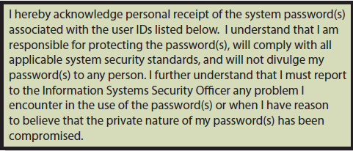
Sample Account Acknowledgment Form
Notes:
Employees required to sign statements similar to this.

Slide 32
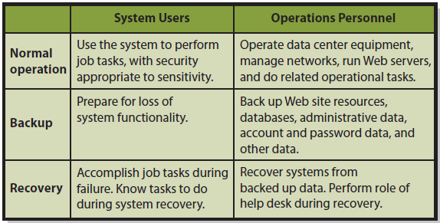
Systems Procedures
Notes:
Definition and use of standardized procedures reduces likelihood of computer crime and other malicious activity by insiders. It also ensures system’s security policy is enforced.

Slide 33
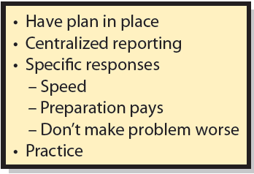
Q8: How Should Organizations Respond to Security Incidents?

Slide 34
How Does the Knowledge in this Chapter Help You?
Aware of threats to computer security as an individual, business professional and employee
Know trade-offs of loss risks and cost of safeguards
Ways to protect your computing devices and data
Understand technical, data, and human safeguards
Understand how organizations should respond to security incidents
Notes:
Helps you by making you aware of the threats to computer security both for you as an individual, business professional, and any organization in which you work.

Slide 35
Guide: Metasecurity
What are the security problems?
What are the managers’ responsibilities for controls over the security system?
Notes:
GOALS
Sensitize students to problems of securing security.
Emphasize the importance of managers’ responsibilities for controls over the security system.
WRAP UP
▪ As a manager, you may have control responsibilities for the security system. If so, take those responsibilities seriously.
▪ Securing security is a challenging, interesting, difficult, and important problem. It could make a great career!

Slide 36
Guide: The Final, Final Word
Routine work will migrate to lower-labor-cost countries
Be a symbolic-analytic worker
Abstract thinking
How to experiment
Systems thinking
Collaboration
Notes:
GOAL
Inspire students to use their learning from this class to find, create, and manage innovative applications of information systems and technology.
WRAP UP
The best is yet to come!
What that best is, what happens next, will be in large measure up to you!
We started this book with a firing and we’re ending it, we hope, with a hiring… yours!

Slide 37
Active Review
Q1: What is the goal of information systems security?
Q2: How big is the computer security problem?
Q3: How should you respond to security threats?
Q4: How should organizations respond to security threats?
Q5: How can technical safeguards protect against security threats?
Q6: How can data safeguards protect against security threats?
Q7: How can human safeguards protect against security threats?
Q8: How should organizations respond to security incidents?

Slide 38
Case 12: Moore’s Law, One More Time …
Doubling CPU speed helps criminals
Enables more powerful password crackers
iOS, Android phones, and millions of mobile devices increase data communications and exponential opportunities for computer criminals.
Notes:
What can we learn from these seven scenarios?
Very cheap storage enables criminals to inexpensively store:
- Millions of common passwords
- Multiple-language dictionary words
- Gigabytes of data from snooping

Slide 39
