Slide 1
Chapter 11
Information Systems
Management

Slide 2
"I Don’t Know Anything About Doing Business In India.”
Realistic description of what can happen to a small organization new to off-shore outsourcing
Dilemma: Want savings of off-shore outsourcing, but don’t want problems that are 10,000 miles away and easy to ignore until deadlines or payments due
Notes:
GOALS
Illustrate the dilemma of offshore outsourcing.
It can be considerably cheaper than domestic development, but it is replete with problems and risks
In addition to problems of off-shore outsourcing, you can use PRIDE to discuss functions of an IS department.

Slide 3
Study Questions
Q1: What are the functions and organization of the IS department?
Q2: How do organizations plan the use of IS?
Q3: What are the advantages and disadvantages of outsourcing?
Q4: What are your user rights and responsibilities?

Slide 4
Q1: What are the Functions and Organization of the IS Department?
Plan how to use IS to accomplish organizational goals and strategy
Manage outsourcing relationships
Protect information assets
Develop, operate, and maintain organization’s computing infrastructure
Develop, operate, and maintain enterprise applications
Notes:
A list of the typical IS department functions
Protection function is the topic of Chapter 12.
Develop functions are important for IS majors, but less so for other business professionals and are not considered in this text. To set the stage, consider the organization of the IS Department.

Slide 5
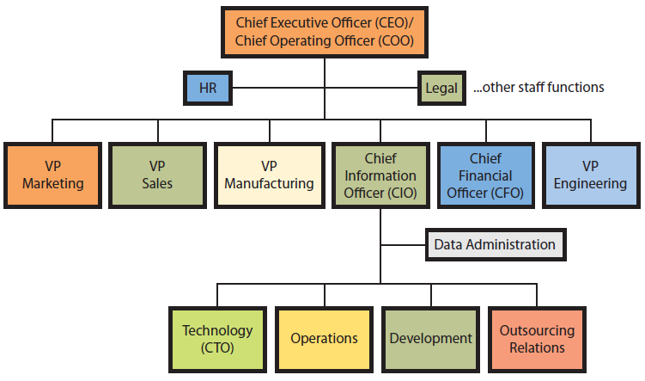
How Is the IS Department Organized?
Notes:
Organizational structure varies depending on organization’s size, culture, competitive environment, industry, and other factors.
Chief information officer (CIO) is responsible for aligning IS to support organizational strategies.
Chief technology officer (CTO) investigates new information systems technologies and determines how organization can benefit.
Operations manages the computing infrastructure and responds to user problems.
Development group manages the process of creating new information systems and maintenance.
Outsourcing relations group negotiates outsourcing agreements.
Data administration staff protects company data and information assets.

Slide 6
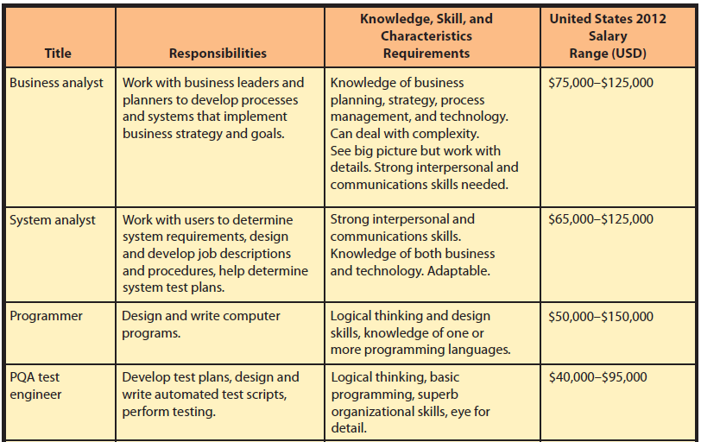
What IS-Related Job Positions Exist?
Notes:
With the exception of computer technician, and possibly PQA test engineer, all of these positions require a 4-year degree and require business knowledge or business degree, and good verbal communications and writing skills.

Slide 7
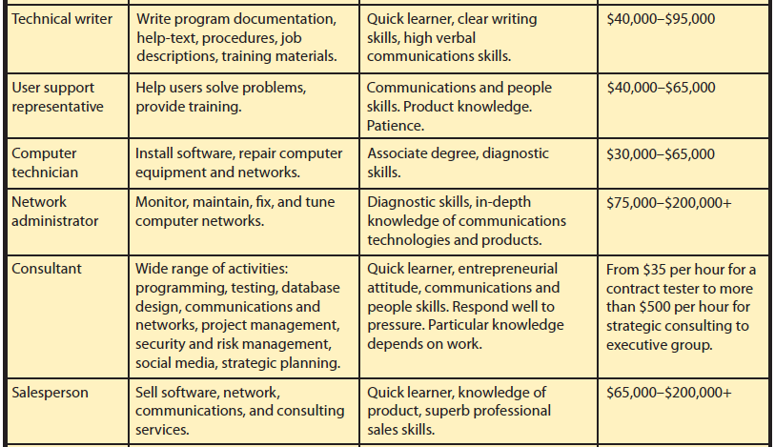
What IS-Related Job Positions Exist? (cont’d)

Slide 8
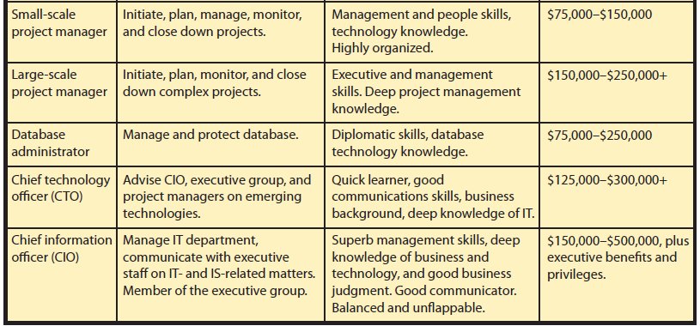
What IS-Related Job Positions Exist? (cont’d)

Slide 9
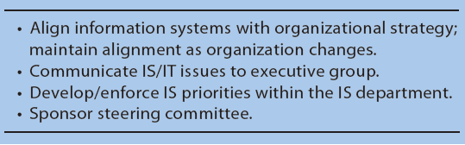
Q2: How Do Organizations Plan the Use of IS?
Notes:
Maintaining alignment between IS capabilities and organizational strategy is a continual process. Without a strong CIO, IS can be perceived as a drag on organization’s opportunities.
A steering committee is a group of senior managers from the major business functions that works with the CIO to set the IS priorities and decide among major IS projects and alternatives. IS department sets up the steering committee’s schedule, agenda and conducts the meetings.

Slide 10
Q3: What Are the Advantages and Disadvantages of Outsourcing?
Process of hiring another organization to perform services
Any value chain business activity can be outsourced
“Your back room is someone else’s front room.” (Peter Drucker)
Notes:
Outsourcing is done to save costs, gain expertise, and free management time.
Outsource employee cafeteria to a food services company. It’s their front room operation.

Slide 11
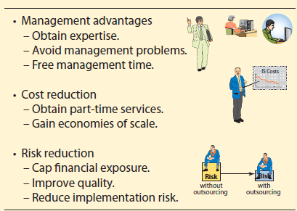
Popular Reasons for Outsourcing IS Services
Notes:
Many companies outsource portions of their information systems activities. Figure 11-4 lists popular reasons for doing so.
Lucas at GearUp has skills to manage a new software development project, but may not choose to invest the time. Note, too, that it's not just Lucas' time. Fox Lake has outsourced its new facilities scheduling system to the cloud.

Slide 12
Risk Reduction
Caps financial risk
Ensures level of quality or avoids having substandard quality
Less likely to pick wrong hardware, wrong software, wrong network protocol, or implementing tax law changes incorrectly
Risk management vendor’s responsibility
Easier to hire another vendor than fire and rehire internal staff

Slide 13
International Outsourcing
India
Large, well-educated, English-speaking, labor cost 70-80% less than in US
China and other countries
Modern telephone technology and Internet-enabled service databases
Customer support and other functions operational 24/7
Notes:
With modern telephone technology and Internet-enabled service databases, a single customer service call can be initiated in United States, partially processed in India, then Singapore, and finalized in Ireland.
Amazon.com operates customer service centers in the United States, India, and Ireland.

Slide 14
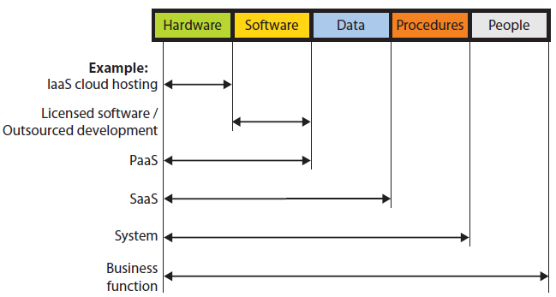
What Are Outsourcing Alternatives?
Notes:
Major categories of alternatives according to information systems components and outsourcing of hardware to the cloud.
Electronic Data Systems (EDS) successful for more than 30 years as outsource vendor of hardware infrastructure.
Software as a service (SaaS) an outsourcing alternative that provides hosted applications and data storage. Salesforce.com is a typical example of a SaaS provider.
Outsource an entire system: Oracle provides entire payroll function as an outsourced service. Client company only provides employee and work information, while payroll outsource vendor does the rest.
A Web storefront is a form of application outsourcing. Amazon.com provides a Web storefront for product vendors and distributors who choose not to develop their own Web presence.
Some organizations choose to outsource an entire business function. Many companies outsource to travel agencies the function of arranging for employee travel. Some outsource vendors operate offices within other company’s facilities.

Slide 15
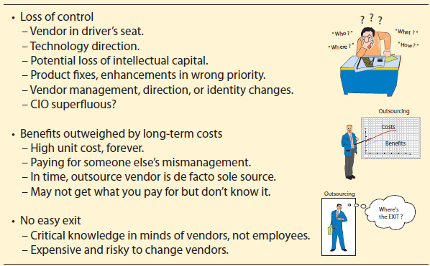
Risks of Outsourcing
Notes:
Outsourcing presents significant risks, as listed in Figure 11-6.
Loss of control over important business functions, loss of human capital and important management resources
Difficulty in identifying or realizing benefits
Difficulty in ending outsourcing dependencies

Slide 16
Benefits Outweighed by Long-Term Costs
Unit fixed cost contract may prevent benefits of economies of scale
Vendor de facto sole source
Changing pricing strategy
No easy exit
Difficult to know if vendor well managed
Notes:
Initial benefits of outsourcing can appear huge.
Although a fixed cost does cap exposure, however it removes the benefits of economies of scale.
Vendor becomes de facto sole source and might increase its prices.
Vendor learns more about the business and as relationships develop between the organization’s and vendor’s employees, it becomes difficult for other firms to compete for subsequent contracts.
Organization may pay for vendor’s mismanagement, gross inefficiency and not know it.
No easy exit
Vendor becomes tightly integrated into the business such that parting company can be exceedingly risky.
Outsource vendor’s employees have gained significant knowledge of the company.
Vendor knows the server requirements in customer support, patterns of usage, and the best procedures for downloading operational data into the data warehouse. Consequently, your lack of knowledge make it difficult to bring outsourced service back in-house.
Company must invest considerable work, duplication of effort, management time, and expense to change to another vendor.

Slide 17
InClass Exercise 11: Setting up the PRIDE Systems IS Department
Assume investment group formed a new company, PRIDE System
Employ managers, sales and marketing, and customer support personnel
IS Department through combination of in-house personnel and outsourcing
You are asked to help plan new department. Form a group as instructed by your professor and answer the exercise questions.

Slide 18
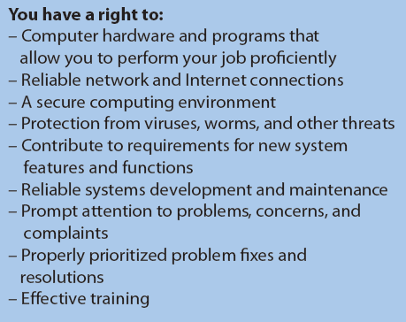
Q4: What Are Your IS Rights and Responsibilities?
Notes:
If you process huge files for data-mining applications, you have a right to the huge disks and fast processor that you need. However, if you merely receive email and access corporate Web portal, then your right is for more modest requirements.
Reliable means you can process without problems almost all of the time.
Organization should protect your computer and files, and you should not normally even need to think about security.
Participate in requirements meetings for new applications you will use and for major changes to applications you currently use.
Receive prompt attention to your problems, concerns, and complaints about information services. Right to have means to report problems, and to know your problem has been received and registered with IS department. Right to have your problem resolved, consistent with established priorities.
Training that is convenient to you, easy to understand and enables you to use systems to perform your job.

Slide 19
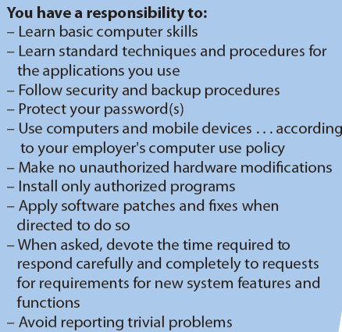
What Are Your IS Rights and Responsibilities? (cont’d)
Notes:
Your responsibilities toward IS department and organization.
Do not expect hand-holding for basic operations. Nor should you expect to receive repetitive training and support for the same issue.
Responsible for protecting your password(s), computer, your organization’s networks and databases.
Unauthorized modifications could interfere with automated maintenance programs for upgrading your computer and cause problems the IS department will have to fix.
Responsibility to treat information systems professionals professionally. One form of professional behavior is to learn basic computer skills so that you avoid reporting trivial problems.

Slide 20
How does the Knowledge in This Chapter Help You?
Better consumer of IS Department services
Know kinds of work to outsource
Advantages, disadvantages, and choices for outsourcing
Enables you to be a more effective business professional by setting reasonable expectations
Notes:
The Knowledge in this chapter can enable you to be a more effective business professional by setting reasonable expectations as to what you can expect from the IS Department, while knowing what the IS Department expects of you.

Slide 21
Ethics Guide: Using the Corporate Computer
Suppose you are a manager at a company with this stated policy.
“Computers, email, and the Internet are to be used primarily for official company business. Small amounts of personal email can be exchanged with friends and family, and occasional usage of the Internet is permitted, but such usage should be limited and never interfere with your work.”
You learn one of your employees has been engaged in activities listed in the Ethics Guide.
Notes:
GOALS
Evaluate the ethics of employee activities in terms of a particular computer-use policy.
Forewarn students that employers have the right to monitor computer usage, and many do.
Develop techniques for managing employees’ computer use.
This guide focuses on the student’s role as a manager rather than as a computer user.

Slide 22
Guide: Is Outsourcing Fool’s Gold?
Paying premium for services of former employees, now managed by strangers and paid by vendor
Vendor managers evaluated on how well they follow vendor’s profit-generating procedures
Turn your operation into a clone of their other clients
All critical knowledge in vendor’s employees, who are prohibited from going to work for you
Expensive leap away from responsibility
Notes:
GOAL
Investigate advantages and disadvantages of computer infrastructure outsourcing.
Background
Outsourcers get their first-level employees by hiring the ones you had. What you’re really outsourcing is middle-level management of the same IT personnel you had.
No way of knowing whether the managers they supply are any better.
Paying a premium for the services of your former employees, who are now managed by strangers who are paid by the outsource vendor, who evaluates those managers on how well they follow the outsource vendor’s profit-generating procedures.

Slide 23
Active Review
Q1: What are the functions and organization of the IS department?
Q2: How do organizations plan the use of IS?
Q3: What are the advantages and disadvantages of outsourcing?
Q4: What are your user rights and responsibilities?

Slide 24
Case Study 11: iApp$$$$ 4 U
Ideas are only as good as their implementation
How can you go about getting your iOS application developed?
Average cost of creating an iPhone app $6453
Programming time cost excluding time for specifying requirements, designing user interface, testing, Apple review process
Notes:
What is the value of that idea? According to Raven Zachary, no professional iPhone developer will take equity or the promise of future revenue sharing in exchange for cash. There is too much cash-paying work. Ideas are only as good as their implementation.

Slide 25
What Are Your Options?
Do as much as you can yourself.
Determine how many SDLC stages you can do yourself.
Design user-interface and specify ways users will employ it.
Develop a test plan skeleton.
Perform some testing tasks yourself.
Outsource to US or EU programmer ($10k).
Notes:
Goal:
Give students some understanding options for real-world outsourcing iOS app development.
How can you go about getting your iOS application developed?

Slide 26
What Are Your Options? (cont’d)
Outsource off-shore or hire a computer-science student. But students may be undependable.
Elance.com – clearing house for iOS development experts
Lists developers, their locations, typical costs and ratings of previous customers
Hire developers in India, Russia, the Ukraine, Romania, and other countries ($2000+).
Break big app into smaller, easily doable smaller apps.
Notes:
Check Elance.com a clearing house for iOS development experts. Lists developers, their locations, typical costs, and ratings of previous customers

Slide 27
