Slide 1
Chapter 10
Information Systems Development

Slide 2
“We Need to Support Other Watches and Mobile Devices, and at Least Android Phones.”
Need to define and document business procedures, train staff, involve other partners.
Make system more generally available.
Strategic implication: Spin off PRIDE as separate business?

Slide 3
Study Questions
Q1: What is systems development?
Q2: Why is systems development difficult and risky?
Q3: What are the five phases of the SDLC?
Q4: How is system definition accomplished?
Q5: What is the users’ role in the requirements phase?
Q6: How are the five components designed?
Q7: How is an information system implemented?
Q8: What are the tasks for system maintenance?
Q9: What are some of the problems with the SDLC?

Slide 4
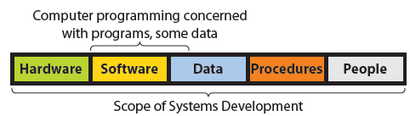
Q1: What is Systems Development?
Process of creating and maintaining information systems
Requires
    Establishing system goals
    Setting up the project
    Determining requirements
    Business knowledge and management skill

Slide 5
Q2: Why is Systems Development
Difficult and Risky?
Many projects are never finished. Those that finish are often 200-300% over budget.
Some projects finish within budget and schedule, but don't accomplish goals.
Even with competent people following an accepted methodology, the risk of failure is still high.

Slide 6
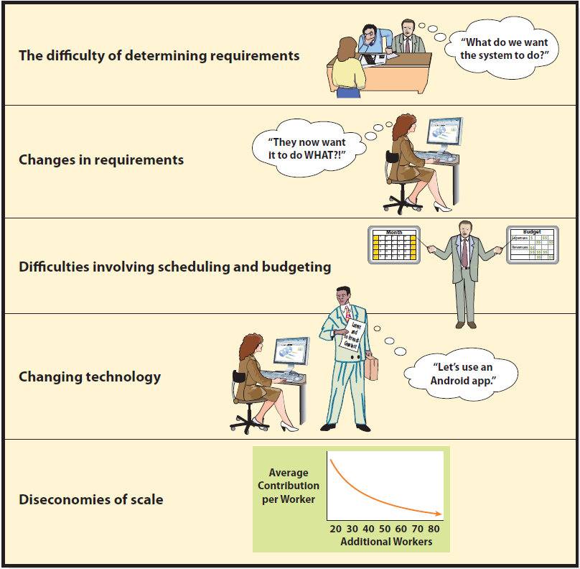
Major Challenges to System Development
Notes:
Before the system can be finalized, detailed requirements also need to be specified.

Slide 7
Difficulty of Requirements Determination
  What specifically is system to do?
  What, exactly, does the report that the doctors receive look like?
  Will they have both standard and exception reports? Are those reports fixed in structure or can user adapt them? If the latter, how?
  How many practices and how many patients per practice will PRIDE support?
  How much cloud resource needed?
      Must create environment where difficult questions are asked and answered.
Notes:
PRIDE system started with a prototype. As they think about the operational system, what are the true requirements?
What does privacy mean, in the details? Who sets patient privacy policy? Who can change it? What granularity of permission is needed? As any experienced systems analyst knows, there will undoubtedly be important questions that no one knows to ask.

Slide 8
Changing Requirements
Systems development aims at a moving target.
The bigger the system, the longer the project, the more requirements change.
What should the development team do?
Incorporate changes, build, complete and make changes in maintenance phase?
Notes:
Midway through the development process, a major health club chain approaches Flores with a lucrative contract proposal. That proposal necessitates major changes in PRIDE's planned reporting requirements.

Slide 9
Scheduling and Budgeting Difficulties
  How long to build it?
  How long to create data model?
  How long to build database applications?
  How long to do testing?
  How long to develop and document procedures?
  How long for training?
  How many labor hours? Labor cost?
  What’s the rate of return on investment?
Notes:
If you cannot estimate how much a system costs, then how do you perform a financial analysis to determine if system generates an appropriate rate of return?

Slide 10
Changing Technology
Do you want to stop your development to switch to the new technology?
Would it be better to finish developing according to the existing plan?
Why build an out-of-date system?
Can you afford to keep changing the project?
Notes:
Example: While developing PRIDE's maintenance application, Apple, Microsoft, and Google and their business partners release hot, new mobile devices with vastly improved graphics and animation. You know these new devices can create far better animations. What to do?

Slide 11
Diseconomies of Scale
  Brooks’ Law
    “Adding more people to a late project makes the project later.”
    New staff must be trained by productive members who lose productivity while training.
    Schedules can be compressed only so far.
    Once a project is late and over budget, no good choice exists.
Notes:
“Nine women cannot make a baby in one month.”

Slide 12
Is It Really So Bleak?
Yes and No.
Successful methodologies exist, when supported and managed properly.
Systems development life cycle (SDLC), most common methodology

Slide 13
Q3: What are the Five Phases of the SDLC?
1. System definition
2. Requirements analysis
3. Component design
4. Implementation
5. Maintenance

Slide 14
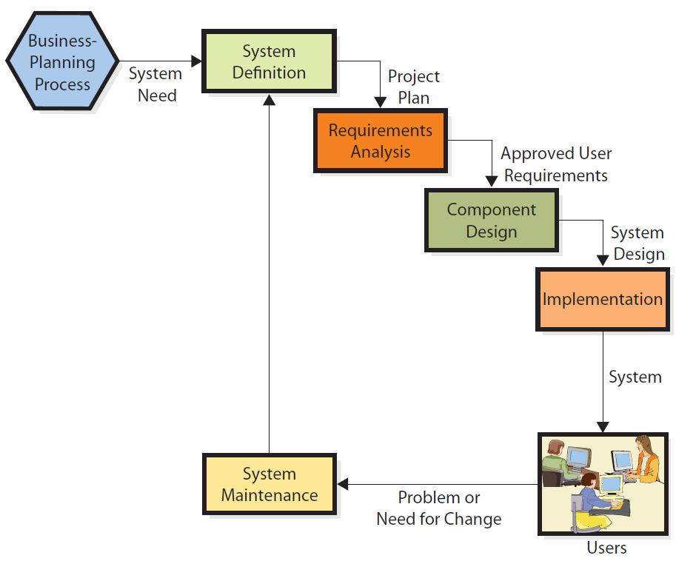
Phases in the SDLC
Notes:
For PRIDE system, Dr. Flores had initial idea to connect his practice to patient exercise data in the cloud. He hired Maggie Jensen, a business analyst, to develop a prototype to test desirability of system to his patients and his practice. Now, he wants to start a systems development process to create an operational capability.

Slide 15
Q4: How is System Definition Accomplished?
Assign a team to define new system, assess its feasibility, and plan project.
Initial team – both users and IS professionals
Dr. Flores hired Maggie, an independent expert, to work with partners, staff, and patients to define PRIDE system.

Slide 16
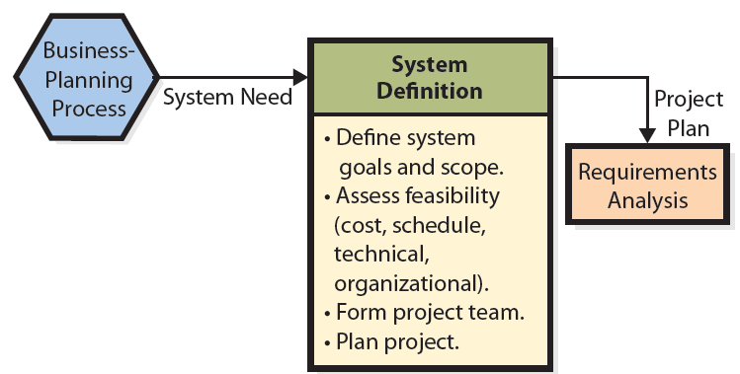
Define System Goals and Scope
Notes:
Feasibility has four dimensions: Cost, schedule, technical, and organizational.
Cost feasibility depends on the scope of the project.
Schedule feasibility is difficult to determine because it is hard to estimate the time it will take to build a system.
Technical feasibility refers to whether existing information technology is able to meet needs of new system.
Organizational feasibility concerns whether the new system fits within the organization’s customs, culture, charter, or legal requirements.

Slide 17
Form a Project Team
  Typical development team
  Systems analyst and/or business analyst
  Managers
  Programmers
  Software testers
  Users
  Outside contractor
Notes:
Normally, team consists of both IS professionals and user representatives. Project manager and IS professionals can be in-house personnel or outside contractors.
Business analysts specialize in understanding business needs, strategies, and goals and helping businesses implement systems to accomplish their competitive strategies.
Systems analysts are IT professionals who understand both business and technology.

Slide 18
Team Composition Changes Over Time
Requirements definition – heavy with business and systems analysts
Design and implementation – heavy with programmers, testers, and database designers
Integrated testing and conversion – augmented with testers and business users
Users have active involvement and take ownership of project throughout entire project.
Notes:
First major task for project team is to plan project. Members of project team specify tasks to be accomplished, assign personnel, determine task dependencies, and set schedules.

Slide 19
Experiencing MIS InClass Exercise 10: GardenTracker
Suppose that you and two or three other students have been groundskeepers at Fox Lake, and you have decided to go out on your own and open a business that offers landscaping services. Your goal is to develop a list of clients for whom you provide regular and recurring services, such as mowing, weeding, and pool cleaning, as well as specialty services, such as pruning, garden preparation, tree removal, sprinkler installation and repair, and the like.
Need information system for tracking customers, services you have provided, and services you are scheduled to provide in the future. As a new small business, you want a simple and affordable system based on Excel or Access. The name of the system is GardenTracker.

Slide 20
Experiencing MIS InClass Exercise 10: GardenTracker (cont’d)
Explain how you would use the SDLC to develop GardenTracker.
Define the scope of your system.
Explain the process you would use to determine the feasibility of GardenTracker.
List data you need for such an assessment, and explain how you might obtain or estimate that data.
Notes:
See textbook for more Exercise questions.

Slide 21
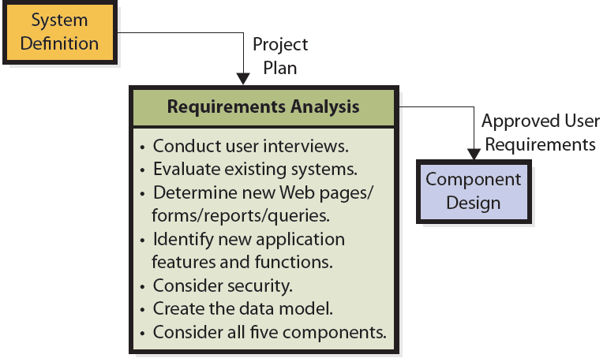
Q5: What is the Users’ Role in the
Requirements Phase?
Interviewing skills crucial
Notes:
This phase requires interviewing dozens of users and documenting potentially hundreds of requirements.
Requirements definition is expensive and difficult.
If requirements are wrong, resulting system will be wrong.

Slide 22
Review And Approve Requirements
Requirements for all five IS components, not just for software and data
Requirements for communications and network hardware
Requirements for procedures and personnel
Requirements or rules restricting activities for certain categories of employees

Slide 23
Role of a Prototype
Provides direct experience for users
Provides evidence to assess technical and organizational feasibility
Used to estimate development and operational costs
Often re-used in operational system
Notes:
Developers face a dilemma when funding prototypes; cost of prototype occurs early in process, sometimes well before full project funding is available.

Slide 24
Q6: How are the Five Components
Designed?
Determine hardware specifications
Determine software specifications
Database design
Procedure design
    Normal, backup, and failure recovery procedures
Design Job Descriptions
    Create and define new tasks and responsibilities
Notes:
Team designs each component by developing alternatives, evaluating each of those alternatives against requirements, and then selecting among those alternatives.
Accurate requirements are critical; if they are incomplete or wrong, then they will be poor guides for evaluation.

Slide 25
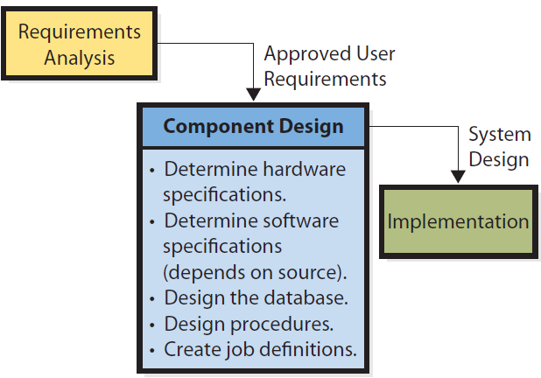
SDLC: Component Design Phase

Slide 26
For PRIDE
Data and some application processing done in the cloud.
Hardware design – what cloud resources are needed?
Users need to decide mobile devices to support.
Software design; if uses thin-client application, can support more devices

Slide 27
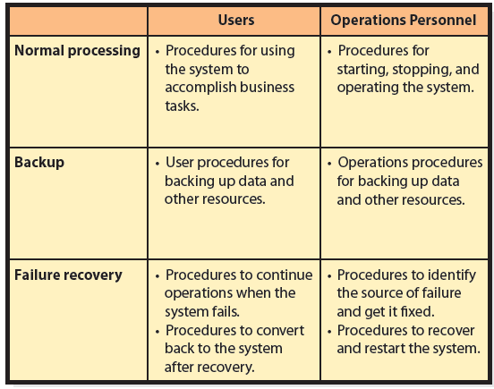
Procedures to be Designed
Notes:
Usually, teams of systems analysts and key users design the procedures.

Slide 28
Design of Job Descriptions
Teams of systems analysts and users determine job descriptions and functions.
Duties and responsibilities for new jobs and revised jobs coordinated with human resources policies

Slide 29
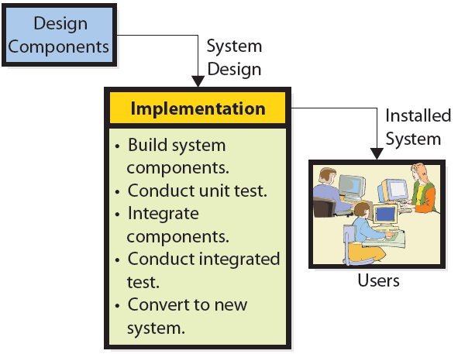
Q7: How is an Information System
Implemented?
Notes:
Tasks in this phase are to build, test, and convert the users to new system.

Slide 30
System Testing
Test plan
Product Quality Assurance (PQA)
User testing
  Develop test plans and test cases
Beta testing
  Final say on whether system is “production ready”

Slide 31
System Conversion Approaches
Pilot | Implement entire system in limited portion of business Limits exposure to business if system fails
Phased | System installed in phases or modules Each piece installed and tested
Parallel | Complete new and old systems run simultaneously Very safe, but expensive
Plunge | High risk if new system fails Only used if new system not vital to company operations
Notes:
IS professionals recommend any of first three, depending on the circumstances. In most cases, avoid “taking the plunge!”

Slide 32
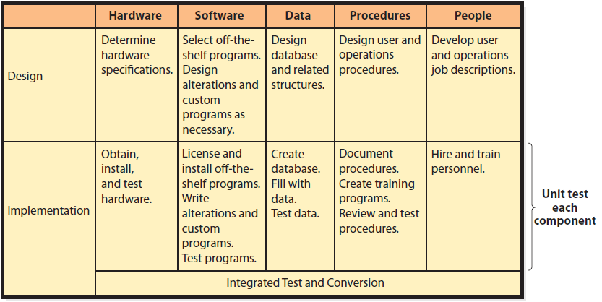
Design and Implementation for the Five Components

Slide 33
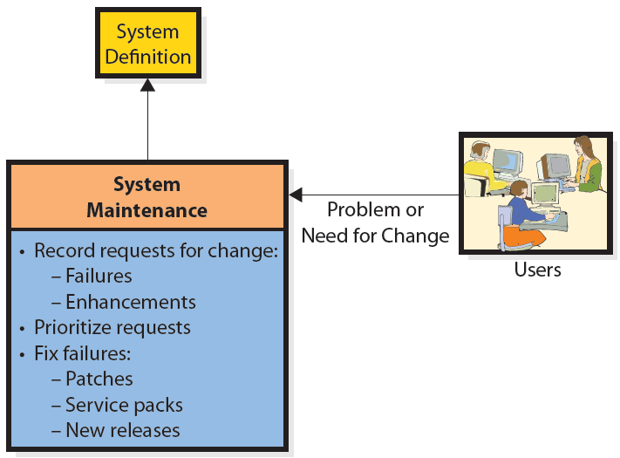
Q8: What are the Tasks for System
Maintenance?
Failure is a difference between what system does and what it is supposed to do.
Notes:
Maintenance is a misnomer; work done during this phase is either to fix the system so that it works correctly or to adapt it to changes in requirements.
Needs to have a means for tracking both failures and requests for enhancements to meet new requirements.
Software developers group fixes for high-priority failures into patches and service packs.

Slide 34
Q9: What Are Some of the Problems with the SDLC?
SDLC Waterfall Method
Requirements documentation difficulty
    Business requirements change
    “Analysis paralysis” – projects spend so much time on documentation it hampers progress
Scheduling and budgeting difficulties
    Time and cost estimates for large project way off
    People who make initial estimates know little about how long it will take or cost

Slide 35

SDLC Waterfall Method
Notes:
Sequence of non-repeated phases
It rarely works smoothly, causing development team to go back and forth, raising costs and delaying project

Slide 36
How Does the Knowledge In This Chapter Help You?
  Someday, you will be running a business unit or a department or a project that needs to develop an information system.
  You need to know how to proceed.
  Knowledge of this chapter will get you started on right path.

Slide 37
Ethics Guide: Estimation Ethics
Estimating is just “theory.” Average of many people’s guesses
Buy-in game
Projects start with overly optimistic schedules and cost estimates
At what point is a buy-in within accepted boundaries of conduct?
Notes:
GOALS
Introduce the concept of buy-in as it pertains to information systems.
Assess the ethics of buy-ins in different settings.

Slide 38
Ethics Guide: Estimation Ethics
Contractor agrees to produce system for less than what will really be required
    Time and materials contract
    Fixed-cost contracts
In-house projects are often started with buy-ins
    Projects often start with hopes of more money later.
    Team members disagree about costs. Do you report it?
    Not all costs included in initial estimates. Report it?
Do you buy-in on project schedule if you can’t make that schedule?

Slide 39
Guide: The Real Estimation Process
Software developers are optimists.
People can’t work all the time.
Apply a factor like 0.6 to compute number of effective labor hours for each employee.
Be aware of consequences of negotiating a schedule.
Notes:
GOALS
Sensitize students to the challenges of software scheduling.
Alert students to possible consequences when negotiating a schedule.

Slide 40
Active Review
Q1: What is systems development?
Q2: Why is systems development difficult and risky?
Q3: What are the five phases of the SDLC?
Q4: How is system definition accomplished?
Q5: What is the users’ role in the requirements phase?
Q6: How are the five components designed?
Q7: How is an information system implemented?
Q8: What are the tasks for system maintenance?
Q9: What are some of the problems with the SDLC?

Slide 41
Case Study 10: Cost of PRIDE
Typical example of a new software venture
So focused on technology and making it work, they neglect to consider what will happen, longer term, if it is a success
Some problem solutions involve staff training and procedures
Longer term, Flores and his partners need a direction.
Notes:
GOALS
Illustrate the difference between application development and systems development.
Motivate the need for the SDLC or other development process.
Illustrate some of the difficulties in creating and managing an inter-enterprise system.

Slide 42
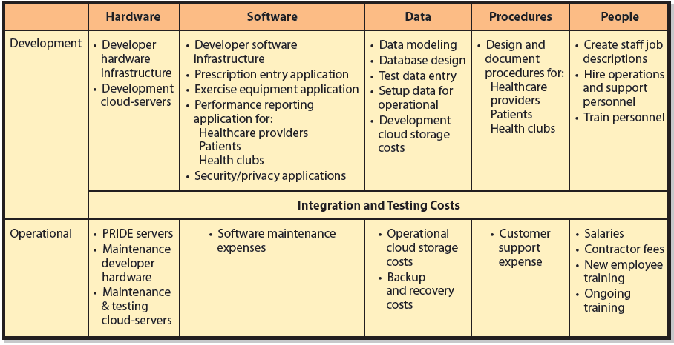
Sources of PRIDE Costs

Slide 43
