Slide 1
Chapter 9
Business Intelligence Systems
Notes:
This chapter considers applications of business intelligence systems that use employee knowledge, organizational data and purchased external data.

Slide 2
“We Can Produce Any Report You Want, But You’ve Got to Pay for It.”
Different expectations about what a report is
Great use for exception reporting
Feature PRIDE prototype and supporting data are stored in profile, profileworkout, and equipment tables
Need legal advice on system
Notes:
GOALS: Use the PRIDE system to:
Illustrate a practical application for business intelligence systems, specifically reporting.
Show the use of animation for reporting on a mobile device.
Provide a setting to teach standard reporting terminology.

Slide 3
Study Questions
Q1: How do organizations use business intelligence (BI) systems?
Q2: What are the three primary activities in the BI process?
Q3: How do organizations use data warehouses and data marts to acquire data?
Q4: What are three techniques for processing BI data?
Q5: What are the alternatives for publishing BI?
Notes:
Chapter begins by summarizing reasons organizations use business intelligence. Then, it describes three basic activities in business intelligence process and illustrates those activities using GearUp.
Next, are discussions of data warehouses, data marts, data mining and knowledge management applications, followed by alternatives for publishing BI results.

Slide 4
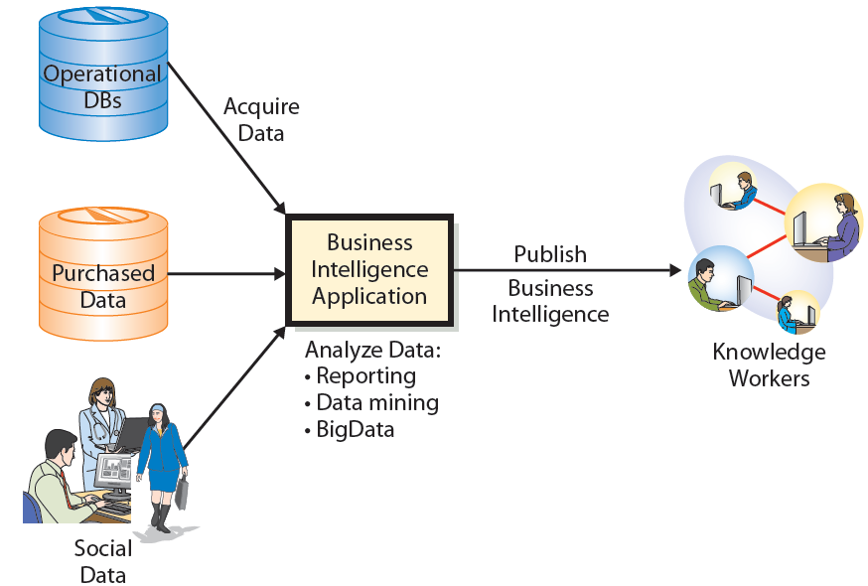
Q1: How Do Organizations Use Business Intelligence (BI) Systems?
Notes:
Business intelligence systems are information systems that process operational and other data to identify patterns, relationships, and trends for use by business professionals and other knowledge workers.
Five standard IS components of BI systems: hardware, software, data, procedures, and people.

Slide 5
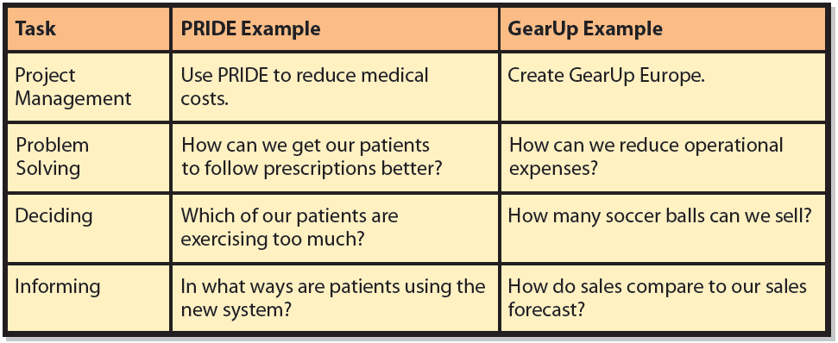
Example Uses of Business Intelligence
Notes:
Note the hierarchical nature of these tasks. Business intelligence is used for all four of the collaborative tasks described in Chapter 2.

Slide 6
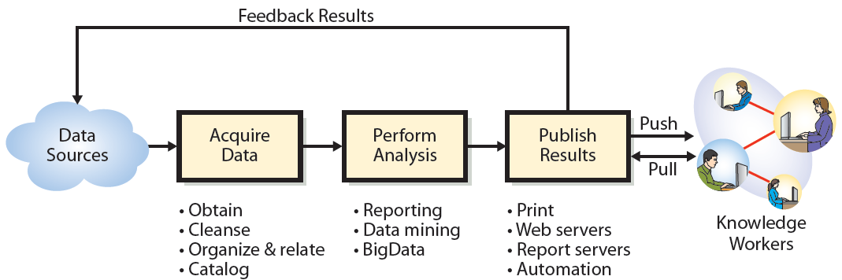
Q2: What Are the Three Primary Activities in the BI Process?
Notes:
Three primary activities in the BI process.
> Publish results: The process of delivering business intelligence to the knowledge workers who need it.
Push publishing delivers BI according to a schedule, or as a result of an event or particular data condition without any request from users.
Pull publishing requires users to request BI results.

Slide 7
Using BI for Problem-solving at GearUp: Process and Potential Problems
Obtain commitment from vendor
Run sales event
Sells as many items as it can
Order amount actually sold
Receive partial order and damaged items
If received less than ordered, ship partial order to customers
Some customers cancel orders

Slide 8
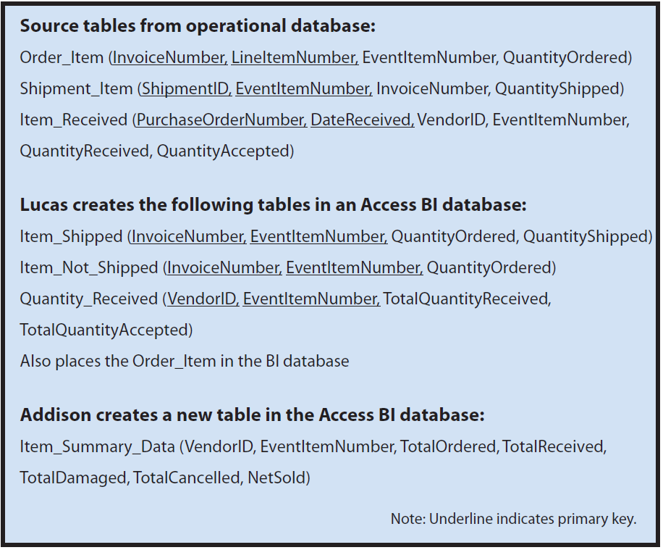
Tables Used for BI Analysis at GearUp
Notes:
Top section shows three of tables in GearUp’s operational database used to produce the data extract.
Lucas uses these data to create Item_Shipped, Item_Not_ Shipped, and Quantity_Received tables.
Addison summed quantities from tables to create Item_Summary_Data table.

Slide 9
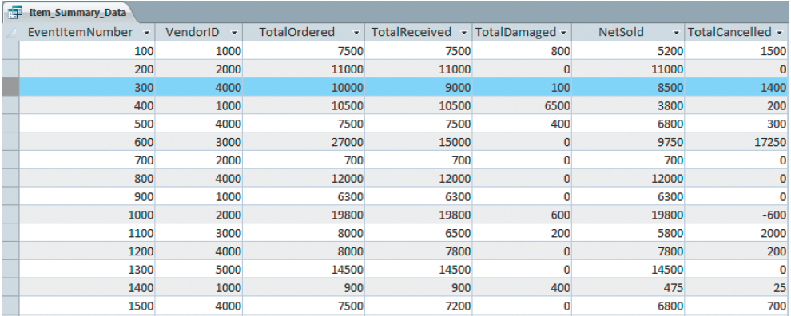
Extract of the Item_Summary Table
Notes:
To discriminate between orders lost to damage and those lost to cancellations, GearUp computes TotalCancelled, but it must do so indirectly.

Slide 10
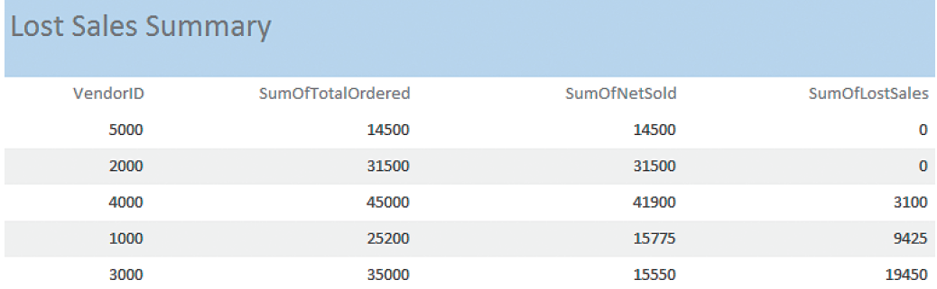
Lost Sales Summary Report
Notes:
To determine the extent of sales lost due to short shipments or damage, Addison created an Access report (Figure 9-6) to sum data from the Item_Summary_Data table
The extract of ITEM_SUMMARY Table is shown in Lost_Sales_Summary. From this report, vendors 5000 and 2000 have never had a shortage or quality problem. Vendor 4000 has a modest problem, vendors 1000 and 3000 have caused numerous lost sales, either due to shortages or damaged goods. 55.5% of sales of vendor 3000’s items have been lost (19,450/35,000).

Slide 11
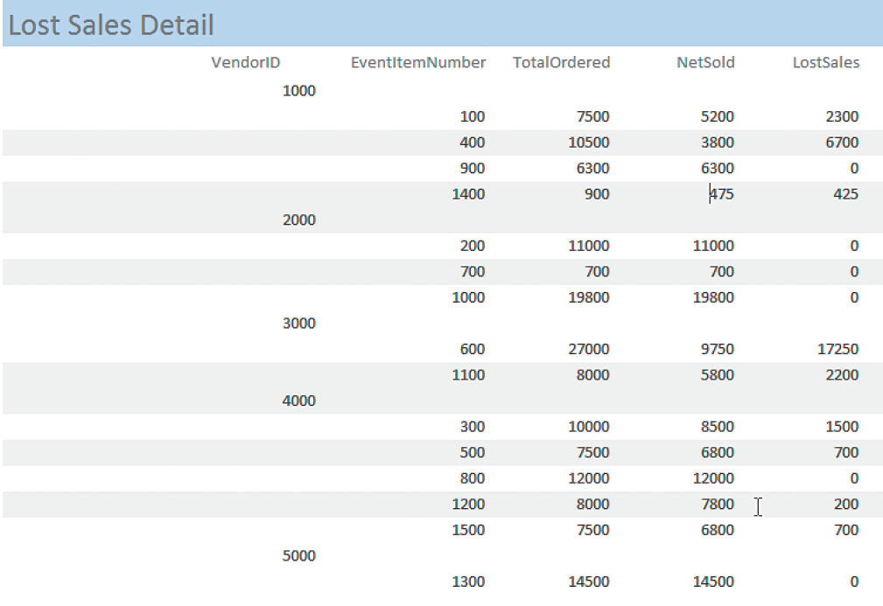
Lost Sales Details Report
Notes:
This report shows items by EventItemNumber and not by item name, event date, and event date. A sample of an Excel spreadsheet with event data, including vendor and item names, is shown on next slide.

Slide 12
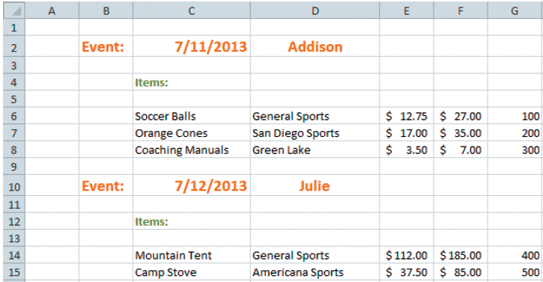
Event Data Spreadsheet
Notes:
If Drew’s spreadsheet were in tabular format, it would be easy to import this data from Excel to Access. However, it is not. Someone must either put it into tabular format or extract the data from the spreadsheet and enter it manually.

Slide 13
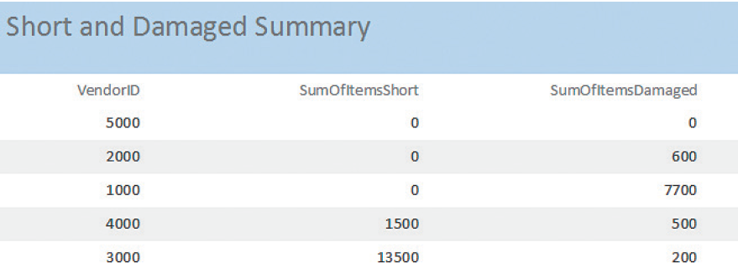
Short and Damaged Shipments Summary
Notes:
All vendor 1000 problems are caused by damage, vendor 1000 always shipped the appropriate number.

Slide 14
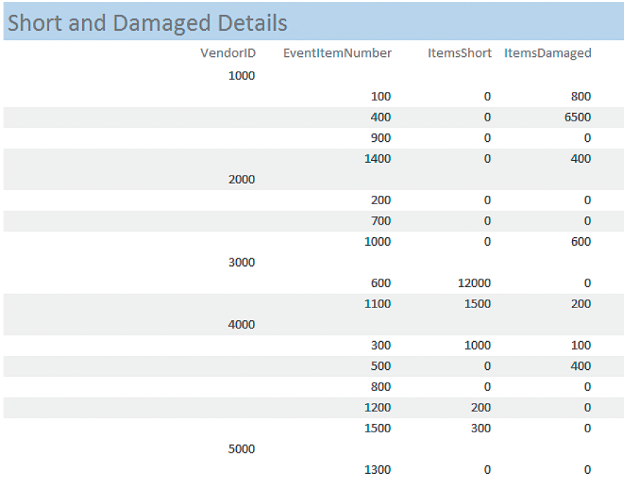
Short and Damaged Shipments Details Report
Notes:
This report shows vendor 1000 has persistent damage problems and vendor 3000's shipments are short.

Slide 15
Publish Results
Options
Print and distribute via email or collaboration tool
Publish on Web server or SharePoint
Publish on a BI server
Automate results via Web service
Notes:
These options are discussed in more detail in Q5. For now, just realize that GearUp would choose among these alternatives according to its needs. Most likely, they will print the results and email them or share them via a collaboration tool.

Slide 16
Q3: How Do Organizations Use Data Warehouses and Data Marts to Acquire Data?
Why extract operational data for BI processing?
Security and control
Operational not structured for BI analysis
BI analysis degrades operational server performance
Notes:
IS professionals do not want business analysts processing operational data because if they make an error, it could have severe consequences on operations.
Also, operational data is structured for fast and reliable transaction processing, and not for BI analysis.

Slide 17
Functions of a Data Warehouse
Obtain or extract data from operational, internal and external databases
Cleanse data
Organize, relate, store in a data warehouse database
DBMS interface between data warehouse database and BI applications
Maintain metadata catalog

Slide 18
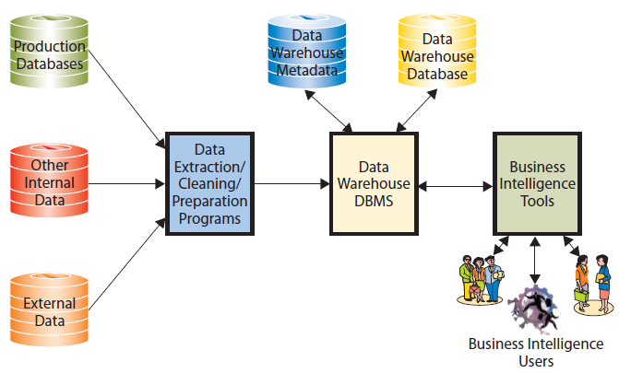
Components of a Data Warehouse

Slide 19
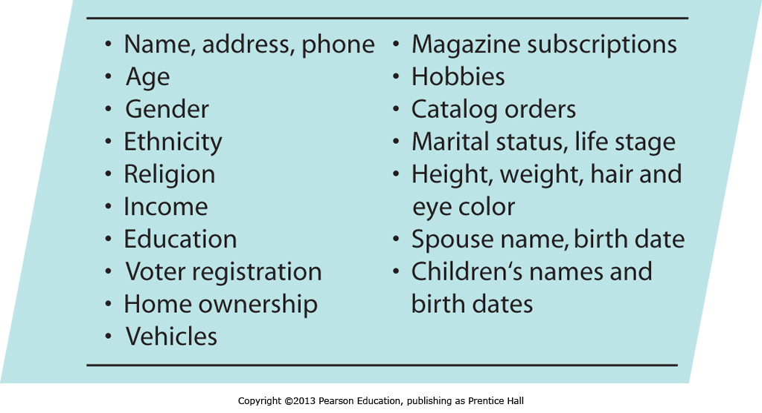
Examples of Consumer Data that Can Be Purchased

Slide 20
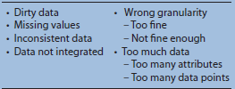
Possible Problems with Source Data
Notes:
Most operational and purchased data have problems that inhibit their usefulness for business intelligence.

Slide 21
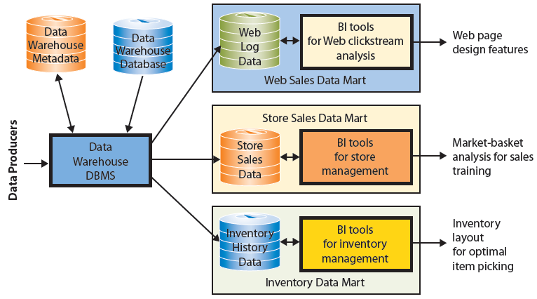
Data Marts Examples
Notes:
A data mart is a subset of a data warehouse. A date mart addresses a particular component or functional area of the business.

Slide 22
Q4: What Are Three Techniques for Processing BI Data?
Basic operations:
Sorting
Filtering
Grouping
Calculating
Formatting

Slide 23
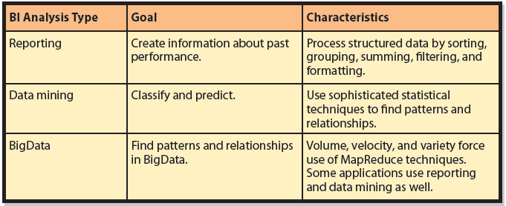
Three Types of BI Analysis
Notes:
Goals and characteristics of three fundamental types of BI analysis.

Slide 24
Unsupervised Data Mining
Analyst does not create a priori hypotheses or model
Hypotheses created after to explain patterns found
Example: Cluster analysis
Notes:
Cluster analysis: A statistical technique to identify groups of entities that have similar characteristics; commonly used to find groups of similar customers from customer order and demographic data

Slide 25
Supervised Data Mining
Develop a priori model to compute estimated parameters of model
Used for prediction, such as regression analysis
Ex: CellPhoneWeekendMinutes =
(12 + (17.5 X CustomerAge) +
(23.7 X NumberMonthsOfAccount)
=12 + 17.5*21 + 23.7*6 = 521.7
Notes:
With regression equation, analysts predict number of minutes of weekend cell phone use by summing 12, plus 17.5 times the customer’s age, plus 23.7 times the number of months of the account.
17.5 and 23.7 are the regression model coefficients.

Slide 26
BigData
Huge volume – petabyte and larger
Rapid velocity – generated rapidly
Great variety
Free-form text
Different formats of Web server and database log files
Streams of data about user responses to page content; graphics, audio, and video files
Notes:
Describe data collections characterized by huge volume, rapid velocity, and great variety. Considering volume, BigData refers to data sets at least a petabyte in size, and usually larger.

Slide 27
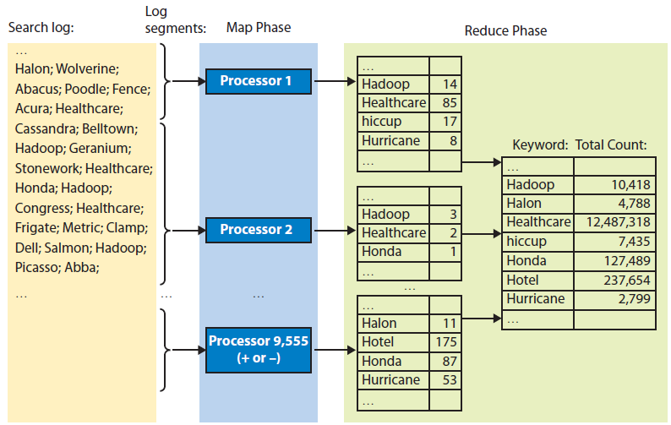
MapReduce Processing Summary
Google search logs broken into pieces
Notes:
Technique for harnessing power of thousands of computers working in parallel
Basic idea is BigData collection is broken into pieces, and hundreds or thousands of independent processors search these pieces for something of interest

Slide 28
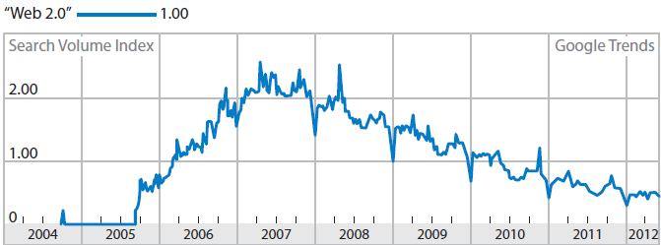
Google Trends on the Term Web 2.0
Notes:
This particular trend line supports the contention that the term "Web 2.0" is fading from use.

Slide 29
Hadoop
Open-source program supported by Apache Foundation2
Manages thousands of computers
Implements MapReduce
Written in Java
Amazon.com supports Hadoop as part of EC3 cloud offering
Pig – query language

Slide 30
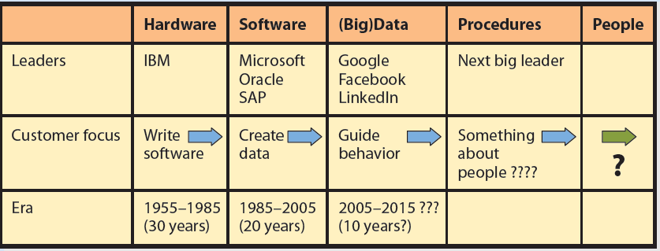
Experiencing MIS InClass Exercise 9: What Wonder Have We Wrought?
Notes:
Data aggregator is a company that obtains data from public and private sources and stores, combines, and publishes it in sophisticated ways.
See Instructor’s Manual for example answers to questions.

Slide 31
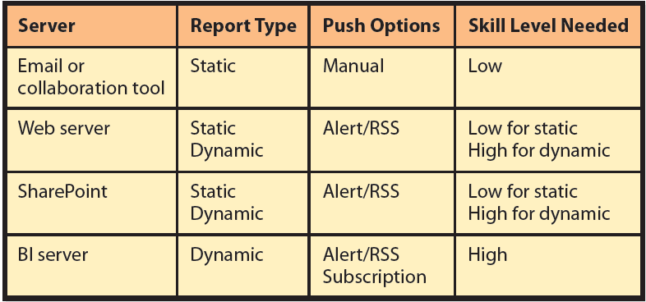
Q5: What Are the Alternatives for Publishing BI?
Notes:
This table lists four server alternatives for BI publishing.

Slide 32
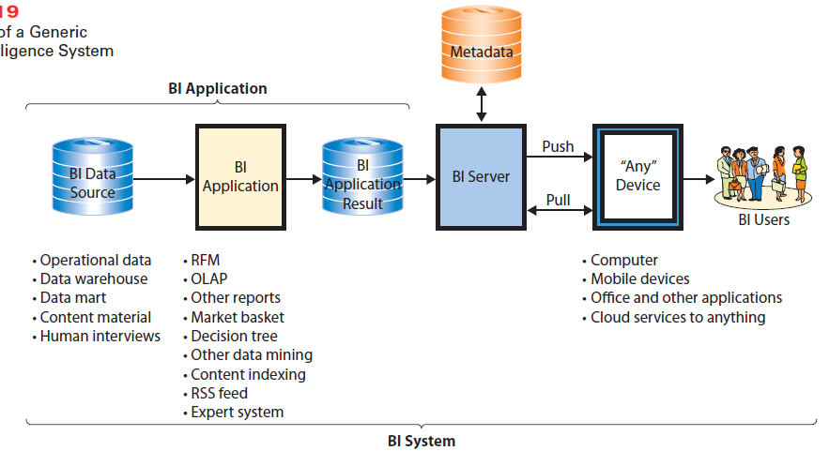
What Are the Two Functions of a BI Server?
Notes:
Components of a Generic Business Intelligence System
A BI server is a Web server application created for the publishing of business intelligence.
It maintains metadata about authorized allocation of BI results to users. Server tracks what results are available, what users are authorized to view those results, and provided results to authorized users. It adjusts allocations as available results change and users come and go.

Slide 33
How Does the Knowledge in This Chapter Help You?
Companies will know more about your purchasing habits and psyche.
Singularity – machines build their own information systems.
Will machines possess and create information for themselves?
Notes:
You have learned the three phases of BI analysis, as well as, common techniques for acquiring, processing, and publishing business intelligence. This knowledge will enable you to imagine innovative uses for data that your employer generates and to know some of the constraints of such use.

Slide 34
Ethics Guide: Data Mining in the Real World
Problems:
• Dirty data
• Missing values
• Lack of knowledge at start of project
• Over fitting
• Probabilistic
• Seasonality
• High risk—cannot know outcome
Notes:
GOAL
Teach real-world issues and limitations for data mining.
Investigate the ethics of working on projects of doubtful or harmful utility to the sponsoring organization.
Case has two major themes: realistic problems in data mining and an ethical dilemma—when you know something that could be self-defeating to reveal. Both are important.

Slide 35
Guide: Semantic Security
Unauthorized access to protected data and information
Physical security
Passwords and permissions
Delivery system must be secure
Unintended release of protected information through reports and documents
What, if anything, can be done to prevent what Megan did?
Notes:
GOALS
Discuss trade-off between information availability and security.
Introduce, explain, and discuss ways to respond to semantic security.
Megan is able to combine data in various reports to infer protected information about company employees.
She was not supposed to see this information, but only used reports she was authorized to see.

Slide 36
Active Review
Q1: How do organizations use business intelligence (BI) systems?
Q2: What are the three primary activities in the BI process?
Q3: How do organizations use data warehouses and data marts to acquire data?
Q4: What are three techniques for processing BI Data?
Q5: What are the alternatives for publishing BI?

Slide 37
Case Study 9: Hadoop the Cookie Cutter
Third-party cookie created by a site other than one you visited
Generated in several ways, most common occurs when a Web page includes content from multiple sources
DoubleClick
IP address where content was delivered
Records data in cookie log

Slide 38
Case Study 9: Hadoop the Cookie Cutter (cont'd)
Third-party cookie owner has history of what was shown, what ads clicked, and intervals between interactions
Cookie log contains data to show how you respond to ads and your pattern of visiting various Web sites where ads placed

Slide 39
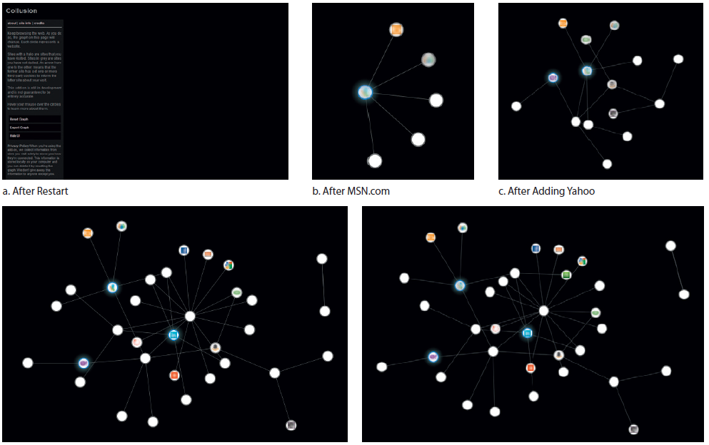
FireFox Collusion
Notes:
FireFox has an optional feature called Collusion that tracks and graphs all the cookies on your computer. Figure 9 shows the cookies that were placed on a computer as browser visited various Web sites. Collusion 0.22 is a Mozilla experimental add on.

Slide 40
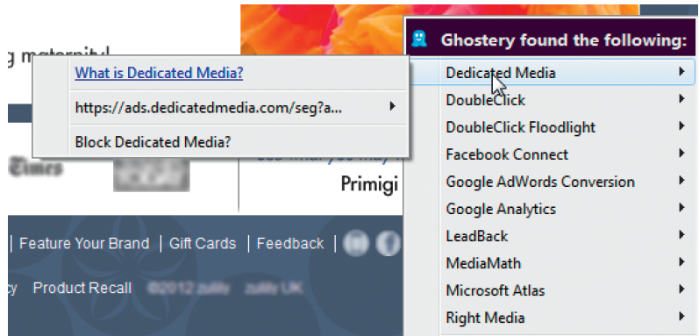
Ghostery in Use (ghostery.com)
Notes:
Who are these companies that are gathering my browser behavior data? You can find out using ghostery, another useful browser add-in feature (www.ghostery.com).
How do they analyze those entries to determine which ads you clicked on? How do they then characterize differences in ads to determine which characteristics matter most to you? The answer, as you learned in Q4, is to use parallel processing. Using a MapReduce algorithm, they distribute the work to thousands of processors that work in parallel. They then aggregate the results of these independent processors and then, possibly, move to a second phase of analysis where they do it again.

Slide 41


