Slide 1
Chapter 8
Social Media
Information Systems
Notes:
Chapter focuses on principles, conceptual frameworks, and models that will last over changes in social media services and technology and be useful when students address the opportunities and risks of social media systems in their professional career.

Slide 2
“Nobody Is Going to See Pictures of You in Your PJs on Your Treadmill”
PRIDE – patients exercise at home and still have a group experience
Members’ performance displayed on cell phone
Will technology support application?
Will elderly patients use it?
Will it increase motivation?
Notes:
GOALS
Illustrate the use of reporting on mobile devices.
Show students an innovative application for mobile + cloud.
Consider a unique application of social networking for health care.
Provide students an opportunity to consider similar, but different applications for social applications using mobile + cloud.

Slide 3
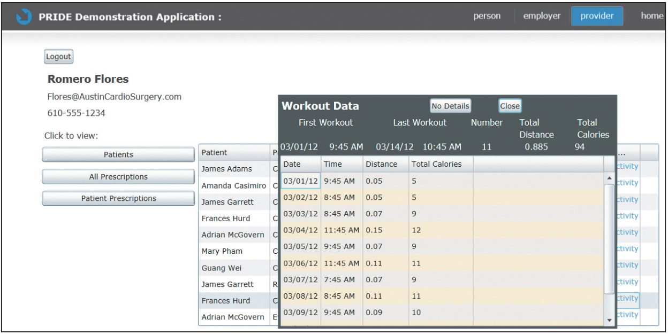
PRIDE Application Prototype

Slide 4
Study Questions
Q1: What is a social media information system (SMIS)?
Q2: How does SMIS advance organizational strategy?
Q3: How does SMIS increase social capital?
Q4: How can organizations manage the risks of social media?
Q5: Where is social media taking us?

Slide 5
Q1: What Is a Social Media Information System (SMIS)?
Social media (SM)
    Use of IT to support sharing content among networks of users
    Enables communities, tribes, or hives
    People related by a common interest
Social media information system (SMIS)
    Supports sharing of content among networks of users

Slide 6
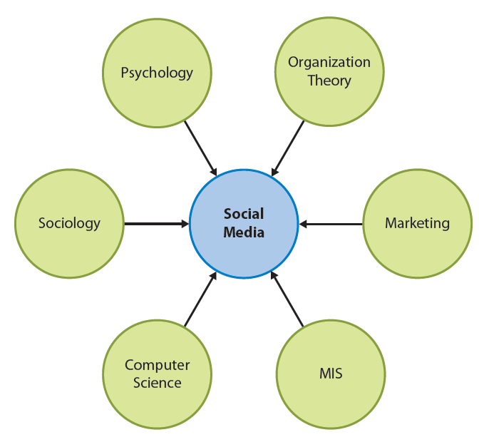
SMIS: Convergence of Disciplines
Notes:
Social media is the merger of many disciplines.

Slide 7
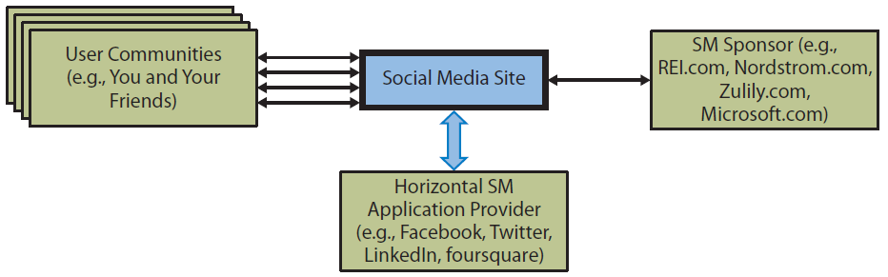
SMIS Organizational Roles
Notes:
Three fundamental SMIS organizational roles.
User communities — SM communities are formed based on mutual interests and transcend familial, geographic, and organizational boundaries.
SM sponsor
SM application provider

Slide 8
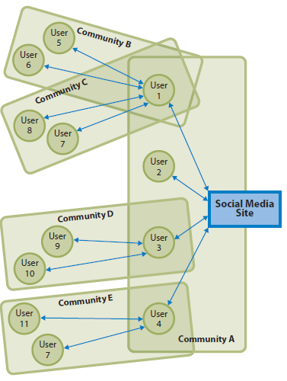
Community/Social Media Site Relationship
Notes:
Community A is a first-tier community consisting of users that have a direct relationship to that site. User 1 belongs to three communities — A, B, and C.
Communities B–E are second-tier communities because their relationship to those communities is intermediated by a first-tier user.
The number of second and higher tier community members grows exponentially.
Exponential nature of these relationships offers sponsoring organizations both a blessing and a curse.
If the social media site is interested in pure publicity, it will want to viral hook to relate to as many communities as it can.

Slide 9
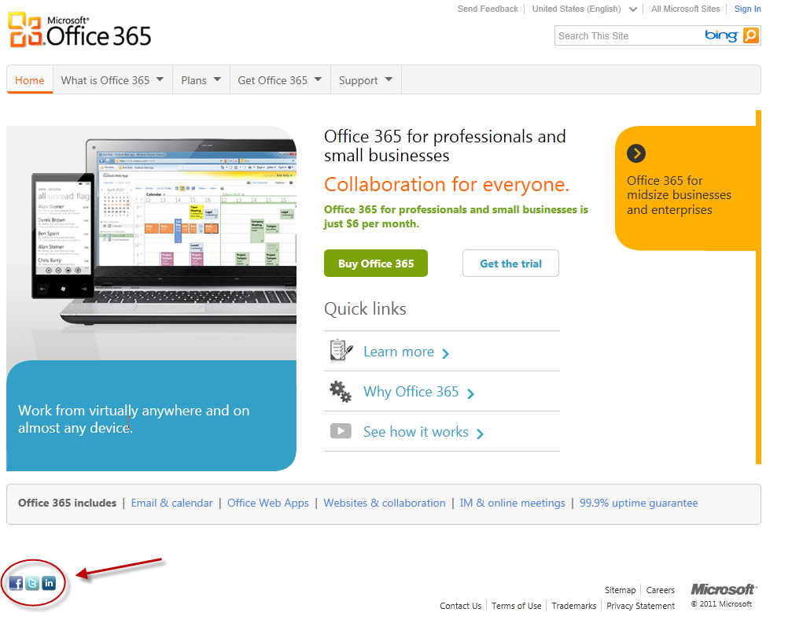
Social Media Sponsors
Not Casual Commitment
Notes:
Social media sponsors are companies and other organizations that choose to support a presence on one or more social media sites.
When Microsoft places those icons on its promotional pages, it is making a commitment to invest considerable employee time and other costs to support social media.

Slide 10
Social Media Application Providers
Facebook, Twitter, LinkedIn, and Google create features and functions of the site
Free to users
Sponsors may or may not pay a fee
Most earn revenue through some type of advertising model
Notes:
Social media application providers are companies that operate the social media site.
Users typically use social media applications without a license fee or other charge.
Sponsors might pay a fee, depending on the application and what they do with it. On Facebook, creating a company page is free, but Facebook charges a fee to advertise to communities that “Like” that page.
Most SM applications earn revenue through some type of advertising model.

Slide 11
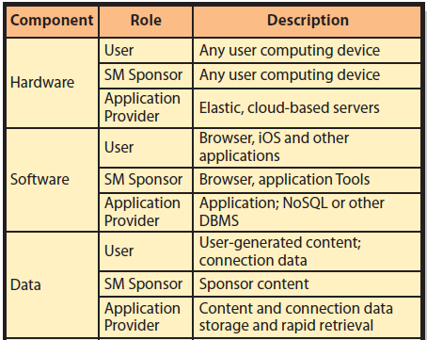
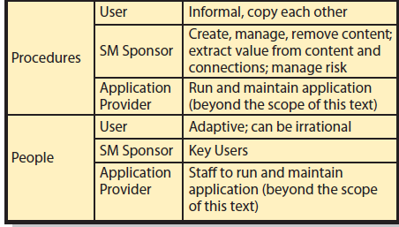
Components of SMIS
Notes:
Typically, SM application providers host the SM presence using elastic servers in the cloud.
SM application providers develop and operate custom, proprietary, social networking application software.
Content data are data and responses to data contributed by users and SM sponsors.
Connection data is data about relationships.
Organizations must develop procedures for creating content, managing user responses, removing obsolete or objectionable content, and extracting value from content.
Social media is creating new job titles, new responsibilities, and need for new types of training.

Slide 12
Q2: How Do SMIS Advance Organizational Strategy?
Defenders of Belief
    Share a common belief
    Seek conformity
    Want to convince others
    Facilitate activities like sales and marketing
    Form strong bonds and allegiance to an organization
Notes:
Two kinds of communities important to commerce

Slide 13
Q2: How Do SMIS Advance Organizational Strategy? (cont’d)
Seekers of the Truth
    Share common desire to learn something, solve a problem, make something happen
    Seldom form a strong bond

Slide 14
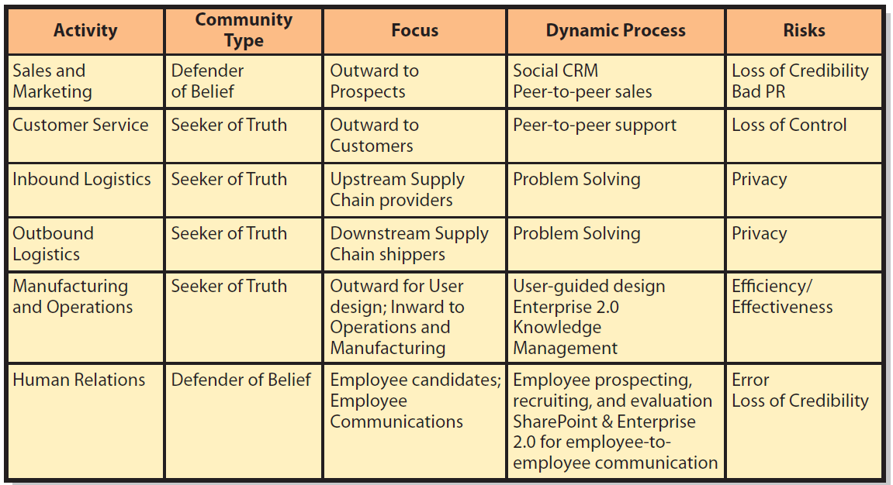
SM in the Value Chain Activities
Notes:
This table summarizes how social media contributes to the five primary value chain activities and to human resources support activity.
Social CRM is a dynamic, social-media based customer relationship management process. Relationships between organizations and customers emerge in a dynamic process as both parties create and process content. Employees create wikis, blogs, discussion lists, frequently asked questions, sites for user review and commentary, and other dynamic content. Customers search this content, contribute reviews and commentary, ask more questions, create user groups and so forth.

Slide 15
Social Media and the Sales and
Marketing Activity
Relationships between organizations and customers emerge in a dynamic process
Each customer crafts relationship
Blogs, discussion lists, FAQ, user reviews and commentary, other dynamic content
Customers likely to generate most business get most attention
Notes:
Traditional CRM is centered on customer lifetime value. SM CRM, customers most likely to generate most business get most attention.

Slide 16
Social Media and Customer Service
Product users help each other solve problems
Selling to or through developer networks most successful
Risk loss of control
Notes:
Risk of peer-to-peer support is loss of control.

Slide 17
Social Media and Manufacturing and Operations
Crowdsourcing
Enterprise 2.0
Folksonomy
SLATES
Notes:
Crowdsourcing: Dynamic process of employing users to participate in product design or product redesign.
Enterprise 2.0: Application of social media to facilitate cooperative work of people inside organizations. Enterprise 2.0 can be used in operations and manufacturing to enable users to share knowledge and problem-solving techniques.
Enterprise 2.0 uses tags organized into unplanned structure, called a folksonomy, that emerges from processing of many user tags.
Enterprise 2.0 is defined by six characteristics.

Slide 18
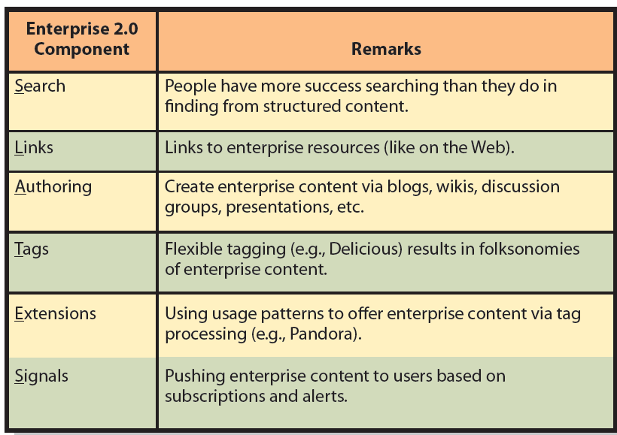
McAffee's SLATES Enterprise 2.0 Model
Notes:
Enterprise 2.0 is the application of social media to facilitate the cooperative work of people inside organizations. Enterprise 2.0 can be used to enable people to share knowledge and problem-solving techniques.

Slide 19
Social Media and Human Resources
Employee communications, using internal, personnel sites
Ex: MySite and MyProfile in SharePoint
Risks:
Forming erroneous conclusions about employees
Site becomes defender of belief or promulgating unpopular management message

Slide 20
Q3: How Does SMIS Increase Social Capital?
Types of business capital
Physical capital – factories, machines, manufacturing equipment
Human capital – human knowledge and skills
Social capital – social relations
Notes:
Physical capital: resources used in producing goods and services
Human capital: investment in human knowledge and skills for future profit
Social capital: investment in social relations with the expectation of returns in the marketplace

Slide 21
What Is the Value of Social Capital?
Information
Influence
Social credentials
Personal reinforcement
Value of social capital
Number of relationships, strength of relationships, and resources controlled
Notes:
Relationships in social networks can:
Provide information about opportunities, alternatives, problems, and other factors important to business professionals.
Provide an opportunity to influence decision makers who are critical to your success.
Be a form of social credentials.
Reinforce a professional’s image and position in an organization or industry.

Slide 22
How Do Social Networks Add Value to Businesses?
Progressive organizations:
    Maintain a presence on Facebook, LinkedIn, Twitter, and other SN sites.
    Encourage customers and interested parties to leave comments.

Slide 23
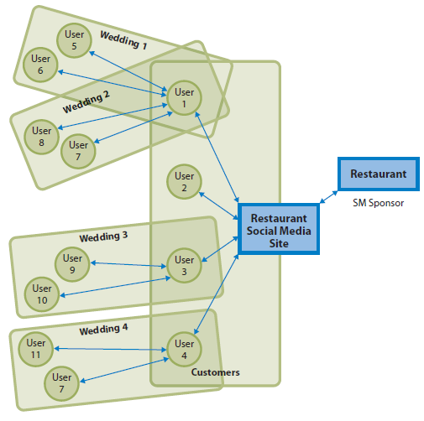
Using Social Networking to Increase the Number of Relationships
Notes:
Users 1–4 have a direct relationship with restaurant customers who have a direct relationship with restaurant’s SM site.
This diagram indicates that receptions can potentially contribute more than just revenue.
If restaurant can induce reception attendees to form a direct relationship with it, wedding receptions will contribute substantially to number of relationships in its social network and, depending on the strength and value of those connections, possibly contribute substantially to restaurant’s social capital.

Slide 24
Using Social Networks to Increase the Strength of Relationships
Three ways to increase social capital
Ask them to do you a favor
Frequent interactions strengthen relationships
Connect to those with more assets
Social Capital = NumberRelationships x RelationshipStrength x EntityResources
Notes:
Strength of a relationship – likelihood a person or organization in the relationship will do something that will create valuable benefits.

Slide 25
InClass Exercise 8: Computing Your Social Capital
Social capital is not an abstract concept.
It applies to you.
You and your classmates are accumulating social capital now.
What is the value of that capital?
Notes:
Form groups to answer exercise questions .

Slide 26
Q4: How Can Organizations Manage the Risks of Social Media?
Managing Risk of Employee Communication
  Three Pillars of Social Organizations
  Disclose
  Protect
  Use Common Sense

Slide 27
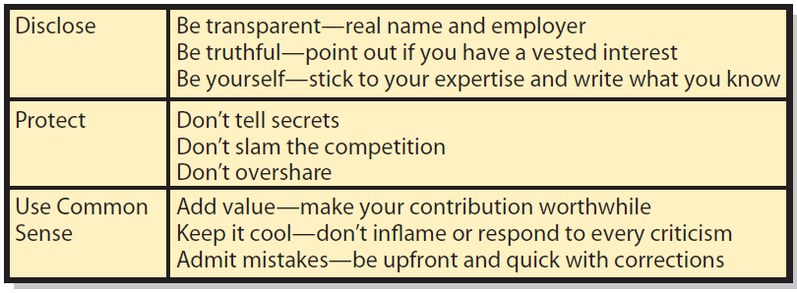
Intel’s Rules of Social Media Engagement
Notes:
This list contains great advice and considerable wisdom. Visit the full description at: http://www.intel.com/content/www/us/en/legal/intel-social-media-guidelines.html
There are two noteworthy elements. First, the call for transparency and truth. Second, social media contributors and their employers should be open and above board. If you make a mistake, don’t obfuscate. Instead, correct it, apologize and make amends.

Slide 28
Managing the Risk of User-Generated Content
Sources of Problems
Junk and crackpot contributions
Inappropriate content
Unfavorable reviews
Mutinous movements

Slide 29
Responding to Social Networking Problems
Leave it
Respond to it
Delete it
      Determine how to deal with problematic content before engaging in social media.
Notes:
If it is a reasonable criticism of the organization’s products or services, leave it.
Responding to problematic content is dangerous. If the response could be construed as patronizing or insulting, it could enrage the community and generate a strong backlash. “Never wrestle with a pig; you’ll get dirty and the pig will enjoy it.” Instead, allow the community to constrain the user.
Deleting should be reserved for inappropriate, irrelevant and obscene content.

Slide 30
Q5: Where Is Social Media Taking Us?
Vendors lose control of the customer relationships
Employees craft own relationships with employers
Employers provide endoskeleton to support work of people on exterior

Slide 31
How Does the Knowledge In This
Chapter Help You?
Components SNIS and commitment organization makes
How organizations use SNIS to achieve strategies across primary value chain activities
How SNIS increase social capital
How organizations need to manage SN risk
SM challenge to you in future

Slide 32
Ethics Guide: Hiding the Truth?
How is social networking different in business than in private life?
Do the ethics vary between private and business use of social networking?
Notes:
Goals
Distinguish between using social networking for fun and for business.
Explore ethical questions about deception on business social networking sites.
Formulate ethical principles when creating or using social networks for business.
Wrap Up
It’s great that your knowledge and skills of social networking transfer to the business world.
However, think twice before you transfer your private site social networking ethics and behavior to a business social networking site. Your actions can impact your career, not just your social life!

Slide 33
Guide: Social Recruiting
Employees sharing personal information on SN
Technology blurs line between work life and home life
Work is portable and always on
Be careful about what you say
Work networks are not social networks
Notes:
Goals
Encourage students to think seriously about the work they need to do to obtain the job they want.
Help students to understand the consequences of their social media sites on potential job opportunities.
Encourage students to use capabilities like Google+ circles to isolate and protect their private data and the data they reveal to their friends.
Consider some of the ethical consequences of using social media data in hiring decisions.

Slide 34
Guide: Social Recruiting (cont’d )
Use communities to locate prospects
Get a sense of candidate to find any potential behavior or attitude problems
Exposing protected data illegal to use for hiring decisions
Treat every candidate the same
Join LinkedIn, use Google + circles
Keep your personal social data out of any circle that can be publicly accessed
Social media is a double-edged sword

Slide 35
Active Review
Q1: What is a social media information system (SMIS)?
Q2: How does SMIS advance organizational strategy?
Q3: How does SMIS increase social capital?
Q4: How can organizations manage the risks of social media?
Q5: Where is social media taking us?

Slide 36
Case Study 8: Sedona Social
Suppose Sedona Chamber of Commerce hired you as manager of community social media
Want you to provide advice and assistance to local businesses in development of social media sites and manage CoC’s social media presence
Notes:
GOAL:
Get student to think of ways to use social media.

Slide 37
