Slide 1
Chapter 7
Organizations and Information Systems
Notes:
This chapter explores structured processes and information systems within an organization. It extends discussion of business process (Chapter 3) to investigate three types of processes and scope of information systems they use.

Slide 2
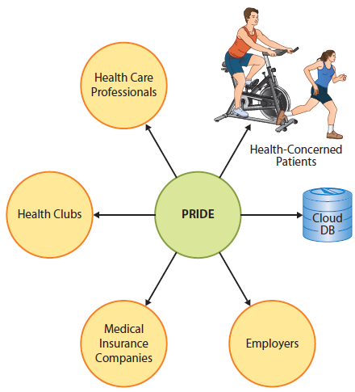
“Every Morning, I Get A Report About the Exercise Your Mother's Getting So I Can See How She's Doing.”
Notes:
A cardiac surgeon, Dr. Romero Flores, is driving to develop a prototype of the health care and patient portion of the PRIDE system. He is focused on a prototype to learn whether patients will achieve expected benefits. Once they have answered those questions, they will determine how to proceed to an operational system that involves other organizations.

Slide 3
Study Questions
Q1: How do information systems vary by scope?
Q2: How do enterprise IS solve the problems of departmental silos?
Q3: What are the differences among CRM, ERP, and EAI systems?
Q4: How do inter-enterprise IS solve the problems of enterprise silos?
Notes:
This chapter explores:
Concept of process quality and explains how information systems can be used to increase process quality.
Problem of information silos and why silos can be problematic.
How three types of enterprise systems can eliminate silo problems.
Role enterprise resource planning (ERP) systems play in organizations today, purpose and components of an ERP, and major ERP vendors.
Major ERP challenges by showing how service-oriented architecture can benefit enterprise systems.

Slide 4
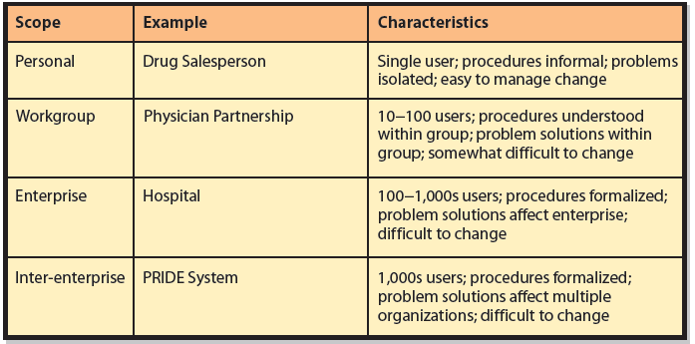
Q1: How Do Information Systems Vary by Scope?
Notes:
Modern organizations use four types of information systems that vary according to the scope of the organizational unit.

Slide 5
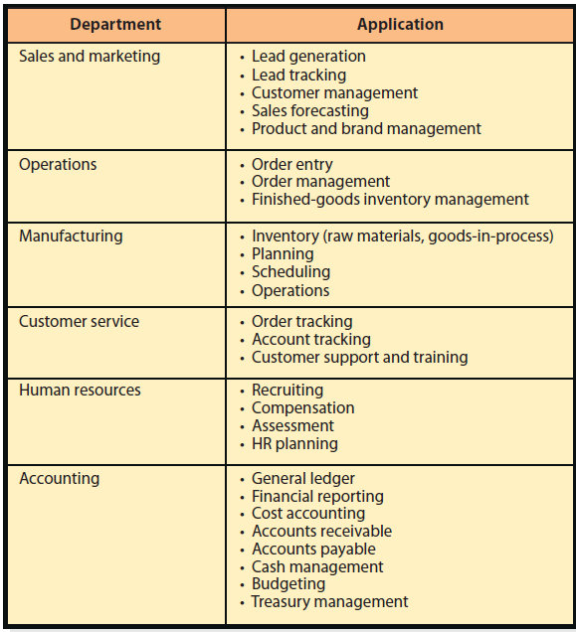
Q2: How Do Enterprise IS Solve the Problems Of Departmental Silos?
Notes:
An information silo is the condition that exists when data are isolated in separated information systems. Silos come into existence as entities at one organizational level create information systems that meet their particular needs only.
Each application processes customer, sales, product, and other data, but each uses that data for different purposes and store somewhat different data.

Slide 6
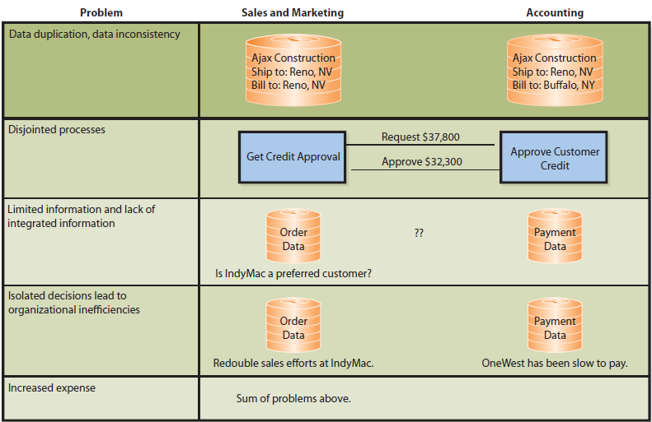
What Are the Problems of Information Silos?

Slide 7
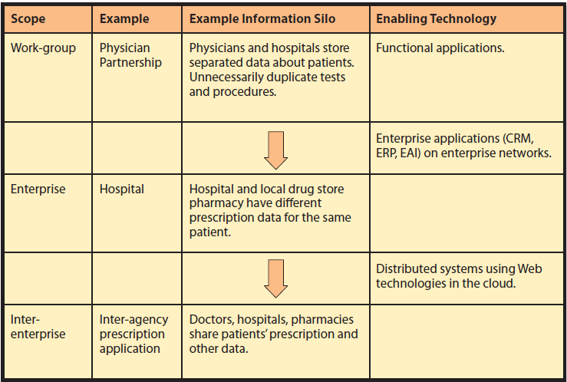
How Do Organizations Solve the Problems of Information Silos?

Slide 8
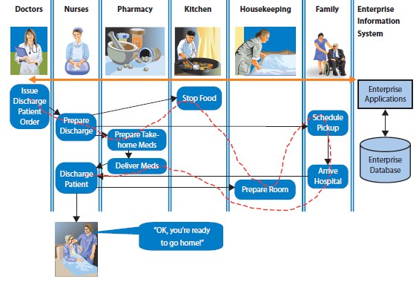
An Enterprise System for Patient Discharge
Some Departments Involved in Patient Discharge

Slide 9
Business Process Reengineering
Altering and designing business processes to take advantage of new information systems
Difficult, slow, and exceedingly expensive
Systems analysts interview key personnel throughout organization
Requires high-level, expensive skills and considerable time
Notes:
Many early projects stalled when the enormity of the project became apparent. Some organizations partially implemented systems that had disastrous consequences. Personnel didn't know if they were using the new system, the old system, or some hacked-up version of both.

Slide 10
Q3: How Do CRM, ERP, and EAI Support Enterprise Systems?
Help organizations rethink how they do work
Inherent processes save money and time in business process reengineering (“industry best practices”)
Eliminate costs of developing complex applications in-house
Notes:
Inherent processes are predesigned procedures for using the software products; they save organizations from expensive and time-consuming business process reengineering. Organizations license software and obtain prebuilt procedures based upon “industry best practices.”

Slide 11
Customer Relationship Management (CRM)
Suite of applications, a database, and a set of inherent processes
Manage all interactions with customer through four phases of customer life cycle:
Marketing, customer acquisition, relationship management, loss/churn
Intended to support customer-centric organization
Notes:
CRM is a suite of applications, a database, and set of inherent processes for managing all interactions with customer from lead generation to customer service. Every contact and transaction with customer is recorded in CRM database.

Slide 12
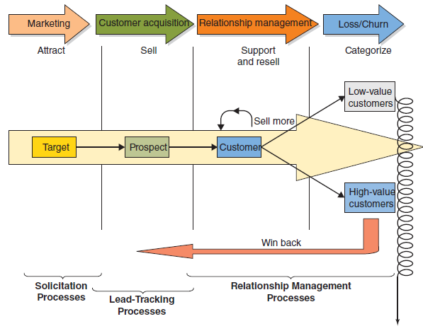
Customer Life Cycle
Notes:
Marketing sends messages to target market to attract customer prospects. When prospects order, they become customers who need to be supported. Additionally, relationship management processes increase value of existing customers by selling them more products. Over time, organization loses some customers. When this occurs, win-back processes categorize customers according to their value and attempt to win back and turn them into high-value customers.

Slide 13
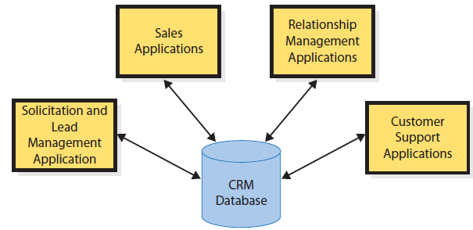
CRM Applications
Notes:
CRM components exist for each stage of the customer life cycle. All applications process a common customer database. This design eliminates duplicated customer data and removes possibility of inconsistent data. Also means each department knows what has been happening with customer at other departments.

Slide 14
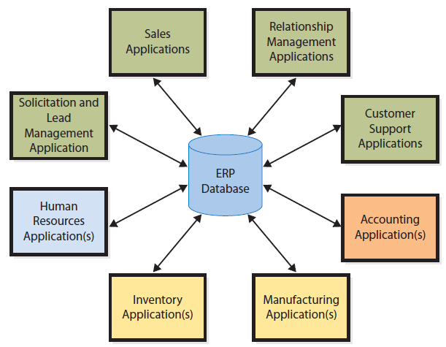
ERP Applications
Notes:
An ERP is a suite of applications (modules), a database and a set of inherent processes for consolidating business operations into a single, consistent, computing platform. ERP systems are IS based on ERP technology.

Slide 15
Enterprise Application Integration (EAI)
Connects system “islands”
Enables communicating and sharing data
Provides integrated information
Provides integrated layer-over while leaving functional applications “as is”
Enables a gradual move to ERP
Notes:
ERP might not be appropriate for some companies. For them, enterprise application integration (EAI) can help solve silo problems. EAI is a suite of software applications that integrates existing systems by providing layers of software that connect applications.

Slide 16
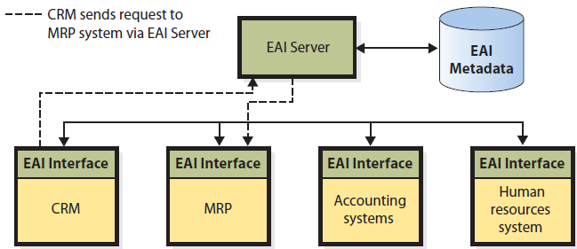
Enterprise Application Integration (EAI) Architecture
“Virtual Integrated Database”
Notes:
ERP might not be appropriate for some companies. For them, enterprise application integration (EAI) can help solve silo problems. EAI is a suite of software applications that integrates existing systems by providing layers of software that connect applications.
Although there is no centralized database, EAI software keeps files of metadata that describe where data are located. Users can access the EAI system to find needed data. In some cases, EAI system provides services to create a “virtual integrated database”. EAI enables organizations to use existing silo applications while eliminating many of the serious problems of isolated systems.

Slide 17
What Are the Challenges When Implementing New Enterprise Systems?
Four Primary Factors
Collaborative management
Requirements gaps
Transition problems
Employee resistance
Notes:
With no single department manager in charge, implementation is a collaborative effort with committees and steering groups.
Organization must identify gaps and decide what to do with them.
Must change from using isolated departmental systems to using new enterprise system, while continuing to run the business.
Managing resistance to change occurs because change requires effort and it engenders fear. Considerable research and literature exists about reasons for change resistance and how organizations can deal with it.
Senior-level management needs to communicate the need for change throughout the entire transition process.
Employees fear change because it threatens self-efficacy.
Employees may need to be given extra inducement to change to the new system.

Slide 18
Experiencing MIS In-Class Exercise 7: Choosing a CRM Product
1. Act! and GoldMine
Learn about Act (www.act.com) and Goldmine (www.frontrange.com/goldmine.aspx).
Google or Bing the phrase “Act vs. Goldmine.” Read several comparisons.
Summarize your findings in a 2-minute presentation. Include intended market, costs, and relative strengths and weaknesses.
Notes:
This exercise is designed to give students a sense of the challenges involved when choosing a CRM product. Form teams, have teams use the Web to address the exercise.

Slide 19
Experiencing MIS In-Class Exercise 7: Choosing a CRM Product (cont’d)
2. Salesforce.com and Sugar
Learn about these products, visit www.salesforce.com and www.sugarcrm.com.
Google or Bing the phrase “Salesforce vs. Sugar CRM.” Read several comparisons.
Summarize your findings in a 2-minute presentation. Include intended market for these products, costs, and relative strengths and weaknesses.
Notes:
Salesforce.com and Sugar are CRM products that are intended for use by larger organizations than Act! and GoldMine.

Slide 20
Experiencing MIS In-Class Exercise 7: Choosing a CRM Product (cont’d)
3. Microsoft Dynamics CRM and Oracle
Visit http://crm.dynamics.com/en-us/Default.aspx and www.oracle.com/us/solutions/crm/index.htm.
Google or Bing “Microsoft CRM vs. Oracle CRM.”
Summarize your findings in a 2-minute presentation. Include intended market for these products, costs, and relative strengths and weaknesses.

Slide 21
Experiencing MIS In-Class Exercise 7: Choosing a CRM Product (cont’d)
4. Recommend two of the CRM products you’ve explored for further research. For each of the following businesses:
An independent wedding planner who is working as a sole proprietor
An online vendor, such as www.sephora.com
A musical venue, such as www.santafeopera.org
A vendor of consulting services, such as www.crmsoftwaresolutions.ca
A vacation cruise ship line, such as www.hollandamerica.com
Present your findings to the rest of the class.

Slide 22
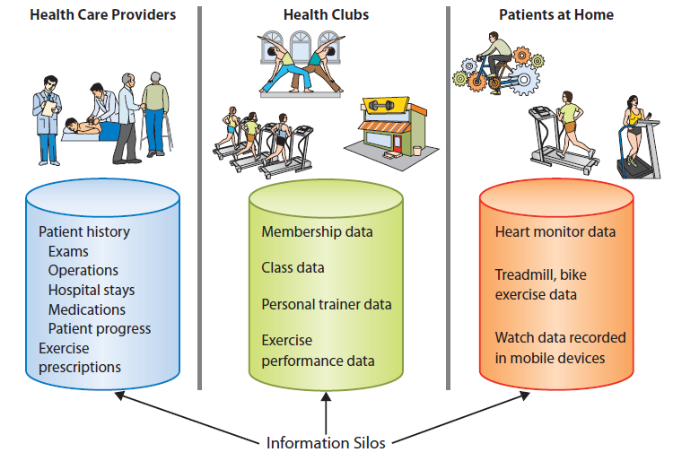
Q4: How Do Inter-enterprise IS Solve the Problems of Enterprise Silos?
Notes:
Isolation of data causes problems. Doctors would like to have reports on exercise data stored on patient devices and in health clubs. Patients would like to have prescription data from their providers as well as exercise data from their health clubs. Health clubs would like to have exercise prescriptions and home workout data to integrate with data they have.

Slide 23
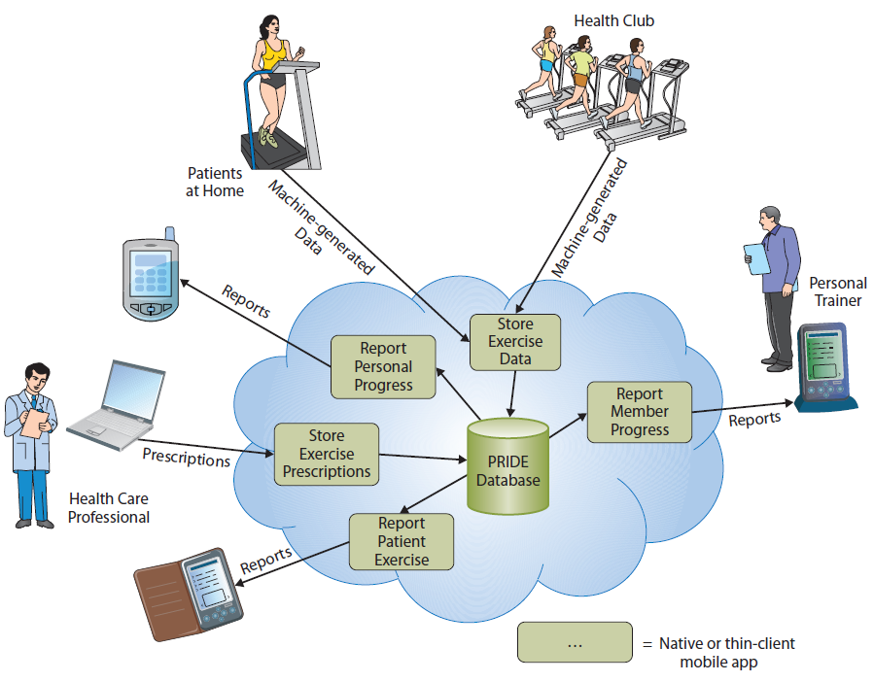
Inter-enterprise PRIDE System
Notes:
PRIDE is a distributed system because processing is distributed across multiple computing devices. Standards such as http, https, html5, CSS3, JavaScript, and others enable programs on varied and disparate devices to flexibly communicate with cloud servers and database, and, indirectly communicate with each other.

Slide 24
How Does the Knowledge in this Chapter Help You?
Helps you understand levels of information systems and problems at each level
Helps you put information systems you use into perspective and understand how they may create information silos
Helps you know potential problems of silos and how to resolve them

Slide 25
How Does the Knowledge in this Chapter Help You? (cont’d)
Helps you know what these systems are, what they do, and some issues you will run into when using and implementing them
Gives you background for investigating use of the cloud for other applications

Slide 26
Ethics Guide: Dialing for Dollars
Assume you are a salesperson
It’s been a bad quarter. Vice president of sales authorized a 20% discount on new orders.
Only stipulation—customers must take delivery prior to end of quarter so Accounting Dept. can book order for this quarter.
VP says “Start dialing for dollars, and get what you can. Be creative.”
You identify your top customers to offer discount deal.
Notes:
GOALS
Understand how business pressures motivate people to act unethically and sometimes illegally.
Discuss ethical principles among three different aggressive sales techniques.
Illustrate how deception in the use of an interdepartmental information system may cause unintended consequences.

Slide 27
Ethics Guide: Dialing for Dollars: Scenario 1
To one customer, “Take full delivery now and return your unsold inventory next quarter.”
Customer wants this stipulated on purchase order
But, accounting will not book full sales amount with stipulation
Salesperson agrees to email the stipulation
Accounting books full amount
Notes:
Three techniques used here are:
1. The side letter
2. The delayed discount
3. The fictitious account
All three of the stuffing techniques are unethical.

Slide 28
Ethics Guide: Dialing for Dollars: Scenario 1 (cont’d)
Significant amount of unsold product will be sent back next quarter for refund
Q: Is it ethical to write agreement to take back product in an email?
Q: What would you say if the boss finds out?

Slide 29
Ethics Guide: Dialing for Dollars: Scenario 2
With another customer, you don’t offer discount, but agree to post 80% of sale due this quarter with 20% credit posted next quarter
Accounting books full price now, then takes off 20% next quarter
Hurts next quarter sales revenue
Notes:
Impact on the balance sheet is to overstate revenue in this quarter.

Slide 30
Ethics Guide: Dialing for Dollars: Scenario 3
Sell product to fictitious company owned by relative
Accounting books full sale this quarter
All merchandise returned next quarter for full refund
Q: Is this ethical?
Q: Is this legal?
Notes:
Shipping to the fictitious company is both illegal and unethical.

Slide 31
Ethics Guide: Dialing for Dollars: Scenario 3 (cont’d)
Company’s MRP II system is scheduling production for next quarter based on this quarter’s sharply increased sales. It generates a schedule with substantial production increases and schedules workers for production runs.
Q: What impact do your sales activities have on next quarter’s inventories?
Notes:
Sales this quarter may cause MPS to increase production. Inventories are going to go up unless someone tells production to ignore the depletion of inventory.

Slide 32
Guide: The Flavor-of-the-Month Club
Management never listens
Employees want change from bottom-up
Change management programs are silly
Managers forget about programs
When program loses support, new one introduced
Employees grow more cynical with each failed program
Notes:
Goals
Understand sources of resistance to change management activities.
Encourage students to think about the reality of change management and how to deal with forces that oppose change.
Understand how change management relates to BPM.
The main character in this case believed that management never listened to him. He thought he was smarter than management, and thought most attempts at change management were silly, almost as if management went to a training program, learned certain words to recite, then, recited those words without any real care for the employees.
Scenario for class discussion: To illustrate how difficult change management can be, consider the following scenario: Suppose an organization changes its competitive strategy from a differentiating strategy to a cost-leader strategy.

Slide 33
Active Review
Q1: How do information systems vary by scope?
Q2: How do enterprise IS solve the problems of departmental silos?
Q3: What are the differences among CRM, ERP, and EAI systems?
Q4: How do inter-enterprise IS solve the problems of enterprise silos?

Slide 34
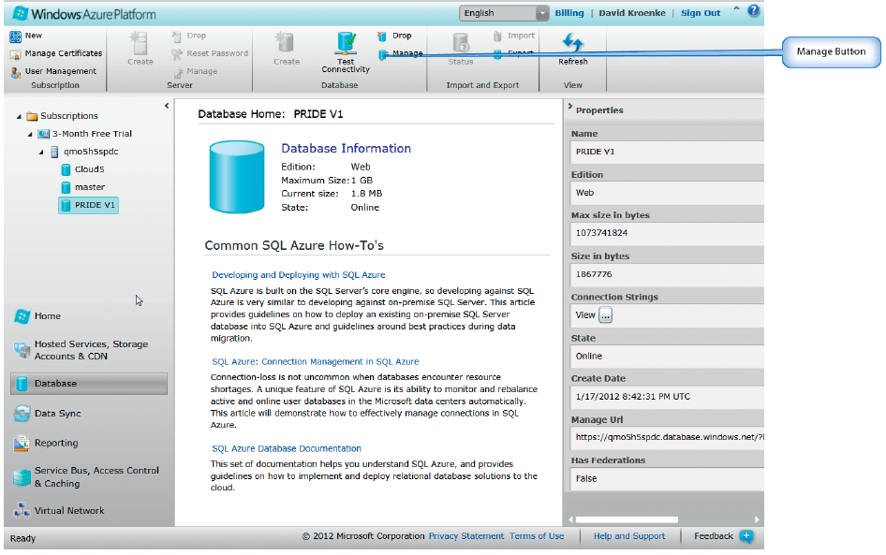
Case Study 7: The PRIDE Database
Notes:
Goal
Students to create a process diagram similar to Figure 7-27
See the questions at the end of the case for exercises to assign to students

Slide 35
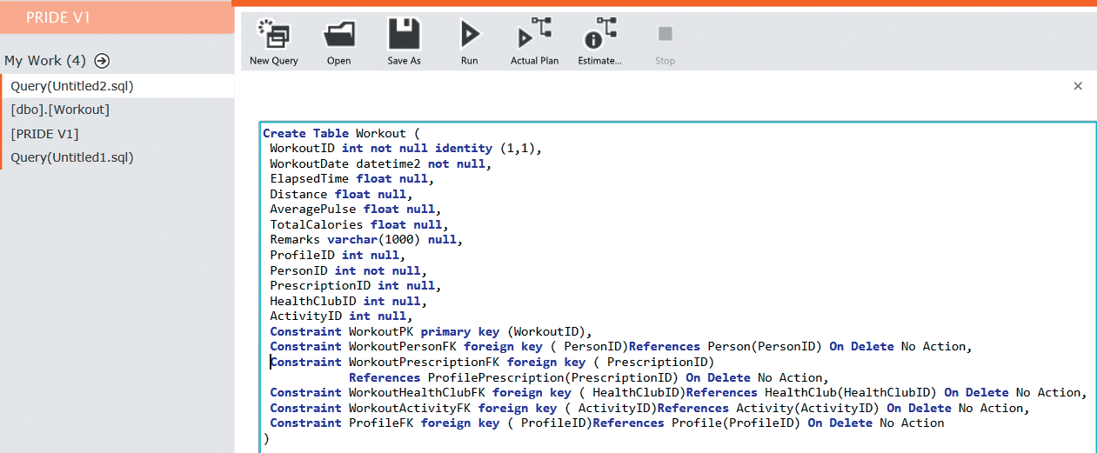
Defining the Workout Table with SQL

Slide 36
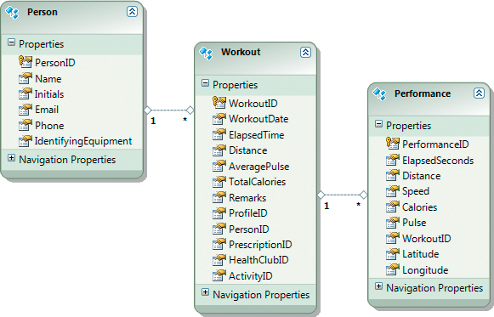
PRIDE, Person, Workout, and Performance Tables

Slide 37
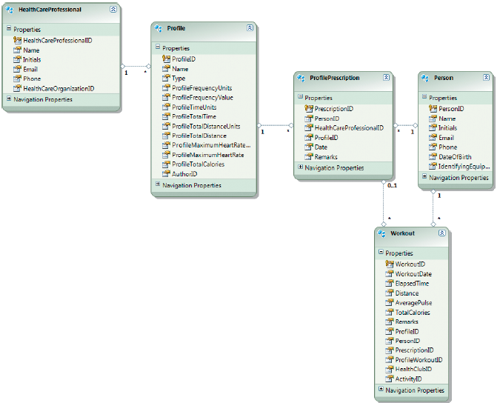
Tables Relating to Exercise Prescriptions

Slide 38
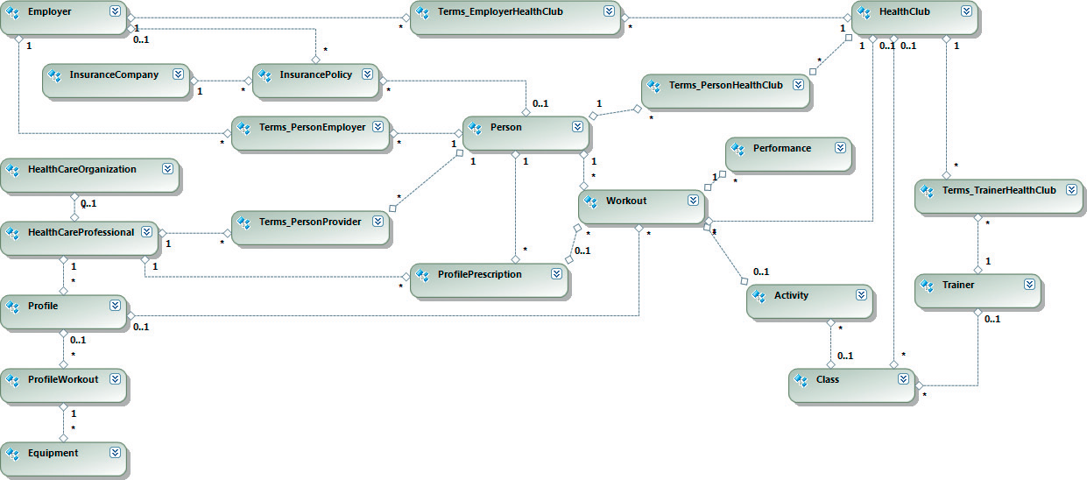
PRIDE Database Tables

Slide 39
