Slide 1
Chapter 6
Data Communication and the Cloud

Slide 2
“No, I Mean 25 Cents an Hour.”
GearUp’s Web hosting costs rising rapidly
Lucas suggests provisioning Web servers and databases in the cloud
Provision server resources by the hour
Costs: $50/mo plus 25-cents per hour for processing time used
Could yield huge savings
Notes:
GOALS
Illustrate importance (and promise) of the cloud.
Show nontechnical business managers (Kelly and Emily) needing to engage in conversations and make decisions about information technology.
See firsthand benefits of the cloud to business… in this case, a small startup that needs to conserve its cash.

Slide 3
Study Questions
Q1: What is a computer network?
Q2: What are the components of a LAN?
Q3: What are the fundamental concepts you should know about the Internet?
Q4: What processing occurs on a typical Web server?
Q5: Why is the cloud the future for most organizations?
Notes:
This chapter defines essential data communications terms and explains basic concepts. It begins with a discussion of LANs, Internet fundamentals, Web servers and purpose of basic Web technologies. Next, a discussion of why the cloud is the future for most organizations and how it can be used.

Slide 4
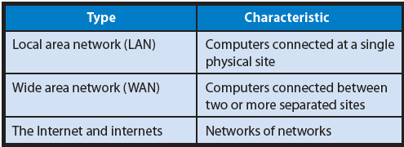
Q1: What Is a Computer Network?
Notes:
A computer network is a collection of computers that communicate with one another over wired and wireless transmission media.

Slide 5
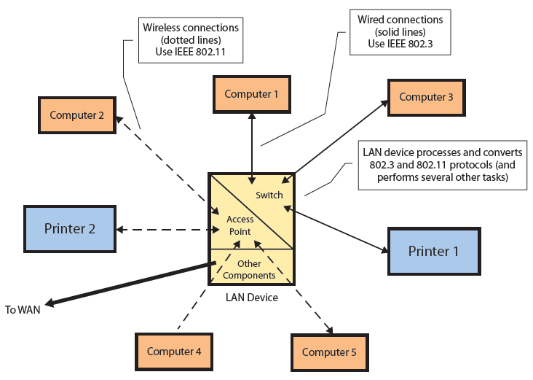
Q2: What Are the Components of a LAN?
SOHO LAN
Notes:
Computers and printers in a typical SOHO communicate via a mixture of wired and wireless connections. Computers 1, 3 and Printer 1 use wired connections, while Computers 2, 4, 5 and Printer 2 use wireless connections.
Most LAN connections use unshielded twisted pair (UTP) cable. If connection carries a lot of traffic, UTP cable may be replaced by optical fiber cables.
Wireless computers and printers have a wireless NIC (WNIC) instead of a NIC.

Slide 6
LAN Protocol
IEEE 802.3
Wired LAN
10/100/1000 Mbps
Ethernet
IEEE 802.11
Wireless LAN
802.11n
Bluetooth
Notes:
IEEE 802.3 protocol is used for wired LAN connections. Ethernet specifies hardware characteristics, such as which wire carries which signals. It describes how messages are packaged and processed for wired transmission over the LAN. NICs in most personal computers support 10/100/1000 Ethernet.
Wireless LAN connections use the IEEE 802.11 protocol. Several versions of 802.11 exist. IEEE 802.11n allows speeds of up to 600 Mbps.
Bluetooth is common wireless protocol designed for transmitting data wirelessly over short distances.

Slide 7
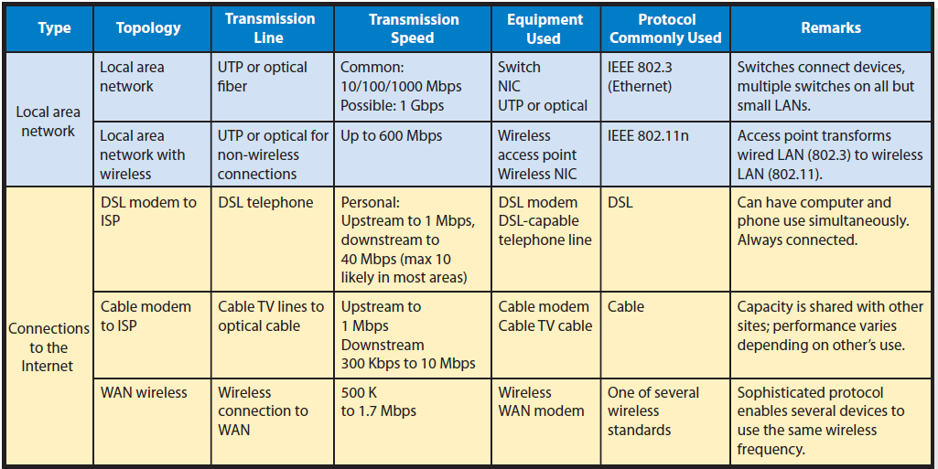
Three Common Alternatives for Connecting a SOHO to the Internet

Slide 8
Connecting to an ISP
Internet Service Provider (ISP) functions
    Provides legitimate Internet address
    Serves as gateway to Internet
    Pays Internet access fees

Slide 9
Experiencing MIS InClass 6 — A Group Exercise: Opening Pandora’s Box
Sonos: leverages technology to provide entertainment
High-quality, wireless LAN audio systems
Uses wired Ethernet to link up to 32 other Sonos devices around home
Each device can play own music or same audio program
Includes a small computer running Linux and a proprietary Sonos protocol
Notes:
Goal
Get students to see how telecommunications knowledge can have personal uses.

Slide 10
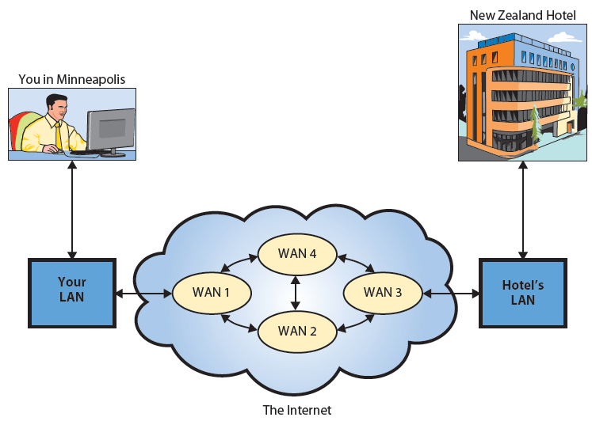
Q3: What Are the Fundamental Concepts You Should Know About the Internet?
Notes:
Assume you send a message to a server in New Zealand hotel. The message is too big to travel in one piece, so it’s broken into packets and each packet passes along from WAN to WAN until it reaches its destination. Once all packets arrive, message is reconstructed and delivered to server for processing. All of this is accomplished by computers and data communications devices that most likely have not interacted before.

Slide 11
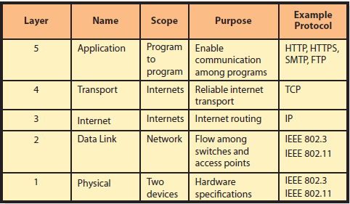
TCP/IP Protocol Architecture
Notes:
Protocols used on the Internet are arranged according to an international standardized structure known as TCP/IP Protocol architecture. TCP/IP has five protocol types arranged in layers. Data communications and software vendors write computer programs that implement the rules of a particular protocol.
“Why should I know about this?” So that you will understand the terms you will hear and the products you will use, buy, or possibly invest in that relate to each other via this architecture.

Slide 12
Application-Layer Protocols
Hyper Text Transport Protocol (HTTP)
HTTPS — secure HTTP data transmission
Simple Mail Transfer Protocol (SMTP )
File Transfer Protocol (FTP)
Web — Internet-based network of browsers and servers that process HTTP or HTTPS
Sending a file via FTP uses the Internet, but not the Web
Notes:
HTTP is the protocol used for data communication between browsers and Web servers.
HTTPS is a secure data transmission.
SMTP is the protocol for email transmissions.
FTP is the protocol for transmitting files over the Internet.

Slide 13
TCP and IP Protocols
  TCP or Transmission Control Protocol
    Breaks traffic up into packets and sends each one along its way
  IP (Internet Protocol)
  Routers
  Special-purpose computer moves packets according to IP protocol
Notes:
These protocols manage traffic as it passes across an internet (including the Internet) from one network to another. Most important protocol in transport layer is Transmission Control Protocol (TCP).
IP (Internet Protocol) specifies routing of the message packets through networks and internets, and the Internet.
A packet is a piece of a message handled by programs that use IP.

Slide 14
IP Addressing
Public IP Address
    Identifies a device on Internet
    Public IP addresses must be unique, worldwide
    Assignment controlled by ICANN (Internet Corporation for Assigned Names and Numbers)
  Private IP Address
    Identifies a device on private network
Major benefits
Public IP: All devices on LAN share a public IP address
Private IP address, need not register device with ICANN-approved agencies
Notes:
ICANN (Internet Corporation for Assigned Names and Numbers)

Slide 15
Functions of the LAN Device
Switch processing: IEEE 802.3 wired LAN traffic
Access-point processing: IEEE 802.11 wireless LAN traffic
Translating between IEEE 802.3 and IEEE 802.11
Converting between Analog and Digital
Assigning private IP addresses
Converting IP address between private and public IP addresses
Routing packets
And more…

Slide 16
Public IP Addresses and Domain Names
IPv4
    Four decimal dotted notation like 173.194.35.177
Domain name
    Worldwide-unique name affiliated with a public IP address
    Affiliation of domain names with IP addresses is dynamic
    Multiple domain names to same IP address
URL (Uniform Resource Locator): http:// or ftp://
Notes:
IPv6 allows for millions of more IP addresses than IPv4
Domain name is a worldwide-unique name affiliated with a public IP address.
Affiliation of domain names with IP addresses is dynamic. Owner of domain name can change the affiliated IP addresses at its discretion.

Slide 17
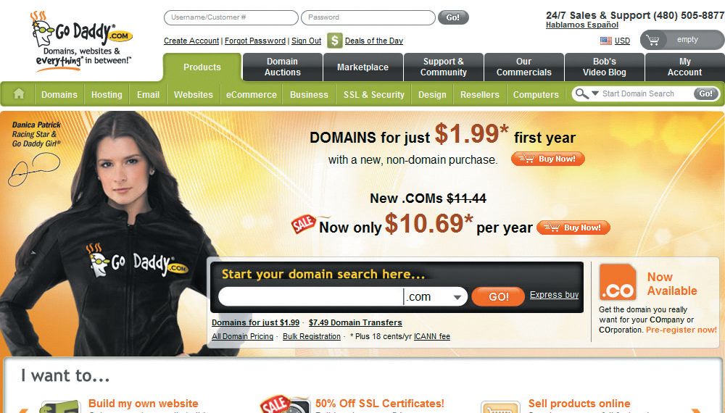
Domain Registrar Company

Slide 18
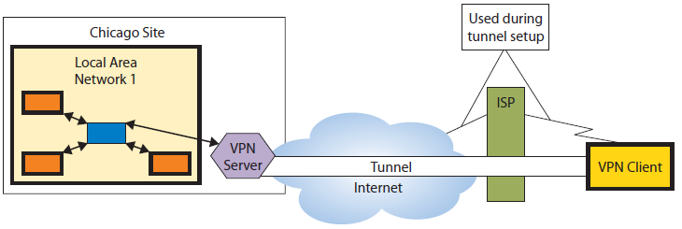
Remote Access Using VPN
Notes:
A VPN server uses Internet to create a secure, private point-to-point connection.

Slide 19
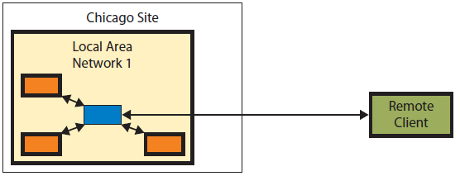
Remote Access Using VPN: Apparent Connection
Remote user perspective

Slide 20
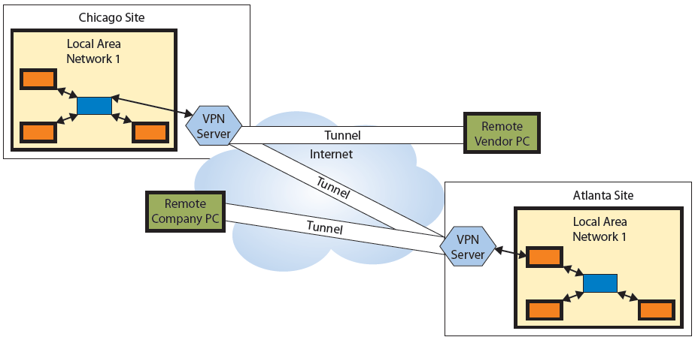
WAN Using VPN
Notes:
VPN client software encrypts original message; then, appends Internet address of VPN server to message and sends it over Internet to VPN server. When VPN server receives message, it strips off address, decrypts coded message, and sends plain text message to designated address on LAN.

Slide 21
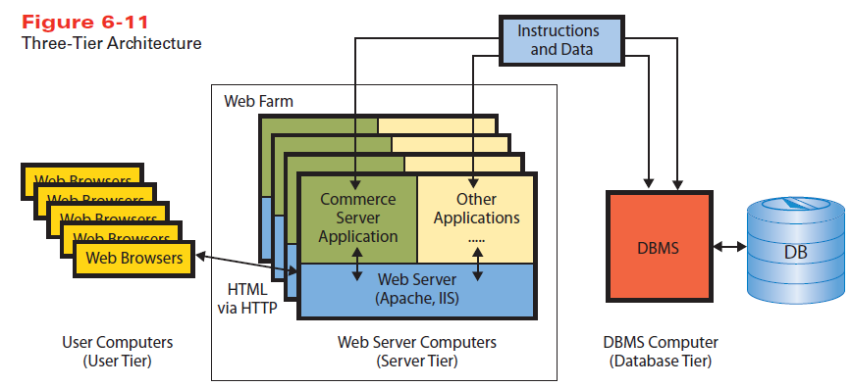
Q4: What Processing Occurs on a Typical Web Server?
Notes:
Almost all e-commerce applications use the three-tier architecture.
User tier consists of computers, phones, and other devices with browsers that request and process Web pages.
Server tier consists of computers running Web servers and application programs.
Database tier consists of computers that run a DBMS that processes SQL requests to retrieve and store data.
Commerce server — an application program that runs on a server-tier computer. It receives requests from users via Web server, takes some action, and returns a response to users. Typical commerce server functions are to obtain product data from a database, manage items in a shopping cart, and coordinate checkout process.

Slide 22
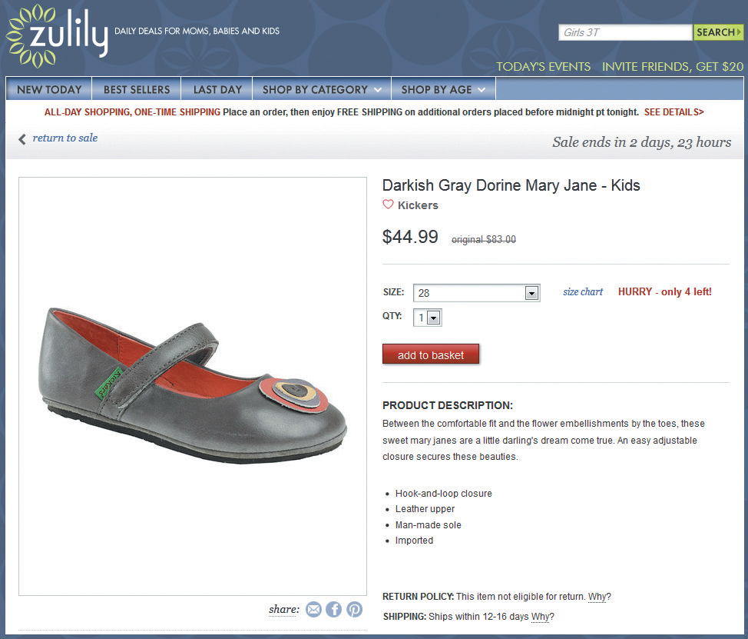
Sample of Commerce Server Page
Notes:
Assume customer has navigated through zulily.com to find an item. To produce this page, commerce server accessed a database to obtain product picture, price, special terms, product information, and related products. Customer places items in shopping cart.
When customer checks out, commerce server program processes payment, schedules inventory processing, and arranges shipping.

Slide 23
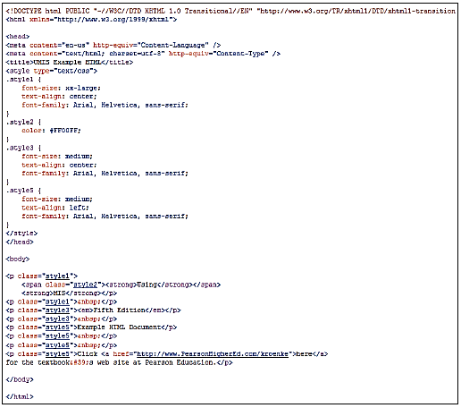
Hypertext Markup Language (HTML)
Notes:
Hypertext Markup Language (HTML) code defines structure and layout of Web pages.
HTML headings provide metadata about page and a body that contains content. Tag <h1> means to format indicated text as a level-one heading; <h2> means a level two heading. Tag <a href=“http://...”> defines a hyperlink.
Each attribute has a standard name. Attribute for a hyperlink is href, and its value indicates URL of Web page to display when link is clicked.
HTML has problems and limitations overcome by newer technologies. HTML5 most current version.

Slide 24
Q5: Why Is the Cloud the Future for Most Organizations?
What is the Cloud?
    Elastic leasing of pooled computer resources over the Internet
Elastic?
    Dynamically increasing/decreasing leased resources programmatically in short time span, and only pay for resources used
Notes:
Cloud resources “pooled” because many different organizations use same physical hardware and share it using virtualization.
Cloud resources accessed via Internet protocols that enable cloud-hosting vendors to provide processing capabilities in flexible, yet standardized ways.

Slide 25
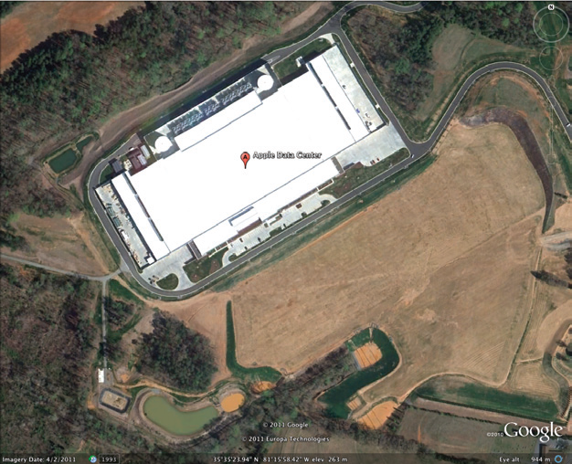
Apple Data Center in Maiden, NC
Notes:
Building contains computers in a Web farm to support Apple’s iCloud offering.
Billion-dollar facility contains more than 500,000 square feet. IBM, Google, Amazon, Microsoft, Oracle, and others operate similar farms.

Slide 26
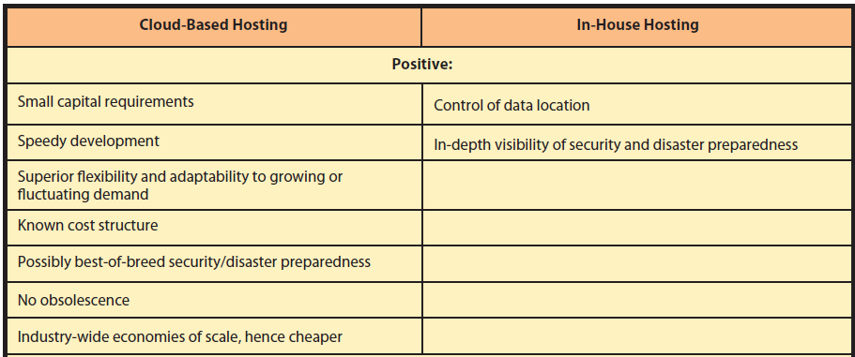
Why Is the Cloud Preferred to In-House Hosting?
Notes:
Positives heavily tilted toward cloud-based computing. Cloud vendor, RackSpace, will lease one medium server for as low as 1.5 cents per hour. Companies can obtain and start using cloud services in a few minutes.
As long as you’re dealing with large, reputable cloud vendors, you will get the best-of-breed security and disaster recovery services.

Slide 27
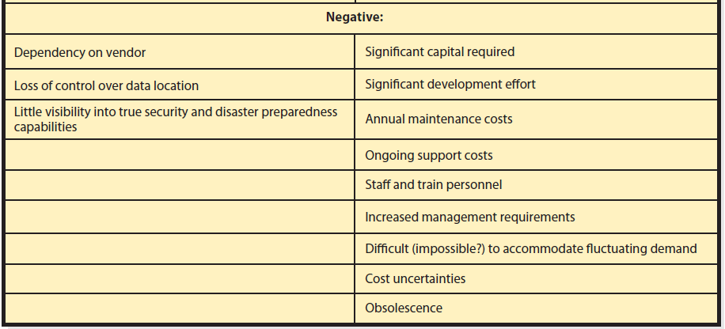
Why Is the Cloud Preferred to In-House Hosting? (cont’d)
Notes:
Negatives of cloud computing involve loss of control due to vendor dependency. Changes in management, policies, and prices are beyond your control. You don’t know where your data are located, how many copies there are, where they’re located, or whether security and disaster preparedness measures are actually in place.

Slide 28
Why Now?
Technology now supports construction and use of enormous data centers
    Processors, data communication, data storage nearly free
    Web farms providing virtual machine for about 1.5¢ per hour

Slide 29
When Does the Cloud Not Make Sense?
Law or industry standard practices require physical control over the data
Private cloud
    In-house hosting, delivered via Web service standards
Notes:
It might not make sense when required by law, or by industry standard practices, to have physical control over the data. Organizations, such as a financial institution, might be forced to create and maintain their own hosting infrastructure.

Slide 30
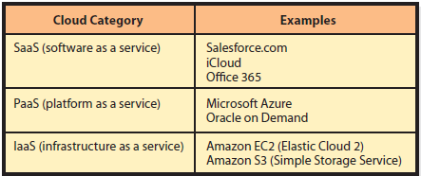
How Can Organizations Use the Cloud?
Three Fundamental Cloud Type
Notes:
SaaS provides hardware infrastructure, operating systems and application programs.
PaaS vendors provide hosted computers, an operating system, and possibly a DBMS.
IaaS is cloud hosting on barebones server or disk drive.
GearUp needs to put its Web servers and its database server in the cloud using PaaS. GearUp could use Windows Azure for Web servers and SQL Azure for database server.

Slide 31
How Does the Knowledge In This Chapter Help You?
Provides general knowledge needed by business professionals
Helps you develop project plans and budgets involving IT and data communications
Helps you be a better consumer of IT services
Helps you understand how your organization can weave cloud-based applications into its strategy

Slide 32
Ethics Guide: You Said What? About Me??? In Class???
Packet analyzer (a.k.a., packet sniffer)
Read, record, and display all wireless packets around them
www.wireshark.com
Pickup instant messages, most email, and any http:// web traffic
Notes:
GOAL - Alert students to:
Dangers of email, texting, and http processing on Web sites over public wireless nets
Ease with which packing sniffing can be done
Availability of https://google.com

Slide 33
What Can You Do?
Use https://
Packet sniffer will know where you went, but won’t obtain data about what you did there.
Do not to use your computer or mobile device for any unauthorized purpose in class.

Slide 34
Guide: Thinking Exponentially Is Not Possible, But…
  Humans think linearly, not exponentially
No one in the 1990s could imagine growth in magnetic storage and what we would do with it.
Exponential growth in:
Number of Internet connections
Web pages
Amount of data accessible on Internet
Notes:
GOALS
Sensitize students to the difficulty of thinking exponentially.
Describe strategies that students can use to deal with exponential phenomena in their professional lives.

Slide 35
Guide: Thinking Exponentially Is Not Possible, But…(cont’d)
What can we do to better anticipate?
People want to do what they’re already doing.
Hedging your bets
    Position yourself to move quickly as direction becomes clear
Risk: Error increases exponentially as time frame increases.

Slide 36
Active Review
Q1: What is a computer network?
Q2: What are the components of a LAN?
Q3: What are the fundamental concepts you should know about the Internet?
Q4: What processing occurs on a typical Web server?
Q5: Why is the cloud the future for most organizations?

Slide 37
Case Study 6: Turbulent Air in Those Azure Clouds
Microsoft needs a profitable way to put a big part of its business out of business
If successful, Office 365 will replace Windows Server and SQL Server, which is 24% of current revenue
Notes:
Goal:
Stimulate thinking about what changes cloud computing might cause.
To get students to see how important the Cloud and Azure are as a paradigm shift, a game changer, for companies like Dell and Microsoft that sell Web servers.
Microsoft has a huge problem. Change is in the air, the Cloud is real. Apple currently has momentum with young and hip customers.

Slide 38
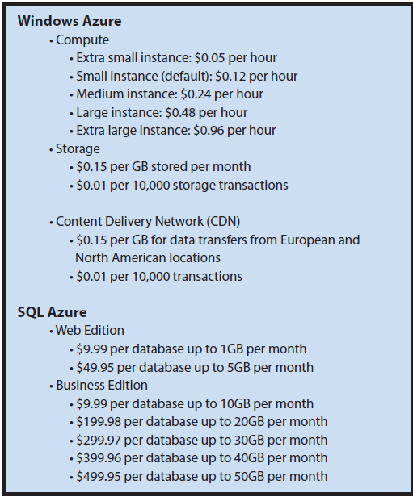
Azure Standard Rates

Slide 39
