Slide 1
Chapter 5
Database Processing
Notes:
Businesses use databases to keep track of things. Huge corporations might use NOSQL DBMS. GearUp uses databases as a crucial part of their operations without having a trained and experienced staff to manage and support the databases.

Slide 2
"No, Drew, You Don’t Know Anything About Report Writing.”
GearUp needs operating data to analyze for cost-cutting decisions
Need to extract and combine data from customer order, shipping system, and accounts payable systems
Will use Access to create reports
Notes:
Goals
Use GearUp to:
Illustrate the utility of processing operational data.
Demonstrate a realistic example of why students might want to become proficient using both Access and Excel.
GearUp managers need data on all cancelled customer orders resulting from a supplier canceling a shipment or making a partial shipment.
Data will be extracted from multiple isolated systems, and combined and imported to Access so reports can be created.

Slide 3
Study Questions
Q1: What is the purpose of a database?
Q2: What is a database?
Q3: What is a database management system (DBMS)?
Q4: How do database applications make databases more useful?
Q5: What is a NoSQL DBMS?
Q6: How does the knowledge in this chapter help you?
Notes:
This chapter focuses on the basic components and functions of database technology.

Slide 4
Q1: What Is the Purpose of a Database?
Organize and keep track of things
Keep track of multiple themes
General rule:
  Single theme store in a spreadsheet
  Multiple themes require a database
Notes:
Basic purpose of a database is to organize and keep track of things. Databases are needed when you need to keep track of multiple themes, such as grades, students, office visits and email messages.
General rule:
Use a spreadsheet for lists of data involving single theme.
Use a database for data with multiple themes.

Slide 5
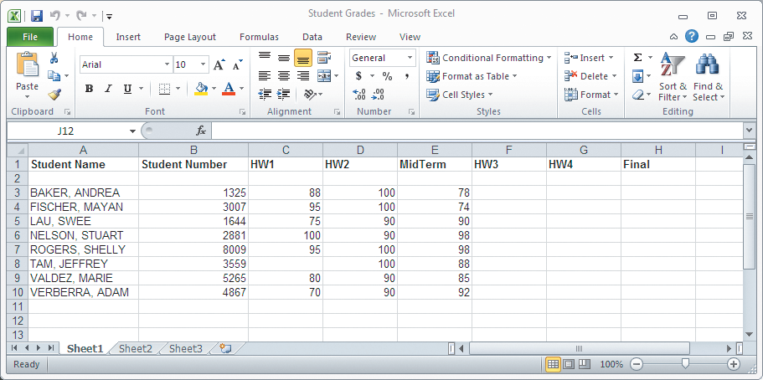
A List of Student Grades Presented in a Spreadsheet – Single Theme
Notes:
Spreadsheet with a single theme – Grades.

Slide 6
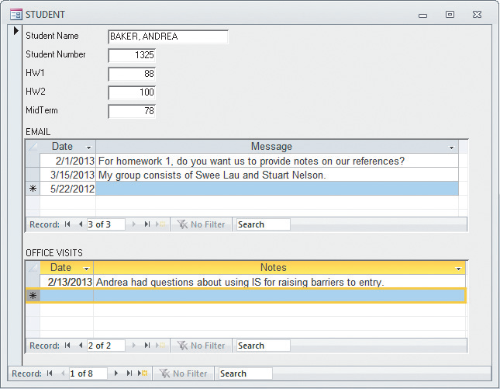
Student Data Form With Multiple Themes
Notes:
Forms are difficult, if not impossible, to produce from a spreadsheet, but are easily produced with a database.

Slide 7
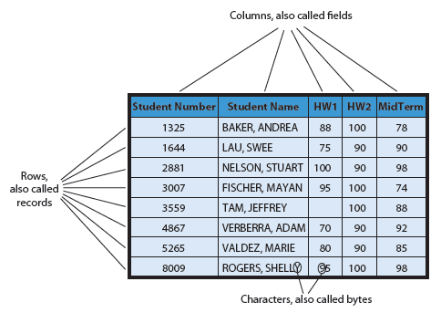
Q2: What Is a Database?
Notes:
A database is a self-describing collection of integrated records.

Slide 8
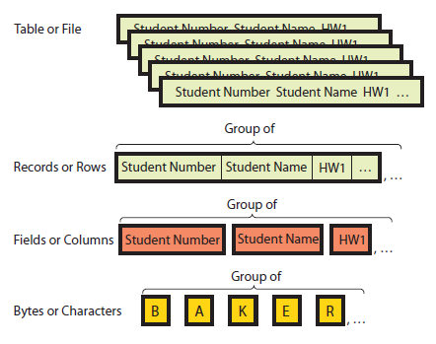
Hierarchy of Data Elements

Slide 9
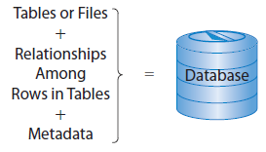
Components of a Database
Notes:
Formal term for table is “relation”. Linking relations together creates relationships. A database is a group of related tables. Metadata describes the definitions of the tables, fields and relationships.

Slide 10
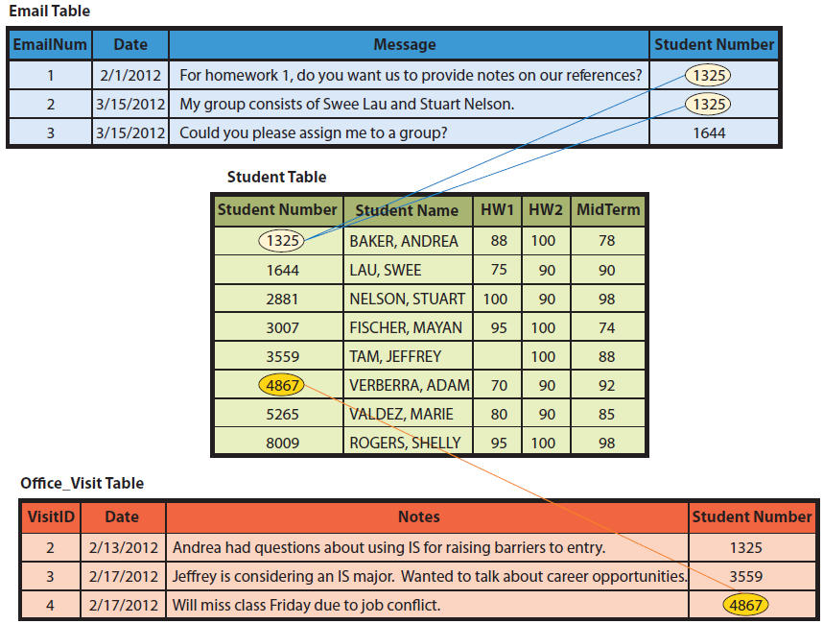
Example of Relationships Among Rows?
Notes:
This example shows a value in a row of one table is related to values in rows of different table. Notice all three tables have a field named Student Number. Several special terms are used to describe these relationships.
Foreign keys are used to create relationships by linking a primary key of one table to the foreign key of another table. The result is called a relational database.

Slide 11
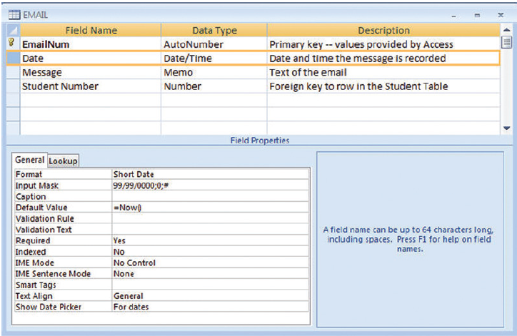
Metadata: Data that Describes Data
Notes:
This is an Access example of metadata for the Email table. It is metadata that makes a database self-describing.

Slide 12
Experiencing MIS InClass Exercise 5: How Much Is a Database Worth?
Data has resale value
Data on everything customers do
Use to target customer for offerings they care about, avoid those they don’t
Costly and difficult to replace data collected over many years
Notes:
GearUp’s database contains data on everything customers do. Their database is the single most important asset. “Take away our customer database, however, and we’d have to start all over. It would take us years to get back to where we are now.”
Customers make about 15,000 visits a year, an average of 500 visits per day. GearUp keeps data on every customer and every visit.
That data could be sold to others. It has competitive value because it can be used to improve GearUp’s services and facilities, identify trend, etc. Replacing years of rich data would take a long time and be very expensive.

Slide 13
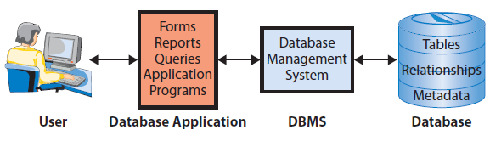
Q3: What Is a Database Management System (DBMS)?
Database Application System Components
Notes:
Components of a database application system include a user, database applications, the DBMS and the actual database. Applications make databases more accessible and useful for people. Users employ database applications that consist of forms, formatted reports, queries, and application programs.
DBMS is software used to create applications, process data, provide access to the database, and manage the database. Popular DBMSs include: DB2, Microsoft Access, SQL Server, Oracle, MySQL (open-source DBMS).

Slide 14
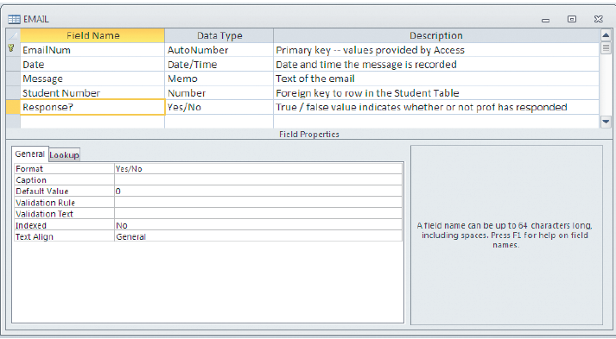
Creating the Database and Its Structure: Adding a New Column to a Table
Notes:
DBMS is to provide a means for creating a database application. Here, the developer creates the Email table. The user specifies filed names and declares various properties for each field, such as data type, format, caption default value, validation rule, etc. Tables can be easily changed by adding new fields.

Slide 15
Processing the Database
Four DBMS operations
  Read
  Insert
  Modify
  Delete data
Notes:
These operations are requested in applications that call upon the DBMS in different ways.

Slide 16
Structured Query Language (SQL)
SQL (see-quell)
  International standard
  Used by most popular DBMS
Notes:
Structured Query Language (SQL) is used for processing the database. SQL is an international standard language for creating databases and database structures, and processing databases. SQL is used by all popular DBMS products.

Slide 17
SQL Statement Inserts a New Row
Into Student Table
INSERT INTO Student
([Student Number], [Student Name], HW1, HW2, MidTerm)
VALUES (1000, ‘Franklin, Benjamin’, 90, 95, 100);

Slide 18
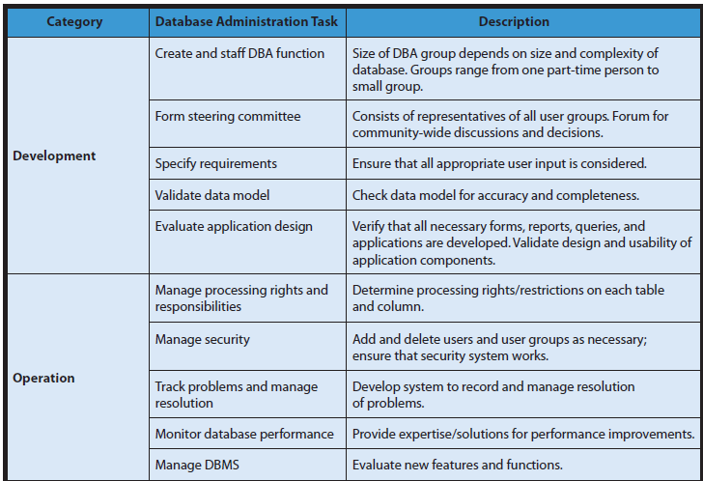
Summary of Database Administration Tasks
Notes:
Third DBMS function is to provide tools to assist in database administration. Database administration involves a wide variety of activities. For example, the DBMS can be used to set up a security system involving user accounts, passwords, permissions, and limits for processing the database.
Permissions can be limited in very specific ways. A particular user may be limited to reading only Student Name from the Student table. A different user could be given permission to read the entire Student table, but limited to update only the HW1, HW2, and MidTerm columns. Other users could be given other permissions.

Slide 19
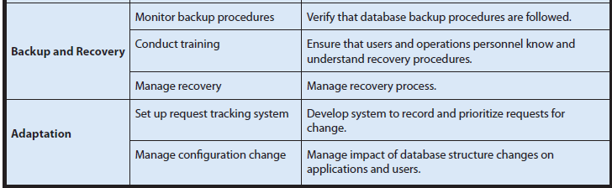
Summary of Database Administration Tasks (cont'd)
Notes:
Third DBMS function is to provide tools to assist in database administration. Database administration involves a wide variety of activities. For example, the DBMS can be used to set up a security system involving user accounts, passwords, permissions, and limits for processing the database.
Permissions can be limited in very specific ways. A particular user may be limited to reading only Student Name from the Student table. A different user could be given permission to read the entire Student table, but limited to update only the HW1, HW2, and MidTerm columns. Other users could be given other permissions.

Slide 20
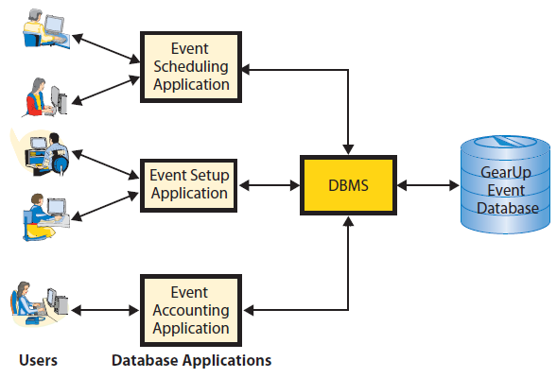
Q4: How Do Database Applications Make Databases More Useful?
Applications used at GearUp
Notes:
GearUp buyers use the first application to schedule events. Operations personnel use the Event Setup application to setup the graphics, auction terms and screens. Accounting personnel use the Event Accounting application to process event financial results. These applications have different purposes, features, and functions, but they all use the same Event Database.

Slide 21
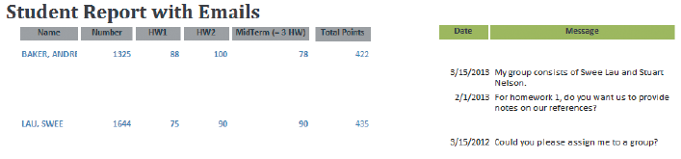
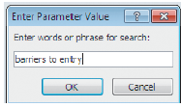
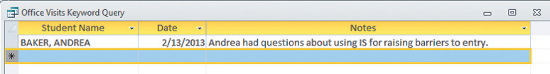
What Are Forms, Reports, and Queries?
Notes:
This is a typical database application report, query form and query report. The structure of this report creates information because it shows student data in a context that is meaningful to the professor.
DBMS programs provide comprehensive and robust features for querying database data.

Slide 22
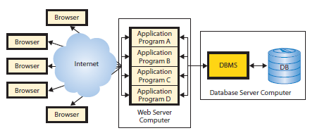
Why Are Database Application Programs Needed?
Process logic specific for a business need
Processing via Internet
Notes:
An important use of application programs is to enable database processing over the Internet. The application program serves as an intermediary between the Web server and the database. The application program responds to events, such as when a user presses a submit button. It also reads, inserts, modifies, and deletes database data. This figure shows four different database application programs running on a Web server computer.

Slide 23
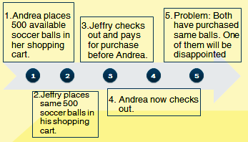
Multi-User Processing Lost-Update Problem
Notes:
Lost-update problem is one of the special characteristics of multi-user database processing. To prevent this problem, some type of locking must be used to coordinate the record update activities of multiple users. Locking has own set of problems and those problems must be addressed as well.
Realize that converting a single-user database to a multi-user database requires more than simply connecting another computer. The logic of the underlying application processing needs to be adjusted as well. If you find inaccurate results, you may be experiencing multi-user data conflicts. Contact your IS department for assistance.

Slide 24
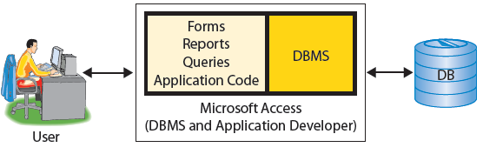
Enterprise DBMS vs. Personal DBMS
Personal DBMS for smaller databases used by 1 to 100 users.
Notes:
Enterprise DBMS process large organizational and workgroup databases. These products support many simultaneous users and database applications. They support 24/7 operations and can manage databases that span dozens of different magnetic disks with hundreds of gigabytes of data. IBM’s DB2, Microsoft’s SQL Server, and Oracle’s Oracle are examples of enterprise DBMS products.
Personal DBMS products are designed for smaller, simpler database applications for personal or small workgroup applications that involve fewer than 100 users, and normally fewer than 15.

Slide 25
Q5: What is a NoSQL DBMS?
NOSQL DBMS (NotRelational DBMS
    Supports very high transaction rates
    Relatively simple data structures
    Replicated on many servers in the cloud
Examples
    Dynamo (Amazon)
    Bigtable (Google)
    Cassandra (Facebook)
Notes:
Software systems that support very high transaction rates by processing relatively simple data structures, replicated on many servers in the cloud

Slide 26
Will NoSQL Replace Relational DBMS Products?
Conversion very expensive and disruptive
Very technical, limited to those with a deep background in computer science
Requires years of training to use
Organization may choose NoSQL products for specialized applications

Slide 27
NoSQL’s Impact on the DBMS Product Market
Database software market experienced viable new entrants
More reliance on open source community
Will DBMS vendors lose some of their market to NOSQL products and vendors?
Will they become less of a seller of services supporting open source software?

Slide 28
Q6: How Does the Knowledge in this Chapter Help You?
Provides
    Some rudimentary knowledge of Access
    Awareness that it is common for end-users to receive extracts of operational data to create queries and reports
Will help you in your career

Slide 29
Ethics Guide: Nobody Said I Shouldn’t
Chris made copy of backup database, took it home
Queried sysTables to find table and field names
Found data on orders, customers, salespeople
Discovered peculiar sales discounts
Mentioned it to Jason (the sales clerk)
Chris fired next business day
Notes:
GOALS
Illustrate the utility of metadata and SQL, even for non-authorized purposes.
Discuss the ethics of unauthorized data access.
Consider the need for organizational data policies.
As a future business manager or owner, what does the ease with which this can be done tell you?
What is a reasonable policy for an organization to have regarding employees taking data home?
Chris most likely uncovered a kickback scheme involving Jason. Jason’s boss might be involved also, which is why Chris was fired.
Chris has two options: (1) He could report what he found to higher-level management, or (2) talk to a lawyer about getting whistleblower protection, or pursuing legal action.

Slide 30
Ethics Guide: Nobody Said I Shouldn’t (cont’d)
Where did Chris go wrong?
Was it illegal, unethical, or okay for Chris to copy the database and take it home?
How could Chris have handled his discovery of the anomaly and protected himself?
Does Chris have any legal recourse over being fired?
How can a business protect its databases from unauthorized use or duplication?

Slide 31
Guide: No, Thanks, I’ll Use a Spreadsheet
Databases take time to build
Complicated to operate
Need IS people to create and keep them running
Salesman doesn’t want to share data
Spreadsheets sometimes better option, especially if data needs are simple
Notes:
GOALS
Explore the differences between a spreadsheet and a database.
Understand one way that users respond to technology challenges.
Discuss ways of managing a difficult employee (or perhaps just a difficult situation).
Often database failures involve small businesses or workgroups that have attempted to develop a database on their own. Such failure is usually either incompetent database developers or underfunding of the project.
The salesman says the database is too difficult for him to send form letters or email. Yet, he can’t send letters with his spreadsheet either. Then, he says sending letters is not important to his sales activity. What’s his real problem?
Cramming all of his data into the Car Interests and Notes columns will cause enormous problems if he ever tries to import his data to a database.

Slide 32
Active Review
Q1: What is the purpose of a database?
Q2: What is a database?
Q3: What is a database management system (DBMS)?
Q4: How do database applications make databases more useful?
Q5: What is a NoSQL DBMS?
Q6: How does the knowledge in this chapter help you?

Slide 33
Case Study 5: Fail Away with Dynamo, Bigtable, and Cassandra
Current relational DBMS products not designed for large, multi-server systems
NoSQL databases – Dynamo, Bigtable, Cassandra
Amazon: Dynamo
Google: Bigtable processes petabytes of data on hundreds of thousands of servers
Both designed to be elastic
Cassandra used by Facebook, Twitter, Digg, Reddit
Notes:
Goal
To illustrate complexity of Amazon’s Dynamo database server system, Google’s Bigtable and Facebook’s Cassandra.
Stress the competitive importance of a company’s database system.
Illustrate Moore’s Law at work.
Current relational databases cannot efficiently process high volume of orders on Amazon’s 10,000 servers. Amazon engineers developed Dynamo, a specialized data store for reliably processing massive amounts of data on its servers. Dynamo provides an always-open, fail-safe database for Amazon’s retail customers.

Slide 34


