Slide 1
Chapter 4
Hardware and Software

Slide 2
"If We Don't Have an iPad App, We Don't Have A Business."
GearUp needs to make IT decisions and build infrastructure for next stage of growth
Suppliers forcing GearUp to change
Need to understand advantages and disadvantages of open source computing
Conflict between low cost and technical competitiveness
Notes:
GOALS
Illustrate the need for business professionals’ knowledge of basic technology and terminology.
Learn a practical application for the difference between hardware (iPad) and software (iOS).
Set up the need for business managers (like Emily and Drew) to know about the differences between native and thin-client applications.
Set up the need for business managers (like Emily and Drew) to know about mobile devices and mobile device user experiences.
This scenario highlights that GearUp’s managers know very little about IT, IT concepts and jargon. Their main competitors are ahead of them in applying IT. Suppliers are pressuring GearUp to provide iPad, iPhone access. Classic conflict about whether IT is an expense or an investment.

Slide 3
Study Questions
Q1: What do business professionals need to know about computer hardware?
Q2: What do business professionals need to know about operating systems software?
Q3: What do business professionals need to know about applications software?
Q4: Is open source software a viable alternative?

Slide 4
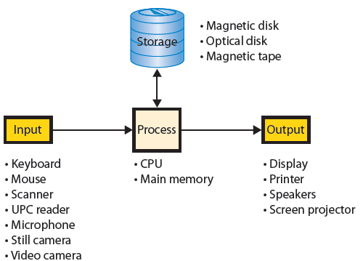
Q1: What Do Business Professionals Need To Know About Computer Hardware?
Notes:
Components of a generic computer
Dual-processor and Quad-processor. Some high-end computers have 16 or more.

Slide 5
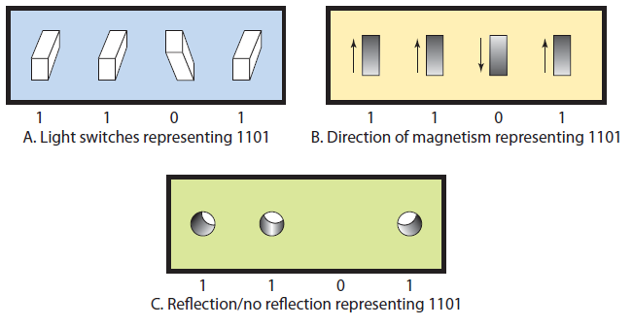
Computer Data: Binary digits (bits)
Notes:
Bits are used for computer data because they are easy to represent electronically.
Bits are used to represent electronically. A switch can be open or closed.
An open switch represents 0 or “off” and a closed switch represents “1” or “on”.

Slide 6
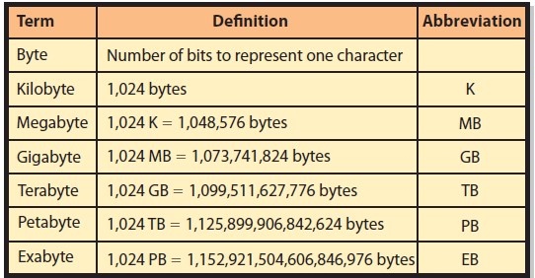
Important Storage Capacity Terminology
Notes:
All computer data represented by bits. Data can be numbers, characters, currency amounts, photos, recordings, or whatever. All are simply a string of bits. Specifications for size of main memory, disk, and other computer devices are expressed in bytes.

Slide 7
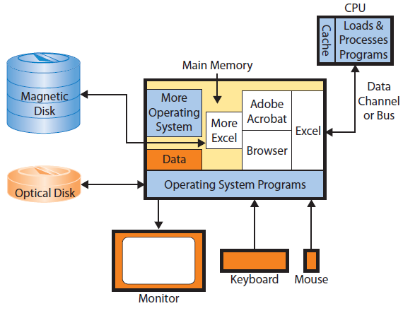
How Does a Computer Work?
Notes:
CPU is major actor. To run a program or process data, computer first transfers the program or data from disk to main memory. To execute an instruction, a copy of instruction is moved from main memory to CPU via data channel or bus. CPU has a small amount of very fast memory called a cache. CPU keeps a copy of frequently used instructions in cache. Having a large cache makes the computer faster, but more expensive.

Slide 8
How Does a Computer Work? (cont’d)
Main memory (RAM)
Program instructions
Operating system instructions
Operating system (OS)
Controls computer’s resources and blocks of data
Provides services to application programs and users
Notes:
Main memory contains program instructions, and a block of data and instructions for operating system.
Main memory is too small to hold all programs and data a user might want. No PC has enough memory to hold all of the code in Microsoft Word, Excel, and Access. Consequently, CPU loads programs into memory in chunks.

Slide 9
Memory Swapping
When RAM too small to hold all open programs and data
CPU loads new program segments into free memory
If none available, operating system swaps out existing instructions, or data, to a disk and copies requested program, or data, to freed space
Swapping slows down computer
Notes:
If insufficient memory, will remove something, then replace just-requested program or data into vacated space.

Slide 10
Why Does a Manager Care How a Computer Works? (cont’d)
Simple tasks do not need fast CPU
64-bit dual processor, 8+GB RAM for large, complicated spreadsheets, large database files, large picture, sound, movie files
Cache and main memory are volatile, so save frequently
Notes:
Do not need fast CPU, a 32-bit, 1.5 GHz CPU will be fine.

Slide 11
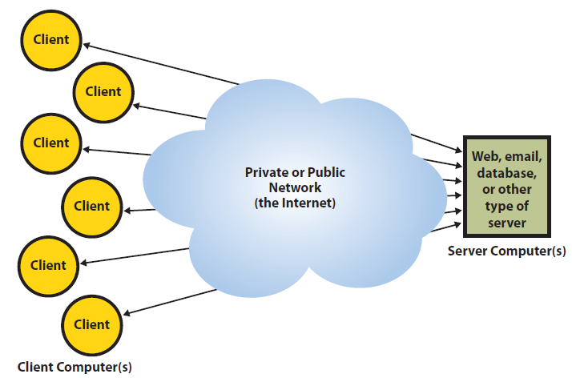
What Is Difference Between a Client and a Server?
Notes:
Users employ client computers for word processing, spreadsheets, database access, etc. Most client computers have software that enables connecting to a network or Internet.

Slide 12
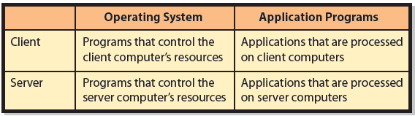
What Is Difference Between a Client and a Server?
Notes:
Servers provide services, such as email, Web sites, large and shared databases, and some provide all of these functions.
Must be fast, have multiple CPUs, lots of main memory (at least 4GB), and very large disks (often a terabyte or more).
Increasingly, server infrastructure delivered as a service in the cloud.
Sites with large numbers of users, servers are organized into a collection of servers called a server farm.

Slide 13
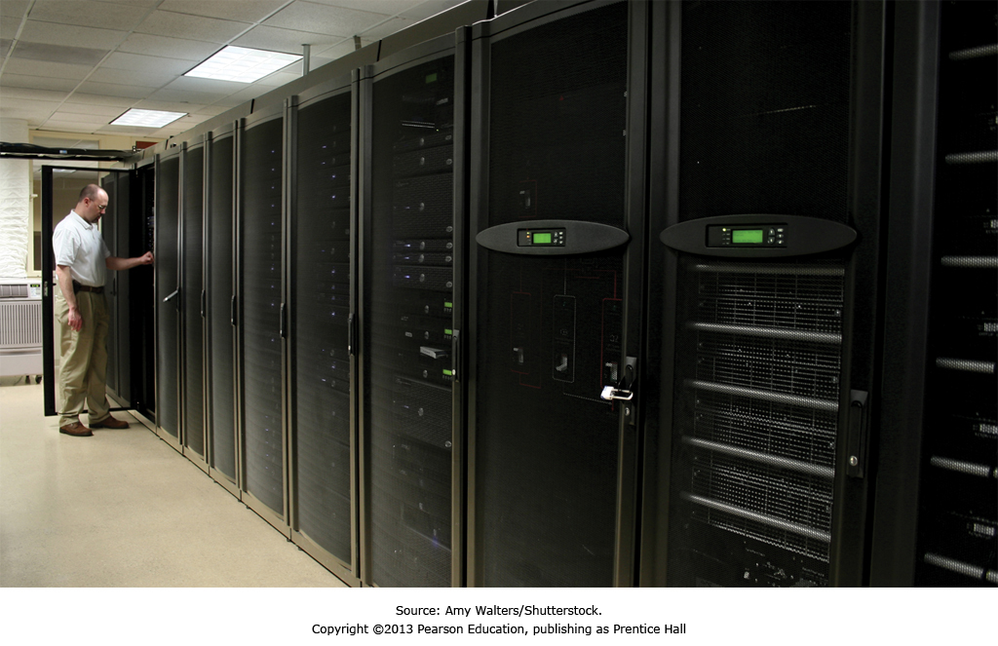
Server farm
Large collection of coordinated servers

Slide 14
Q2: What Do Business Professionals Need To Know About Operating System Software?
Operating systems
Run only on particular types of hardware
Must conform to instruction set of CPU
Windows works only on Intel instruction set CPUs
Application programs
Written for a particular operating system

Slide 15
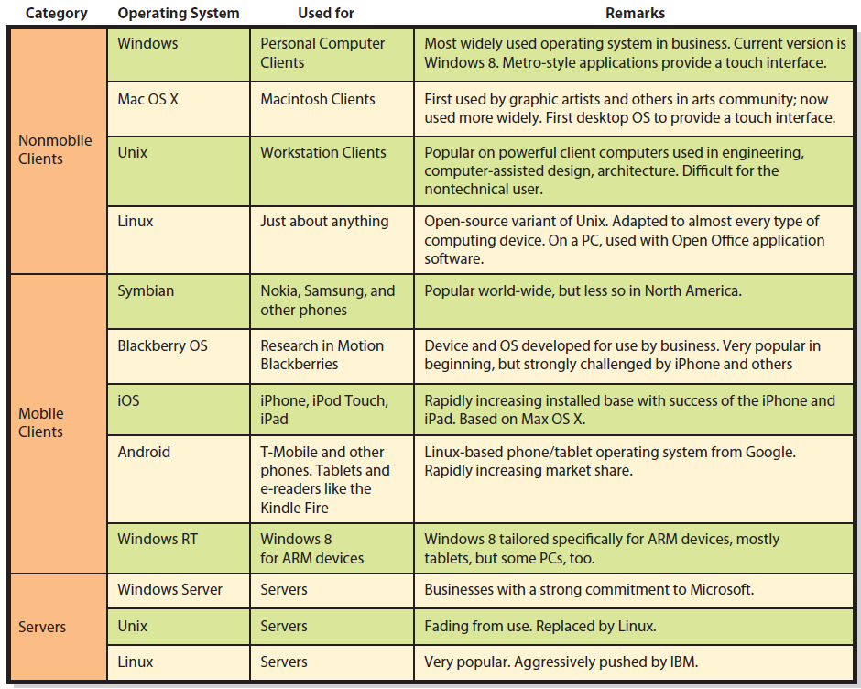
Operating Systems
Notes:
Important constraints.
A particular version of an operating system is written for a particular type of hardware.
Windows works only on Intel processors that conform to the Intel instruction set.
32-bit version of Windows runs only on Intel computers with 32-bit CPUs. Windows 64-bit runs only on Intel computers with 64-bit CPUs. Many versions of Linux exist for many different instruction sets and for both 32- and 64-bit computers.
Application programs are written to use a particular operating system.

Slide 16
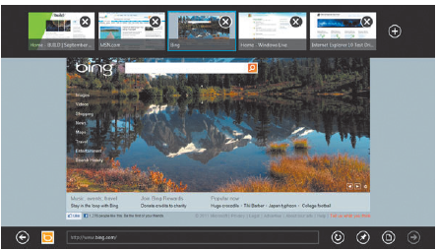
Metro Interface
Notes:
Metro-style applications are touch-screen oriented and provide context-sensitive, pop-up menus that can be used with a mouse and keyboard.

Slide 17
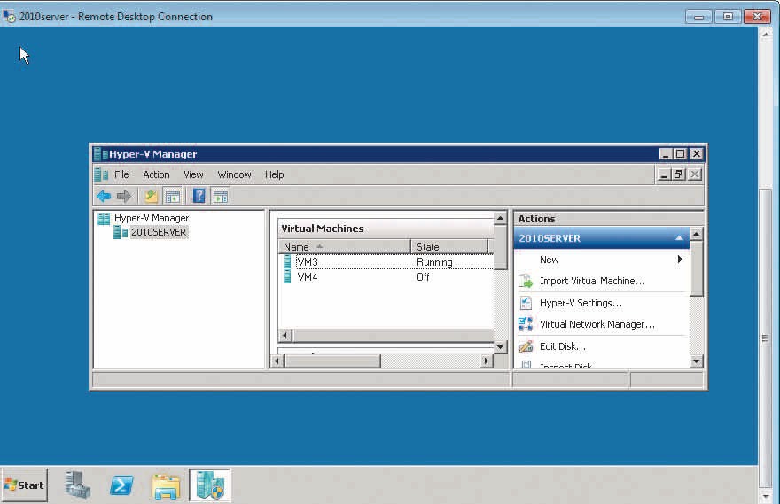
Windows Server Computer Hosting Two Virtual Machines
Notes:
Virtualization: process by which one computer hosts the appearance of many computers. One operating system, called the host operating system runs one or more operating systems as applications. Hosted operating systems are called virtual machines (vm).
Each virtual machine has disk space and other resources allocated to it. Operates as if installed on own computer.
Host operating system controls activities of virtual machines to prevent them from interfering with one another.

Slide 18
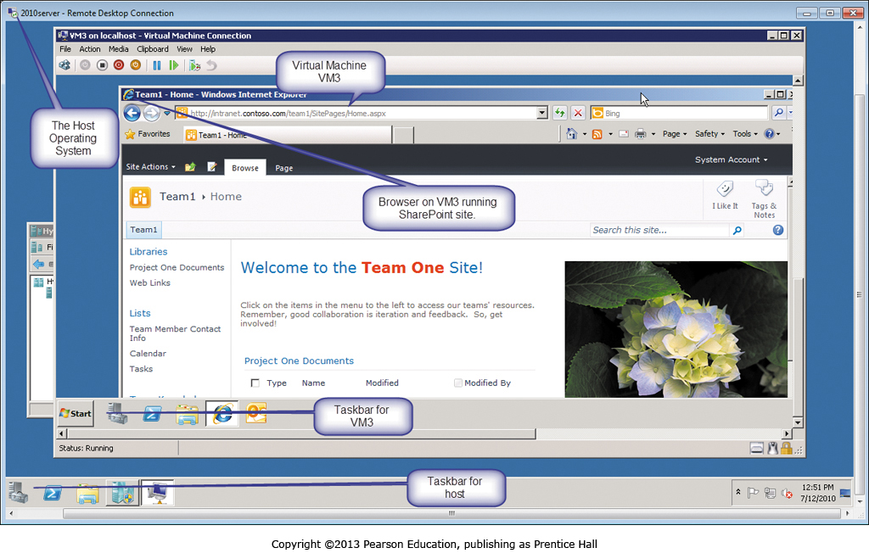
How Virtual Machine VM3 Appears to a User
Notes:
User of VM3 is running a browser accessing SharePoint.

Slide 19
Own Versus License
License
Right to use specified number of copies
Limits vendor’s liability
Site License
Flat fee to install software product on all company computers or all computers at a specific site
Open Source
No license fee
Notes:
You do not actually own a program—you own a license or right to use the program.
When you buy a Windows license, Microsoft is selling you the right to use Windows. Microsoft continues to own the Windows program.
Large organizations negotiate a site license that authorizes the company to install the product on all company computers or a specific site.
Linux, no company can sell you a license to use it. It is owned by the Open Source Community.

Slide 20
Q3: What Do Business Professionals Need To Know About Applications Software?
Categories of Application Programs
Horizontal-market applications
Provide capabilities common across all organizations and industries
Vertical-market applications
Serve the needs of a specific industry
One-of-a-kind applications
Developed for a specific, unique need

Slide 21
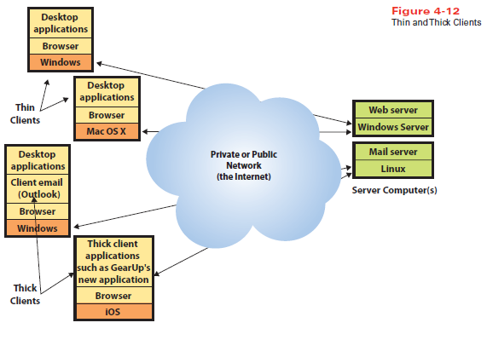
Thin vs. Thick Clients
Notes:
Windows Server computer supporting a Web server, and Linux server supporting email.

Slide 22
Thin-client Versus Thick-client Mobile Custom Software
Thin client
Requires nothing more than browser
Does not require installation and administration of client software
Thick client
More code to run on it
More features and functions
More expense and administration

Slide 23
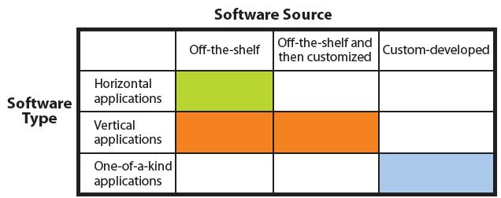
Software Sources and Types

Slide 24
What Is Firmware?
Computer software installed on read-only memory
Printers, print servers, communication devices
Coded like other software
Can be changed and upgraded
Notes:
Software installed into special, read-only memory of printer or other device and becomes part of device’s memory
Users do not need to load firmware into memory
Can be changed or upgraded, but normally a task for IS professionals

Slide 25
Q4: Is Open Source Software a Viable Alternative?
GNU general public license agreement
Standard for open source software
Successful open source projects
Open Office (a Microsoft Office look-alike)
Firefox (a browser)
MySQL (a DBMS, see Chapter 5)
Apache (a Web server, see Chapter 6)
Ubuntu (a Windows-like desktop operating system)
Android (a mobile-device operating system)
Cassandra (a NoSQL DBMS, see Chapter 5)
Hadoop (a BigData processor, see Chapter 8)
Notes:
GNU’s Not Unix
GNU Project started 1983 as a free software, mass collaboration project
Open source code available to public
Closed source is highly protected, only available to trusted employees and carefully vetted contractors. Only trusted programmers can make changes to a closed source project.

Slide 26
Why Do Programmers Volunteer Their Services to Open Source Projects?
It’s fun
Freedom to choose projects
Exercise creativity on interesting and fulfilling projects
Exhibit one’s skill to get a job
Start a business selling services
Notes:
Programming is an intense combination of art and logic. Designing and writing a complicated computer program is exceedingly pleasurable (and addictive).
Programmers can exercise creativity while working on projects they find interesting and fulfilling.
Programmers can exhibit their skill, both for pride, finding a job or consulting employment, or start a business selling services to support an open source product.

Slide 27
How Does Open Source Work?
Closed-source or proprietary software source code is not available to users or public. Only available to trusted employees and carefully vetted contractors.
Open-source software available to users in source code form.
Machine code: Source code is compiled into instructions executed directly by a computer’s CPU
Source code: Human readable computer code
Software
Notes:
Collaboration of many programmers
Examining source code and identifying a need, creates new feature or redesigns existing feature, or fix a problem
Code evaluated and extended by others
Iteration, peer reviews and well-managed project yield high-quality code

Slide 28
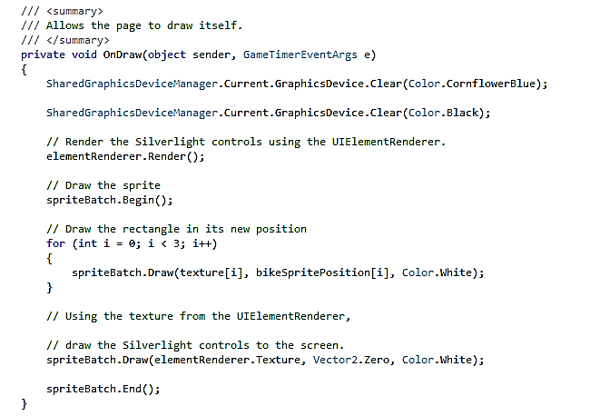
Source Code Sample

Slide 29
So, Is Open Source Viable?
Depends on requirements and constraints of situation
“Free” open source software still requires support and operational costs that could cost more than a licensing fee.
Future will involve a blend of both proprietary and open source software
Notes:
Depends on requirements and constraints of situation. You will learn more about matching requirements and programs in Chapter 10.

Slide 30
Experiencing MIS InClass Exercise 4: Place Your Bets Now!
Microsoft Surface, a tablet device to compete with iPad and Kindle
Google purchased Motorola Mobility for $12.5 billion
150 million Android phones in use, largest market share of mobile phone operating systems
Android phones manufactured by 39 different vendors
No single Android phone matched iPhone in popularity

Slide 31
Experiencing MIS InClass Exercise 4: Place Your Bets Now! (cont’d)
Confounded channel; 38 other Android phone manufacturers fear acquisition gives Google phones an unfair advantage
Android is open source operating system
Motorola Mobility had 17,000 patents with 7,000 in pipeline
Patents protect Google from patent infringement lawsuits from Microsoft, Apple, and others

Slide 32
Experiencing MIS InClass Exercise 4: Place Your Bets Now! (cont’d)
Motorola is a market leader in the home devices and video solutions business. What does that mean?
Form a group to discuss and formulate answers to Exercise questions.
Notes:
Goal:
Get students to practice iteration and feedback in group discussion.
Get students to apply concepts discussed in chapter and apply general business knowledge.

Slide 33
How Can You Use This Knowledge?
Know enough about hardware and software to ask good questions, and avoid embarrassing gaffs.
Know sources of application software, and reasons for choosing one source over another.
Know open source is a movement that creates quality software products, and a viable alternative.

Slide 34
Active Review
Q1: What do business professionals need to know about computer hardware?
Q2: What do business professionals need to know about operating systems software?
Q3: What do business professionals need to know about applications software?
Q4: Is open source software a viable alternative?

Slide 35
Ethics Guide: “Because It’s Where the Money Is . . .”
Hackers write code where the money is
Windows had a vastly greater market share than Mac
Malware: Viruses, Trojan horses, Spyware, Adware
Apple better get ready for an avalanche of attacks.
Notes:
GOALS
Understand that malware issues follow product popularity.
Learn basic malware definitions.
Investigate the ethics of spyware and adware.
Sensitize students to the vulnerability of email, texting, and http use.

Slide 36
Guide: Keeping up to Speed
Relentless pace of change in technology
21st century business professional cannot bury head in sand
Use knowledge of IT to gain competitive advantage
Don’t ignore technology
Read articles, technology ads, attend seminars and workshops
Get involved as a user representative in technology committees
Notes:
GOALS
Raise students’ awareness of unrelenting change of technology.
Encourage students to take a stand about how they will react to technological change.
Emphasize this issue is inescapable in business. If students ignore it, they are choosing a personal competitive disadvantage.
Teach the students the benefits of this class and of IS education.

Slide 37
Case Study 4: The Apple of Your i
Tripled market share in three years
Second largest public company in world
Pioneered well-engineered home computers and innovative interfaces for students and knowledge workers
Every sales success feeds other sales successes
Notes:
Apple tripled its market capitalization to become second largest public company in the world.
Pioneered well-engineered home computers and innovative interfaces with Apple II PC and Macintosh computer for students and knowledge workers.
Succession of CEOs made numerous mistakes, such as not rewarding innovative engineering, creating too many products for too many market segments, and losing respect of the retail computer stores.
1996, Apple bought Job’s NeXT Computing and gained technology that became foundation of Mac OS X. Apple created new markets with iPod, iPhone, iPad and Internet sales of music and apps.
Encourages customer visits and earns loyalty with its open and inviting sales floor, Genius Bar help desk, and well-trained sales force. Apple shares its revenue with application developers who created 445,000 iOS applications.

Slide 38
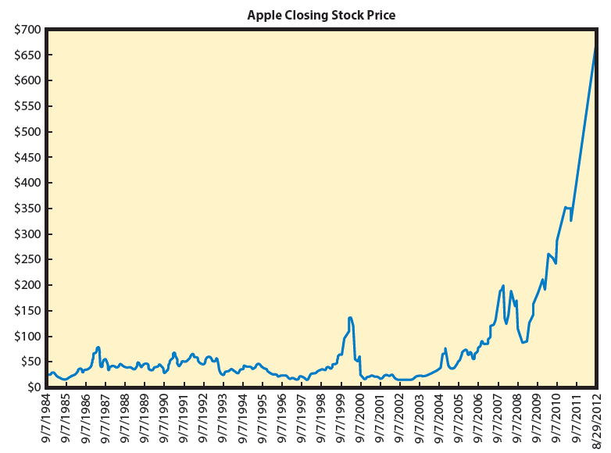
Case Study 4: The Apple of Your i (cont’d)

Slide 39
