Slide 1
Chapter 3
Organizational Strategy, Information Systems, and Competitive Advantage

Slide 2
“Give Me Real Data, I Want Solid Grounding.”
Competitive strategy: To provide absolute lowest, rock-bottom prices on everything we sell
Problem: Reduce operating expenses
Goal: Figure out innovative ways to reduce costs
Solutions:
Need data to identify problematic vendors
Maybe change information system to automatically order and drop ship to customer
Notes:
GOALS
Use GearUp to:
Practice using Porter’s Five Forces Model.
Understand how strategy determines decisions about everything, including IS.
Consider the risks of changes in operations to competitive strategy.
Help students understand how important it is to
a. Know their employers strategy.
b. Pay attention to that strategy in everything they do.

Slide 3
Scenario Highlights Need To:
Practice using Porter’s Five Forces model.
Understand application of competitive strategy.
Consider risks of changes in operations to competitive strategy.
Understand how information and IS can help inform a decision.

Slide 4
Study Questions
Q1: How does organizational strategy determine information systems requirements?
Q2: What five forces determine industry structure?
Q3: What is competitive strategy?
Q4: How does competitive strategy determine value chain structure?
Q5: How do value chains determine business processes and information systems?
Q6: How do information systems provide competitive advantages?

Slide 5
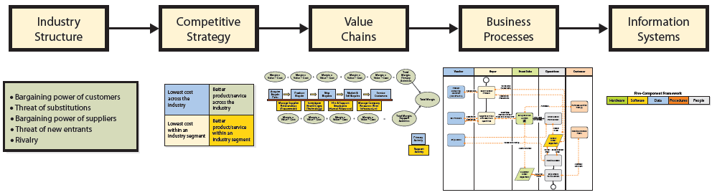
Q1: How Does Organizational Strategy Determine Information Systems Structure?
Industry structure determines competitive strategies.
Competitive strategy determines value chains and business processes.
Business processes determine supporting information systems.
Notes:
Figure 3-1 summarizes a planning process used by many organizations. In short, organizations examine the structure of their industry and, from that, develop a competitive strategy. That strategy determines value chains, which determine business processes. Remember, the nature of business processes determines the requirements and functions of information systems.
Michael Porter developed three different models incorporated in Figure 3-1.

Slide 6
Q2: What Five Forces Determine Industry Structure?
Porter’s five forces
Competitive Forces
Competition from vendors of substitutes
Competition from new competitors
Competition from existing rivals
Bargaining Power Forces
Bargaining power of suppliers
Bargaining power of customers
1
Figure 3-2
4
5
Notes:
Five forces model is used for determining the characteristics of an industry, how profitable it is, and how sustainable that profitability will be. It provides a way to understand competitive environments. That understanding is used to formulate a competitive strategy.

Slide 7
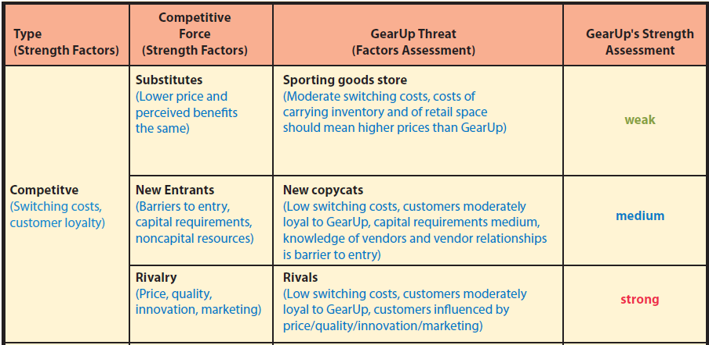
Five Forces and GearUp
Notes:
Two strength factors that relate to all three forces (Substitutes, New Entrants, Rivalry) are switching costs and customer loyalty.

Slide 8
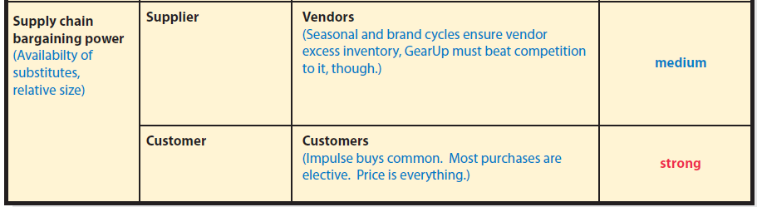
Five Forces and GearUp (cont’d)
Notes:
Bargaining power of GearUp’s vendors is weak. There are many of them and because of the seasonality of sports and the obsolescence of sports products, they all have excess inventory. Side note: the better the vendors can use information systems to predict sales and manage inventory, the lower that excess will be.
Finally, bargaining power of GearUp’s customers is strong because it is mostly impulsive, and driven by super-low prices.

Slide 9
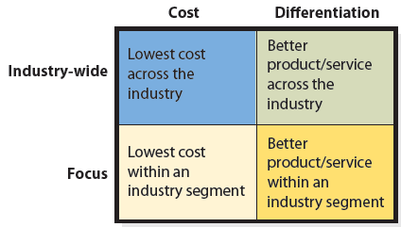
Q3: What Is Competitive Strategy?
Porter’s Four Competitive Strategies
Notes:
To be effective, organization’s goals, objectives, culture, and activities must be consistent with organization’s strategy.
Additionally, information systems must facilitate the competitive strategy.

Slide 10
Q4: How Does Competitive Strategy Determine Value Chain Structure?
Competitive strategy implemented by creating value
Value
Margin = Value – cost
Value chain
Notes:
Value — amount of money a customer is willing to pay for a resource, product, or service
Margin — difference between value an activity generates and cost of that activity
Value chain — a network of value-creating primary and support activities

Slide 11
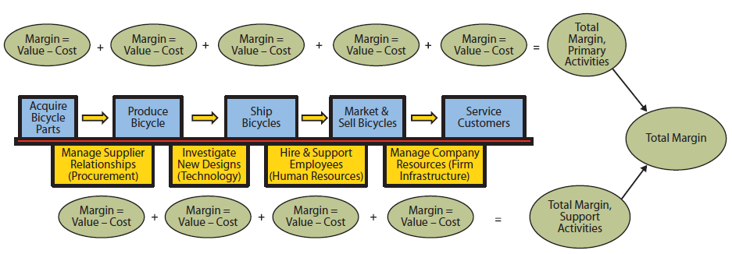
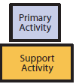
Bicycle Maker’s Value Chain
Notes:
Each stage of this generic chain accumulates costs and adds value to the product. The net result is total margin of value chain.

Slide 12
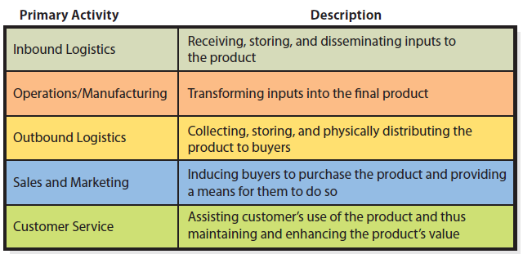
Summary of Value Chain Primary Activities

Slide 13
Support Activities in the Value Chain
Support Activity
Description
Technology | R & D, New Techniques, Methods, Procedures
Procurement | Raw Materials
Human Resources | Training, Recruiting, Compensation
Firm Infrastructure | General Management, Finance, Accounting, Legal, Government Affairs
Notes:
Support activities facilitate the primary activities and contribute indirectly to the production, sale, and service of the product.
Margin of support activities often difficult to calculate due to intangible costs and benefits.

Slide 14
Value Chain Linkages
Interactions across value activities readily supported by information systems
Manufacturing systems use linkages to reduce costs
Sales forecasts used to plan production
Material needs used to schedule purchases
Reduced inventory sizes and costs
Production plan determines raw materials needs
Just-in-time inventory
Notes:
Linkages are interactions across value activities.
For example, manufacturing systems use linkages to reduce inventory costs. Such a system uses sales forecasts to plan production; production plan to determine raw materials needs and to schedule purchases. The result is just-in-time inventory, which reduces inventory sizes and costs.

Slide 15
Q5: How Do Value Chains Determine Business Processes and Information Systems?
Business processes implement value chains or portions of value chains.
Each value chain supported by one or more business process.

Slide 16
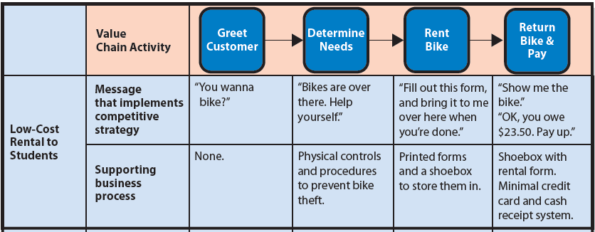
Value Chain for Bicycle Rental Company
Notes:
Note that the value chain activities are the same for both companies. Both greet the customer, determine the customers’ needs, rent a bike, and return the bike. However, each company implements these activities in ways that are consistent with its competitive strategy.

Slide 17

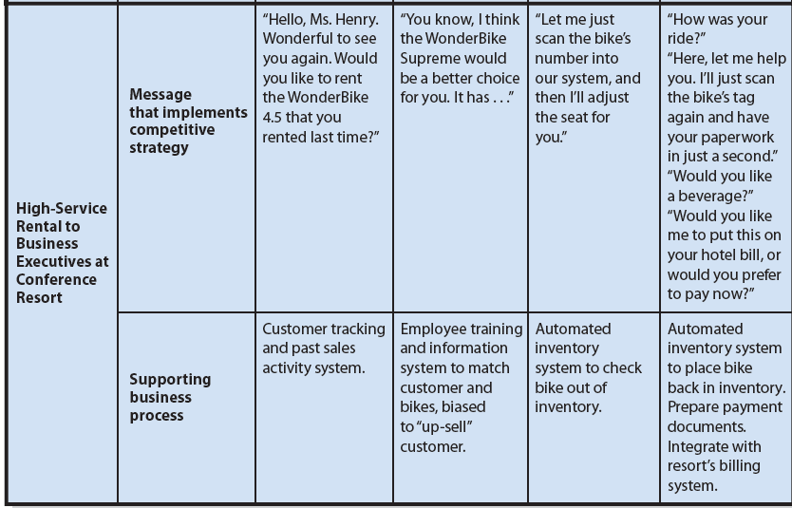
Value Chain for Bicycle Rental Company (cont’d)

Slide 18
Experiencing MIS InClass Exercise 3: Competitive Strategy Over the Web
Industry Structure
Value Chains
Information Systems
Competitive Strategy
Business Processes
www.sportsauthority.com vs. www.soccer.com
www.target.com vs. www.sephora.com
www.woot.com vs. www.amazon.com
www.petco.com vs. www.wag.com
www.llbean.com vs. www.rei.com
Notes:
Use knowledge of organization’s market, together with observations of structure and content of Web storefront, to infer organization’s competitive strategy and make inferences about its value chains and business processes.

Slide 19
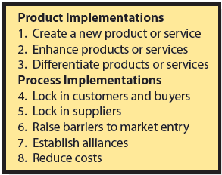
Q6: How Do Information Systems Provide Competitive Advantages?
Notes:
Organizations gain a competitive advantage by creating new products or services, by enhancing existing products or services, and by differentiating their products and services from those of their competitors.
Lock in customers by creating high switching costs.
Make it easy for suppliers to connect to and work with your organization.
Alliances establish standards, promote product awareness and needs, develop market size, reduce purchasing costs, and provide other benefits.
Create better business processes to reduce costs.
An information system can be part of a product or can provide support for a product or service.

Slide 20
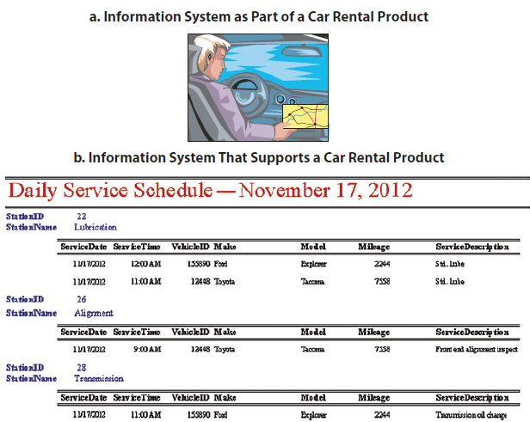
How Does an Actual Company Use IS to Create Competitive Advantages?
Notes:
Illustrates how ABC successfully uses information technology to gain competitive advantage.
ABC maintains customer account data that includes customer’s name, address, and billing information, and data about the identity of customer and locations to which the customer ships.

Slide 21
How Does an Actual Company Use IS to Create Competitive Advantages?
Maintains customer account data
IS collects information for ABC (adds value)
IS saves customers time by automatically filling in part of form (adds value for customer)
Package & information delivery system
IS helps customer to select delivery address and generate shipping labels
What value does shipper get?

Slide 22
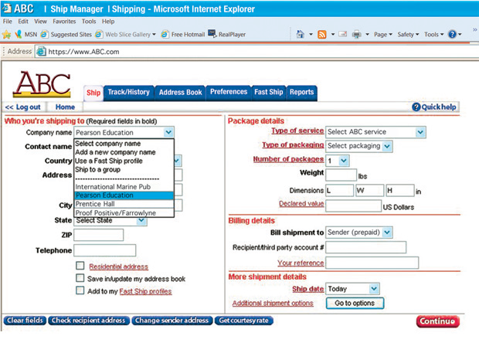
ABC Web Page to Select Recipient from Customer’s Records
Notes:
Shows a Web form that an ABC customer is using to schedule a shipment. When the ABC system creates the form, it fills the Company name dropdown list with the names of companies that the customer has shipped to in the past.

Slide 23
ABC Web Page to Select a Contact from Customer’s Records
Notes:
When the user clicks Company name, the underlying ABC information system reads customer’s contact data from a database. Data consist of names, addresses, and phone numbers of recipients from past shipments. User then selects a Contact name, and system inserts that contact’s address and other data into the form using data from the database

Slide 24
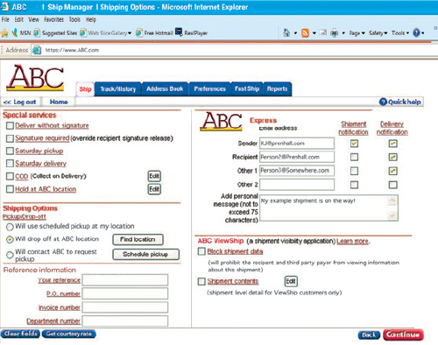
ABC Web Page to Specify Email Notification
Notes:
On right-hand side of form, the customer can request ABC send email messages to the sender (the customer), recipient, and others.
By adding this capability to shipment-scheduling system, ABC extended its product from a package-delivery service to a package- and information-delivery service.

Slide 25
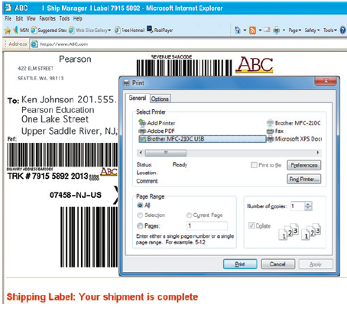
ABC Web Page to Print Shipping Label
Notes:
By doing this, the company reduces errors in preparation of shipping labels, and causes customer to provide paper and ink for document printing.

Slide 26
How Does This System Create a Competitive Advantage?
Enhances existing products
Differentiates products
Locks in customers
Raises barriers to market entry
Increases profit margins by decreasing costs and decreasing errors

Slide 27
How Does Knowledge in This Chapter Help You?
Explain how Kelly’s comments are consistent with GearUp’s competitive strategy.
Explain why Lucas’ idea of adding value to justify a price increase is inconsistent with GearUp’s strategy.
Explain relationship between competitive strategy and information systems requirements.
Summarize what you learned in a statement you could make in a job interview.

Slide 28
Yikes! Bikes! Goals
You are the operations manager for Yikes! Bikes, a manufacturer of high-end mountain bicycles.
New owners plan to pursue lowest-cost vendor strategy by importing low-cost, lower quality bikes
New owners are not being honest with employees about cutting jobs
Say you might be promoted to new general manager. Should you trust them?
Q: Are owners actions illegal? Unethical?
Notes:
GOALS
Sensitize students to the fact that a competitive strategy is not just an academic topic. Changing competitive strategy has dramatic impacts on personnel and company culture.
Understand practical applications of business reports.
Explore ethical questions concerning communication about sensitive topics.
This guide illustrates the uncomfortable position many managers face when they possess knowledge that cannot be communicated to others in the company.
As a manager, you will sometimes have information that you are not supposed to communicate to employees. If an employee asks you directly about that information, you can either divulge it or lie. Which would you choose? What are the consequences of either choice?
Is there an alternative between inappropriately divulging information and lying? What is it? What disadvantages does that alternative have?
In general what are the consequences on the organization’s culture of moving from a differentiation strategy to a low-cost strategy?
In general what are the consequences on the organization’s culture of moving from a low-cost strategy to a differentiation strategy?

Slide 29
Guide: Your Personal Competitive Advantage (cont’d
Who will be your competitors when you seek a job after graduating from college?
What will be your competitive advantage in the job market?
What can you do before you graduate to develop your competitive advantage?
Notes:
GOALS
Raise students’ awareness that they should be engaged in job planning/searching right now.
Show the application of the principles of competitive advantage to career planning.
Suggest innovative tasks for job searching.
Students seldom understand how their status as students gives them access to businesspeople that they will lose after they graduate. Why should students talk with businesspeople and start building their networks now?
Encourage students to realize that they aren’t competing just with the students on their campus or their state. They are competing with students all over the world.

Slide 30
Guide: Your Personal Competitive Advantage (cont’d)
How do these elements of
competitive advantage apply to you personally?
Switching costs?
Differentiating products?
Creating barriers?
Establishing alliances?
Reducing costs, increasing revenues?

Slide 31
Active Review
Q1: How does organizational strategy determine information systems requirements?
Q2: What five forces determine industry structure?
Q3: What is competitive strategy?
Q4: How does competitive strategy determine value chain structure?
Q5: How do value chains determine business processes and information systems?
Q6: How do information systems provide competitive advantages?

Slide 32
BOSU Case Study
Analyze the five competitive forces for Bosu’s market.
Visit www.bosu.com. What appears to be Bosu’s competitive strategy?
Explain Bosu’s five primary value chain activities.
What information systems can Bosu create to enhance or differentiate its product?
Notes:
BOSU has successfully used the principles of product enhancement, customer lock-in, raising entry barriers, and alliances to defeat copycat products.
Information systems were very important. The database of trainer data was used extensively to help create and maintain the close relationship Fitness Quest desired with their trainers.

Slide 33
BOSU Case Study
What information systems can Bosu develop to create barriers to entry to the competition?
What information system can Bosu develop to lock in customers?
What information systems can Bosu develop to establish alliances?
Notes:
Fitness Quest could enhance its products through information systems. BOSU buyers could register for email-based newsletters, participate in chat groups about how they like and use their BOSU trainers. Buyers could track and monitor their weight loss and fitness goals on the website and share progress with others. Fitness instructors could share ideas about BOSU-based classes. These features would help distinguish BOSU from copycats. The systems described here would help to strengthen ties to customers.
Barriers to entry are raised because a competitor would have to develop the trainer and develop the supporting information systems that customers expect. If BOSU provides valuable product enhancement through its information systems, then customers are likely to stay loyal.
Fitness Quest should focus on information systems that help communicate with and support its trainers who are interested in creating IndoRow classes. Trainers could register for email-based newsletters. Trainers could participate in chat groups about how they like and use their IndoRow machines. Fitness instructors could share ideas about IndoRow-based classes in forums. Trainers could provide feedback on the devices that could lead to product enhancements or extensions of the product line. Referral rewards could be provided to trainers who sign up their colleagues.

Slide 34
