Slide 1
Chapter 2
Business Processes, Systems Information, and Information

Slide 2
“How Would We Do That? Where’s the Data?”
Buyers don’t communicate with operations when negotiating with vendors
Buyers need data to look at prices and costs of dealing with individual vendors
Need more data and people involved in making negotiating deals.
Notes:
GearUp’s competitive strategy is to be the low-price leader, which requires them to minimize their costs. An information system that tracks the expense of working with individual vendors would help them negotiate better deals. At this point, their information systems are not supporting their strategy as well as they could.
GOALS
Practice recognizing the need for changes to processes.
Understand how competitive strategy guides IS development.
Understand how information and IS can inform a decision.
Use a business scenario to underline the difference between data and information
Use GearUp to:
Practice using Porter’s Five Forces Model.
Understand the application of competitive strategy.
Consider the risks of changes in operations to competitive strategy.

Slide 3
Study Questions
Q1: Why does the GearUp team need to understand business processes?
Q2: What is a business process?
Q3: How can information systems improve process quality?
Q4: What is information?
Q5: What data characteristics are necessary for quality information?
Notes:
This chapter focuses on how information systems support competitive strategy and how IS can create competitive advantages. A Porter’s Five Forces model is used to explain how organizations analyze their industry and select a competitive strategy. The value chain model is used to explain the creation of business processes and how strategy, value chain and processes determine information systems structure. In the last section is a discussion of how companies use information systems to gain a competitive advantage.

Slide 4
Q1: Why Does the GearUp Team Need to Understand Business Processes?
Needs to understand its existing processes and to identify the problems they have.
Needs to redesign its current processes.
Needs to know where and how to save costs?
Notes:
Procurement and sales process will show how an information system can help GearUp to record problems and better negotiate with, or avoid, its problematic vendors.

Slide 5
Q2: What is a Business Process?
Network of activities for accomplishing a business function
Such as: buying & managing inventory, making sales to customers, paying bills, collecting revenue, and hundreds of other business functions

Slide 6
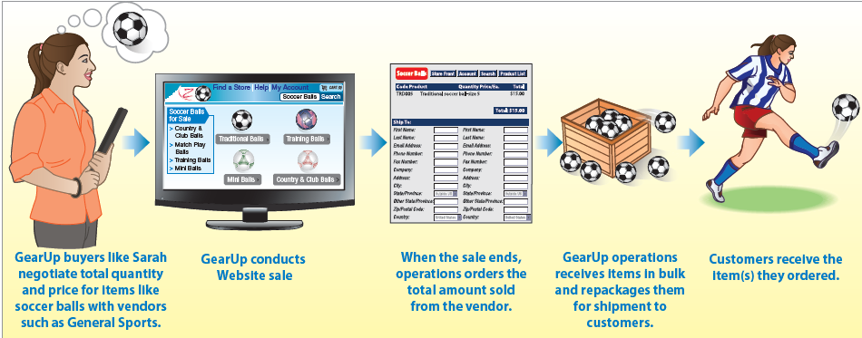
GearUp Ordering Activities
Notes:
As shown, vendors agree to sell a certain quantity of items to GearUp at very low prices. Typically these items are discontinued, or out of season, or out of style, or for which the vendor has a need to reduce its inventory

Slide 7
How GearUp Works
Vendor agrees to sell certain quantity of items to GearUp at very low prices.
GearUp negotiates price and number of items, then conducts an auction on GearUp’s Web site.
After action closes, GearUp orders total number of items sold.
GearUp receives items in bulk from vendor, repackages them, and ships to customers.
Example: http://www.zulilly.com/

Slide 8
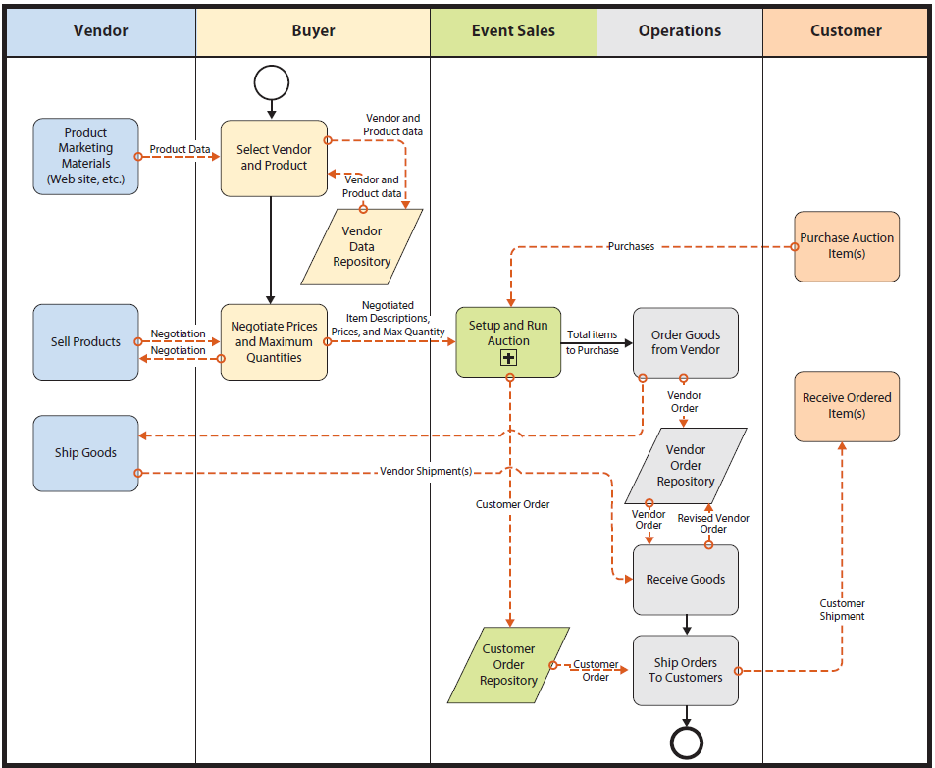
Existing GearUp Business Process Using BPMN
Notes:
Figure 2-2 is organized in what is called swimlane format, which is a graphical arrangement of activities for a given role.

Slide 9
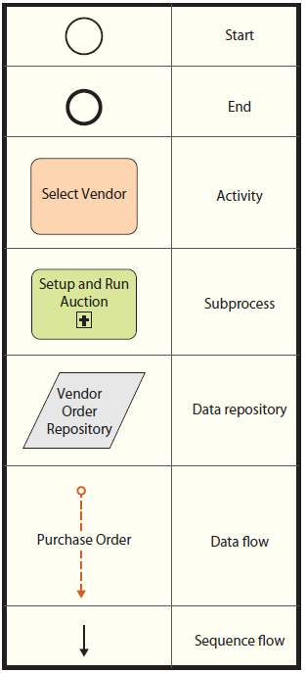
Process Symbols (BPMN Standard)

Slide 10
Components of a Business Process
Activities – Transform resources and information of one type into another type
Decisions – A question that can be answered Yes or No
Roles – Sets of procedures
Resources – People, or facilities, or computer programs assigned to roles
Repository – Collection of business records

Slide 11
Q3: How Can Information Systems Improve Process Quality?
Dimension of Process Quality
Effectiveness:
Business process enables organization to accomplish its strategy.
Efficiency
Ratio of benefits to costs
Costs – time and infrastructure
Notes:
GearUp’s current process, shown in Figure 2-2, is not effective. GearUp wants to provide lowest-possible prices, and Kelly and Emily think its operational costs are too high. Drew believes if buyers knew about problems caused by certain vendors, buyers could negotiate compensation for the cost of the problems, or avoid those vendors entirely.
Examine Figure 2-2 to see source of the ineffectiveness. The Receive Goods activity of Operations stores results of vendor shipments in Vendor Order Repository. However, when Buyers are deciding which vendors and products to sell and negotiating with chosen vendor, they use only the Vendor Data Repository. They do not have access to the data in the Vendor Order Repository.
One way to make this process more effective, and raise product quality, is to change its structure.

Slide 12
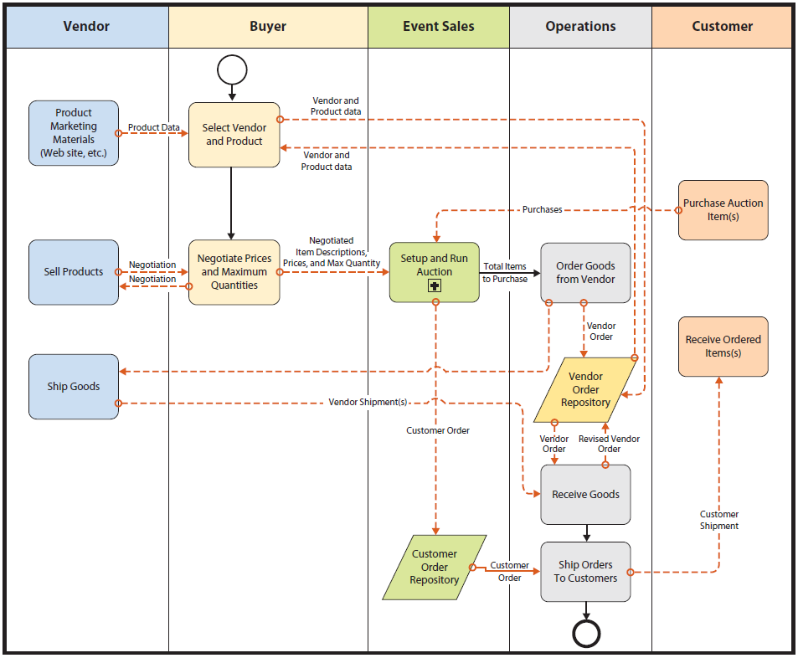
Revised GearUp Process Using BPMN
Buyers and Operations share a single, integrated repository of vendor data
Notes:
Figure 2-4 shows a different version of this business process, in which Buyers and Operations share a single, integrated repository of vendor data.

Slide 13
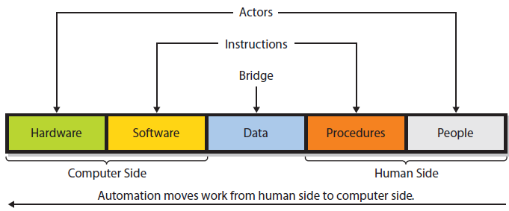
Using Information Systems to Improve Process Quality
Notes:
Notice the symmetry of these components. Outer most components, hardware and people are both actors, they take action. Software and procedure components are sets of instructions. Software is instructions for hardware and procedures are instructions for people. Data is the bridge between the computer side and human side.

Slide 14
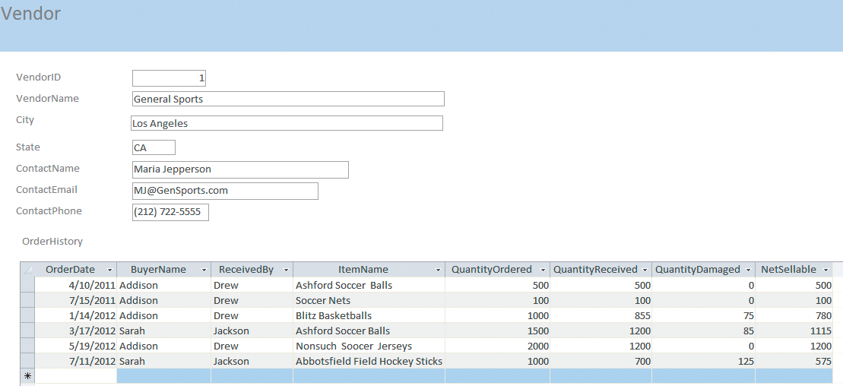
GearUp Data on General Sports
Notes:
General Sports consistently shipped fewer items (Quantity Received) than it agreed to ship (QuantityOrdered). Some items were damaged. With this data, buyers can negotiate price concessions on future orders to compensate for extra operational expense of these short shipments. If so, GearUp can pass those lower prices on to its customers, and better achieve its strategy. The report shown in Figure 2-6 makes this process more effective.
Bottom line: information systems can increase process quality by increasing both process efficiency and effectiveness.

Slide 15
Q4: What Is Information?
Knowledge derived from data, where data is defined as recorded facts or figures
Data presented in a meaningful context
Processed data, or data processed by summing, ordering, averaging, grouping, comparing, or other similar operations
A difference that makes a difference
Notes:
That employees James Smith earns $17.50 per hour and Mary Jones earns $25.00 per hour are data.
That the average hourly wage of all the aerobics instructors is $22.37 per hour is information.
Average wage is knowledge derived from the data of individual wages.

Slide 16
Where Is Information?
Graph is not, itself, information
Graph is data you and others perceive, use to conceive information
Ability to conceive information from data determined by cognitive skills
People perceive different information from same data
Notes:
Does that graph contain information? If it shows a difference that makes a difference or if it presents data in a meaningful context, then it fits two of the definitions of information, and it’s tempting to say that the graph contains information.
However, show that graph to your family dog. Does your dog find information in that graph?

Slide 17
Most Important Part of Any Information System
YOU!
Quality of your thinking, your ability to conceive information from data, determined by your cognitive skills
Information is value you add to information systems.

Slide 18
Experiencing MIS InClass Exercise 2: How Much Is a Quarter Worth?
Some universities operate on quarter system of 10-11 weeks each. Most students attend three quarters a year.
Majority of universities operate on 15-16 week semester system.
One unit of credit in quarter systems is worth two-thirds of semester credit.

Slide 19
Experiencing MIS InClass Exercise 2: How Much Is a Quarter Worth? (cont’d)
Consider following business processes and their costs
Schedule classes
Allocate classrooms and related equipment
Staff classes
Enroll students
Prepare and print course syllabi
Adjust enrollments via add/drop
Schedule finals
Allocate final exam rooms
Grade finals
Record final grades

Slide 20
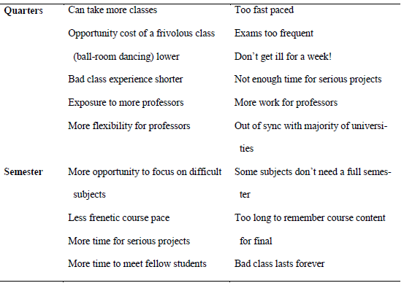
Experiencing MIS InClass Exercise 2: How Much Is a Quarter Worth? (cont’d)
Notes:
Summary of opinions on relative merits of two systems.

Slide 21
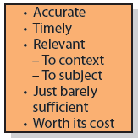
Q5: What Data Characteristics Are Necessary for Quality Information?
Notes:
Accurate – Correct and complete, crucial for management, can cross-check information to ensure accuracy
Timely – Produced in time for intended use
Relevant – To context and subject
Just sufficient – For purpose it is generated, avoids too much or extraneous information
Worth its cost – Relationship between cost and value; information systems cost money to develop, maintain, and use; must be worth that cost

Slide 22
How Does the Knowledge In This Chapter Help You?
Be able to document GearUp’s business processes, and explain in a professional way how GearUp should develop new or adjust existing information systems
Think about similar issues you will likely encounter in your career.

Slide 23
Ethics Guide: Egocentric vs. Empathetic Thinking (summary)
Egocentric thinking
Centers on self
Someone who considers his or her view as “the real view” or “what really is”
Empathetic thinking
Considers their view as one possible interpretation and actively works to learn what other people are thinking
Notes:
Goals
Raise the level of professionalism in the class.
Explore empathetic thinking and discuss why it’s smart.
Discuss two applications of empathetic thinking.
Emphasize that a problem is a perception and that perceptions differ among people.
Discuss that different problem perceptions require different information systems.

Slide 24
Egocentric Thinking
“Professor Jones, I couldn’t come to class last Monday. Did we do anything important?”
Egocentric Thinking Approach
Implies student isn’t accountable for his/her actions
Implies professor lectured on nothing important
Doesn’t take into account professor’s view of absences
Assumes professor has time to rehash class discussions and activities one-on-one
Puts responsibility on professor to remember everything said in class

Slide 25
Empathetic Thinking
Important skill in all business activities
Skilled negotiators always know what other side wants; effective salespeople understand customers’ needs
Buyers who understand problems of their vendors get better service

Slide 26
Guide: Understanding Perspectives and Points of View
Everyone speaks and acts from a personal perspective.
Everything we say or do is based on and by that point of view.
Conflicting perspectives can all be true.
Ability to discern and adapt to perspectives and goals of others will make you much more effective.
Notes:
Goals
Reinforce the text’s statement that, although none of us can change our IQ, we can improve the way we think, and thus improve our effective “smarts.”
Teach the importance of perspective in thinking and communication—everyone interprets the world in the context of their perspective.
Encourage the students to think critically about the text, about your presentations, and about comments made by their fellow students.

Slide 27
Ethics Guide: Understanding Perspectives and Points of View (cont’d)
You buy a new laptop and it fails within a few days. Repeated calls to customer support produce short-term fixes, but your problem continues.
Three plausible reasons for the problem
Customer service does not have data about prior customer contacts.
Customer support reps recommended a solution that did not work.
Company is shipping too many defective laptops.

Slide 28
Guide: Understanding Perspectives and Points of View (cont’d)
A “problem” is a perceived difference between what is and what ought to be
Development team needs a common definition and understanding of problem in order to communicate
What can a development team do to create common definitions and understanding?

Slide 29
Active Review
Q1: Why does the GearUp team need to understand business processes?
Q2: What is a business process?
Q3: How can information systems improve process quality?
Q4: What is information?
Q5: What data characteristics are necessary for quality information?

Slide 30
Case Study 2: Fulfillment by Amazon (FBA)
 | Sold via Amazon.com | Sold elsewhere
Order handling (per order) | $1.00 | $4.75 (+)
Pick & pack (per item) | $1.00 | $0.75
Weight handling (per pound) | $0.37 | $0.45 (+)
Storage (cubic foot per month) | Minimum $0.45 (rates vary by time of year) | Minimum $.045 (rates vary by time of year)
Notes:
The table summarizes the FBA fees for products like sporting goods as of May 2012.
Goods sold via Amazon.com, Amazon uses its own information systems to drive the order fulfillment process.
Goods are sold via an FBA customer’s sales channel, then the FBA customer must connect its own information systems with those at Amazon.
Amazon provides a standardized interface by which this is done called Amazon Marketplace Web Service (MWS).
FBA enables companies to outsource order fulfillment to Amazon, thus avoiding the cost of developing their own processes, facilities, and information systems for this purpose. Is FBA right for GearUp?

Slide 31
