Slide 1
Chapter 1
The Importance of MIS

Slide 2
“But Today, They’re Not Enough.”
Jennifer lacks skills FlexTime needs
Abstract reasoning skills
Systems thinking skills
Collaboration skills
Experimentation skills
Notes:
GOALS
Use GearUp to:
Engage students’ interest and emotions.
Impart that Reich’s four skills are not an academic theory; they are skills needed by business professionals today.
Convey that people without Reich’s four skills are at a disadvantage.
Establish that this course is an excellent way to learn Reich’s four skills.
Setup the GearUp case for use with Chapters 2–6.

Slide 3
Study Questions
Q1: Why is Introduction to MIS the most important class in the business school?
Q2: What is an information system?
Q3: What is MIS?
Q4: Why is the difference between information technology and information systems important to you?
Q5: What is your role in IS security?

Slide 4
Q1: Why Is Introduction to MIS the Most Important Class in the Business School?
Number of transistors per square inch on an integrated chip doubles every 18 months
Speed of computer chip increases in proportion to density of transistors
Price/performance ratio falls dramatically

Slide 5
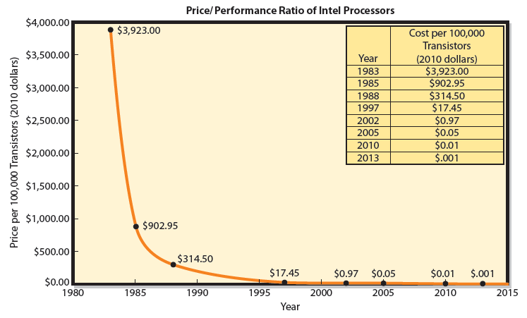
Computer Price/Performance Ratio Decreases
Notes:
You needn’t care how fast a computer your company can buy for $100.
Moore’s Law: See Thomas Moore Video Podcast

Slide 6
All of These Companies Exist Because of Moore’s Law
YouTube
iPhone
Facebook
Second Life
Pandora
Twitter
LinkedIn
Cost of data communications and data storage essentially zero
Notes:
What happens when the cost of data communications and data storage is essentially zero?

Slide 7
What Are Cost-Effective Business Applications of Facebook and Twitter or Whatever Will Soon Appear?
Are these applications cost-effective?
Do they generate revenue worth the time and expense of running them?
Someone needs to be examining that question, and that person works in marketing ... not in a technical field.
Notes:
It's not over. Facebook and Twitter are not the end. Right now, companies are employing an application you'll study in Chapters 7–12 and new processing capabilities called the cloud in innovative ways ... using technology and techniques that have never been seen before.

Slide 8
How Can I Attain Job Security?
Knowledge and skills are your job security
Ability to cope with rapid technological change
Develop non-routine cognitive skills and ability
Organizations favor those with strong non-routine cognitive skills
Notes:
There is no job security, no secure investments and no security in Social Security. Your only job security is a marketable skill and courage to use it.
Rapid technological change and increased international competition spotlight non-routine cognitive skills and the ability to adapt to changing technology and shifting demand
Students need to develop strong non-routine cognitive skills and the ability to cope with rapid technological change.

Slide 9
How Can I Attain Job Security? (cont'd)
Business professionals need to assess, evaluate, and apply emerging information technology to business.
Knowledge gained in this course will help you attain skills that lead to greater job security.

Slide 10
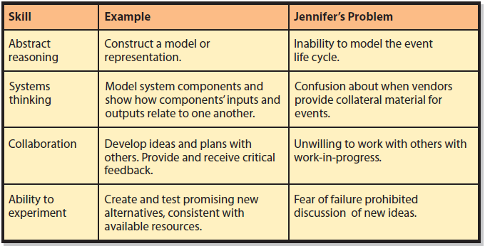
Why Jennifer Lost Her Job
Notes:
It is important for students to know that these skills can be developed and enhanced through training and practice, just like other skills.

Slide 11
How Can Intro to MIS Help You Learn Non-Routine Skills?
Abstract Reason
Chapter 1: Model of an information system
Chapter 2: How to use IS model to assess scope of any new information system project
Chapter 5: How to create data models
Chapter 7: How to make process models
Notes:
Abstract thinking involves using models. One or more models in every course topic and book chapter.

Slide 12
How Can Intro to MIS Help You Learn Non-Routine Skills? (cont’d)
Systems Thinking
Ability to model system components, connect inputs and outputs among components to reflect structure and dynamics of system observed
Every chapter, especially Ch. 2–7 and 10
Notes:
All of those tasks will prepare you for systems thinking as a professional.

Slide 13
How Can Intro to MIS Help You Learn Non-Routine Skills? (cont’d)
Collaboration
Activity of two or more people working together to achieve a common goal, result, or work product
Chapter Extensions 2A and 2B discuss collaboration skills and illustrate several sample collaboration information systems
Notes:
Chapter Extensions 1 and 2 will teach you collaboration skills and illustrate several sample collaboration information systems. Every chapter of this book includes collaboration exercises that you may be assigned in class or as homework.

Slide 14
How Can Intro to MIS Help You Learn Non-Routine Skills? (cont’d)
Ability to Experiment
Make reasoned analysis of an opportunity; developing and evaluating possible solutions
“I’ve never done this before.”
“I don’t know how to do it.”
“But will it work?”
“Is it too weird for the market?”
Fear of failure paralyzes
Notes:
Using features and functions of Microsoft Excel, Access not used before. Collaborating using Microsoft SharePoint, Google Docs and Spreadsheets, or other collaboration tools.
Think about GearUp's margin problem. Is there a way it could use social networking within the company to reduce expenses? Could buyers use Facebook or Twitter to share ideas on negotiating the best price? Or, would Google+ be a better choice? Is there anyone in the world who can tell you what to do? How to proceed?

Slide 15
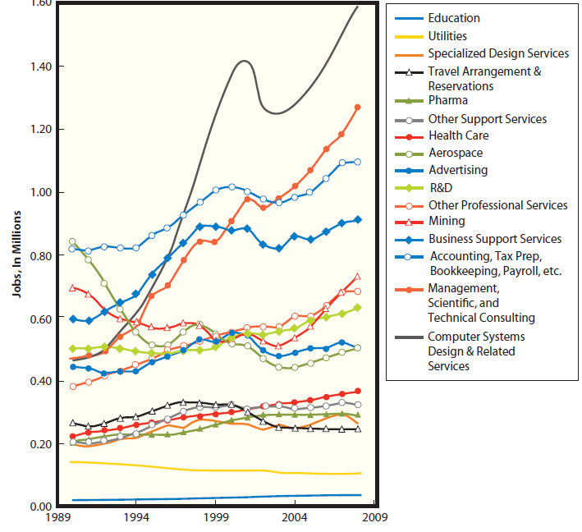
Job Growth over the Past Twenty Years
Notes:
One in two recent college graduates either unemployed or underemployed, but, not in all job categories.
If you have a degree in creative writing or European history, jobs may be hard to find.
Situation is dramatically different for computer related information systems jobs.

Slide 16
What is the Bottom Line?
Assess, evaluate, and apply emerging information systems technology to business.
Learn abstraction, systems thinking, collaboration, and experimentation.
There is strong growth in the number of available jobs for those with strong cognitive skills.
Read Ethics Guides about ethical dilemmas.
Notes:
Ethics Guides in every chapter get students to think about ethical dilemmas and to clarify their values so they will be ready to respond authentically to future ethical challenges.

Slide 17

Q2: What Is an Information System?
Group of components that interact to produce information.
Notes:
There are information systems that do not include computers. Double entry accounting or bookkeeping began in the 15th century.

Slide 18
Experiencing MIS InClass Exercise 1: Information Systems and Online Dating
Basis | Companies
Theory of relationships: personality, compatibility, etc. | Chemistry eHarmony PerfectMatch Plenty of Fish
Political interests | ConservativeDates Liberalhearts
Common social/economic interests | GoodGenes MillionaireMatch
Common activity interests | Golfmates EquestrianCupid CowboyCowgirl Single Firefighters Asexual Pals

Slide 19
Q3: What Is MIS?
Development and use of information systems
Achieve business goals and objectives
Goal of MIS
Aligning IS to achieve business goals and objectives

Slide 20
What Is MIS (cont’d)
Management
Means develop, maintain, and adapt
To create an information system that meets your needs, take an active role in system’s development. Why?
Business professionals understand business needs and requirements.

Slide 21
Development and Use of Information Systems
Business professionals need to:
Take active role in IS to ensure systems meet their needs
Understand how information systems are constructed
Consider users’ needs during development
Learn how to use information systems
Take into account ancillary IS functions (security, backups)

Slide 22
Achieving Strategies
MIS empowers users to achieve business objectives
Information systems exist to assist business people
Information systems exist to help achieve business goals and objectives
Notes:
• “What is the purpose of our Facebook page?”
• “What is it going to do for us?”
• “What is our policy for employees’ contributions?”
• “What should we do about critical customer reviews?”
• “Are the costs of maintaining the page sufficiently offset by the benefits?”

Slide 23
Q4: Why Is the Difference Between Information Technology and Information Systems Important to You?
Information technology (IT)
Products
Methods
Inventions
Standards
IT components = Hardware + Software + Data
IS = IT + Procedures + People

Slide 24
Why Is the Difference Between Information Technology and Information Systems Important to You? (cont’d)
Avoid a common mistake: Cannot buy an IS
Can buy, rent or lease hardware, software and databases, with predesigned procedures.
People execute procedures to employ new IT.
Use of new system requires training, overcoming employees’ resistance, and managing employees as they use new system.
Notes:
Assume your organization decides to develop a Facebook page.

Slide 25
Q5: What Is Your Role in IS Security?
Security systems have five components, including people.
Security system ultimately depends on behavior of its users.
If security procedures are not followed, then hardware, software, and data components of security system are wasted expense.
Notes:
Chapter 12 is devoted to security.

Slide 26
Passwords Are Necessary
Should have a strong password
Protect passwords from others (critical)
Practice proper etiquette
Never write down your password
Do not share it with others
Never ask others for their password

Slide 27
Creating a Strong Password
Rules for strong password:
Use ten or more characters
Do not include your user name, real name, or company name
Do not use complete dictionary word in any language
Is different from previous passwords you have used
Contains both upper- and lowercase letters, numbers, and special characters (such as ~ ! @; # $ % ^; &; * ( ) _ +; – =; { } | [ ] \ : “ ; ’ <; >;? , . /)

Slide 28
Password Etiquette: Mark of a Business Professional
Never write down your password, do not share it with others
Never ask others for their password
Never give your password to someone else
“do-si-do” move—one person getting out of way so another person can enter a password—common professional practice

Slide 29
How Does the Knowledge in This Chapter Help You?
Learn Reich’s four key skills: abstract reasoning, systems thinking, experimentation, and collaboration. Then, practice, practice, practice.
Future belongs to businesspeople who can creatively envision new applications of information systems and technology.

Slide 30
How Does the Knowledge in This Chapter Help You? (cont’d)
Learn IS components and understand business professionals need to take active role in information systems development
Know difference between IT and IS
Create strong passwords, use them and follow professional password etiquette

Slide 31
Ethics Guide: Ethics of Misdirected Information Use
You overhear a conversation between a real estate agent and the couple competing with you to purchase a condo.
Should you listen?
Should you use the information you hear?
You receive same information above through an email accidentally sent to your inbox.
Should you read the email?
Should you use the information to your advantage?
Notes:
Goals
Teach students about the problem of unintentionally revealing sensitive data in public places.
Explore ethical issues concerning the use of misdirected data.
Differentiate between unethical and illegal.

Slide 32
Ethics Guide: Ethics of Misdirected Information Use (cont’d)
While selling computer software, a customer mistakenly sends you an internal email that contains maximum amount they can pay.
Q: Do you share the email with others?
Q: Do you notify the person who sent it?
Q: Do you use the information or recuse yourself from the deal?
Q: What’s the ethical thing to do? What’s the best long-term business thing to do? Explain.

Slide 33
Ethics Guide: Ethics of Misdirected Information Use (cont’d)
A friend inadvertently emails you personal medical data. You read the email and learn embarrassing information about the friend. Your friend asks if you read the email.
Q: What should you say?

Slide 34
Ethics Guide: Ethics of Misdirected Information Use (cont’d)
You are a network administrator with unrestricted access to mailing lists. You insert your email address into several lists and receive confidential information. One email shows that your best friend’s department is going to be eliminated.
Q: Do you warn your friend?

Slide 35
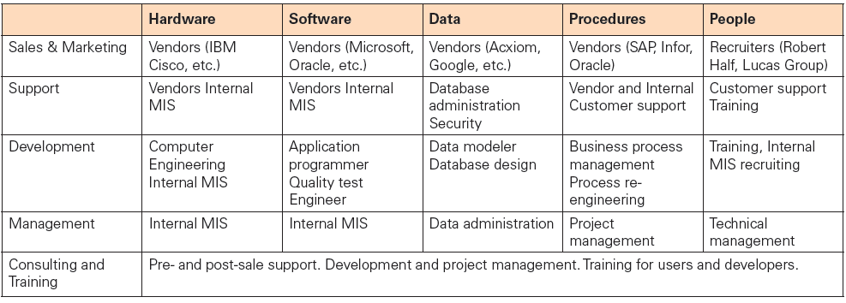
Five-Component Careers
Notes:
GOALS
Motivate the students for study in this course and in others by reminding them of the need to be preparing for jobs now. Employment will not necessarily be easy.
Broaden the students’ perspectives about MIS careers. Many exciting jobs other than programmer or hardware specialist exist.
Make the students aware that a lot of interesting jobs that require MIS skills are not necessarily “computer” jobs. Professional sales are one, for example.
Re-enforce the five component model and show the students another way they can use it to guide their thinking.

Slide 36
Active Review
Q1: Why is Introduction to MIS the most important class in the business school?
Q2: What is an information system?
Q3: What is MIS?
Q4: Why is the difference between information technology and information systems important to you?
Q5: What is your role in IS security?

Slide 37
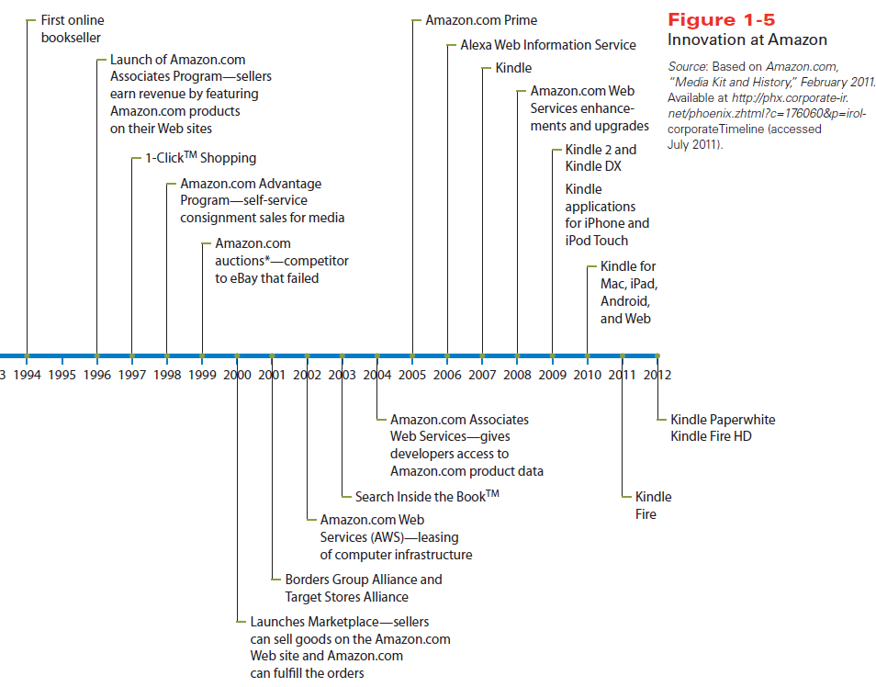
Case Study 1: The Amazon of Innovation
Notes:
Figure shows list of business innovations created by Amazon for online retailing. Began as an online bookstore in 1994, and added new product categories. In 2011, Amazon sold goods in 29 product categories.

Slide 38
Case Study 1: The Amazon of Innovation (cont'd)
Amazon’s business lines three categories:
Online retailing
Own inventory
Associates program
Consignment
Order fulfillment
Cloud services
Notes:
Amazon built an enormous supporting infrastructure to ship 9 million items a day during the busy holiday season. Most of the year, Amazon.com has excess infrastructure capacity. Starting in 2000, Amazon began to lease some of that capacity to other companies and that led to the creation of cloud services.
You can ship your inventory to an Amazon warehouse and access Amazon’s information systems just as if they were yours.
Amazon Web Services allows organizations to lease time on computer equipment in very flexible ways. Organizations can expand and contract their computer resources within minutes.

Slide 39
