Slide 1
Chapter Extension 18
International MIS
Notes:
This chapter extension is a capstone of all 12 chapters of this book.

Slide 2
Study Questions
Q1: How does the global economy impact organizations and processes?
Q2: What are the characteristics of international IS components?
Q3: What are the challenges of international enterprise applications?
Q4: How do inter-enterprise IS facilitate globalization?
Q5: What are the challenges of international IS management?

Slide 3
Q1: How Does the Global Economy Impact Organizations and Processes?
After World War II, Japanese and other Asian countries increase manufacturing
Fall of Soviet Union opened economies of Russia and Eastern Europe
N. American and European economies integrated
Plentiful, cheap telecommunications
Booming economies: India, China, Brazil
EU- and U.S.-based companies find greatest opportunities outside own national markets
Notes:
After World War II, Japanese and other Asian countries began to manufacture and sell goods to the West.
Rise of Japanese auto and semiconductor industries greatly expanded international trade.
Chinese economy became more open to the world.

Slide 4
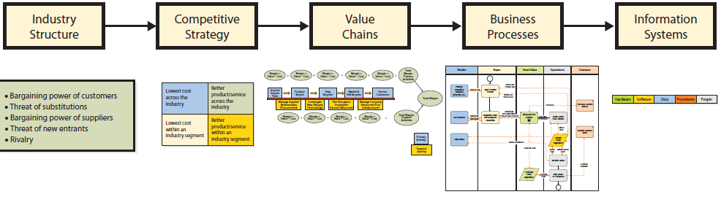
Global Strategy Determines Global Information Systems

Slide 5
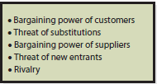
How Does the Global Economy Change the Competitive Environment?
Impact of Internet
Wider range of customers
Wider range of vendors
Facilitates new entrants
Intensifies rivalry
Accelerates flow of data about price, product, availability and service
Notes:
Internet-supported world economy has altered every one of five competitive forces.
Suppliers can reach wider range of customers, and customers can consider wider range of vendors.
Suppliers and customers benefit from greater size of the economy and easy access to data about direct competitors, new entrants and substitute businesses.

Slide 6
How Does the Global Economy Change Competitive Strategy?
Competing in many different countries localized to the language and culture
Internet supports unprecedented market size and product differentiation
Notes:
Competing in many different countries, with products localized to the language and culture of those countries, is an enormous and expensive task.
Size, combined with the Internet, enables unprecedented product differentiation.
Decisions involving a global competitive strategy require the consideration of these two changing factors.

Slide 7
How Does the Global Economy Change Value Chains and Business Processes?
Any or all of value chain activities can be performed anywhere
Final product frequently distributed throughout world
Abundance of low-cost, well-educated, English-speaking professionals allows outsourcing service and support functions
Ability to work 24/7 by moving work into other time zones increases productivity

Slide 8
Q2: What Are the Characteristics of International IS Components
Hardware – sold worldwide
Software and interfaces – in multiple, local languages
Data – choosing language(s) for data descriptions and remarks
Procedures – reflect local cultural values and norms
People – job descriptions and reporting relationships must be appropriate to culture

Slide 9
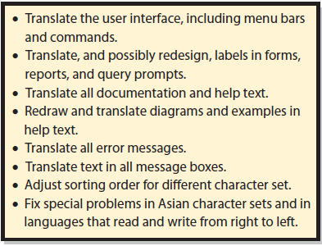
What’s Required to Localize Software?
Notes:
Issues to address when localizing a computer program

Slide 10
What Are the Problems and Issues of Global Databases?
Commit to a single company language
Single database not possible for companies using multiple languages
Need applications to export and import data among separated databases
Slow data transmission speeds may require distributed, partitioned databases and highly skilled personnel
Notes:
Companies often decide to give up on the benefits of a single database to let divisions in different countries use different databases, with data in local languages. These companies need applications to export and import data among the separated databases.
Companies sometimes distribute their database in locations around world when data transmission speeds are too slow to process data from a single geographic location.

Slide 11
Types of Distributed Databases
Distributed database
Single database resides in multiple locations
Replicated database
Multiple copies of a database distributed
Updating requires highly skilled personnel
Partitioned database
Database divided into non-overlapping segments
Notes:
Querying replicated and partitioned database can improve performance without too much development work.
Updating a replicated database, so changes are correctly made to all copies of the data, is full of challenges that require highly skilled personnel to solve.

Slide 12
Q3: What Are the Challenges of International Enterprise Applications?
Independent Functional Systems | Inherent Processes
Unnecessary to accommodate language, business, and cultural differences | Differences in language, culture, norms, and expectations
Requires adequate data interface | Developing and evaluating “as is” models and alternative international processes incredibly challenging
Integrated, cross-functional, international system with high-level processes connected by SOA standards and the cloud
Notes:
Because of these challenges, it is likely that international business processes will be developed more like inter-enterprise business processes. A high-level process will be defined to document the service responsibilities of each international unit. The cloud and Internet standards (such as SOA) will connect those services into an integrated, enterprise, international system. The only obligation of an international unit will be to deliver its defined service.

Slide 13
Advantages of Functional Systems
Lack of integration can have advantages for international organizations and international systems
U.S. order-processing systems operate in English, reflect practices and culture of U.S.
Taiwanese manufacturing information systems operate in Chinese and reflect business practices and culture of Taiwan.
Need adequate data interface between two systems

Slide 14
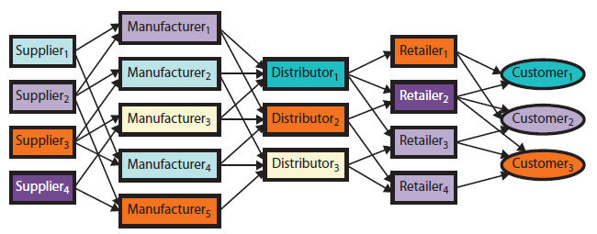
Q4: How Do Inter-enterprise IS Facilitate Globalization?
Notes:
Generic supply chain relationships
Customers order from retailers, who order from distributors, who order from manufacturers, who order from suppliers.
Supply chain also includes transportation companies, warehouses, and inventories and some means for transmitting messages and information among organizations involved.

Slide 15
How Do Global Information Systems Affect Supply Chain Profitability?
Global information systems increase supply chain profitability by:
Reducing inventories.
Reducing or eliminating bullwhip effect.
Producing comprehensive, accurate, and timely information.

Slide 16
What Is the Economic Effect of Global Manufacturing?
Distributes wealth across multiple countries
Rising standards of living
Expanding economies help each other

Slide 17
How Does Social Media Affect International Business?
Do not know how social media affects international business
Do not know effectiveness of Enterprise 2.0 in multinational companies.
May be only in culture where it originates
Same with user-generated content
Both may be ripe for innovation

Slide 18
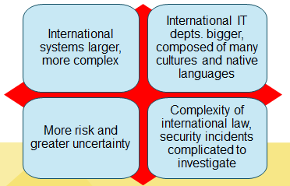
Q5: What Are the Challenges of International IS Management?
Notes:
Size and complexity make international IS management challenging.
Projects to develop them are larger and more complicated to manage.
International IS departments are bigger and composed of people from many cultures with many different native languages.
International organizations have more IS and IT assets, and those assets are exposed to more risk and greater uncertainty. Because of the complexity of international law, security incidents are more complicated to investigate.

Slide 19
Why Is International IS Development More Challenging?
Define a set of standard business processes
Requires adapting to different work processes
People resist change, especially if it violates cultural norms
Develop alternative versions of system to support different processes in different countries
High maintenance expenses
Notes:
To see why, consider the five components.
Running hardware in different countries is not a problem, and localizing software is manageable, assuming programs were designed to be localized. Databases pose more difficulties.
An international system is used by people who live and work in cultures that are vastly different from one another. The way that customers are treated in Japan differs substantially from the way that customers are treated in Spain, which differs substantially from the way that customers are treated in the United States. The procedures for using a CRM will be correspondingly different.
If the underlying business processes differ, the specific requirements for the information system will differ. Managing requirements for a system in one culture is difficult, but managing requirements for international systems can be many times more difficult.

Slide 20
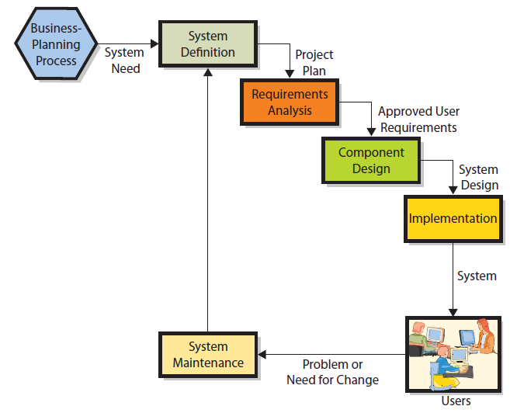
Why Is International IS Development More Challenging? (cont'd)

Slide 21
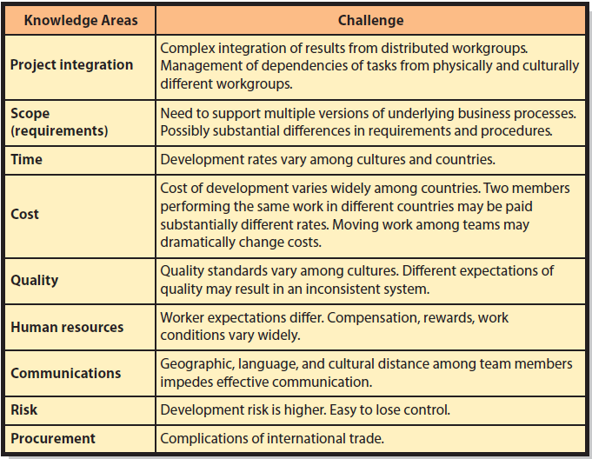
What Are the Challenges of International Project Management?
Notes:
This figure summarizes challenges for each knowledge area.
Many things can go wrong. Project integration is complex; requirements are difficult to determine; cost, time, and quality are difficult to manage; worker conditions vary widely; and communication is difficult. Finally, project procurement is complicated by the normal challenges of international commerce.

Slide 22
What Are the Challenges of International IT Management?
Aligning IT and IS resources with competitive strategy more complex and difficult
Conducting operations in different countries, cultures, and languages adds complexity
Integrating different company systems
Integrating with outsource vendors’ information systems
Protecting IS and IT infrastructure
Notes:
Chapter 11 defined the four primary responsibilities of the IT department:
Plan, operate, develop, protect information systems and IT infrastructure
Each of these responsibilities becomes more challenging for international IT organizations.

Slide 23
How Does the International Dimension Affect Computer Security Risk Management?
IT assets subject to more threats
Political threats, civil unrest, terrorists, natural disasters
Likelihood of a threat more difficult to estimate
Uncertainty about risks high
Human safeguards chosen and evaluated on a culture-by-culture basis
Notes:
International data centers may be more subject to typhoons, hurricanes, earthquakes, floods, volcanic eruption, mudslides or epidemics that affect data center employees.
What is the likelihood that a computer programmer in India will insert a Trojan horse into code that she writes on an outsourcing contract?
Multitude of cultures, religions, nations, beliefs, political views, and crazy people in the world, uncertainty about risks to IS and IT infrastructure is high.
In short, risk management for both international information systems and IT infrastructure is more complicated, more difficult, and subject to greater uncertainty.

Slide 24
Active Review
Q1: How does the global economy impact organizations and processes?
Q2: What are the characteristics of international IS components?
Q3: What are the challenges of international enterprise applications?
Q4: How do inter-enterprise IS facilitate globalization?
Q5: What are the challenges of international IS management?

Slide 25
