Slide 1
Chapter Extension 17
Business Process
Management

Slide 2
Study Questions
Q1: Why do organizations need to manage business processes?
Q2: What are the stages of business process management (BPM)?
Q3: How do business processes and information systems relate?
Q4: Which comes first, business processes or information systems?
Q5: How is BPM practiced in the real world?

Slide 3
A Sample Ordering Business Process
You work in sales selling equipment and supplies to the hotel industry.
Products include hotel furniture, cleaning equipment, and supplies (towels, linens, and staff uniforms).
You are the customer’s representative.
Processing an order involves five steps.
Notes:
To set the stage for discussing business process management, consider a simple, representative example.

Slide 4
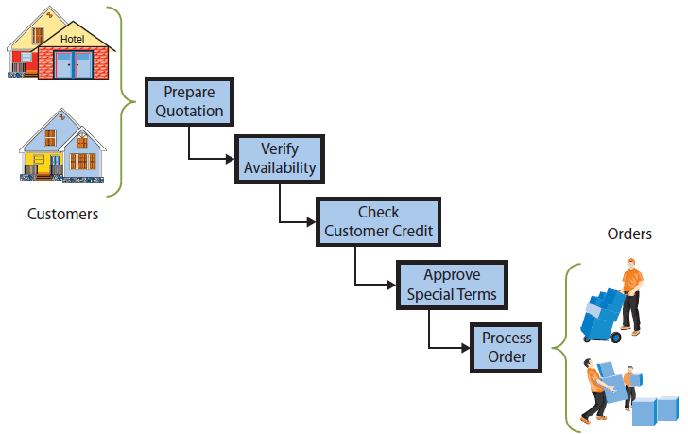
Q1: Why Do Organizations Need to Manage Business Processes?
Notes:
Steps in Processing an Order
Ensure operations department verifies product is available and can be delivered on requested schedule.
Check with Accounting to verify credit required to process the order.
Check with your boss, a sales manager, to approve any special terms the customer might request (discounts, free shipping, extended return policy, and so forth).

Slide 5
Why Does This Process Need Management?
Processes are dynamic and often need to be changed
Improve process quality
Change in technology
Change in business fundamentals
Notes:
Need to monitor process quality and adjust process design, as appropriate.

Slide 6
Examples of Change in Business Fundamentals
Market (e.g., new customer category, change in customer characteristics)
Product lines
Supply chain
Company policy
Company organization (e.g., merger, acquisition)
Internationalization
Business environment

Slide 7
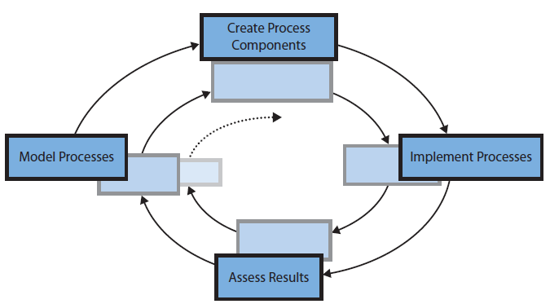
Q2: What Are the Stages of Business Process Management (BPM)?
Stages in the BPM Cycle
Notes:
Business process management (BPM) is a cyclical process for systematically creating, assessing, and altering business processes.
Cycle begins by creating models of business processes.
Usually teams build an as-is model that documents the current situation.

Slide 8
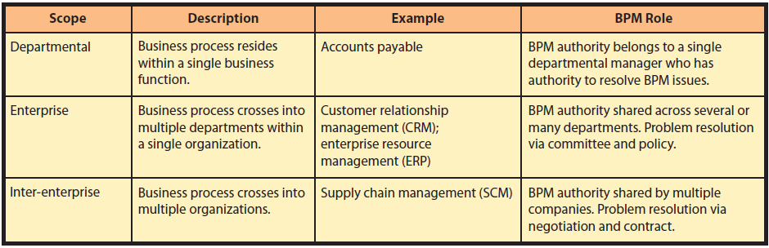
Scope of Business Process Management
Notes:
Nonprofit and government organizations have all three types of processes shown in Figure CE17-3, but most of these processes are service-oriented rather than revenue-oriented.

Slide 9
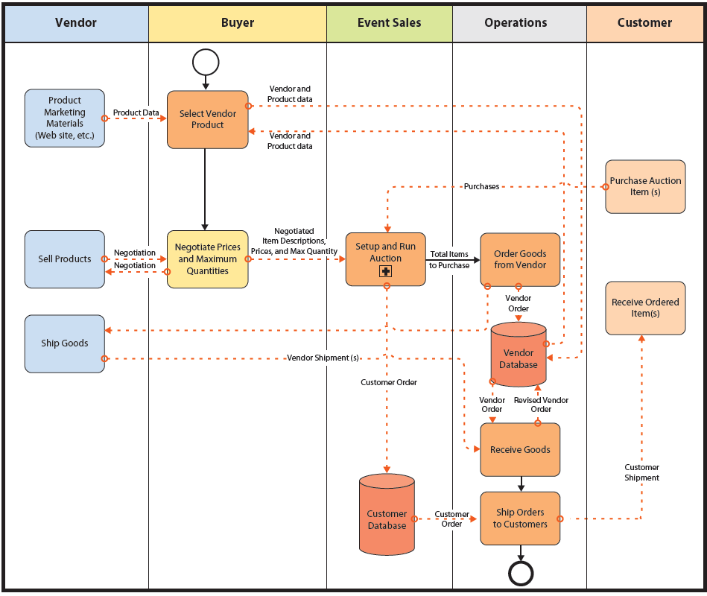
Q3: How Do Business Processes and Information Systems Relate?
GearUp Ordering Process
Notes:
Business processes and information systems are not the same thing. Information systems have the five components as you know by now. Business processes have actors, roles, activities, etc. They overlap, but their purpose and components are different.
We can deduce three important principles from this figure.
Information system elements are embedded within business processes, but some activities in business processes are not part of any information system.
This business process uses two separate information systems, and, in general, a business process can utilize zero, one, or more information systems.
The information system that processes Customer Database will be used by other business processes.

Slide 10
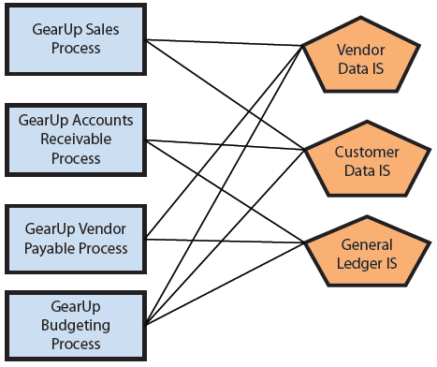
Many-to-many Relationship of Business Processes and Information Systems
Notes:
Business processes and information systems overlap; procedures for using an information system are part of activities of a business process, but there are activities that involve no IS.
Finally, the relationship between business processes is many-to-many.
- Many-to-many relationships between business processes and information systems pose a dilemma when it comes time to build them.

Slide 11
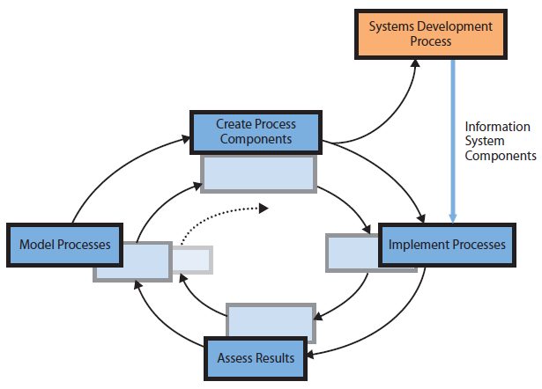
Q4: Which Comes First, Business Processes or Information Systems?
Business Processes First
May work well for business processes under consideration, but cause problems later
Notes:
Organization will engage in business process management and construct system components in create process components stage of BPM cycle.

Slide 12
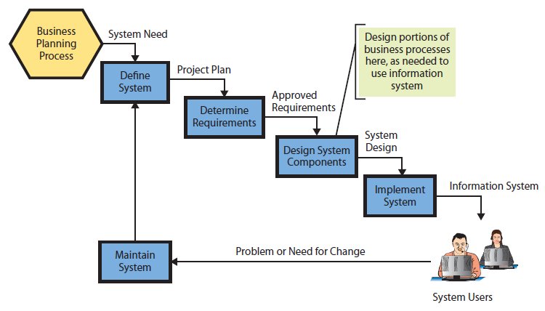
Information System First
Notes:
This development process makes business processes a poor stepchild of information systems development process. Focus is on hardware, software, data, procedures (for using the system only), and user training. Some aspects of business processes will be constructed as part of system implementation, but many activities, not part of the information system, are unlikely to be considered when system is constructed.

Slide 13
Another Factor: Off-the-Shelf Software
Start with business processes first
Likely to choose a package that works well for processes being developed, but not work well for processes that come along later
Start with IS and collects all requirements
May find package works better for all users, but business processes receive short shrift.

Slide 14
And the Answer Is . . .
In theory, better to start with business processes.
More likely to result in processes and systems aligned with organization’s strategy and direction.
In practice, organizations use both approaches.

Slide 15
And the Answer Is . . .
Off-the-shelf software
Start with business processes and select application that works for those processes, application includes features and functions needed by future business processes.
Better to begin with processes, if likely to use licensed application.

Slide 16
Not Possible to Buy Processes or Systems Off-the-Shelf
Neither information systems nor business processes can be purchased off-the-shelf
Procedures and employees that use that application are in-house.
Notes:
Develop IS in-house because the procedures and employees that use that application are in-house.
Even if the vendor of application includes business processes as part of package, as ERP vendors do, those business processes are not yours until you have integrated them into your business and trained your employees.

Slide 17
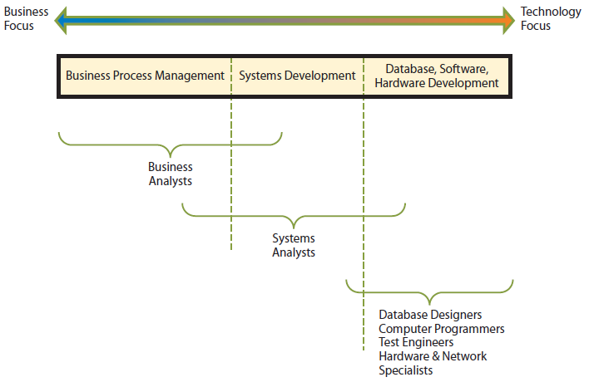
Q5: How Is BPM Practiced in the Real World?
Focus of Personnel Involved in BPM and Systems Development
Notes:
We will assume processes are to be created first, with systems developed during process creation.
This figure implies an organization has a group of business professionals who perpetually assess processes and wait to pounce on any process judged to need improvement.
For most organizations, the need for process change comes from a problem or unmet need. Business requirements force the stages of the BPM cycle. In such organizations, no one thinks about a process until it’s broken.

Slide 18
Defining the Process Problem
Assess existing processes by creating an as-is model.
Specify alternatives for fixing the problem.
Adjust role resources
Change process structure
Do both

Slide 19
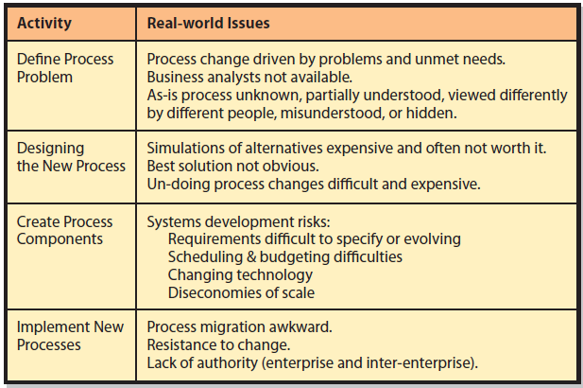
Real-world BPM Issues
Notes:
Most companies form a team to develop and evaluate alternatives. Most promising alternative is chosen for implementation by discussion among the team members.
Four dimensions of feasibility used in SDLC (cost, technical, schedule, and organizational) can help to eliminate some alternatives.

Slide 20
Active Review
Q1: Why do organizations need to manage business processes?
Q2: What are the stages of business process management (BPM)?
Q3: How do business processes and information systems relate?
Q4: Which comes first, business processes or information systems?
Q5: How is BPM practiced in the real world?

Slide 21
