Slide 1
Chapter Extension 16
Agile Development

Slide 2
Study Questions
Q1: Why is the SDLC losing credibility?
Q2: What are the principles of agile development methodologies?
Q3: What is the scrum process?
Q4: How do requirements drive the scrum process?

Slide 3
Q1: Why is the SDLC Losing Credibility?
Systems requirements are fuzzy and always changing
Waterfall method does not work well
Very risky – users cannot see system until end
Project often runs out of money or time before completion
SDLC assumes requirements don’t change

Slide 4
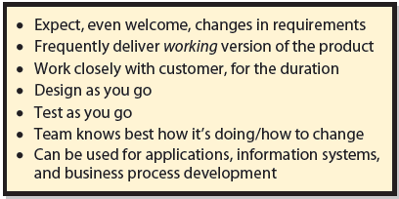
Q2: What Are the Principles of Agile Development Methodologies?
Notes:
Agile methods include rapid application development, unified process, extreme programming, scrum, and others.
Just-in-time design means the design is constantly changing, and existing designs may need to be revised, along with substantial revision to work product produced so far.
Agile development methodologies are generic and can be applied to creation of applications, information systems, and business processes.

Slide 5
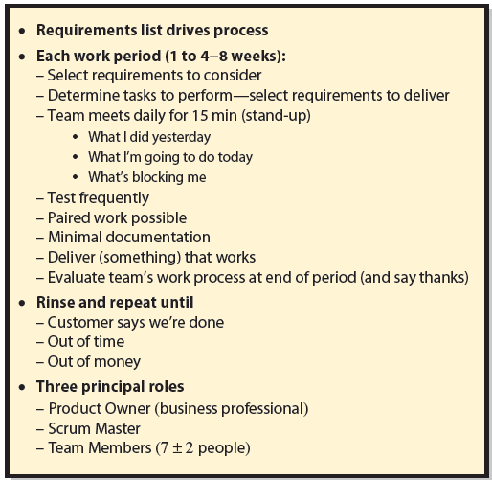
Q3: What Is the Scrum Process?
Notes:
In rugby, a scrum is a gathering of a team into a circle to restart play after a foul or other interruption.
Scrum is an agile development process that follows the principles shown in this figure.
Process is driven by a prioritized list of requirements created by users and business sponsors of new system. Work is divided into scrum work periods.

Slide 6
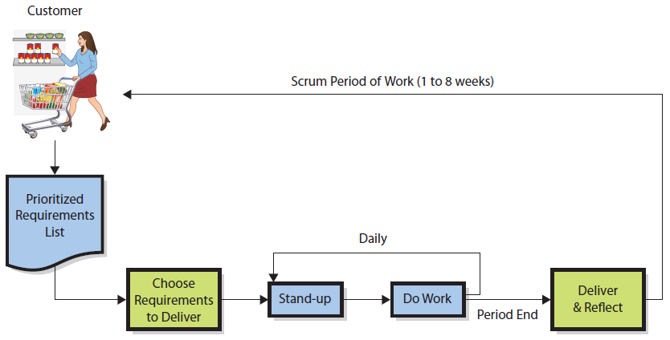
Scrum Process
Notes:
Scrum team members are programmers, systems analysts, business analysts, database designers, cloud-engineers, PQA testing personnel, and any other staff needed to build the work product. Scrum teams are small; five to nine team members.
It’s not clear scrum works well for exceedingly large projects, but no other development process works well, either.
Given a requirement, the team meets to create tasks to be accomplished to meet that requirement. In Figure CE16-3, this work is done in Choose requirements to deliver activity.

Slide 7
Key Roles
Product owner
Business professional who provides requirements, clarification and testing
Scrum master
Coach or referee, guardian of members’ time
Team members
Programmers, systems analysts, business analysts, database designers, cloud engineers, PQA testing personnel, other staff needed

Slide 8
Stand-up Meetings
15-minute meeting each team member states:
What he or she has done in past day
What he or she will do in coming day
Any factors blocking his or her progress
Purpose — accountability for progress and give public forum for blocking factors
Notes:
Often one team member will have expertise to help another, blocked team member resolve the blocking issue.

Slide 9
Paired Programming
Two members share a computer and write a computer program together.
One programmer provides a test, other demonstrates code passes test or changes code.
Minimal documentation created

Slide 10
When Are We Done?
Customer is satisfied with the product created and accepts it, even if some requirements left unsatisfied.
Project runs out of time.
Money runs out.

Slide 11
Q4: How Do Requirements Drive the Scrum Process?
Requirements drive planning and scheduling
Answers "Who does what and why?"
Product owner creates requirements and prioritizes them.
Notes:
Scrum is distinguished from other agile development methodologies by using requirements to drive planning and scheduling.

Slide 12
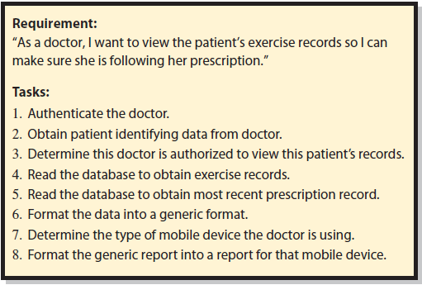
Creating Requirements Tasks
Notes:
Tasks for additional requirements that might be implemented in this scrum period are created also.
Tasks are created as a group, in a team meeting where the team can give feedback to one another. One team member will think of a task to be done that other members may not be aware. Or, a member may realize a particular task is incomplete, or is doable in some other way.

Slide 13
Scheduling Tasks
Way tasks are scheduled makes scrum innovative
Developers terrible determining how long a task will take, good at how long something will take in comparison to something else
Assign each task a difficulty score, called points
Team estimation and planning poker
Notes:
Points form a Fibonacci sequence: {1, 2, 3, 5, 8, 13, 21, 34, 55, 89, 144, and ?}. Any number larger than 144 is meaningless. Most likely 89 and 144 are meaningless as well, and should be subdivided into multiple requirements.
When all tasks have received points, points are summed to a total for the requirement.

Slide 14
Committing to Finish Tasks
Team velocity
Total number of work points team can accomplish each scrum period.
Determines how many requirements team can commit to in next scrum period.
Notes:
Suppose five requirements on prioritized requirements list total 125 points. If a team knows its velocity is 100 points per scrum period, they know they cannot do all five. However, if the top four total, say 80 points, they can commit to doing those four, plus something else.
In this case, the team would go back to product owner and ask if there is a requirement lower on the priority list that can be done for the available 20 points of capacity.

Slide 15
Hocus-pocus?
Scrum incorporates team iteration and feedback for scheduling and tasking.
Team can create something that far exceeds what each member can do individually.
Over time, team learns to assign points more accurately, and knows its true velocity.
Scrum is a good technique, but it's not magic.
Notes:
Second, it provides a framework for process learning.
As a team works more scrum periods together, it learns how to assign points more accurately, and increasingly learns what its true velocity is.

Slide 16
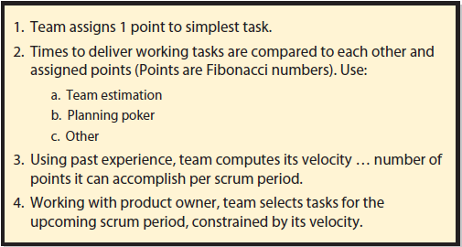
Summary of Scrum Estimation Technique

Slide 17
Active Review
Q1: Why is the SDLC losing credibility?
Q2: What are the principles of agile development methodologies?
Q3: What is the scrum process?
Q4: How do requirements drive the scrum process?

Slide 18
