Slide 1
Chapter Extension 15
Systems Development
Project Management

Slide 2
Study Questions
Q1: Why is formalized project management necessary?
Q2: What are the trade-offs in requirements, cost, and time?
Q3: What are the dimensions of project management?
Q4: How does a work breakdown structure drive project management?
Q5: What is the biggest challenge for planning a systems development project?
Q6: What are the biggest challenges for managing a systems development project?
Q7: What is the single most important task for users on a systems development project?
Notes:
This chapter extension addresses the major components of IS project management. It begins with a discussion of IS project management by discussing project trade-offs.

Slide 3
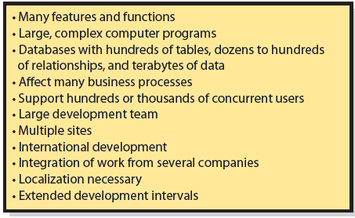
Q1: Why Is Formalized Project Management Necessary?
Notes:
The Internal Revenue Service provides a good example of a large-scale IS project. The IRS employs more than 100,000 people in 1,000 different sites and processes over 200 million tax returns a year. Starting in 1995, it set out to modernize the information systems for processing tax returns. Today, more than 18 years and several billion dollars later, it has not completed that project.

Slide 4
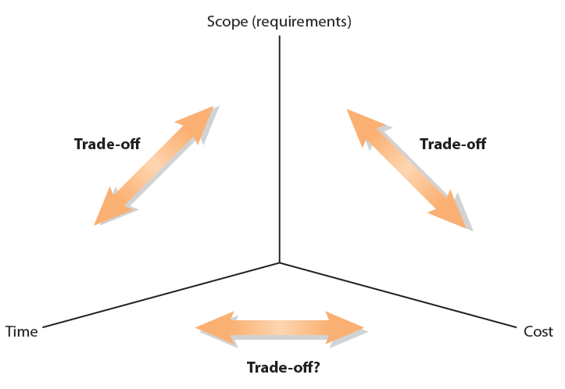
Q2: What Are the Trade-offs in
Requirements, Cost, and Time?
Notes:
Systems development projects require the balancing of three critical drivers: requirements (scope), cost and time.
We can trade off requirements against time and against cost. If we make the necklace simpler, it will take less time. If we eliminate the diamonds and gems, it will be cheaper.
Relationship between time and cost is more complicated. Normally, we can reduce time by increasing cost, but only to a point, because of diseconomies of scale.
Adding more time could decrease or increase cost.

Slide 5
Baseline Plan
Stipulates:
  Tasks to be accomplished
  Resources (human and materials) assigned to tasks
  Schedule for completion of each task

Slide 6
Baseline Plan (cont'd)
Things never go according to plan
  Requires trade-offs between requirements, costs, and time
  Critical people leave
  Hiring freezes
  Natural disasters
  Competitor actions
  Technology changes
  New management

Slide 7
Q3: What Are the Dimensions of Project Management?
Formalized project management for large projects
  Project Management Institute (PMI) best practices, processes, techniques
    International organization
    Endorsed by ANSI and ISO
    Project Management Professional (PMP) certification
PMBOK® (Project Management Body of Knowledge) Guide for Project Management
Notes:
The process promoted by Project Management Institute (PMI) has achieved prominence.
PMI publishes project management documents and offers project management training. It offers Project Management Professional (PMP) certification. Professionals who have 4,500 hours of project work experience can earn certification by passing PMI’s examination.

Slide 8
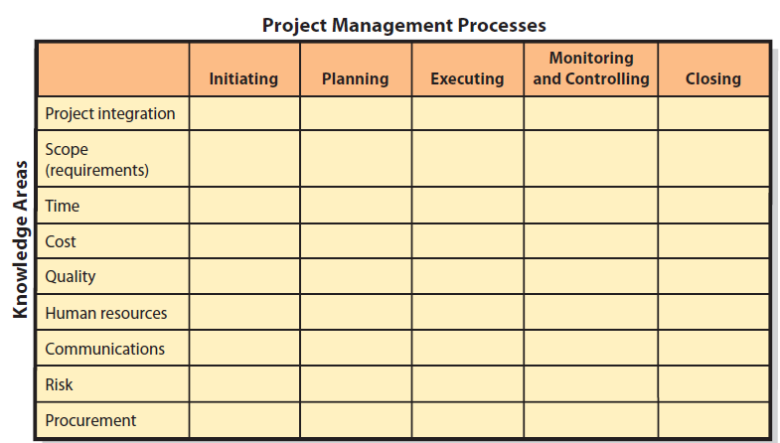
Dimensions of Project Management
Notes:
PMBOK Guide is organized into five process groups and nine knowledge areas. PM Processes refer to five different stages in the life of a project; nine knowledge areas refer to factors to be managed throughout life of the project.

Slide 9
Q4: How Does a Work-Breakdown
Structure Drive Project Management?
Work-Breakdown Structure (WBS)
    Hierarchy of tasks
    Tasks end with deliverables
      Documents, designs, prototypes, data models, database designs, working data entry screens, etc.
    Identifies task dependencies
    Estimate task duration, cost and labor needed
    Created with project management software, such as Microsoft Project
Notes:
Key strategy for large-scale systems development is to divide and conquer. Break up large tasks into smaller tasks and continue breaking up the tasks until they are small enough to manage, thus enabling you to estimate time and costs.

Slide 10
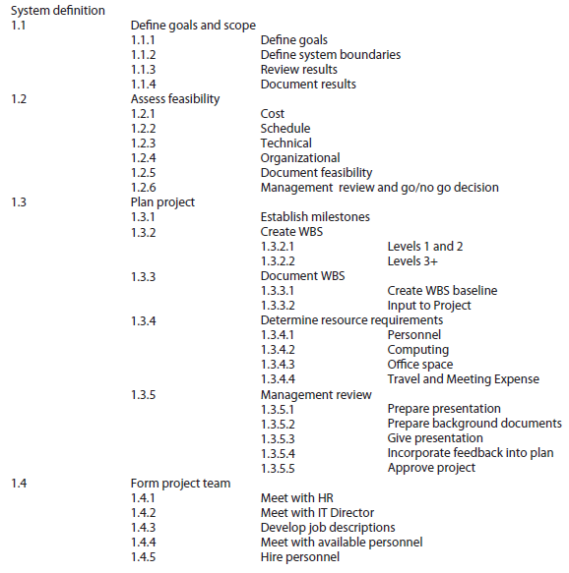
Sample WBS for Definition Phase of a Thin-Client Order-Entry System
Notes:
Note the term “scope” is used in two different ways. As used in this WBS example, scope means to define system boundaries, which is how it is used in SDLC. As noted in Q3, scope for PMBOK Guide means to define the requirements. That use of scope does not appear in Figure CE15-4.

Slide 11
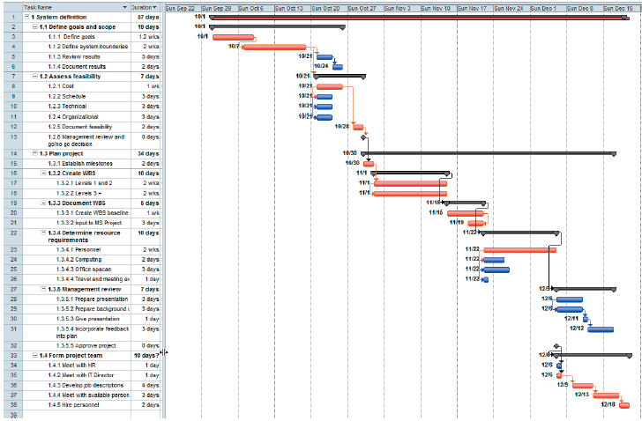
Gantt Chart of WBS for Definition Phase of a Thin-Client System
Critical path tasks in red
Notes:
Gantt chart, shows tasks, dates, and dependencies.
Critical path is a sequence of activities that determine earliest date the project can be completed.

Slide 12
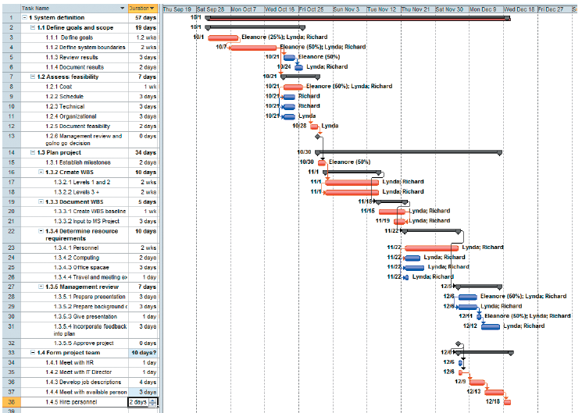
Gantt Chart with Resources Assigned
Notes:
Using Microsoft Project or a similar product, it is possible to assign personnel to tasks and to stipulate the percentage of time that each person devotes to a task.
Final WBS plan is denoted in the baseline.
WBS is the single most important management tool for large-scale projects.

Slide 13
Q5: What Is the Biggest Challenge for Planning a Large-Scale Systems Development Project?
Biggest challenge is scheduling
    How long does it take to:
      Develop a large data model?
      Adapt data model to user satisfaction?
      Develop a computer program?
    Scheduling errors accumulate (e.g., snowball)
    Difficult to do credible planning
    Every task may be on critical path
Notes:
Software is “logical poetry.”
How long does it take to develop a computer program to process PRIDE privacy data on a cloud server? If no one on the team has developed a cloud-based server application before, how do you predict?

Slide 14
Three Approaches to This Challenge
Avoid major schedule risks and license software from vendors.
Admit impossibility of systems development scheduling and plan accordingly.
Attempt to schedule development project despite difficulties.

Slide 15
Estimation Techniques
Estimate using past projects as a guide.
Estimate lines of code to be written.
Use industry or company averages to estimate time required.
Estimate function points in a program, determine number of lines of code, and estimate schedules.

Slide 16
Q6: What Are Biggest Challenges for Managing a Systems Development Project?
Coordination
Diseconomies of scale
Configuration control
Unexpected events
Maintaining team morale over time
Notes:
Coordinating independent groups that might reside in different locations.
Diseconomies of scale from adding more people leads to exponential growth in interactions.
Creating effective configuration control in terms of management policies, practices, and tools to maintain control over resources.
Dealing with project disruptions due to unanticipated events
Maintaining morale is especially difficult for long projects, for projects that require employees to make substantial sacrifices, and after a project gets behind schedule.

Slide 17
Q7: What Is the Single Most Important Task for Users on a Systems Development Project?
Taking responsibility for requirements
  Systems built to support business functions, to help organization achieve goals and objectives
  Managing requirements is critical
  Ensure requirements are complete and accurate
Notes:
Taking responsibility goes beyond participating in requirements meetings and stating your opinion on how things should work. Taking responsibility means understanding the information system is built for your business function and managing requirements accordingly.

Slide 18
Role of Users
  Users cannot be passive
  Responsible for ensuring complete and accurate requirements
  Responsible for managing requirements changes, avoiding requirements creep
  Define testable conditions for functions and features
    Evaluate data models, provide test data and sample scenarios
  Conduct user testing (beta testing)
  Final approval of system

Slide 19
Active Review
Q1: Why is formalized project management necessary?
Q2: What are the trade-offs in requirements, cost, and time?
Q3: What are the dimensions of project management?
Q4: How does a work breakdown structure drive project management?
Q5: What is the biggest challenge for planning a systems development project?
Q6: What are the biggest challenges for managing a systems development project?
Q7: What is the single most important task for users on a systems development project?

Slide 20
