Slide 1
Chapter Extension 14
Geographic Information
Systems

Slide 2
Study Questions
Q1: What are the components of a geographic information system?
Q2: How are GIS maps constructed?
Q3: How do organizations use GIS?
Q4: How do maps deceive?

Slide 3
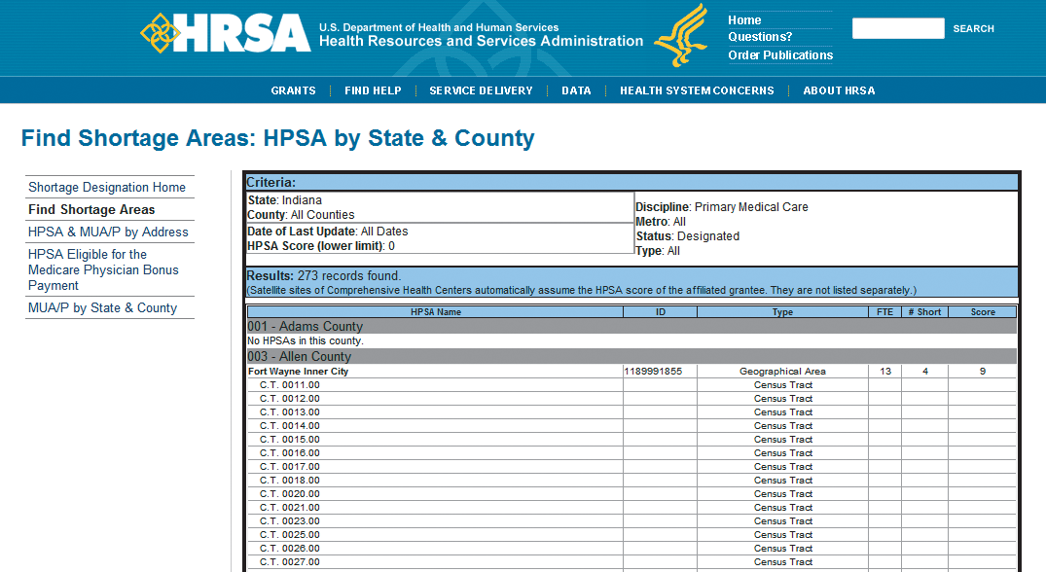
Q1: What Are the Components of a Geographic Information System?
Data not in meaningful context.
Notes:
This figure lists census tracts in the state of Indiana that have primary care physician shortages. Data in this format are not informative because few of us keep the boundaries of census tracts in our minds.

Slide 4
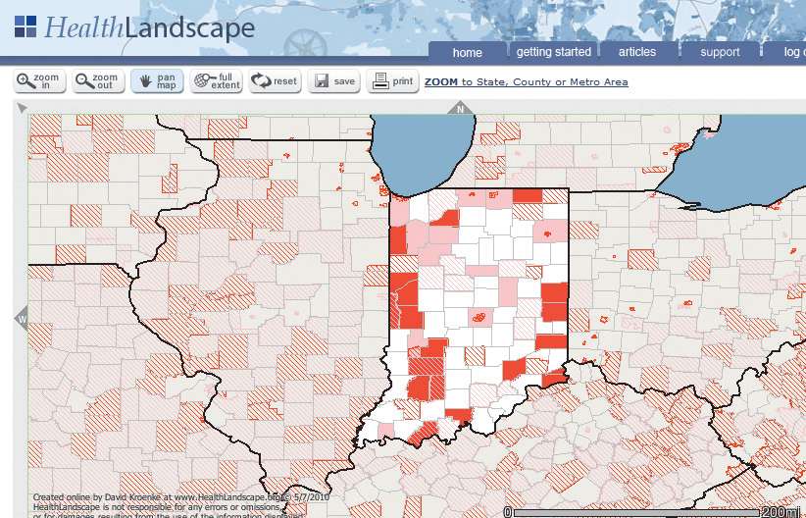
Data in Meaningful Context
Notes:
Same data put in more meaningful context

Slide 5
History of GIS
1990
Most GIS were stand-alone desktop applications
1990s
Some capability moved to thick-client, client-server applications
2000
Some GIS applications, Google Maps and Bing Maps, moved to cloud-based, thin-client applications
Today
GIS applications using HTML5
GIS on all platforms accessing data in the cloud
Notes:
GIS are subject to the same trends as other information systems.

Slide 6
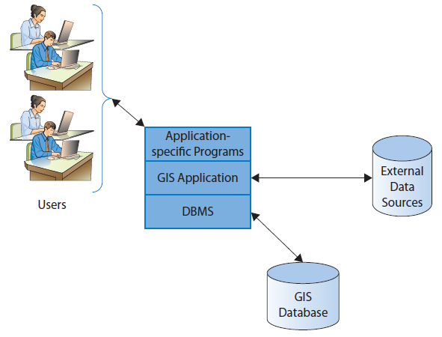
Structure of GIS Application Components
Notes:
Notice the ambiguity in use of the term GIS. We defined a GIS as an information system with all five components.
Unfortunately, GIS also is used to refer to a computer program, GIS application, that manages geospatial data.

Slide 7
GIS Hardware
Client and server computers, network equipment
Surveying equipment, cameras, satellite devices, GPS devices, map scanners, and additional specialized input hardware.

Slide 8
GIS Applications
ArcGIS, Autodesk, MapInfo, Bentley GIS. Open-source GIS include GRASS and uDig and others
Get geospatial data from service like Google Earth or Bing Maps, add organizational-specific data from database, display in browsers.

Slide 9
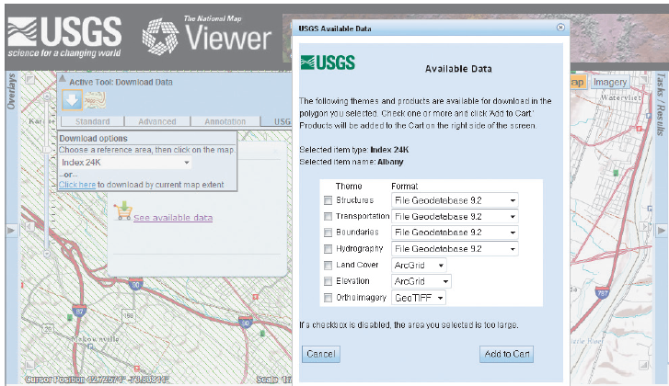
Blend of External Geospatial and Relational Database Data
Notes:
Go to http://viewer.nationalmap.gov/viewer to learn more. (Don’t be misled by the Add to Cart button. The data are free; you add what you want to your cart, input your email address, and the site mails the data for you to input to your GIS application. That data will be useless to you, however, unless you have a GIS program and know how to use it.)

Slide 10
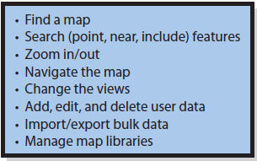
Typical Procedures for GIS Use

Slide 11
Common Types of Users
Casual users
Directions to friend’s house; map of customer’s premise; all houses in neighborhood for sale in given price range
Business Intelligence (BI) users
Company deciding where to locate retail stores; police department track changing locations of crimes
Notes:
GIS application programs can capture, store, and display geospatial data in an automated fashion. However, few GIS applications analyze data.

Slide 12
Common Types of Users (cont'd)
Developers
Create GIS systems in response to requirements
Operations personnel
Run system and maintain database
Field personnel
Capture geospatial data

Slide 13
Q2: How Are GIS Maps Constructed?
Raster map
Consists of pixels with some value, indicatiing color, elevation, temperature, etc.
Easy to create from pictures and scanners at scale created; however blur when enlarged.
Vector map
Consists of points, lines, shapes
Difficult to create, but scales perfectly
Notes:
A GIS map is a composite of several maps placed over one another.
Two types of GIS maps

Slide 14
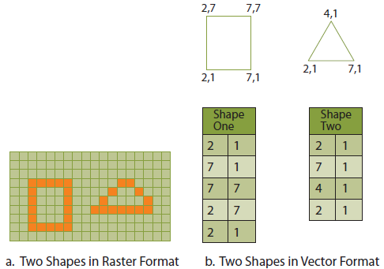
Raster Versus Vector Format
Notes:
Raster map consists of pixels. Each pixel has value, such as a color, elevation or temperature. Pictures that you take with your camera are recorded in color raster format.
Vector map consists of points, lines, and shapes. Figure b shows the outline of the same two shapes in vector format. Here, each shape is an ordered list of points and, because these shapes are closed, the first and last points are the same.

Slide 15
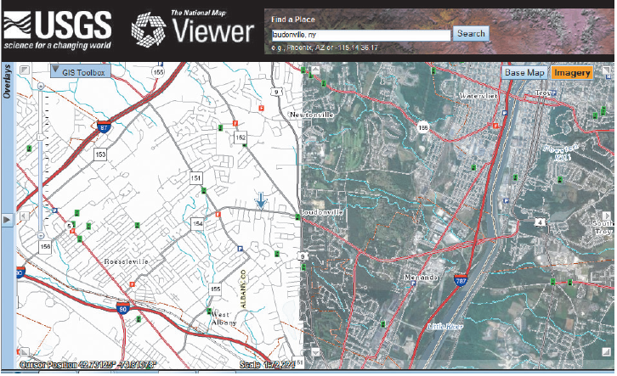
Vector and Raster Image Examples
Notes:
Left-hand section of map is in vector format. Right-hand section is a raster image with vector features added on top.

Slide 16
Vector and Raster Maps
Raster maps
Straight lines can appear irregular
GIS applications cannot readily identify features on a raster map
Vector maps
Difficult to create
Scale perfectly
Any curved shape can be represented

Slide 17
Constructing a Map of Earth Requires Answers to Three Difficult Questions:
How big is the Earth?
What is the radius of the earth?
What is the shape of the earth?
Ellipsoid needs vertical and horizontal radii
How can the curved surface of the earth be shown flat?
It can’t, at least not without error

Slide 18
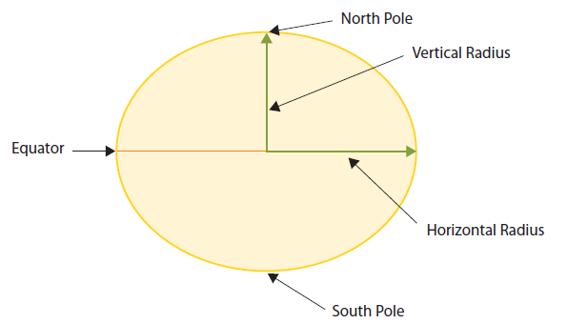
Mapping the Earth
Earth Modeled as an
Ellipsoid
Notes:
To determine how big the earth is, requires measurements for two radii. One radius is needed for vertical dimension and one for horizontal dimension.

Slide 19
Where Is It?
Geographic coordinates
Based on latitude and longitude
Mercator and Peters Map Projections
Military Grid Coordinate System (MGRS)
Divides Earth into 60 north-south zones
Zones divided into squares 6 degrees east/west and 8 degrees north/south
Each square has a two-letter identifier
Distances measured in meters from the east boundary and north boundary

Slide 20
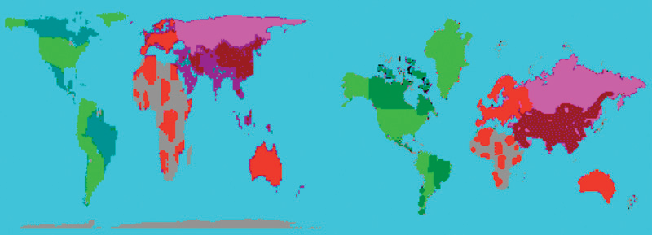
Peters and Mercator Map Projections
Notes:
The Peters Projection is on the left and the Mercator Projection on the right.

Slide 21
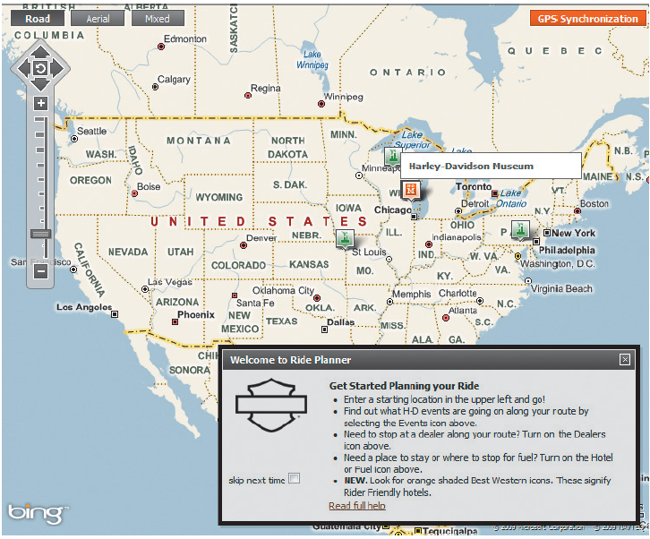
Q3: How Do Organizations Use GIS?
Bing-based vector map
Notes:
This display shows a vector-based map of the United States and public user procedures.
This site uses Microsoft Bing to provide zooming and map display, so map quality is high and user interface is already familiar to many users.

Slide 22
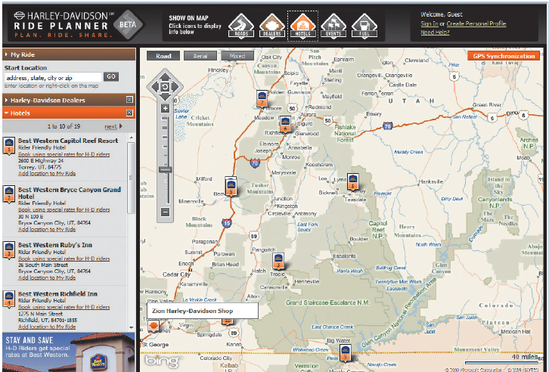
Harley-Davidson Adds GIS Data on Top of Bing-provided Maps.
Notes:
Finally, it provides users an opportunity to contribute content and to form social networks with each other.

Slide 23
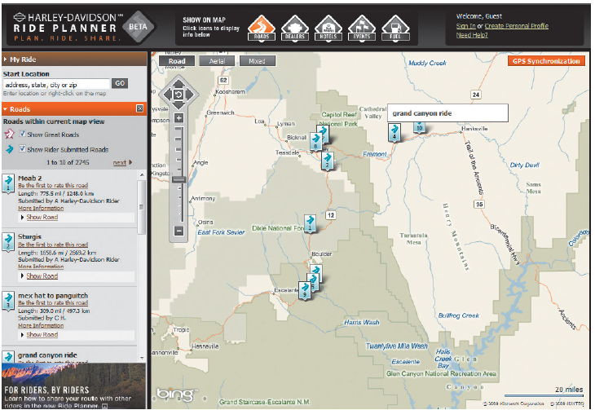
User-Generated Content via GIS
Notes:
When a user clicks Roads, the GIS displays trip reports that had been submitted by Harley-Davidson riders.
This gives Harley-Davidson's customers a more personal connection to the company and facilitates the formation of social networks for riders.

Slide 24
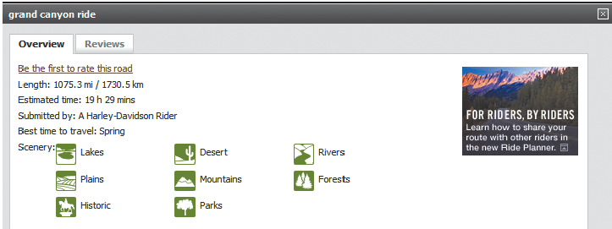
User Contributed Data
Notes:
User contributed content enhances Harley-Davidson's competitive position by raising entry barriers, creating more brand loyalty among customers; reinforcing alliances between manufacturer and franchises, and reinforcing alliances with cooperating hotels.
Because these tools are built on Microsoft Bing, Harley-Davidson was able to bring it to market much faster and at far less expense than if it had developed these capabilities itself.

Slide 25
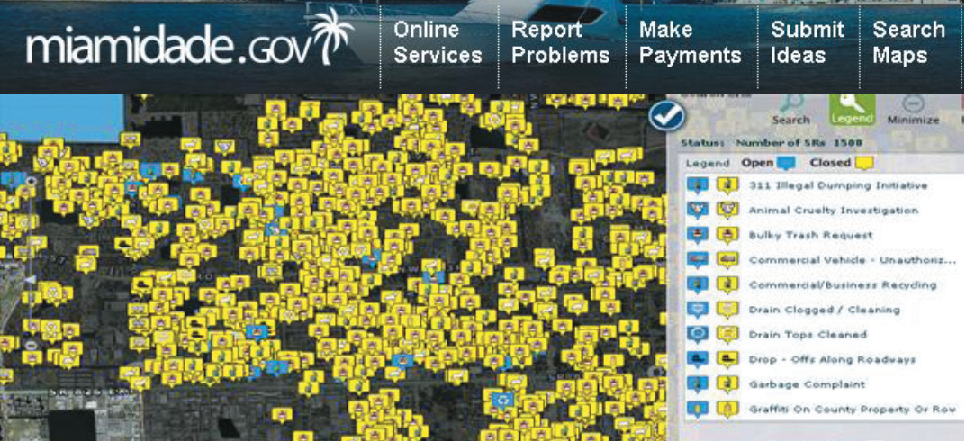
Bing-based Application Developed by the City Of Miami
Notes:
GIS are used on the Web sites of nonprofit organizations as well as government agencies. This display shows 311-call patterns Miami, Florida.

Slide 26
Using GIS for Asset Tracking
Track movement of goods in supply chain
Geofence: Protect company personnel when in non-safe zone
Blue CRM: a risk management firm that provides this capability http://www.bluecrm.co.uk
Notes:
One common example is to track movement of goods in supply chain using a GPS device and a GIS.
An onboard GPS and transmitter reports the location of the asset, say a pallet of goods, a truck, a container, or even a single item within a container. The reported locations are input to a GIS, and the locations of all such assets can be plotted on a GIS display.

Slide 27
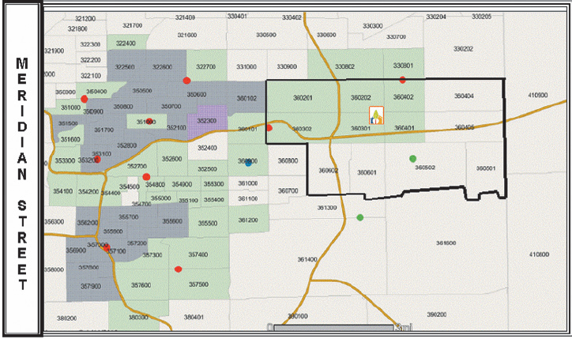
GIS for Business Intelligence
Community Health uses GIS to identify underserved areas.
www.HealthLandscape.org
Notes:
Community Health Network placed its Health Centers in locations with professional shortages or underserved in some other way.

Slide 28
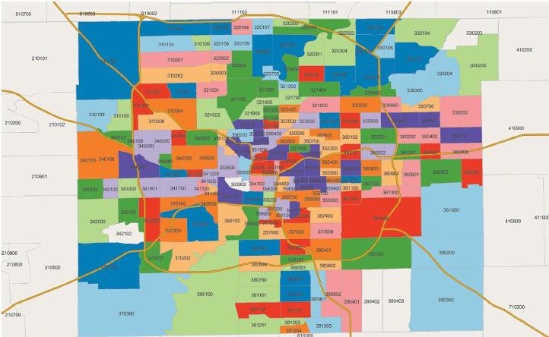
GIS for Business Intelligence (cont’d)
GIS to investigate changes in population and economic conditions
Total Vacant Residences, Q1 2008
Notes:
Map of vacant residences for first and last quarters of 2008.
By comparing these maps, Community Health gains visibility on how medical needs changed during this year. Its analysis includes maps, and other data sources as well.

Slide 29
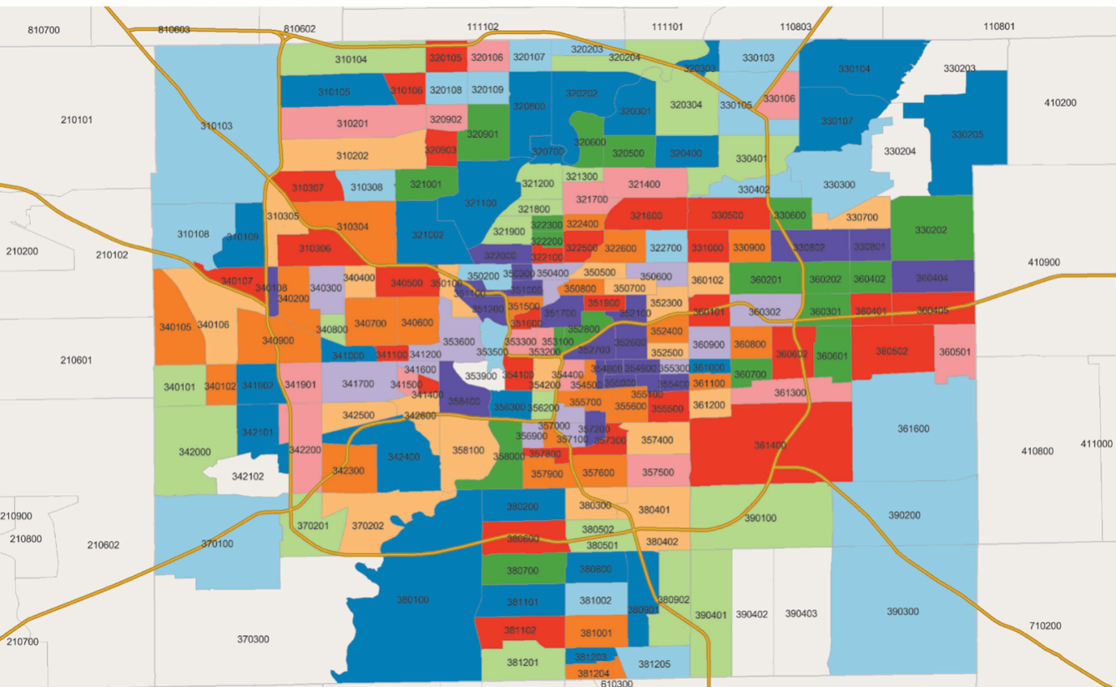
GIS for Business Intelligence (cont’d)
GIS to investigate changes in population and economic conditions
Total Vacant Residences, Q4 2008
Notes:
Map of vacant residences for first and last quarters of 2008.
By comparing these maps, Community Health gains visibility on how medical needs changed during this year. Its analysis includes maps, and other data sources as well.

Slide 30
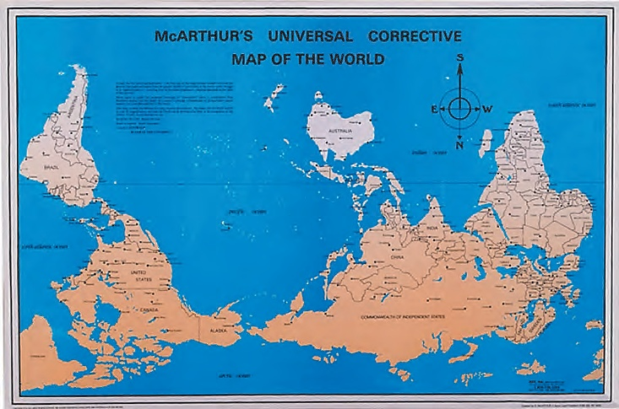
Q4: How Do Maps Deceive?
Maps used for propaganda, advertising, and biased reporting and analysis
Pay attention to map orientation, projection, scale, and source
Notes:
A proper or improper map of the world?

Slide 31
Thematic, Choropleth Maps
Thematic map shows themes about geographic locations
Choropleth map displays colors, shades, or patterns in accordance with category values of underlying data

Slide 32
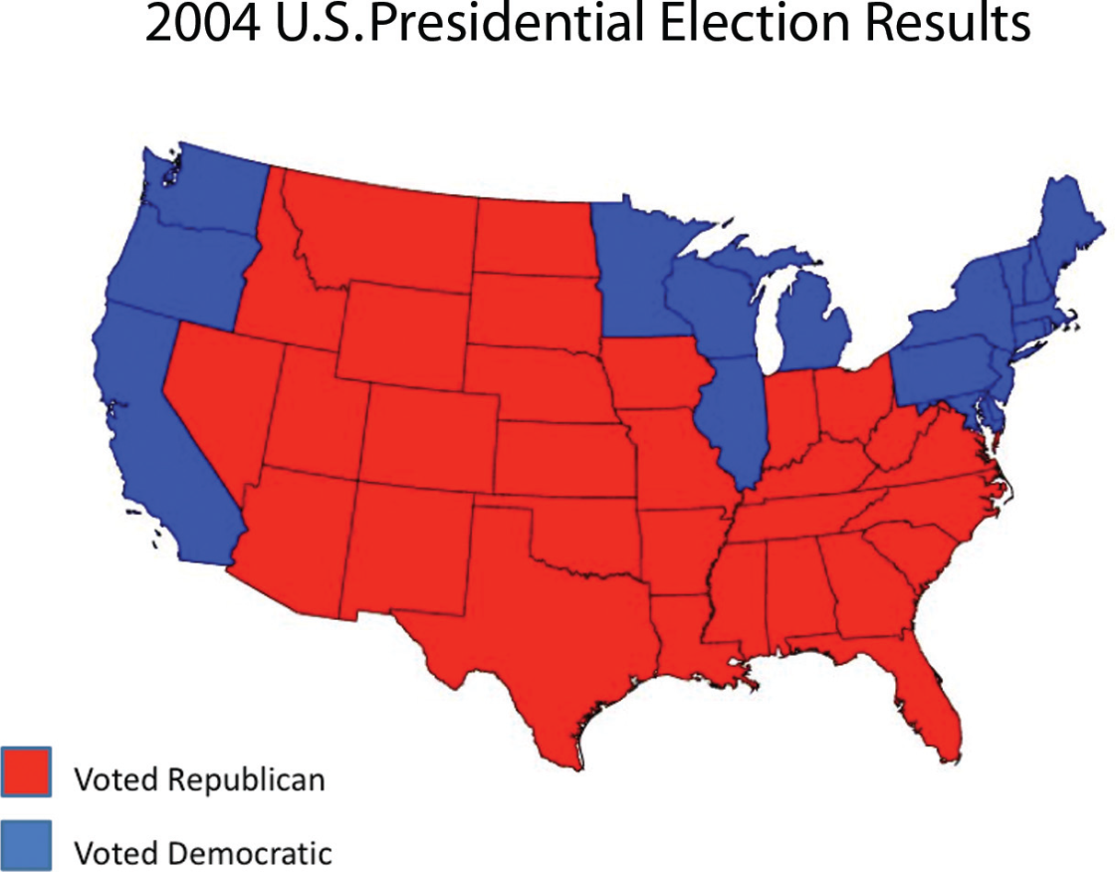
Thematic, Choropleth Map Example
Convey homogeneity that seldom exists

Slide 33
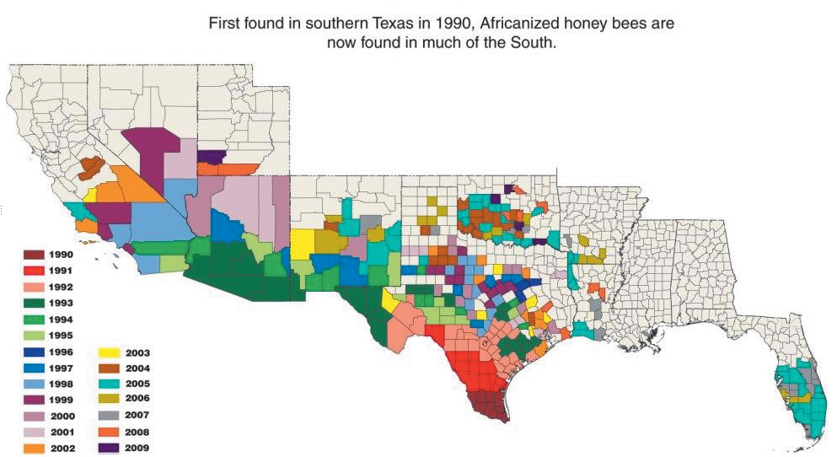
What Is the Information in This Map?
Notes:
A first look at this map would cause you to conclude that Africanized honey bees (so-called killer bees) are a growing menace. Perhaps such bees are a menace, but we can’t conclude that from this map.
This map only communicates that at least one bee was found somewhere in a county in the year indicated.

Slide 34
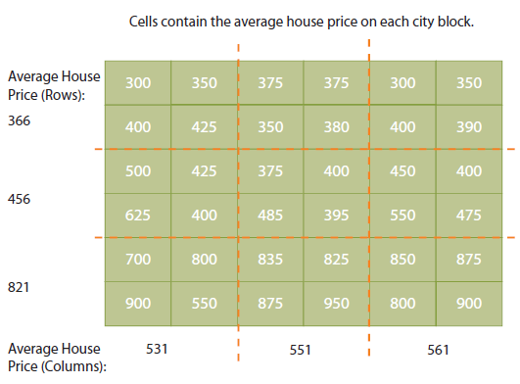
Modifiable Areal Unit Problem (MAUP): Average Housing Prices by City Block
Results depend on definition of regions
Notes:
Suppose that each square represents a city block, and the number represents the average price of houses on that block.
Notice that if data grouped into three vertical columns, the average house prices are 531, 551, and 561; all values are about the same. However, if grouped into three horizontal columns, the average values are 366, 456, and 821. In this form, it is not too difficult to see that these differences are due only to grouping.

Slide 35
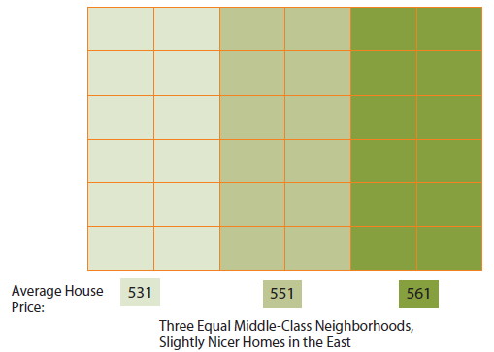
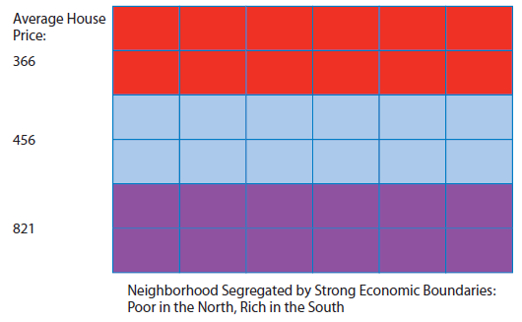
Only Difference Between the Figures Below Is MAUP Gerrymandering
First Grouping of Data
Second Grouping of Data
Understand map distortion, false homogeneity, emotional colors, and MAUP.
Notes:
Grouping the same data in rows, we can also show that this city (no longer ours!) is highly segregated. The poor live in the north and the rich in the south. We can also use emotional colors like red for poor.

Slide 36
Active Review
Q1: What are the components of a geographic information system?
Q2: How are GIS maps constructed?
Q3: How do organizations use GIS?
Q4: How do maps deceive?

Slide 37


