Slide 1
Chapter Extension 13
Reporting Systems
and OLAP

Slide 2
Study Questions
Q1: How do reporting systems enable people to create information?
Q2: What are the components and characteristics of reporting systems?
Q3: How are reports authored, managed, and delivered?
Q4: How are OLAP reports dynamic?

Slide 3
Q1: How Do Reporting Systems Enable
People to Create Information?
Reporting systems
    Create meaningful information from disparate data sources
    Deliver information to user on time
Generate information by:
    Filtering data
    Sorting data
    Grouping data
    Making calculations based on data
Notes:
A reporting system is an information system that enables people to create information by processing data from disparate sources and delivering that information to proper users on a timely basis.

Slide 4
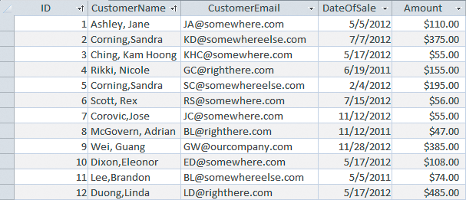
Raw Sales Data: List Contains Little or No Information
Notes:
This partial list of raw data is hardly a meaningful context. It is just a list of data.

Slide 5
Sales Data Sorted by Customer Name
Notes:
Sorting by customer name can create a meaningful context for this data.

Slide 6
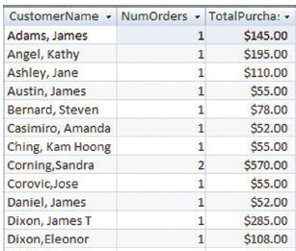
Sales Data Sorted by Customer Name and Grouped by Number of Orders and Purchase Amounts
Produce even more information by grouping
orders
Notes:
The reporting tool grouped orders and computed number of orders for each Customer and total purchase amount per customer.

Slide 7
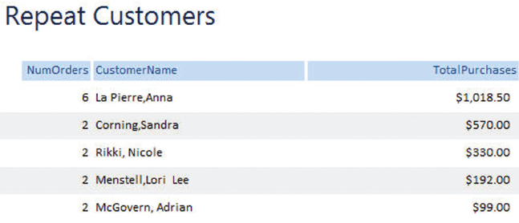
Sales Data Filtered and Formatted to Show Repeat Customers
Produce information by filtering and formatting orders
Notes:
Report in this figure has filtered results formatted for easier understanding.
If your goal is to identify your best customers, this report shows data in a far more useful context and will save considerable work.

Slide 8
Q2: What Are the Components and
Characteristics of Reporting Systems?
Reads and combines data from disparate sources
Filters, sorts, groups, simple calculations
Metadata to prepare and deliver reports
Report characteristics
    Type
    Media
    Mode
Notes:
A reporting system maintains a database of reporting metadata that describes reports, users, groups, roles, events, and other entities involved in reporting activity. Reporting systems use metadata to prepare and deliver reports to the proper users on a timely basis.

Slide 9
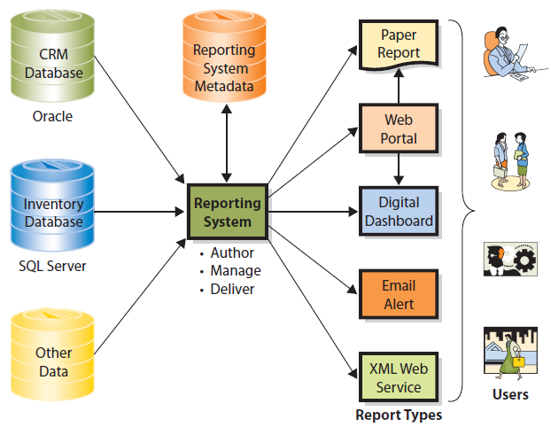
Components of a Reporting System
Notes:
Organizations can prepare reports in a variety of formats.

Slide 10
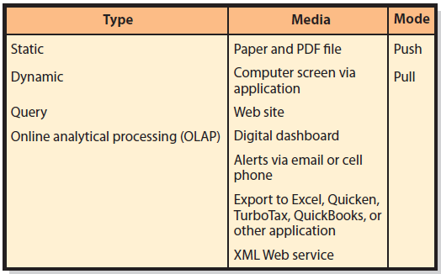
Summary of Report Characteristics
Notes:
Static reports are prepared once from underlying data, and do not change. A report of past year’s sales is a static report.
Dynamic reporting systems read most current data and generate reports using that fresh data; for instance, a report on sales today and a report on current stock prices.
Query reports prepared in response to requests entered by users.
OLAP reports allow user to dynamically change the report grouping structures.

Slide 11
Report Media
Printed on paper
PDFs—Portable Document Format
Computer screens
Digital dashboards
Alerts
Exported to another program
Published via Web service

Slide 12
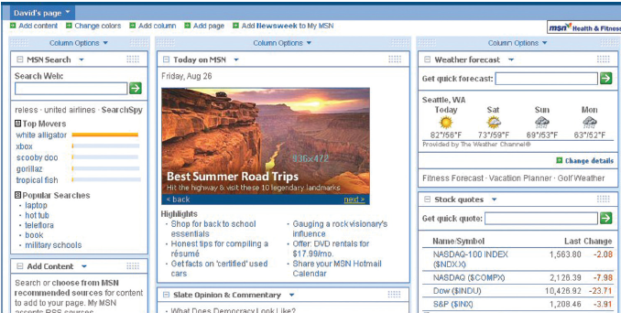
Digital Dashboard Example
Notes:
Digital dashboard is a customized electronic display for a particular user. Vendors like Yahoo! and MSN provide common examples.
Users can define content they want—say, a local weather forecast, a list of stock prices, or a list of news sources—and the vendor constructs customized display for each user.

Slide 13
Q3: How Are Reports Authored, Managed and Delivered?
Report authoring
  Connect to data sources, create report structure, format report
  Examples: MS Access, Visual Studio
Report management
  Defines who receives what reports, when, what format, and by what means
  Defines user accounts and user groups
Notes:
Report authoring involves connecting to data sources, creating the report structure, and formatting the report.

Slide 14
Q3: How Are Reports Authored, Managed and Delivered? (cont'd)
Report delivery
  Push or pull reports based on metadata
  Security components ensures who receives reports
  Serves as intermediary between users and report generator

Slide 15
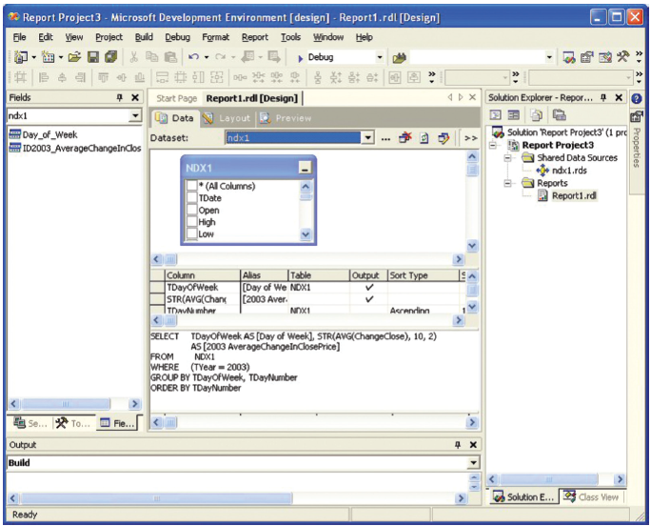
Connecting to a Report Data Source Using Visual Studio
Notes:
One common way to create reports is to use a developer tool such as Microsoft’s Visual Studio, which can connect to many different data sources.
Here Visual Studio connected to a database that contains source data and an SQL statement, shown in the lower-center portion of this display, to generate this report. Visual Studio can be used to format the report as well.

Slide 16
Q4: How Are OLAP Reports Dynamic?
OLAP reports
  Simple arithmetic operations on data
  Dynamic
  Measure
  Dimension
  OLAP vendors and products
Notes:
Measure is the data item of interest. Total sales, average sales, and average cost are examples of measures.
Dimension is a characteristic of a measure. Purchase date, customer type, customer location, and sales region are all examples of dimensions.
Visit www.TableauSoftware.com to useful demos and tutorials. You can also find excellent examples at www.TableauServer.com.

Slide 17
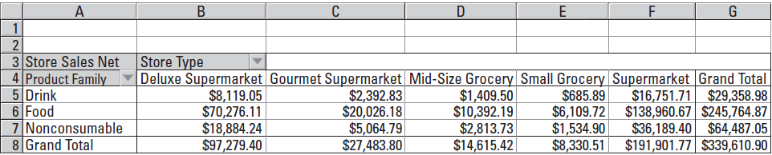
Typical OLAP Report
OLAP Product Family by Store Type
Notes:
Here, measure is Store Sales Net, and dimensions are Product Family and Store Type. This report shows how net store sales vary by product family and store type. Stores of type Supermarket sold a net of $36,189 worth of nonconsumable goods.

Slide 18
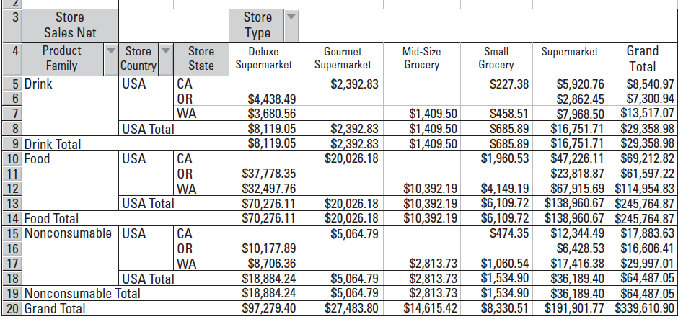
OLAP Product Family and Store Location by Store Type
Notes:
Here, user added dimensions Store (Country) and State to the horizontal display. Product-family sales are now broken out by the location of the stores.
Observe sample data include only stores in the United States and only in the western states of California, Oregon, and Washington.

Slide 19
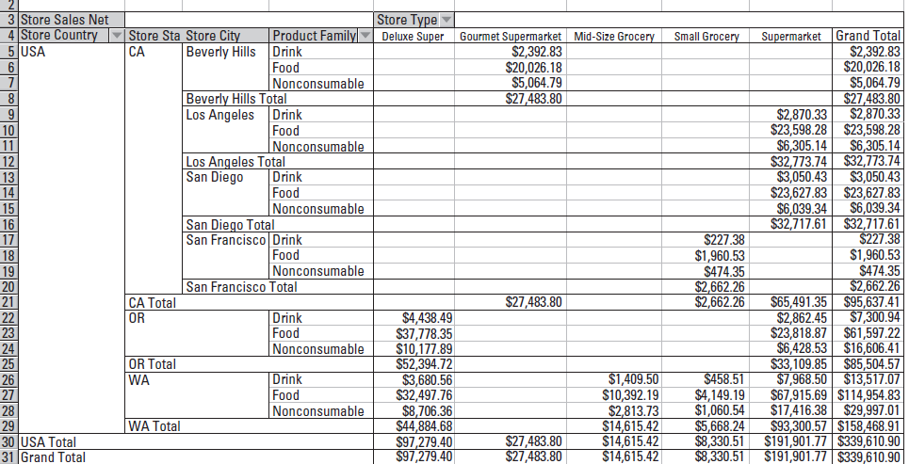
OLAP Product Family and Store Location by Store Type, Showing Sales Data for Four Cities
Notes:
User has drilled down into the stores located in California; OLAP report now shows sales data for four cities in California that have stores.
Notice the user has drilled down and changed the order of the dimensions.

Slide 20
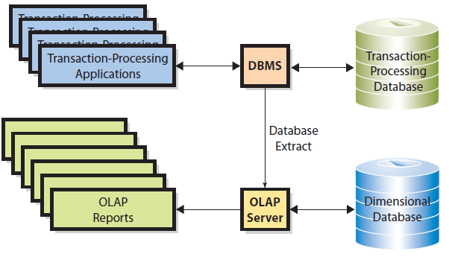
Role of OLAP Server and Dimensional Database
Notes:
OLAP servers are special-purpose products to perform OLAP analysis.
It reads data from an operational database, performs preliminary calculations, and stores the results of those calculations in an OLAP database.
For performance and security reasons the OLAP server and the DBMS run on separate computers.

Slide 21
Active Review
Q1: How do reporting systems enable people to create information?
Q2: What are the components and characteristics of reporting systems?
Q3: How are reports authored, managed, and delivered?
Q4: How are OLAP reports dynamic?

Slide 22
