Slide 1
Chapter Extension 12
Database Marketing

Slide 2
Study Questions
Q1: What is a database marketing opportunity?
Q2: How does RFM analysis classify customers?
Q3: How does market-basket analysis identify cross-selling opportunities?
Q4: How do decision trees identify market segments?

Slide 3
Database Marketing
Application of business intelligence systems to planning and executing marketing programs
Databases and data mining techniques key components
Notes:
Scenario: Mary needs to identify lost customers in a timely way. Database marketing will help classify customers in terms of how recently and how frequently they have purchased, and the size of those purchases. Customers who have not purchased recently, but purchased frequently with high value orders (such as Tootsie Swan) will be identified so Mary can attempt to gain back their business. Mary will need customer purchase records in order to perform analysis.

Slide 4
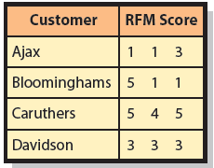
Q2: How Does RFM Analysis Classify
Customers?
Recently
Frequently
Money
Notes:
How recently (R) a customer has ordered, how frequently (F) a customer orders, and how much money (M) the customer spends per order.
Ajax is a good and regular customer. Sales needs to attempt to up-sell more expensive goods.
Bloominghams was a frequent buy, but hasn’t bought in a long time. Sales team should contact Bloominghams immediately.
Caruthers has not ordered for a long time and infrequently. This makes Caruthers a low value customer.
Davidson is all average or just OK.

Slide 5
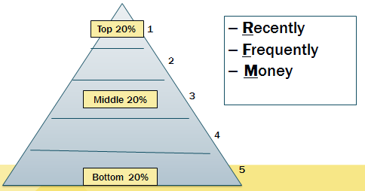
RFM Analysis Classifies Customers
Notes:
To produce an RFM score, a program sorts customer purchase records by date of most recent (R) purchase, divides sorts into quintiles, and gives customers a score of 1 to 5. Process is repeated for Frequently and Money.

Slide 6
Q3: How Does Market-Basket Analysis
Identify Cross-Selling Opportunities?
Data-mining technique for determining sales patterns
    Statistical methods to identify sales patterns in large volumes of data
    Products customers tend to buy together
    Probabilities of customer purchases
    Identify cross-selling opportunities
Customers who bought fins also bought a mask.

Slide 7
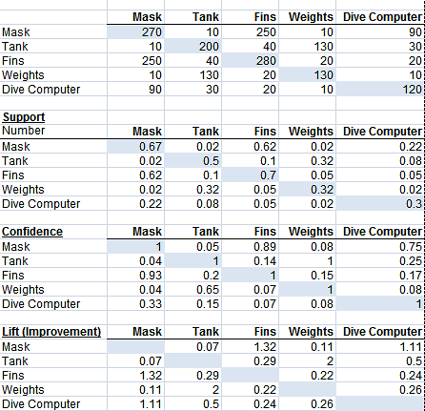
Market-Basket Example:
Transactions = 400
Notes:
Figure CE12-2 shows hypothetical sales data from 400 sales transactions at a dive shop.
The first row of numbers under each column is the total number of times an item was sold.
For example, the 270 in the third row under Mask means that 270 of the 400 (.67) transactions included masks.
The 280 under Fins means that 280 of the 400 (.700) transactions included fins.

Slide 8
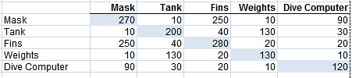
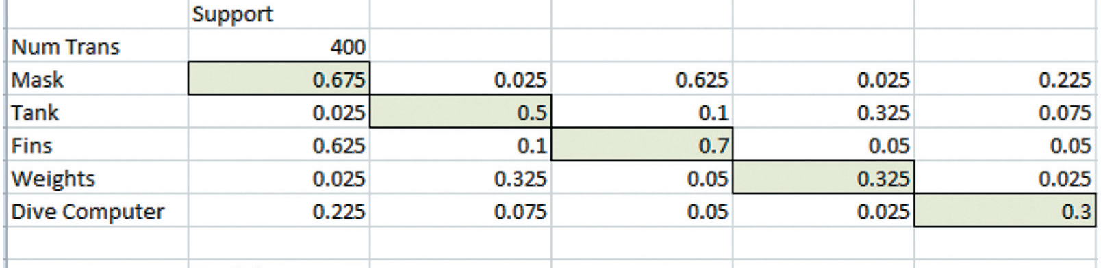
Support: Probability that Two Items Will Be Bought Together
    P(Fins and Mask) = 250/400, or 62%
    P(Fins and Fins) = 280/400, or 70%
Notes:
Support is probability that two items will be purchased together.
To estimate that probability, examine sales transactions and count number of times two items occurred in the same transaction.
Fins and masks appeared together 250 times, thus support for fins and a mask is 250/400, or .625. Similarly, support for fins and weights is 20/400, or .05.

Slide 9
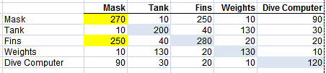
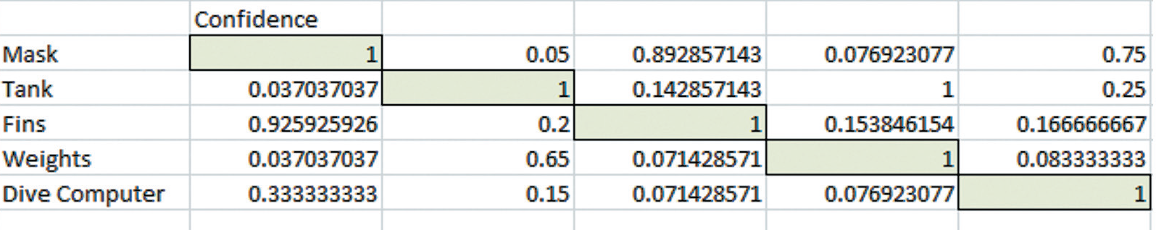
Confidence = Conditional Probability Estimate
    Probability of buying Fins = 250
    Probability of buying Mask = 270
    P(After buying Mask, then will buy Fins)
      Confidence = 250/270 or 93%
Notes:
Confidence is a conditional probability estimate.
Masks were purchased 270 times, and those individuals who bought masks, 250 also bought fins. Thus, given a customer bought a mask, we can estimate probability for buying fins to be 250/270, or 92.6%.

Slide 10
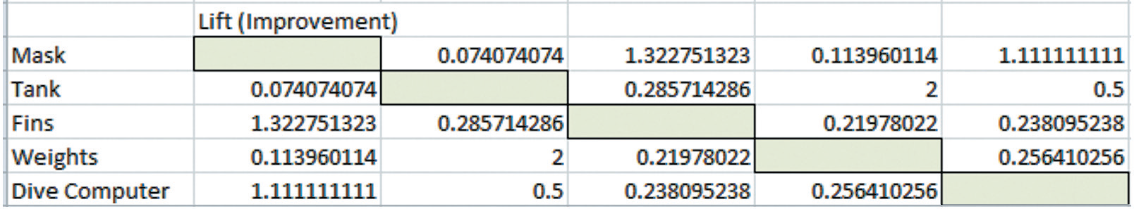
Lift = Confidence ÷ Base Probability
Lift = Confidence of Mask/Base Prob(Fins)
= .926/.625 = 1.32
Notes:
Lift shows how much base probability increases or decreases when other products are purchased.
Lift of fins and a mask is confidence of fins given a mask (.926), divided by base probability of fins (.625), or 1.32. Likelihood that people buy fins when they buy a mask increases by 32 percent.

Slide 11
Warning
Analysis only shows shopping carts with two items.
Must analyze large number of shopping carts with three or more items.
Know what problem you are solving before mining the data.
Notes:
Cannot say what likelihood customers, given they bought one item, will buy both two or more other items.

Slide 12
Q4: How Do Decision Trees Identify Market Segments?
Hierarchical arrangement of criteria to predict a classification or value
Unsupervised data mining technique
Basic idea of a decision tree
    Select attributes most useful for classifying something on some criteria to create “pure groups”
Notes:
Basic idea of a decision tree is to select attributes most useful for classifying entities.

Slide 13
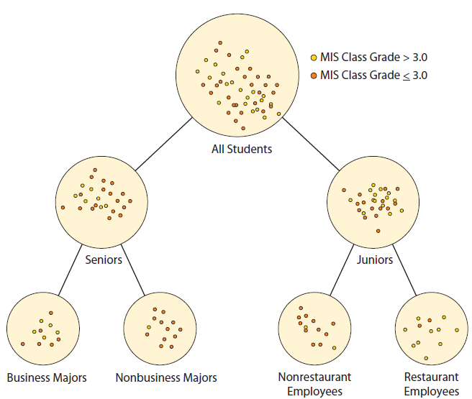
A Decision Tree for Student Performance
Lower-level groups more similar than higher-level groups
If Senior = Yes
If Junior = Yes
Notes:
Classifying students on whether their GPA was greater than 3.0 or less than or equal to 3.0.
This tree examined students’ characteristics, such as class (junior or senior), major, employment, age, club affiliations, and other characteristics to create groups as different as possible on classification of GPA above or below 3.0.

Slide 14
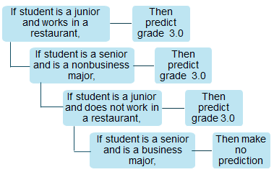
Transforming a Set of Decision Rules
Notes:
Do not confuse these If/Then rules with those in expert systems. These rules are developed as a result of data mining via decision tree analysis which generally identify 10 or 12 rules. Expert system rules are created by interviewing human experts, which typically, results in hundreds or thousands of rules.

Slide 15
Decision Tree for Loan Evaluation
  Classify loan applications by likelihood of default
  Rules identify loans for bank approval
  Identify market segment
  Structure marketing campaign
  Predict problems
Notes:
Common business application

Slide 16
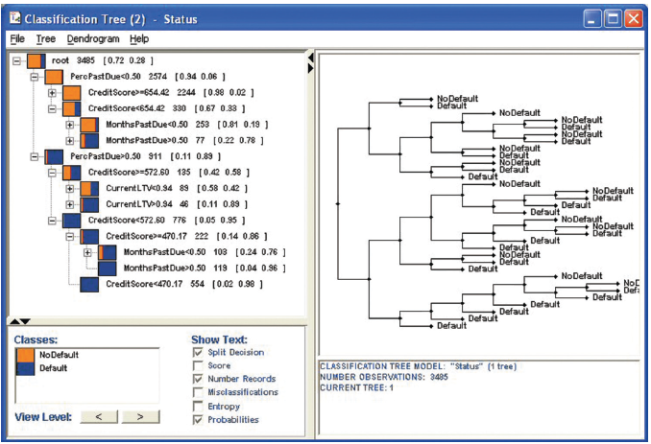
Credit Score Decision Tree
Notes:
Common business application of decision trees is to classify loans by likelihood of default.
This example generated by Insightful Miner. Data from 3,485 loans were examined. Of those loans, 72% had no default and 28% did default. To perform analysis, decision-tree tool examined six different loan characteristics.

Slide 17
Ethics Guide: The Ethics of Classification
Classifying applicants for college admission
    Collects demographics and performance data of all its students
    Uses decision tree data mining program
    Uses statistically valid measures to obtain statistically valid results
    No human judgment involved
Notes:
GOAL
Explore difficult ethical issues about using decision trees for classifying people.

Slide 18
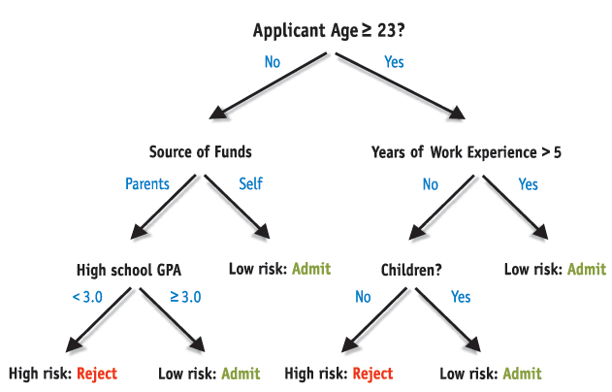
Resulting Decision Tree
Notes:
Classifying people can raise serious ethical issues because:
The challenge of statistically valid measures without human judgment involved
Important data might not be included
Results could reinforce social stereotypes
Might not be organizationally or socially feasible, or legal.

Slide 19
Active Review
Q1: What is a database marketing opportunity?
Q2: How does RFM analysis classify customers?
Q3: How does market-basket analysis identify cross-selling opportunities?
Q4: How do decision trees identify market segments?

Slide 20
