Slide 1
Chapter Extension 11
Hyper-Social Organizations and
Knowledge Management

Slide 2
Study Questions
Q1: What are the characteristics of a hyper-social organization?
Q2: What are the benefits of knowledge management?
Q3: What are expert systems?
Q4: What are content management systems?
Q5: How do hyper-social organizations manage knowledge?

Slide 3
Q1: What Are the Characteristics of a Hypersocial Organization?
Uses social media communities
Transform interactions with customers, employees, and partners into mutually satisfying relationships
Notes:
Using social media in an old-style, organization-centric manner is ineffective. True value of social media can only be achieved when organizations use social media to interact with customers, employees, and partners in a more humane, relationship-oriented way. Rather than sending messages that attempt to manage, influence, and control, hyper-social organizations create relationships in which both parties perceive and gain value.

Slide 4
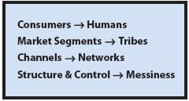
Four Pillars of the Hyper-Social Organization
Notes:
Customers want informed, useful interactions that help them solve particular problems and satisfy unique needs. Customers increasingly ignore prepackaged organizational messages touting product benefits.
An example is the sales force in Apple stores has been trained to act as customer problem-solving consultants and not sellers of products.

Slide 5
Market Segments Become Tribes
Market segments have key traits and characteristics
Tribes have relationships for defending beliefs or seeking truth
Communities comprised of related tribes
Relating to a community increases a company's reach
Notes:
Traditional market-segment thinking, GearUp would promote an upcoming soccer event to a market segment, say, 20- to 25-year-old women who work in retail and live in certain zip codes.
Tribal thinking, GearUp would market to communities that defend the belief that soccer is a great game or to communities that grieved over the last game of the 2011 Women’s World Soccer Cup.

Slide 6
Channels Become Networks
Pre-1980, organizational communication highly restricted to a few channels.
Organizations control messaging via paid advertising and public relations efforts to manipulate editors and writers.
Internet, Web sites, broadcast email, cable TV, and smartphones blew those channels apart.
Notes:
With myriad of communications channels available today, there is so much traffic that organizations find it nearly impossible to obtain attention in these channels.

Slide 7
Channels Become Network (cont'd)
Channels transmit data, networks transmit knowledge
Networks transmit messages valued by recipients.
PRIDE — transmits new techniques for increasing patient exercise, recent research, and post-operation health and cardiac care, and so forth

Slide 8
Structure and Control Become Messy
Can no longer plan and control organizational messaging
Messaging emerges via a dynamic, SM-based process
Engage communities with authentic relationships important to them
Publish successes of community members that favor your organization, take a back seat

Slide 9
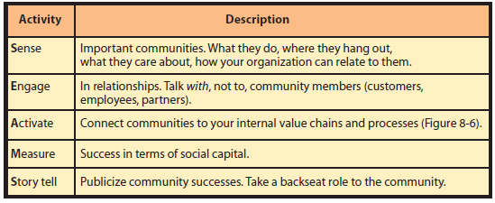
How Can SMIS Foster Hyper-Social Organizations?
SEAMS Dynamic Process Activities
Notes:
All of these activities require involvement of hyper-social organization personnel. Organizations need to staff to manage this activity, just as they did for traditional media buying activities.

Slide 10
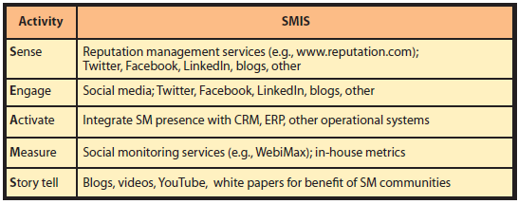
SMIS and SEAMS Activities
Notes:
Hooks into CRM, ERP, and other operational systems need to be discreet and in the appropriate manner. Designing applications according to SOA principles greatly facilitates this task.
Measurements include number of mentions in target communities, and response to organization’s SM presence. These measurements answer questions such as: How many commenters? How many reviewers? What is the traffic rate on the organization’s SM sites, and how is it changing?
Dr. Flores and his staff might commission a video crew to “tell the story” of someone’s surgery and follow-up using PRIDE system and SM site. YouTube is a common site for such videos.

Slide 11
Q2: What Are the Benefits of Knowledge Management?
Knowledge Management
Creating value from intellectual capital and sharing that knowledge with those who need that capital
Preserve organizational memory by capturing and storing lessons learned and best practices of key employees
Goal: Enable employees to use organization's collective knowledge

Slide 12
Q2: What Are the Benefits of Knowledge Management? (cont'd)
Fosters innovation via free flow of ideas
Improves customer service by streamlining response time
Boosts revenues by getting products, services to market faster
Enhances employee retention rates by recognizing employee value
Streamlines operations, reduces costs by eliminating unnecessary processes

Slide 13
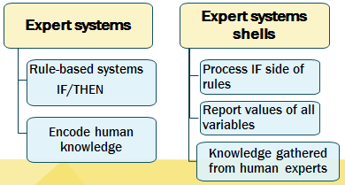
Q3: What Are Expert Systems?
Notes:
Expert systems are rule-based systems that encode human knowledge in the form of If/Then rules.
System of rules created by a development team based on interviews of domain experts.
Expert systems shells — programs that process a set of rules

Slide 14
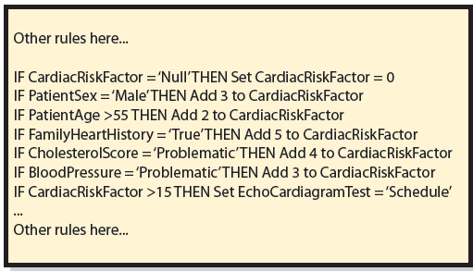
Example of IF/THEN Rules

Slide 15
Drawbacks of Expert Systems
Difficult and expensive to develop
Labor intensive
Ties up domain experts
Difficult to maintain
Changes cause unpredictable outcomes
Constantly needs expensive changes to reflect new knowledge
Don’t live up to expectations
Can’t duplicate diagnostic abilities of humans

Slide 16
Q4: What Are Content Management Systems (CMS)?
Information systems to support management, and to deliver documents and other expressions of employee knowledge

Slide 17
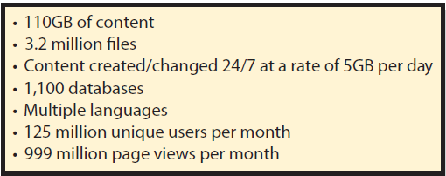
What Are the Challenges of CMS?
Document Management at Microsoft.com (as of December 2003)
Notes:
Content management system functions are huge and complex.

Slide 18
What are CMS Application Alternatives?
• In-house custom
Customer support department develops in-house database applications to track customer problems
• Off-the-shelf
Horizontal market products (SharePoint)
Vertical market applications
• Public search engine
Google

Slide 19
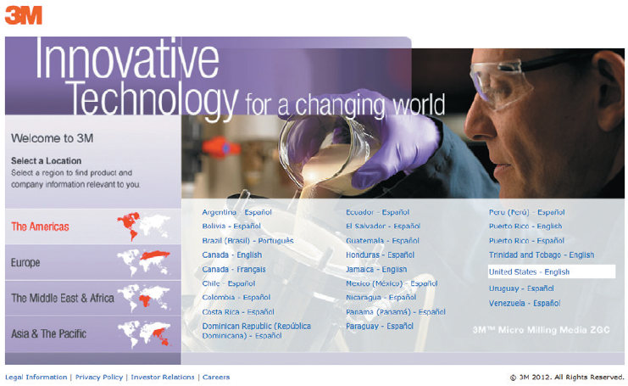
Need for Multilanguage Content
Notes:
Slide shows the many languages 3M needs to provide Web content. 3M has tens of thousands of products and must publish product safety data for products in all the languages shown.

Slide 20
Q5: How Do Hyper-Social Organizations Share Knowledge?
Tweets, Facebook posts, blogs, videos on YouTube et al.
Blogs perceived as authentic
Customers comment on blog entries and tell others how they solved problems themselves.
Notes:
Social media has changed the orientation of knowledge management.

Slide 21
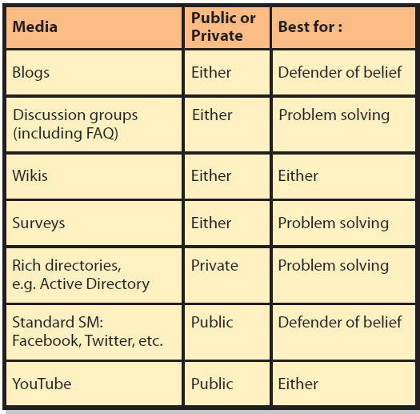
Hyper-Social KM Alternative Media

Slide 22
Employee Resistance to Knowledge Sharing
Reluctant to exhibit ignorance
Internal competition
Shyness, fear of ridicule, inertia
Cure: strong management endorsement for knowledge sharing, praise, and cash

Slide 23
Active Review
Q1: What are the characteristics of a hyper-social organization?
Q2: What are the benefits of knowledge management?
Q3: What are expert systems?
Q4: What are content management systems?
Q5: How do hyper-social organizations manage knowledge?

Slide 24
