Slide 1
Chapter Extension 10
Supply Chain
Management

Slide 2
Study Questions
Q1: What are typical interorganizational processes?
Q2: What is a supply chain?
Q3: What factors affect supply chain performance?
Q4: How does supply chain profitability differ from organizational profitability?
Q5: What is the bullwhip effect?
Q6: How do information systems affect supply chain performance?

Slide 3
Q1: What Are Typical Interorganizational Processes?
Processes occur in two or more independent organizations
Cooperation by negotiation and contract; conflict resolution by negotiation, arbitration, litigation
Simple | Moderately complex | Highly complex
Small retailer credit card sales transaction process | Standardized interorganizational processing of checks among banks using Automated Clearing House (ACH) system. | Customized interorganizational processes among large companies
Notes:
PRIDE system is a customized interorganizational system.

Slide 4
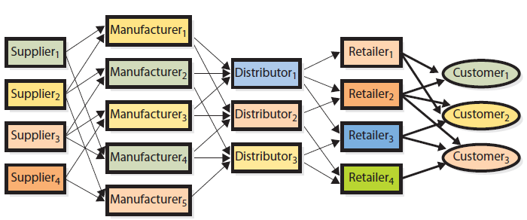
Q2: What Is a Supply Chain?
Supply Chain (Network) Relationships
Because of disintermediation, not every supply chain has all of these organizations
Notes:
The term chain is misleading. Chain implies that each organization is connected to just one company up (toward the supplier) and down (toward the customer) the chain. That is not the case. Instead, at each level, an organization can work with many organizations both up and down the supply chain. Thus, a supply chain and the processes that support it are networks.

Slide 5
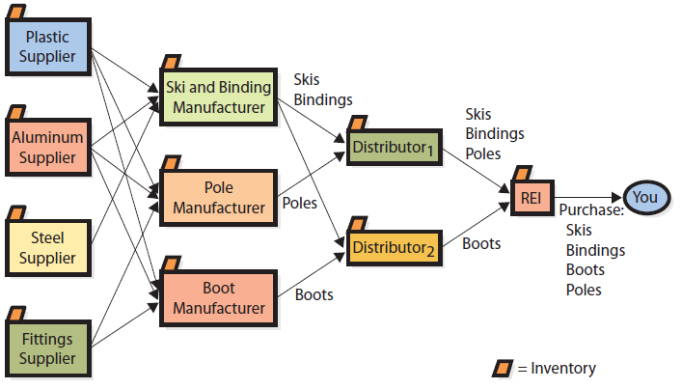
Supply Chain Example: REI
$
$
Customer

Slide 6
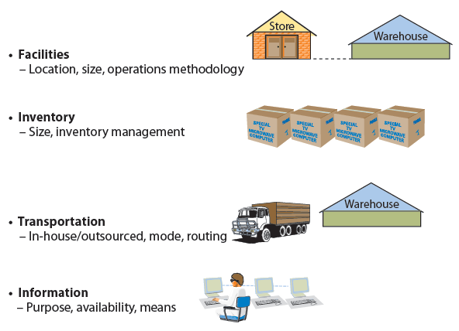
Q3: What Factors Affect Supply Chain Performance?
Drivers
Notes:
Purpose: can be transactional
Availability: ways to share information; with whom, what and when.
Means: methods for transmitting information

Slide 7
Q4: How Does Supply Chain Profitability Differ from Organizational Profitability?
Profit: Total revenue generated minus total costs incurred
Maximum profit from chain
Not achieved if each organization maximizes own profits in isolation
Profitability increases when one or more operate at less than maximum profitability (e.g., carrying inventory larger than optimal)
Why? When one supplier loses sales due to out-of-stock, others in supply chain lose revenue.

Slide 8
Q4: How Does Supply Chain Profitability Differ from Organizational Profitability? (cont'd)
Solving this problem uses some form of transfer payment to induce a distributor to carry a larger boot inventory than their optimal level.
Requires a comprehensive supply-chain information system

Slide 9
Q5: What Is the Bullwhip Effect?
Natural dynamic of multistage supply chain
Variability in size and timing of orders increases at each stage up supply chain, from customer to supplier
Unrelated to erratic customer demand

Slide 10
Q5: What Is the Bullwhip Effect? (cont'd)
Large demand fluctuations force distributors, manufacturers, suppliers to carry larger inventories
Reduces overall profitability of supply chain
Eliminate by giving supply chain participants access to consumer-demand information
Notes:
Unrelated to erratic customer demand
Large fluctuations force distributors, manufacturers, and suppliers to carry larger inventories

Slide 11
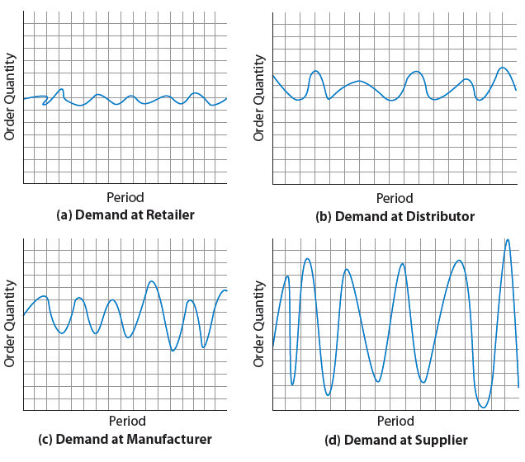
Bullwhip Effect
Notes:
Small changes in demand amplify through supply chain

Slide 12
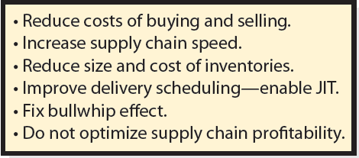
Q6: How Do Information Systems Affect Supply Chain Performance?
Notes:
Information systems have enabled bot suppliers and customers to reduce the size of their inventories and, thus, reduce their inventory costs.
This reduction is possible because speed and efficiency provided by information systems enables processing of small orders, quickly.

Slide 13
Ethics Guide: The Ethics of Supply Chain Information Sharing
Distributor has developed information system that reads data up and down supply chain
A. Store inventories of all retailers are low. You know retailers will be sending rush orders. You have overstocked on supply. You query manufacturer’s database and find finished goods are low. You increase your price claiming extra transportation costs, but really it was to increase your profit instead.
Legal? Ethical? Smart? What’s the risk to you and your business?
Notes:
GOALS
Investigate the differences among aggressive, unwise, unethical, and illegal activities using information systems in the supply chain.
The situations are sorted in increasing order of questionability. The first one is certainly legal and ethical; it may or may not be wise. The last one is certainly unethical, and it may be illegal, or at least a violation of a contract.
These scenarios are similar to those in the Ethics Guide in Chapter 1. They involve the use or misuse of information. The difference is that the information systems here are far more sophisticated than the email systems described in Chapter 1.

Slide 14
Ethics Guide: The Ethics of Supply Chain Information Sharing (cont’d)
Competitor has large supply as well, and does not increase price, so you sell no product. You want to track competitor’s inventories, which can be estimated by watching on manufacturer side and comparing to decrease sales on retail side. You know what was made, sold, and left in your competitor’s inventory.
Legal? Ethical? Smart? What’s the risk to you and your business?
Notes:
There is no Supply Chain Company. Supply chain has no owners, no stockholders, and no employees, and no organization is concerned about the economic welfare of the supply chain to the exclusion of its own economic welfare.
Every organization views the supply chain through the prism of its own goals and objectives. Any information system developed to support supply-chain-wide integration is subject to use or misuse to further the goals of the individual companies.

Slide 15
Ethics Guide: The Ethics of Supply Chain Information Sharing (cont’d)
C. Your agreement with customers permits you to query their inventory levels, but only for orders they have with you. You are not to query orders they have with your competitors. But, system has a flaw and allows you to query all orders.
Legal? Ethical? Smart? What’s the risk to you and your business?

Slide 16
Ethics Guide : The Ethics of Supply Chain Information Sharing (cont’d)
D. Assume same agreement as situation C. One of your developers writes a program allowing you to exploit a hole in retailer’s security system. This gives you access to all of retailer’s sales, inventory, and order data.
Legal? Ethical? Smart? What’s the risk to you and your business?
How do you protect your systems and data in a supply chain?

Slide 17
Active Review
Q1: What are typical interorganizational processes?
Q2: What is a supply chain?
Q3: What factors affect supply chain performance?
Q4: How does supply chain profitability differ from organizational profitability?
Q5: What is the bullwhip effect?
Q6: How do information systems affect supply chain performance?

Slide 18
