Slide 1
Chapter Extension 9
Enterprise Resource Planning (ERP) Systems

Slide 2
Study Questions
Q1: What is the purpose of ERP systems?
Q2: What are the elements of an ERP solution?
Q3: How are ERP systems implemented?
Q4: What types of organizations use ERP?
Q5: How do the major ERP vendors compare?

Slide 3
Q1: What Is the Purpose of ERP Systems?
Primary purpose: integration of purchasing, human resources, production, sales, and accounting data into a single system.
Allows real time global updates whenever a transaction happens.
Critical business decisions can be made using latest data.
Notes:
ERP — Suite of modules, a database, and set of inherent processes for consolidating business operations into a single, consistent, computing platform

Slide 4
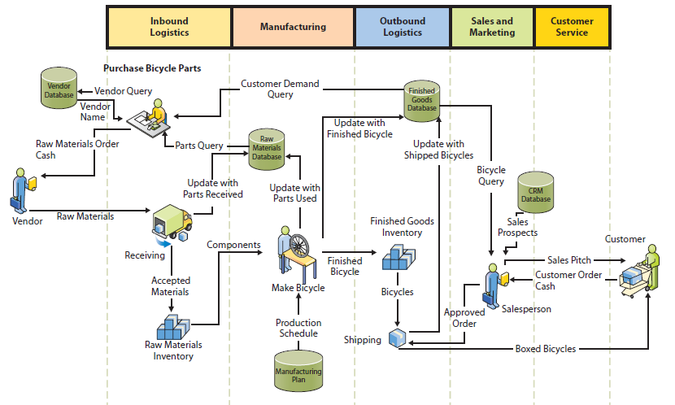
Pre-ERP Information System: Bicycle Manufacturer
Does not include accounting
Five non-integrated databases
Notes:
Functional-area systems are identified by the circles.
This diagram of processes used by a bicycle manufacturer includes five different databases, one each for vendors, raw materials, finished goods, manufacturing plan, and CRM. Consider the problems that appear with such separated data when sales department closes a large order, say for 1,000 bicycles.

Slide 5
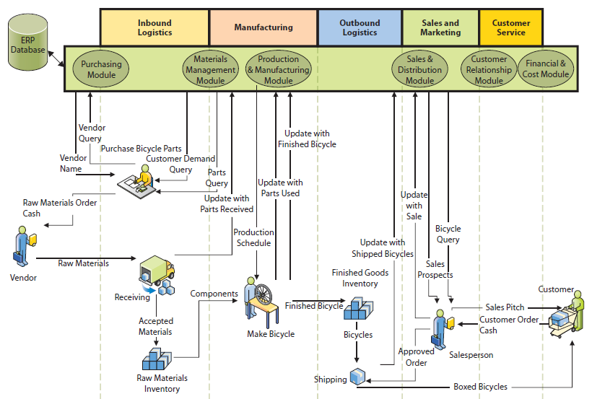
ERP Information System
Notes:
All activity is processed by ERP application programs and consolidated data are stored in a centralized ERP database.

Slide 6
Some Questions Procedures Need to Answer or Resolve
How does sales department determine an order is “large”? By dollars? By volume?
Who approves customer credit (and how)?
Who approves production capacity (and how)?
Who approves schedule and terms (and how)?
What actions need to be taken if customer modifies an order?
How does management obtain oversight on sales activity?
Notes:
It’s easy to draw a rectangle on a chart, label it “ERP application programs,” and assume data integration takes all problems away. It is far more difficult to write those application programs and design the database to store that integrated data. Even more problematic, what procedures should employees and others use to process those application programs?

Slide 7
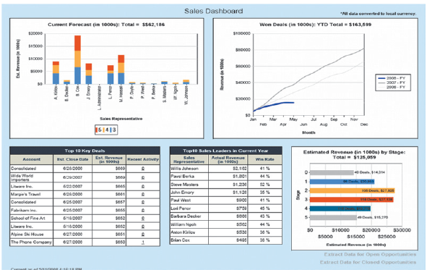
Sales Dashboard
Notes:
ERP systems can display the current status of critical business factors to managers and executives, as shown in the sales dashboard.

Slide 8
ERP Projects
Few organizations develop their own ERP software
Daunting and expensive:
    Multi-year projects, millions of dollars, and hundreds of employees, consultants and vendor personnel.
  SAP ERP databases contain over 15,000 tables!

Slide 9
Q2: What Are the Elements of an ERP Solution?
ERP Application programs
ERP Business process procedures
ERP Databases
ERP Training and Consulting

Slide 10
True ERP Must Integrate: (http://www.erpsoftware360.com/erp-101.htm)
Supply chain
Manufacturing
CRM
Human resources
Accounting
Notes:
• Supply chain (procurement, sales order processing, inventory management, supplier management, and related activities)
• Manufacturing (scheduling, capacity planning, quality control, bill of materials, and related activities)
• CRM (sales prospecting, customer management, marketing, customer support, call center support)
• Human resources (payroll, time and attendance, HR management, commission calculations, benefits administration, and related activities)
• Accounting (general ledger, accounts receivable, accounts payable, cash management, fixed asset accounting)

Slide 11
ERP Solution Components
ERP Application Programs
    Configurable vendor applications
ERP Databases
    Trigger
    Stored Procedure
Notes:
Vendor applications: Configurable, can be alter without changing program code. Set configuration parameters specifying how ERP application programs will operate: Hourly payroll application configured to specify number of hours in standard workweek, hourly wages for different job categories, wage adjustments for overtime and holiday work, etc.
ERP Databases:
- Trigger: Database program to keep database consistent when certain conditions arise
- Stored procedure: Database program to enforce business rules

Slide 12
ERP Solution Components (Cont’d)
ERP Business Processes and Procedures
    Adapt to predefined, inherent processes and procedures, or design new ones?
ERP Training & Consulting
    Training to implement
    Top management support, preparing for change, dealing with resistance
    Training to use
Notes:
Super Users become in-house trainers; train the trainers
Vendor and third-party consultants

Slide 13
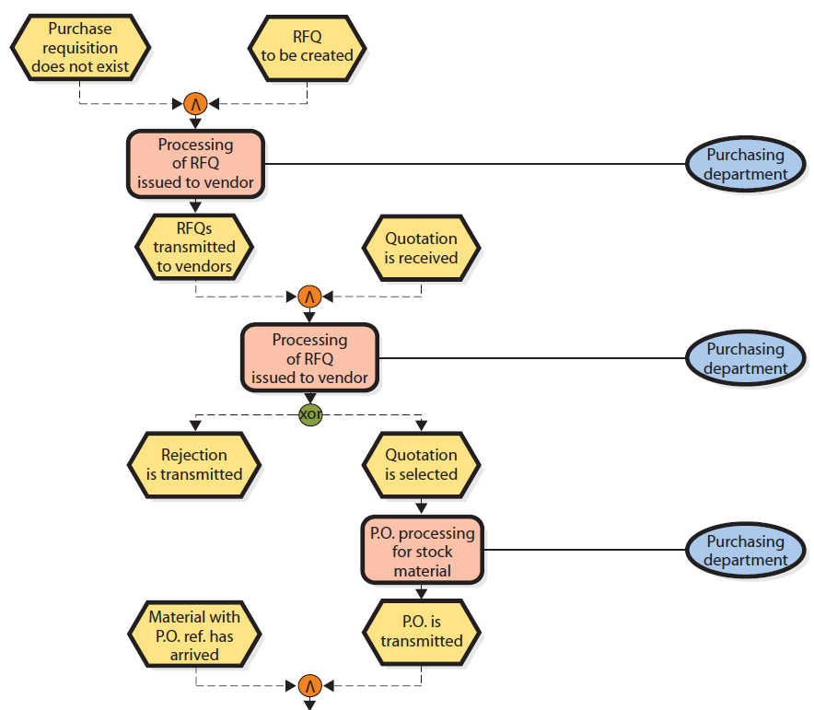
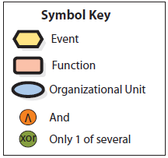
Example of SAP Ordering Business Process Blueprint
Notes:
Top half of Figure CE 9-4

Slide 14
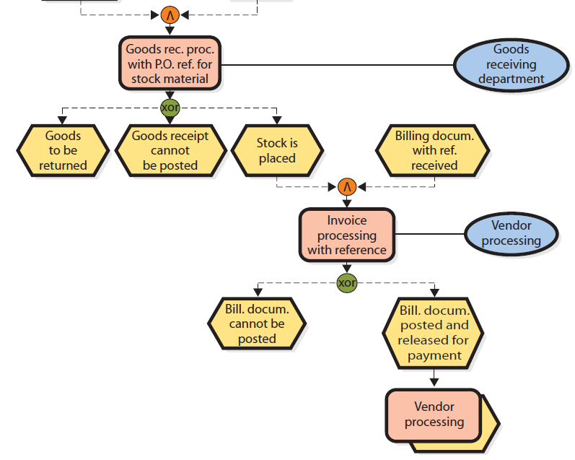
Example of SAP Ordering Business Process Blueprint (cont’d)
Notes:
Bottom half of Figure CE 9-4

Slide 15
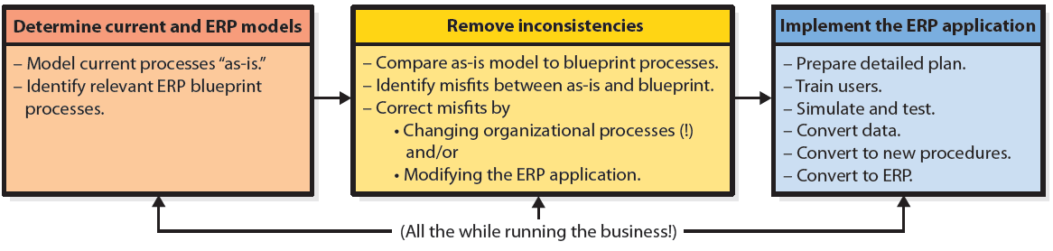
Q3: How Are ERP Systems Implemented?
Major tasks in implementation of an ERP application
Notes:
To appreciate the magnitude of these tasks, consider that SAP blueprint contains over a thousand process models. Organizations that are adopting ERP must review those models and determine which ones are appropriate to them. Then, compare ERP models to models developed based on their current practices.
Inevitably, some current-practice models are incomplete, vague, or inaccurate, so the team must repeat existing process models. In some cases, it is impossible to reconcile any existing system against the blueprint model. If so, the team must adapt, cope, and define new procedures, often to the confusion of current employees.

Slide 16
Magnitude of ERP Implementation
SAP blueprint contains over a thousand process models.
Model current “as is” processes
Compare as-is models with blueprints, note differences
Conduct simulation tests new system
Prepare detailed plan
Identify relevant ERP blueprint processes
Find ways to eliminate differences
Train users processes, procedures, ERP features and functions
Convert to new system
Notes:
This figure summarizes sequential steps in implementing an ERP.

Slide 17
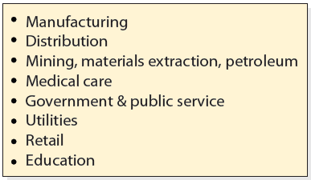
Q4: What Types of Organizations Use ERP?

Slide 18
International ERP
Worldwide consolidation of financial statements on a timely basis
Inherent ERP procedures adaptable to many cultures
Multiple currencies and languages, manage international transfers of goods in inventories, work with international supply chains
http://advice.Cio.Com/puneesh/deploy_erp_to_improve_globalization_efficiency_of_your_organization

Slide 19
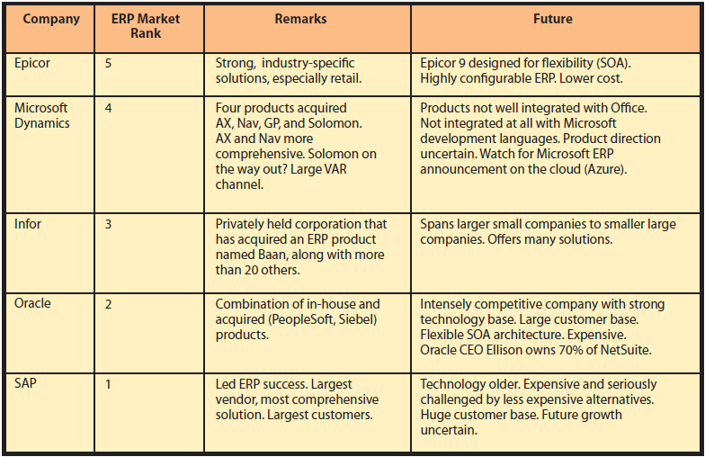
Q5: How Do the Major ERP Vendors Compare?

Slide 20
ERP Vendor Market Ranking
 | Epicore | MS Dynamics | Infor | Oracle | SAP
Revenue (2009) | $410M+ | $1.3B | ~$2B | >$2B | $11.9B
Market Share (2005) | 1% | 4% | 2% | 20% | 42%

Slide 21
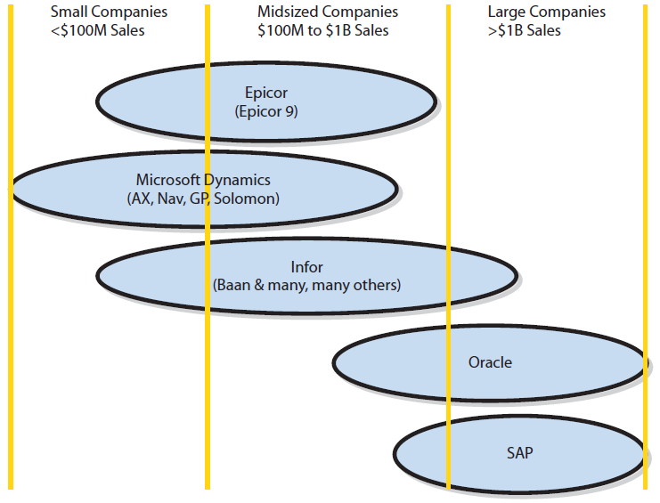
Top ERP Vendors and Customer Size
Notes:
Epicor and Microsoft Dynamics address needs of small and midsized organizations. Infor has a product for almost everyone. Oracle and SAP serve largest organizations.

Slide 22
The Future: ERP in the Cloud
Oracle and SAP acquiring companies with cloud-based products
Cannot plunge into cloud-based solutions without causing considerable organizational turmoil
Companies need to move applications to cloud, while providing thin-client and native mobile applications
Notes:
Expect ERP will continue to evolve over the early years of your career. If you are interested in operations and information systems, this is a great opportunity for employment.

Slide 23
Active Review
Q1: What is the purpose of ERP systems?
Q2: What are the elements of an ERP solution?
Q3: How are ERP systems implemented?
Q4: What types of organizations use ERP?
Q5: How do the major ERP vendors compare?

Slide 24
