Slide 1
Chapter Extension 8
Functional Applications

Slide 2
Study Questions
Q1: What is the difference between a functional IS and a functional application?
Q2: What are the functions of sales and marketing applications?
Q3: What are the functions of operations applications?
Q4: What are the functions of manufacturing applications?
Q5: What are the functions of human resources applications?
Q6: What are the functions of accounting applications?

Slide 3
Q1: What Is the Difference Between a Functional IS and a Functional Application
Functional IS
Functional application
Support a single organizational function within a single department or other workgroup
Computer program component within a functional IS

Slide 4
Creating Functional Information Systems
Implement application in context of supported functional process
Build remaining components of an information system
Determine requirements of function
Evaluate functional applications and select closest fit
Alter process or software
Acquire and install hardware, populate database, adapt standard procedures, and train staff
Notes:
Stages in creating a functional IS.

Slide 5
Example of a Functional Application: Reservation Application
Process: managing patient appointments
Identify potential packages and select
Train users
Determine specific requirements
Create other components
Notes:
Medical partnerships use numerous functional applications. An application for managing patient appointments is a typical example. Many vendors offer appointment applications for professional offices.
Understand the bulk of work occurs after software acquisition.

Slide 6
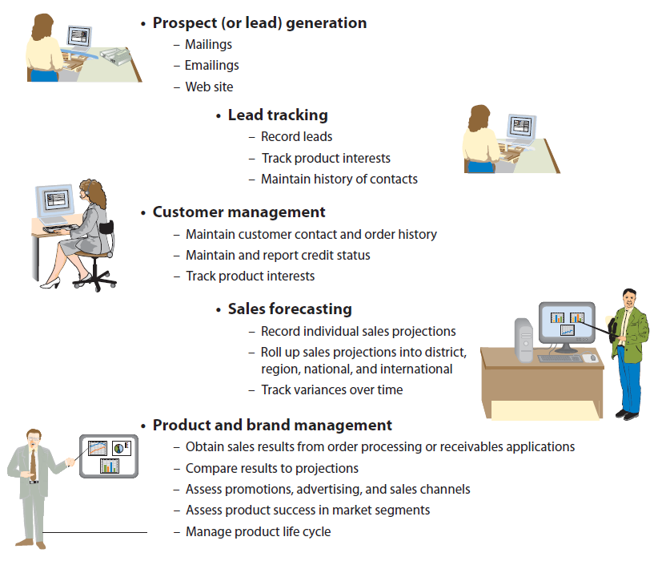
Q2: What Are the Functions of Sales and Marketing Applications?
Find and transform prospects into customers, sell more product to existing customers
Notes:
In marketing, systems exist to manage products and brands. Companies use such systems to assess the effectiveness of marketing messages, advertising, and promotions and to determine product demand among various market segments.
The primary purpose of the sales function is to find prospects and transform them into customers by selling them something. Sales departments also “manage customers” (i.e., selling existing customers more products). Other functional sales activities forecast future sales.

Slide 7
Lead Generation and Lead Tracking Applications
Lead-generation applications
Prospect generation
Send postal mailings and email
Web sites to send product information, white papers for contact information
Lead-tracking applications
Maintain customer name, product interests, past purchases, history of contacts with customer
Notes:
Also called prospect-generation applications, include those used to send both postal mail and email.

Slide 8
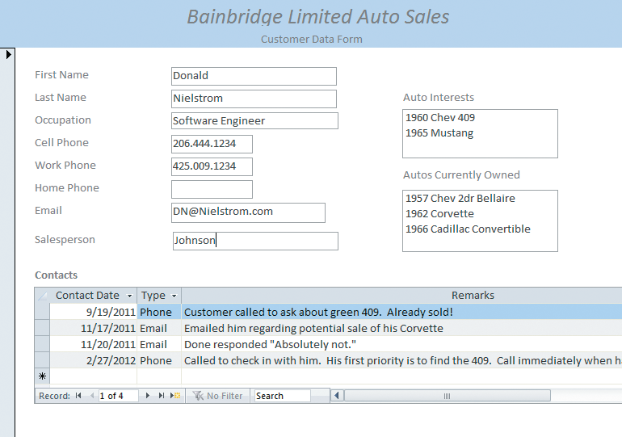
Form for Lead Tracking and Customer Management
Notes:
Lead-tracking applications record lead data and product interests and keep records of customer contacts.

Slide 9
Customer-Management and Product and Brand Management Applications
Customer-management applications
Obtain additional sales from existing customers
Maintain customer contact and order-history data
Track customer credit status
Product and brand management applications
Compare past sales records with projections and estimates
Assess desirability of product to different market segments
Manage product through lifecycles
Notes:
Most common functional applications in marketing are product and brand management applications. With these, records of past sales are imported from order processing or accounts receivable systems and compared to projections and other sales estimates.

Slide 10
Q3: What Are the Functions of Operations Applications?
Manage finished-goods inventory and movement of goods to customer
Used by non-manufacturers, distributors, wholesalers, retailers
Principle operations applications
Finished-goods inventory management
Order entry
Order management
Customer service
Notes:
Operations activities concern management of finished-goods inventory and movement of goods from that inventory to customer.
Operations applications are especially prominent for non-manufacturers, such as distributors, wholesalers, and retailers. For manufacturing companies, many, if not all, operations functions are merged into manufacturing systems.

Slide 11
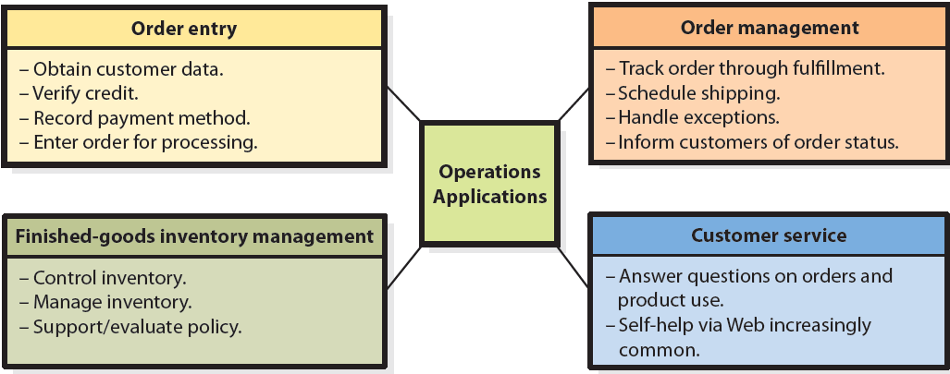
Functions of Operations Applications

Slide 12
Q4: What Are the Functions of Manufacturing Applications?
Manufacturing applications
Inventory applications: Support inventory control, management, and policy
Manufacturing-planning applications
Manufacturing-scheduling applications
Manufacturing operations applications
Notes:
Manufacturing applications facilitate production of goods. Manufacturing applications include inventory, planning, scheduling, and manufacturing operations.

Slide 13
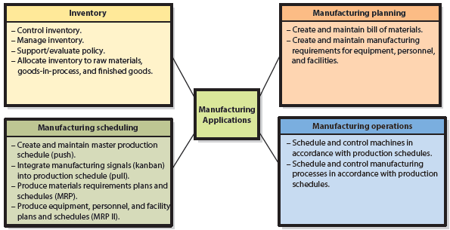
Manufacturing Information Systems

Slide 14
Q4: What Are the Functions of Manufacturing Applications? (cont’d)
Inventory applications
Support inventory control, management, and policy
Cover inventory control, track goods and materials into, out of, and between inventories
Use UPC bar codes and RFID tags
Inventory-management applications
Use past data to compute stocking levels and reorder levels, and reorder quantities according to inventory policy
Computing inventory counts and losses

Slide 15
Inventory Policy: Two Schools of Thought
Inventories as assets
Large inventories to minimize operations disruptions and lost sales due to outage
Increase sales via greater selection & availability
Inventories as liabilities
Keep inventories small, eliminate if possible
Just-in-time inventory policy (JIT)
Hybrid
Large inventories in stores, minimal inventories in warehouses and distribution centers
Notes:
Maybe one could say there are three schools of thought.

Slide 16
Inventory Policy: Two Schools of Thought (cont’d)
Inventory applications help to:
Implement inventory philosophy
Find balance between inventory cost and item availability
Compute ROI
Report effectiveness of current inventory policy
Evaluate alternative policies by performing what-if analyses

Slide 17
Manufacturing-Planning Applications
Bill of materials (BOM)
List of materials that comprise subassemblies to be manufactured
Schedule equipment, people, and facilities
May be augmented to show labor and equipment requirements

Slide 18
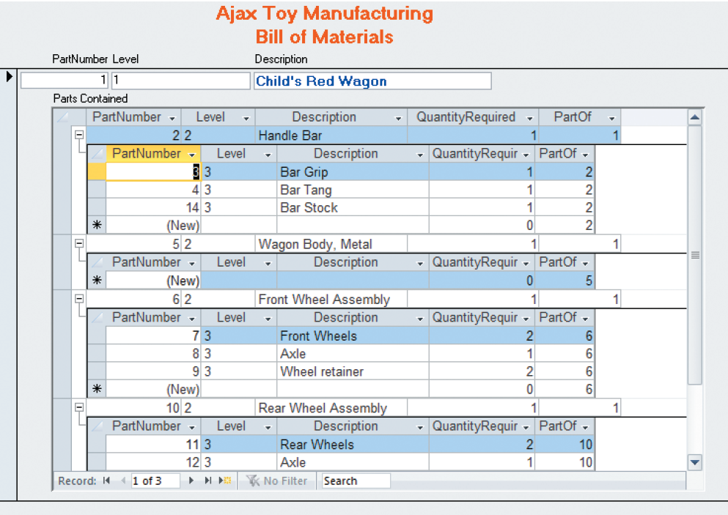
Bill of Materials Example

Slide 19
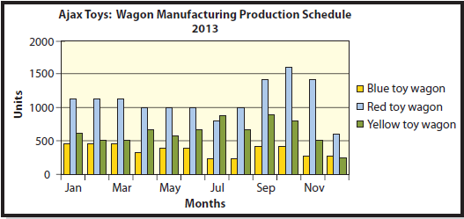
Sample Manufacturing Plan

Slide 20
Three Philosophies of Manufacturing
Push manufacturing process
Analyze past sales levels, estimate future sales, create master production schedule. Produce and push into sales
Master Production Schedule
Pull manufacturing process
Demand pulls products through manufacturing in response to signals from customers or other production processes
Combined push and pull systems
Company creates an MPS, plans manufacturing accordingly, but it uses kanban-like signals to modify schedule
Notes:
Companies use three philosophies to create a manufacturing schedule.
Generate a master production schedule (MPs).
Don’t use a preplanned, forecasted schedule, instead plan manufacturing in response to signals from customers or downstream production processes. The Japanese word kanban, which means “card,” is sometimes used to refer to the signal to build something. Manufacturing processes that respond to kanbans must be more flexible than those that are MPS-based.
Combination of the two. The company creates an MPS and plans manufacturing according to the MPS, but it uses kanban-like signals to modify the schedule.

Slide 21
Manufacturing-Scheduling Applications
Materials requirement planning (MRP)
Application that plans need for materials and inventories used in manufacturing process
Manufacturing resource planning (MRP II)
MRP plus planning of materials, personnel, machinery
Linkages with sales, marketing via MPS
“What-if” analyses on variances
Notes:
MRP does not include the planning of personnel, equipment, or facilities requirements.

Slide 22
Manufacturing Operations
Computer programs operate lathes, mills, and robots, and even entire production lines
Operate production lines
Computer-aided manufacturing
Computer-aided design
Robotics
Run machines rather than support business processes
Notes:
A fourth category of IS in manufacturing is the control of machinery and production processes.

Slide 23
Q5: What Are the Functions of Human Resources Applications?
HR Functions Support
Recruitment
Compensation, pensions, bonuses, and so on in liaison with Payroll
Training and development
Assessment
Notes:
Modern HR applications concern all dimensions of HR activity.

Slide 24
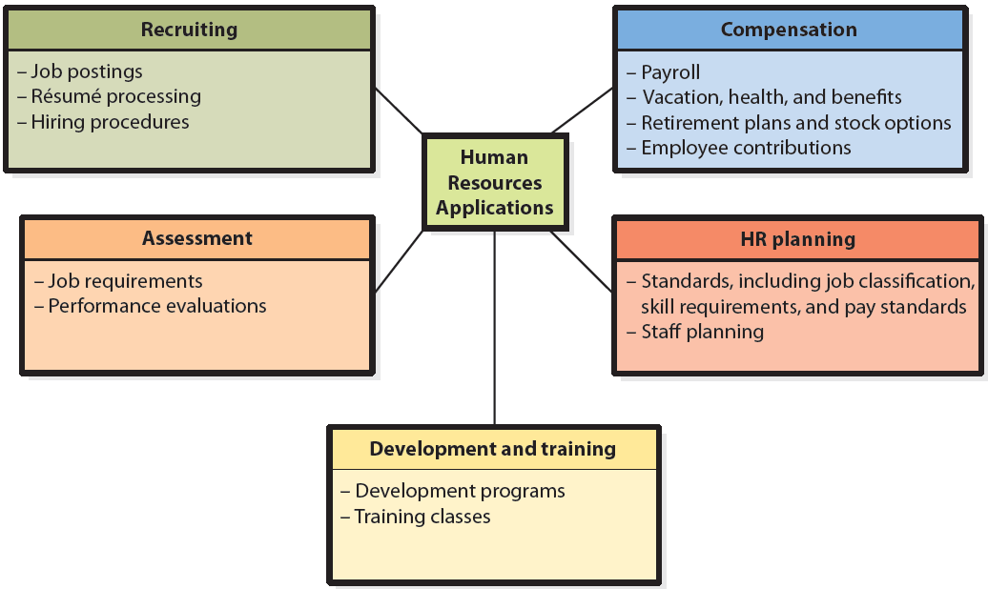
Functions of Human Resources Applications

Slide 25
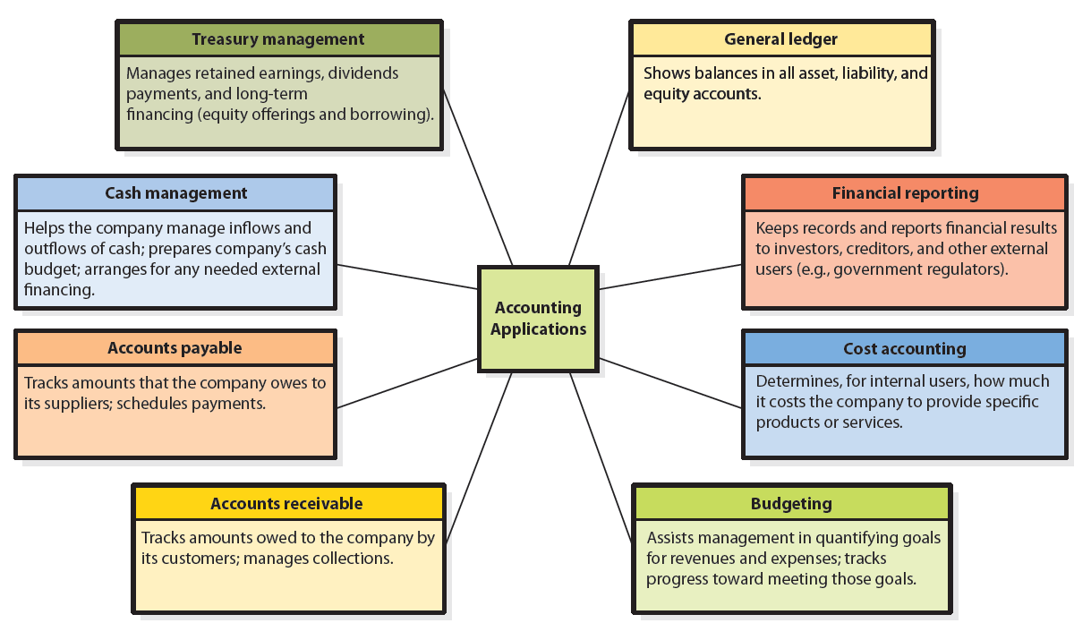
Q6: What Are the Functions of Accounting Applications?
Notes:
Typical accounting applications

Slide 26
Active Review
Q1: What is the difference between a functional IS and a functional application?
Q2: What are the functions of sales and marketing applications?
Q3: What are the functions of operations applications?
Q4: What are the functions of manufacturing applications?
Q5: What are the functions of human resources applications?
Q6: What are the functions of accounting applications?

Slide 27
