Slide 1
Chapter Extension 7
Mobile Systems
Notes:
Chapters 4 and 6 provide the background for this extension.

Slide 2
Study Questions
Q1: What are mobile systems?
Q2: Why are mobile systems important?
Q3: How do native and browser-based mobile applications compare?
Q4: What characterizes quality mobile user experiences?
Q5: What are the challenges of personal mobile devices at work?
Notes:
This text takes the position that social media, especially as manifested in the hyper-social organization, is a new business phenomenon.

Slide 3
Q1: What Are Mobile Systems?
Information systems to support users in motion
Major elements in a mobile system
Users in motion
Mobile devices
Wireless connectivity
Cloud-based resources
Notes:
Users access mobile systems from any place–at home, at work, in the car, on the bus, or the beach–using any smart device, smartphone, tablet, or PC.

Slide 4
Mobile Device
Computing Device
Small
Lightweight
Power-conserving
Capable Of Wireless Access

Slide 5
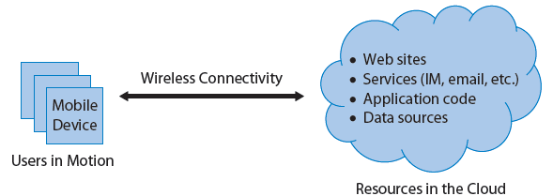
Elements of a Mobile Information System
Notes:
Major elements in a mobile system are users in motion, mobile devices, wireless connectivity, and cloud-based resources.

Slide 6
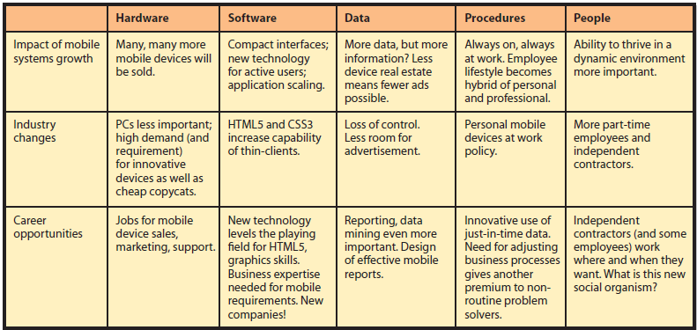
Q2: Why Are Mobile Systems Important?
Five Components of Mobile Change and Opportunity
Notes:
2012, there are 5.9 billion wireless subscriptions. One-third of those subscriptions involve smartphones or other mobile devices, meaning there are already 1.9 billion mobile system subscriptions, worldwide.
Smartphones have achieved mainstream use by 40 percent of the U.S. market in four years. That’s faster than any other technology except television in the early 1950s, which tied the smartphone adoption rate.
Mobile systems are having a major impact on business and society today–an impact that is forcing industry change while creating new career opportunities for mobile-IS-savvy professionals as well as large numbers of new, interesting mobile-IS-related jobs.

Slide 7
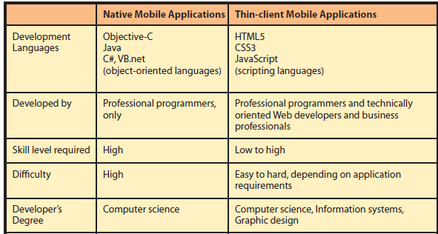
Q3: How Do Native and Browser-based Mobile Applications Compare?
Notes:
Characteristics of Native and Thin-Client Applications
Thin-client development languages are HTML5, CSS3, and Javascript. These are not object-oriented languages and hence are much easier to learn to use.
CSS3 is used with HTML5 to specify the appearance of content coded in HTML. Javascript is a scripting programming language that is much easier to learn than object-oriented languages. It is used to provide the underlying logic of the application.

Slide 8
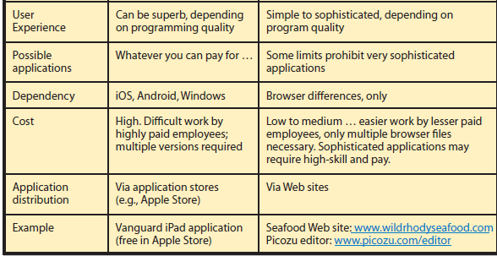
Q3: How Do Native and Browser-based Mobile Applications Compare? (cont’d)
Notes:
User experience provided by a thin-client application varies considerably. Some are simply fancy web-based brochures (www.wildrhodyseafood.com), others are quite sophisticated, such as the Picozu editor.

Slide 9
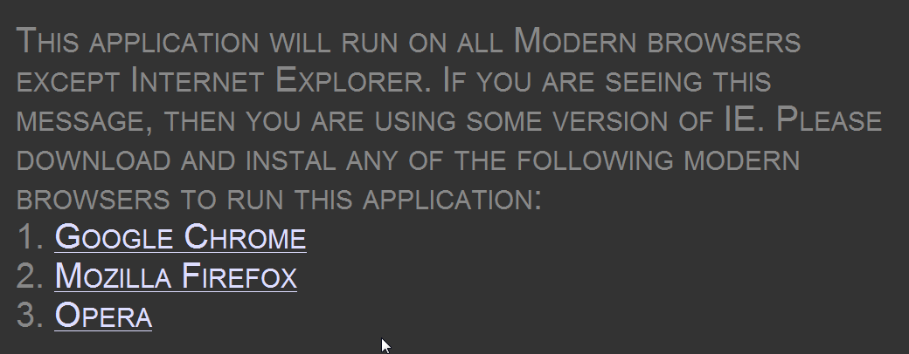
One Consequence of Browser Differences for Thin-client Applications
Notes:
The announcement in Figure exhibits the frustration of GetHuGames’ developers when trying to make their thin-client application SpiroCanvas run on Internet Explorer 9.
Thin-client applications are limited by the capabilities of the browser. While browsers are becoming increasingly sophisticated, they cannot offer the full capabilities of the underlying operating system and hardware. Thus, thin-browser applications are unable to support very specialized and complex applications.

Slide 10
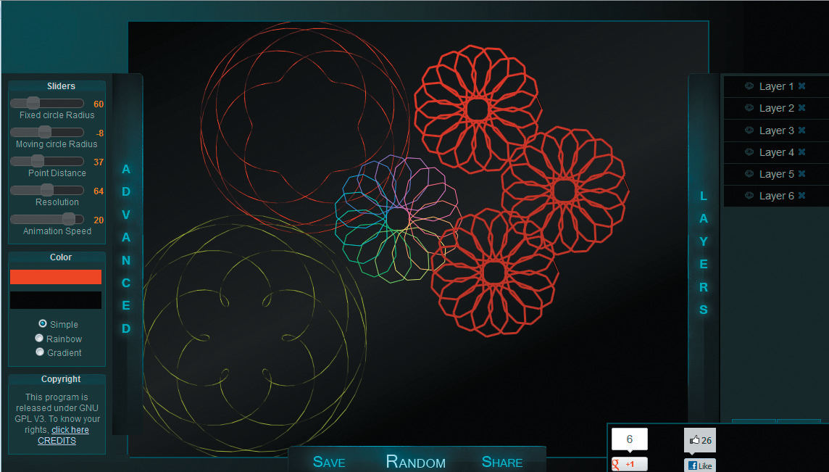
GetHuGames SpiroCanvas
Notes:
Thin-client application varies considerably. Some are simply fancy Web-based brochures (www.wildrhodyseafood.com), others are quite sophisticated, such as SpiroCanvas.(http://GetHuGames.in/)

Slide 11
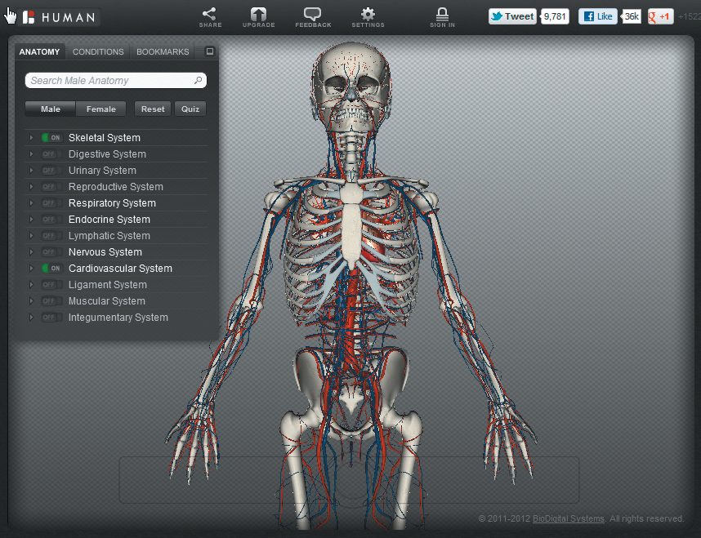
Sophisticated HTML5 Application
Notes:
Even more impressive www.biodigitalhuman.com (runs in Opera; may not yet work in other browsers).

Slide 12
Which Is Better?
Depends on strategy and goals
Application requirements
Budget
Schedule
Tolerance for managing technical projects
Need for application revenue
Thin-client applications cheaper to develop and maintain
May lack the wow factor
Notes:
Choice depends on strategy, particular goals, the requirements for your application, budget, schedule, tolerance for managing technical projects, need for application revenue, and other factors.
In general, thin-client applications are cheaper to develop and maintain, but may lack the Wow factor.

Slide 13
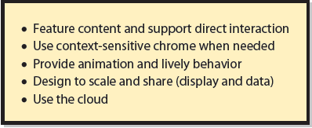
Q4: What Characterizes Quality Mobile User Experiences?
Primary characteristics of quality mobile applications
Notes:
Primary emphasis on users’ content, giving such content as much of the display as possible. Rather than show menus, toolbars, and heavy window borders, the content should be shown cleanly and in center stage.
Context-sensitive chrome, meaning it pops up in the display when appropriate.

Slide 14
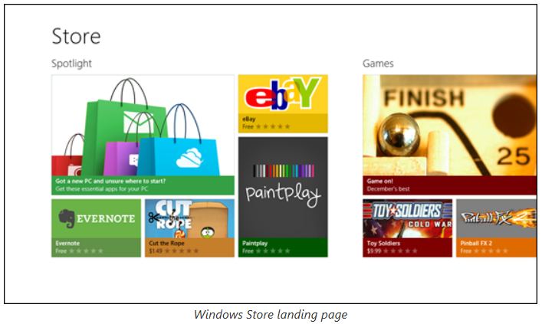
Chrome-less Mobile Windows Store Application
Notes:
Using content to drive application behavior is called direct interaction.

Slide 15
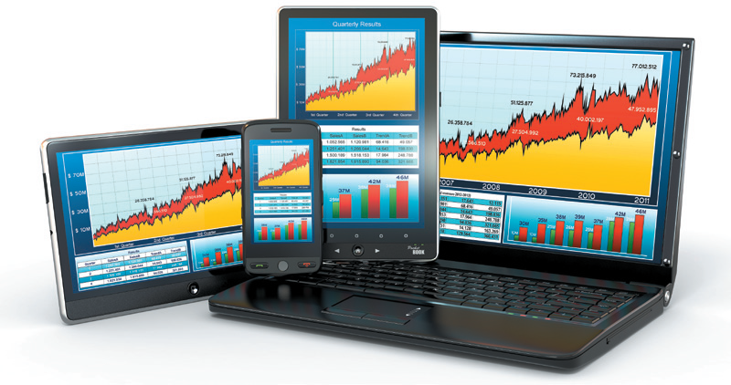
Example of Application Scaling
Notes:
Mobile applications need to be designed to share data. For example, Windows 8 introduces a feature called charms, which are icons that slide in from the right of the display. One of the default charms is Share, and it is used to share data from one mobile application to another.

Slide 16
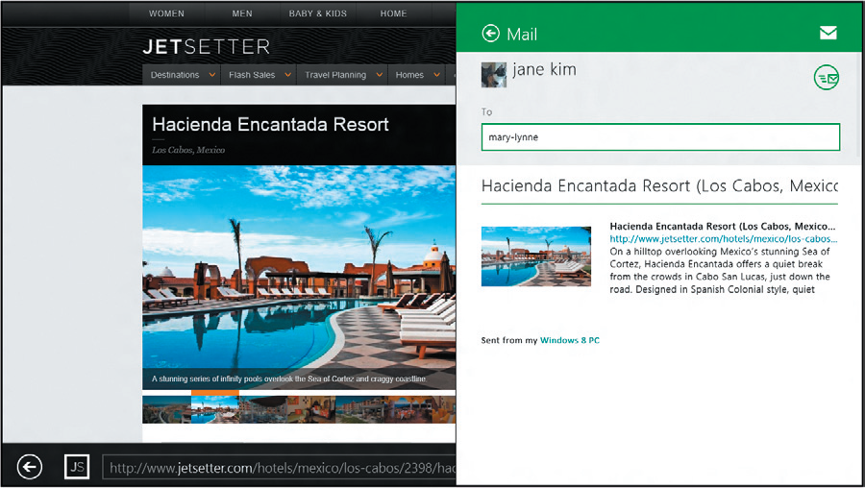
Example of IE10 Charm Sharing

Slide 17
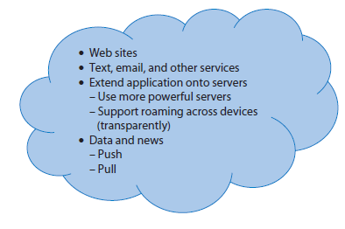
Use the Cloud
Notes:
Push data is data that the server sends to or pushes onto the device. Pull data is data that the device requests from the server. (Notice that those terms use the server’s perspective.) Of the two types, push data is more impressive to users because they need do nothing to receive it. On the other hand, excessive pushing is annoying.

Slide 18
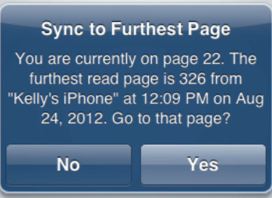
Fire Roaming Message
Notes:
Roaming occurs when users move their activities, especially long-running transactions (reading a book, for example) across devices. The best mobile applications do this transparently; the user need take no action.

Slide 19
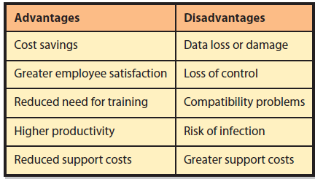
Q5: What Are the Challenges of Personal Mobile Devices at Work?
Notes:
Organizations have a love/hate relationship with their employees’ use of their own mobile devices at work. They love the cost-saving possibility of having employees buy their own hardware, but hate the increased vulnerability and loss of control.

Slide 20
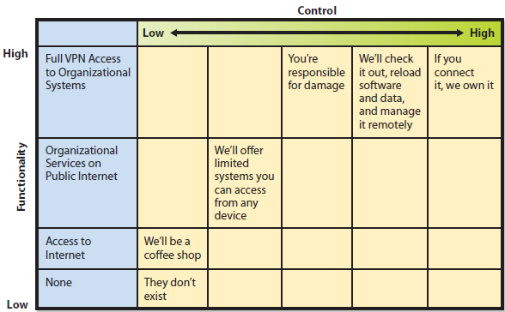
Six Common BYOD Policies
Notes:
A BYOD (bring your own device) policy is a statement concerning employees’ permissions and responsibilities when they use their own device for organizational business.

Slide 21
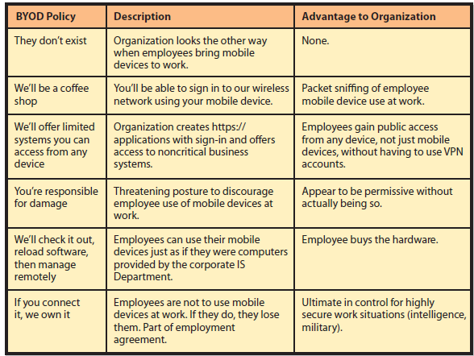
Advantages of Example BYOD Policies
Notes:
BYOD policies are rapidly evolving and many organizations have not yet determined what is best for them. If your employer has a committee to develop such policies, join it if you can. Doing so will provide a great way to gain exposure to the leading technology thinkers at your organization.

Slide 22
Active Review
Q1: What are mobile systems?
Q2: Why are mobile systems important?
Q3: How do native and browser-based mobile applications compare?
Q4: What characterizes quality mobile user experiences?
Q5: What are the challenges of personal mobile devices at work?

Slide 23
