Slide 1
Chapter Extension 6
Using Excel and Access Together
Notes:
Chapter 5 provides the background for this Extension.

Slide 2
Study Questions
Q1: Why use Excel and Access together?
Q2: What is import/export?
Q3: How can you create charts with Excel?
Q4: How can you create group totals in Access?
Q5: How can you use Excel to graph Access data?
Q6: How can you use Access to report Excel data?
Q7: How can you combine Excel and Access to analyze data?
Notes:
This chapter explains how to use Access and Excel together to analyze data in ways that neither can do alone. You will also learn how to create graphs in Excel and group totals in Access queries.

Slide 3
Q1: Why Use Excel and Access Together?
Access is a DBMS for keeping track of things and creating reports
Excel is good for creating sophisticated graphs and analyzing data
Eliminates re-keying data, reduces labor and errors

Slide 4
Q2: What Is Import/Export?
Process of transferring data from one system to another
Creates connection to source data
Connection closed after data transferred

Slide 5
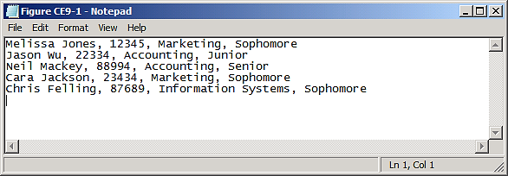
Import/Export of Text Data
Comma-delimited text file
Tab used to create a tab-delimited text file

Slide 6
Creating a Text File in Access
Open a database, click on External Data tab
Select file that contains data to import
Click Import and OK
Multiple-panel wizard opens
Specify data file is delimited
Name fields and data type

Slide 7
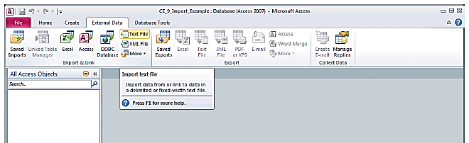
External Data Menu Choice

Slide 8
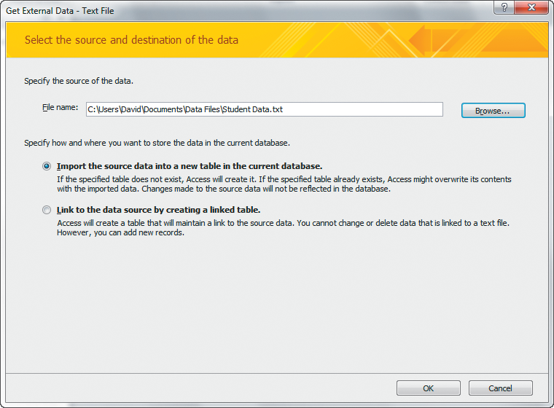
Importing Text Data into Access - Step 1

Slide 9
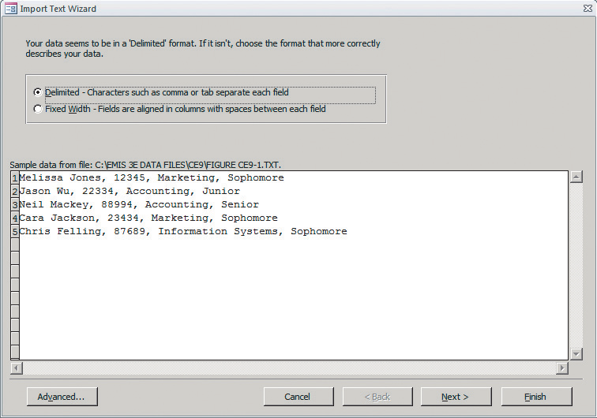
Importing Text Data into Access: Specifying a Delimited File - Step 2

Slide 10
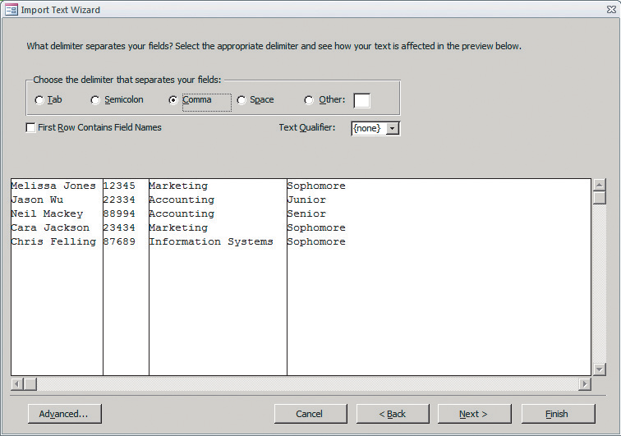
Importing Text Data into Access: Specifying a Comma Delimited File - Step 3

Slide 11
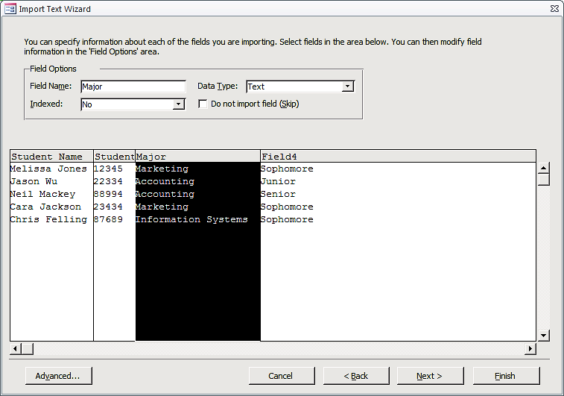
Importing Text Data into Access: Naming & Describing Columns During Import - Step 4

Slide 12
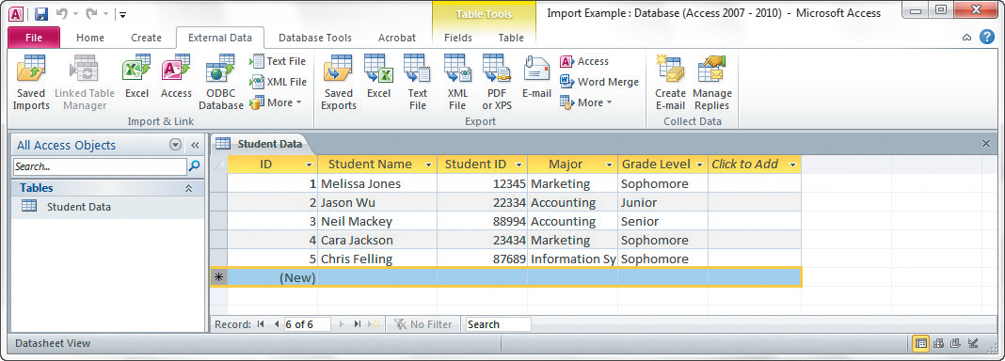
Data After Import

Slide 13
Q3: How Can You Create Graphs with Excel?
Data from Computer Budget workbook used for following examples
Pie chart
Column chart

Slide 14
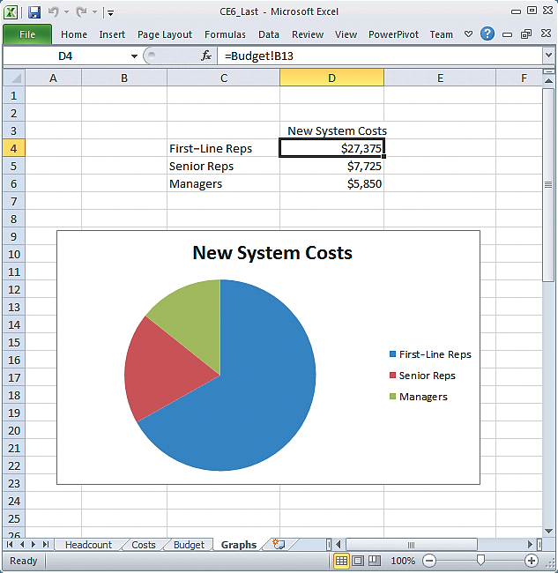
Sample Pie Chart

Slide 15
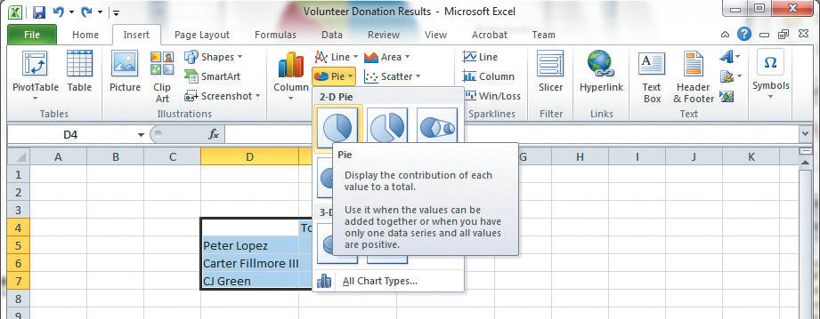
Creating the Pie Chart
Notes:
Click Insert tab in the ribbon, and in Charts section of that ribbon select Pie icon

Slide 16
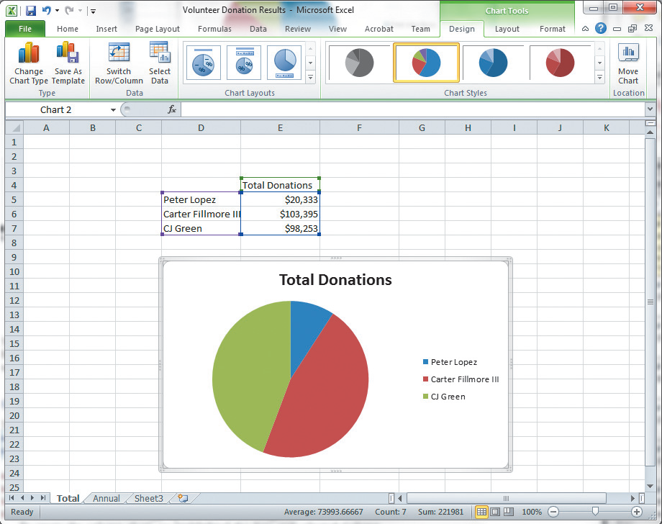
Selecting the Chart Tools
Notes:
Chart tools displayed in ribbon

Slide 17
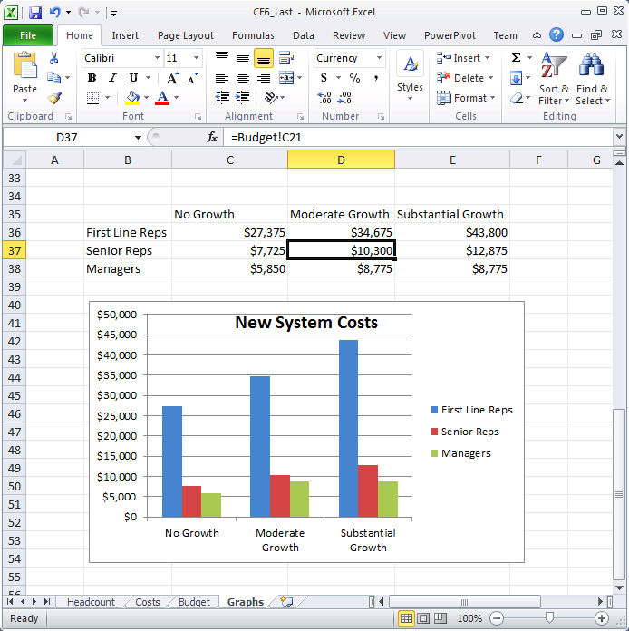
Sample Column Chart

Slide 18
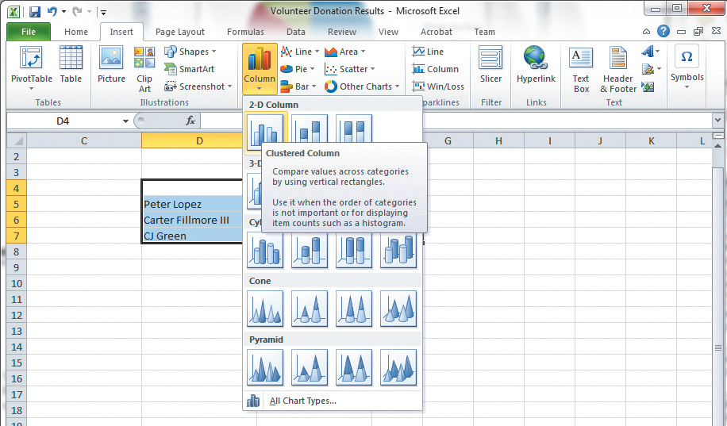
Creating a Column Chart

Slide 19
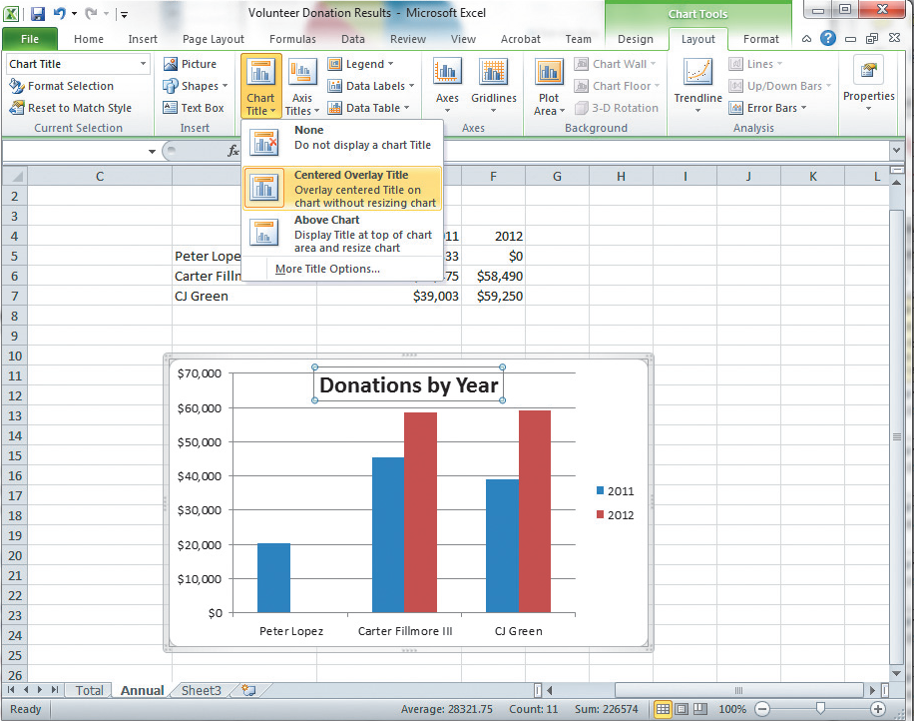
Creating the Chart Title
Notes:
To insert a title, click Column chart, select Chart Tools, click Layout tab, click Chart Title, and select Centered Overlay Title.

Slide 20
Q4: How Can You Create Group Totals in Access?
Volunteer database from CE 5 used in following examples
Scenario:
TV station manager wants to know TotalDonations for each date of fundraising effort. Also wants to know if some dates are better than others.
Using WORK table, create a query to group all donations by date and sum TotalDonations for each group.

Slide 21
How Can You Create Group Totals in Access? (cont’d)
Open Volunteer database
Click Query Design
Click Add
Click Create tab
Select WORK table
Click Close
Notes:
Open the Volunteer database, click the Create tab, click Query Design, then, as shown in next slide, select the WORK table for the query. After adding that table, click Close.

Slide 22
Selecting WORK Table for the Query
Notes:
To open the Volunteer database, click the Create tab, click Query Design, then, select the WORK table for the query. After adding that table, click Close.

Slide 23
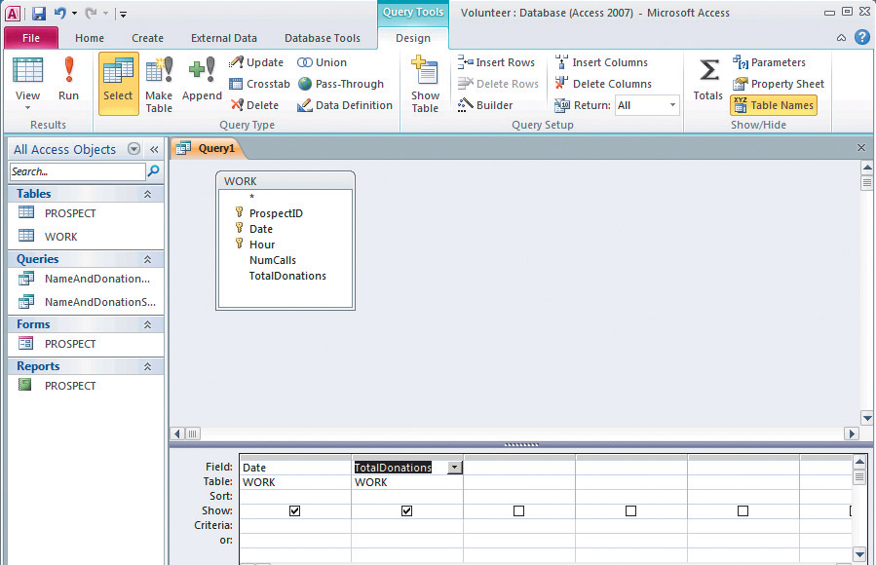
Adding Date and Totaldonations to the Query
Notes:
To add Date and TotalDonations to the query output, click the check boxes for Date and TotalDonations (shown here inside the oval) in the WORK table diagram.

Slide 24
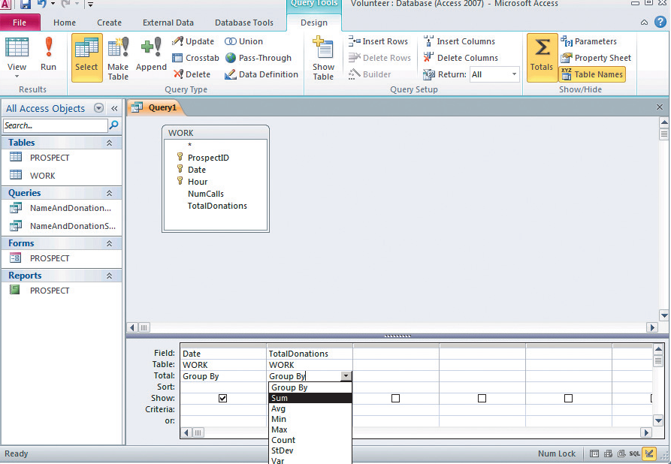
Selecting Sum in Total Row for TotalDonations
Notes:
To group the WORK rows according to date, click the Totals button in the Show/Hide section in Design view (see top oval). This will add a row labeled "Total" to the query contents table (see bottom oval). Select "Sum" in Group By list.

Slide 25
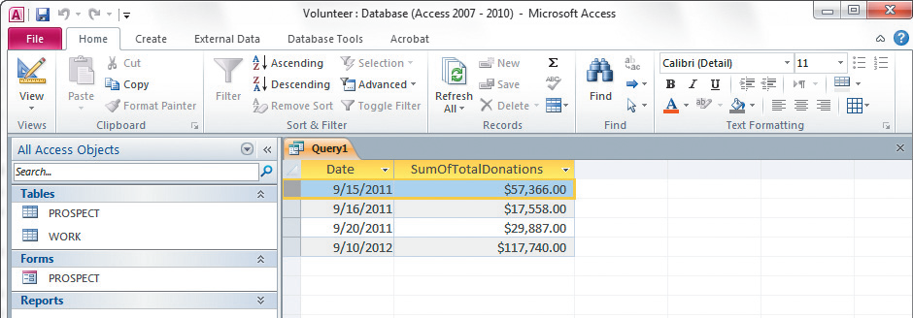
Results of Query with Group by Date

Slide 26
Steps for Creating a Query to Compute Total Hours and Donations for Each Prospect
Double-click Name to insert it into query table
Click Totals icon to insert Total row in query table
In Total row under TotalDonations, select Sum
Create a column heading for TotalDonations as “Total Obtained:”
1
2
3
4
5
6
7
Double-click ProspectID and TotalDonations
In Total row under ProspectID, select Count
Create a column heading ProspectID column by keying “Hours Worked:”

Slide 27
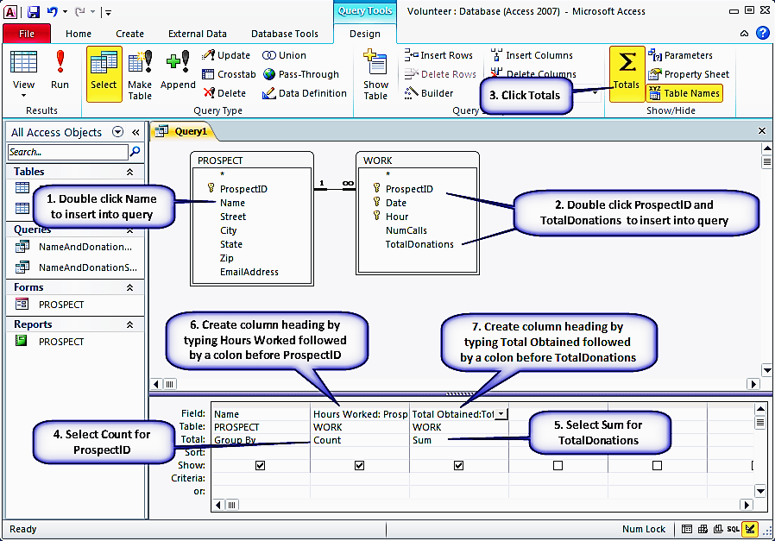
Process for Creating a Query to Compute Total Hours and Donations for Each Prospect

Slide 28
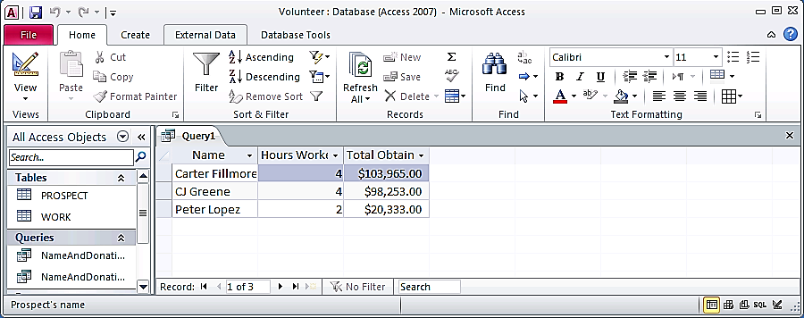
Results of the Query in Previous Slide

Slide 29
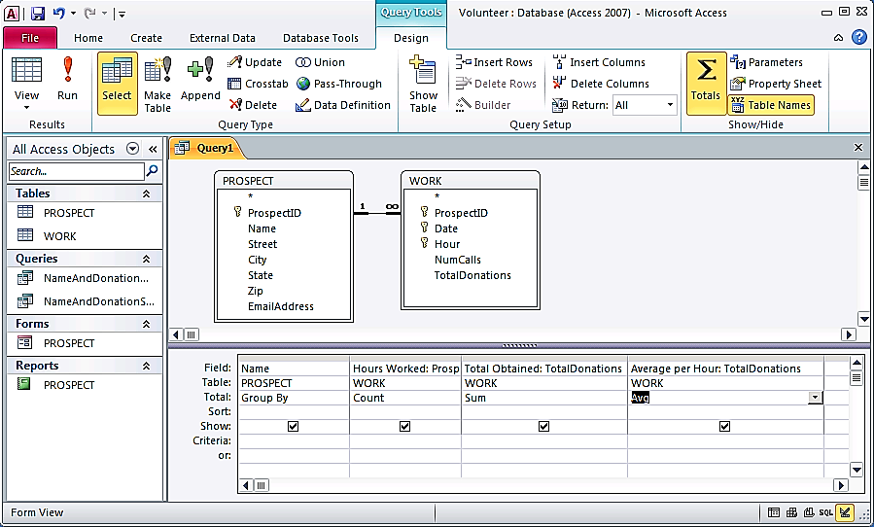
Adding Average Donations Per Hour

Slide 30
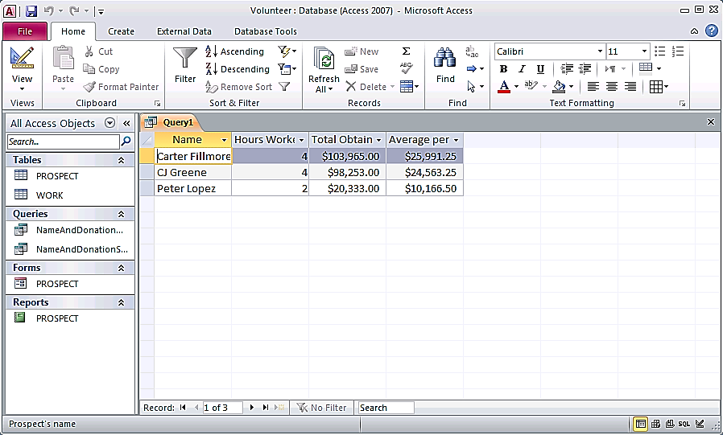
Results of the Query with Average

Slide 31
Q5: How Can You Use Excel to Graph Access Data?
Import Access query into Excel and use Excel’s graphing capability to display results
To import data into Excel:
Click Data tab
Click Get External Data section, select From Access
Select Volunteer database

Slide 32
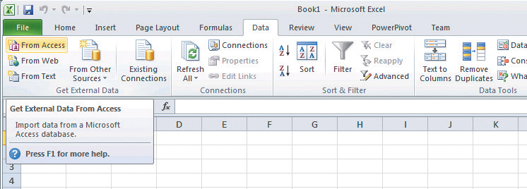
Menu to Import Data from Access into Excel
Click Data tab, then,
Get External Data
Select From Access

Slide 33
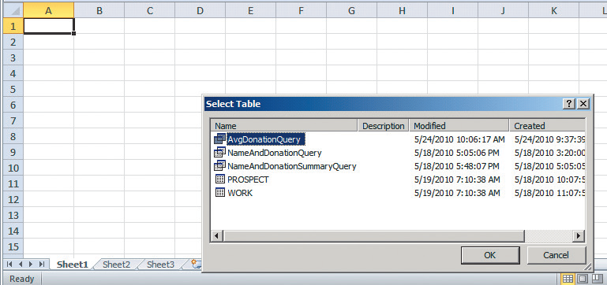
Selecting the Query to Import

Slide 34
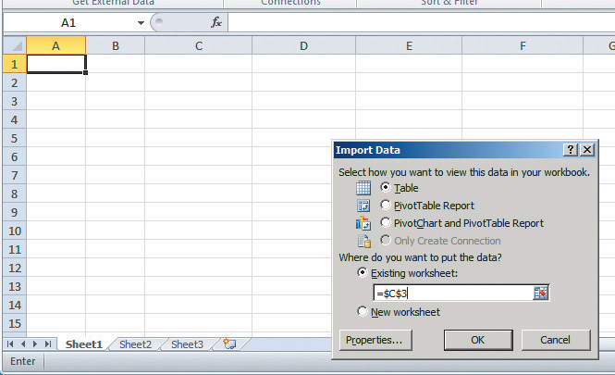
Placing Imported Data into Spreadsheet

Slide 35
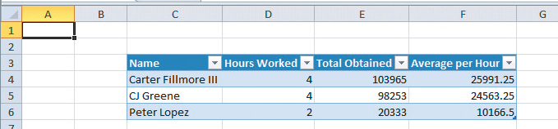
Spreadsheet with Imported Data
Notes:
Notice that Excel does not format the currency values as currency. To overcome this deficiency, highlight the cells containing the currency amounts and click Currency in the Number section of the Home ribbon. Next, click the small arrow in the bottom-right corner of the Number section, and select zero decimal points.

Slide 36
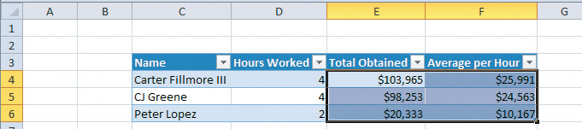
Formatted Imported Data

Slide 37
Bar Chart of the Imported Data
Notes:
Click Insert tab, and select bar chart.
Next, to insert a title, click Chart Tools, Layout, Chart Title, then Centered Overlay Title. Then type chart’s title.

Slide 38
Reflect on What We Have Done
1. Used Access to keep track of volunteers and their received donations, to query and group data—all tasks for which Access is ideally suited.
2. Then, imported that data into Excel and used Excel’s easy graphing capability to create charts.

Slide 39
Q6: How Can You Use Access to Report Excel Data?
Suppose you want to produce two different reports from this data
Group all expenses for a given expense category to produce an expense total.
Group all expenses for particular dates to produce an expense total for each date
Do both by importing Excel data into Access and using Access report generator

Slide 40
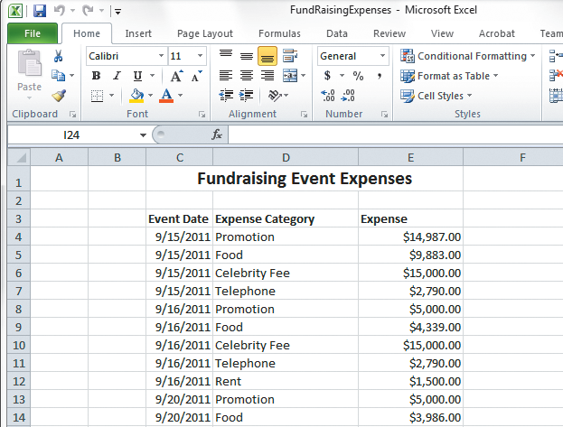
Sample Expense Data

Slide 41
Creating a Named Range in Excel
Highlight data (including column headings) and click Formulas tab
In Defined Names section, click Define Name and enter a suitable name
Note: Range names cannot have any spaces, so use underscores.
Notes:
Identify the data that you want to transfer. An easy way to do this is to create a named range, which is a subset of the cells in a worksheet that has a unique name.

Slide 42
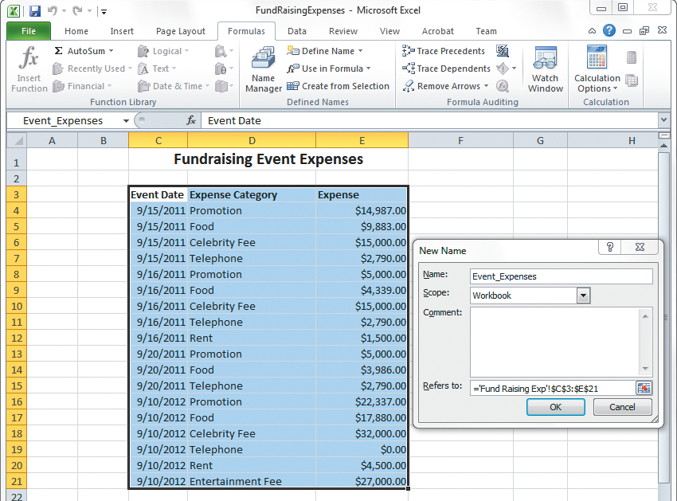
Creating a Named Range
Notes:
Highlight all of data (including column headings), then click Formulas tab. In Define Name section, click Define Name and enter a suitable name.

Slide 43
Importing Data in Named Range into a New Access Table
Close Excel workbook that has data
Click External Data tab, then click Excel in Import section
Check box for First Row Contains Column Names
Click OK
Open Access database for importing
Click Import source data into new table in current database
Click Show Named Ranges, select Event_Expenses

Slide 44
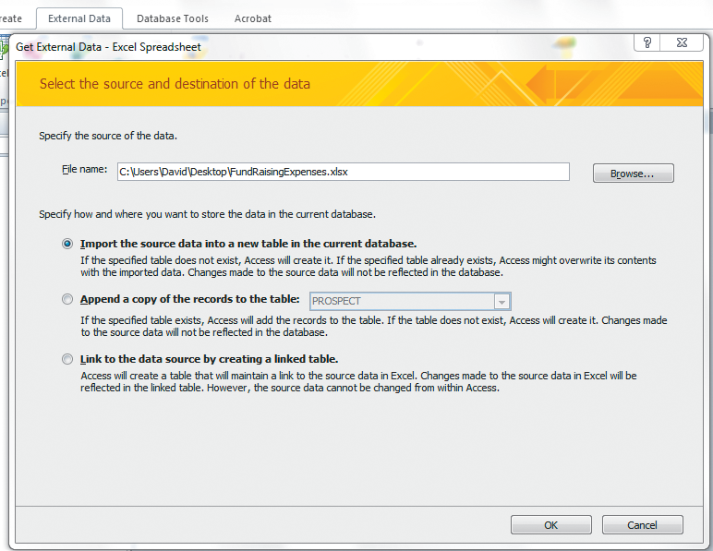
Importing Excel Data into Access

Slide 45
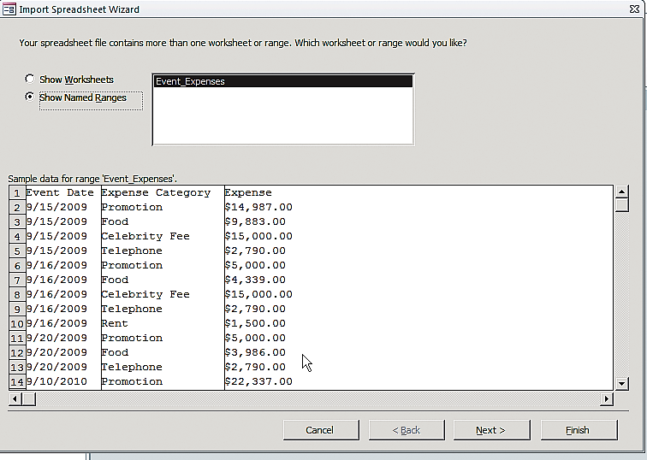
Importing Excel Data into Access: Importing the Data in the Named Range

Slide 46
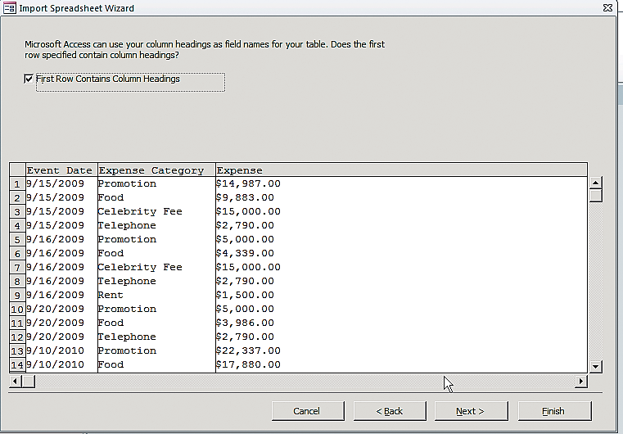
Importing Excel Data into Access: Access Has Metadata to Guide Import

Slide 47
Creating Expense Reports
After clicking Finish, Access creates table with metadata descriptions and places data into Event_Expenses table
Access generates a report to be modified to desired format
Open Event_Expenses table
Click Create, click Report in Reports section
Notes:
Overview of steps for creating expense report

Slide 48
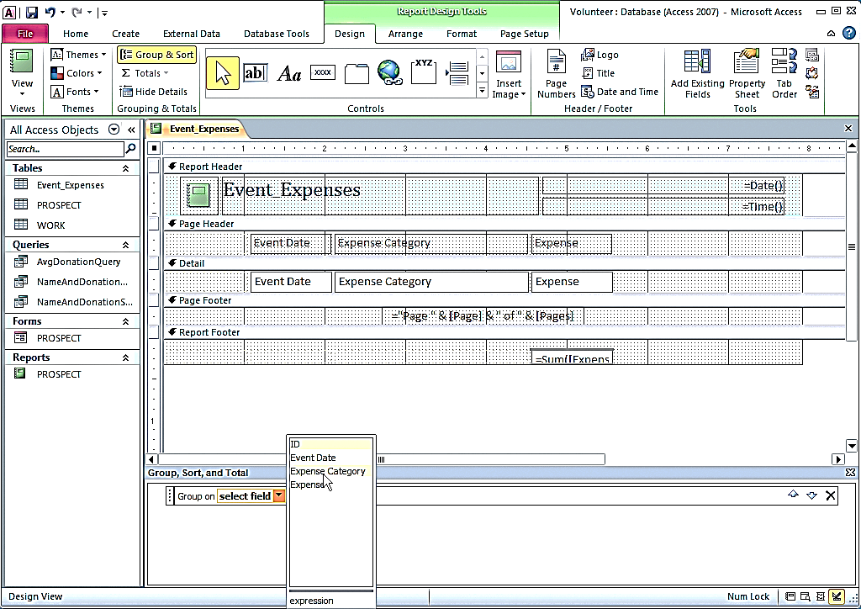
Grouping Report Data by Expense Category

Slide 49
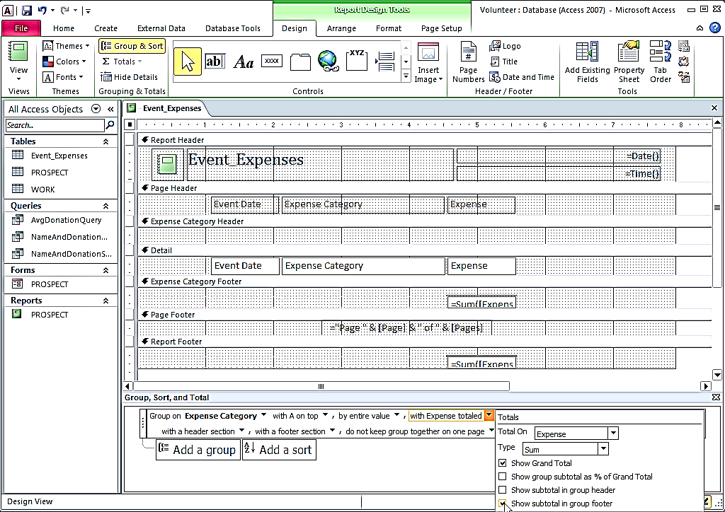
Creating Group Totals

Slide 50
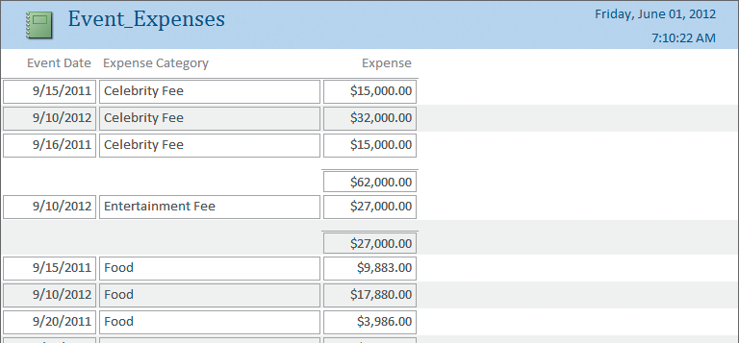
Resulting Report

Slide 51
Q7: How Can You Combine Excel and Access to Analyze Data?
In Design mode, click More and click Expense totaled
In Grouping & Totals section of Design ribbon, click Group & Sort. Click Add
Report finished
Click Expense Category, as shown in next slide
Select Expense for Total On, Show Grand Total and Show in group footer

Slide 52
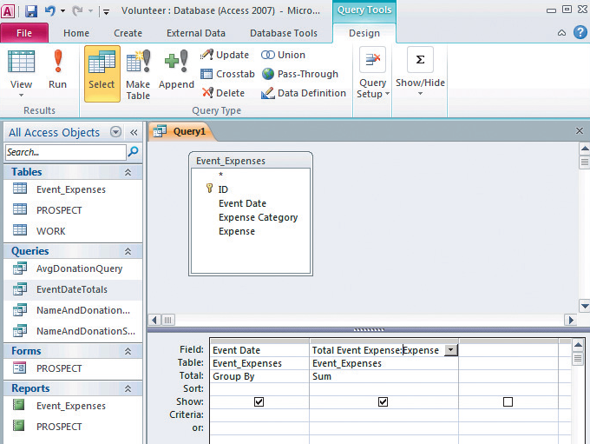
Creating a Query to Sum Expenses by Given Date

Slide 53
Creating a Query to Combine Results of Two Other Queries
Merge EventDateTotals query with EventExpenseTotals query
Click Create/Query Design, then Queries tab in Show Table window, as shown in next slide.
Add both EventDateTotals and EventExpenseTotals to query
Drag Date field in EventDateTotals and drop on top of Event Date in EventExpenseTotals query
Add Date, SumOfTotalDonation, and Total Event Expense to query
Run (!) query
Save query as Event Results and Expenses

Slide 54
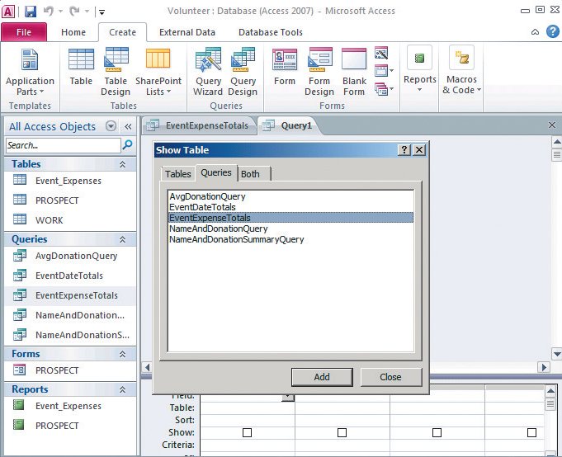
Combining the Results of Two Queries
Notes:
Click Create/Query Design; click Queries tab in Show Table window; Add both EventDateTotals and EventExpenseTotals to query.

Slide 55
Matching Date Values in Two Queries
Notes:
Inform Access that Date values in two queries are the same by dragging Date field in EventDateTotals and dropping it on Event Date in EventExpenseTotals query

Slide 56
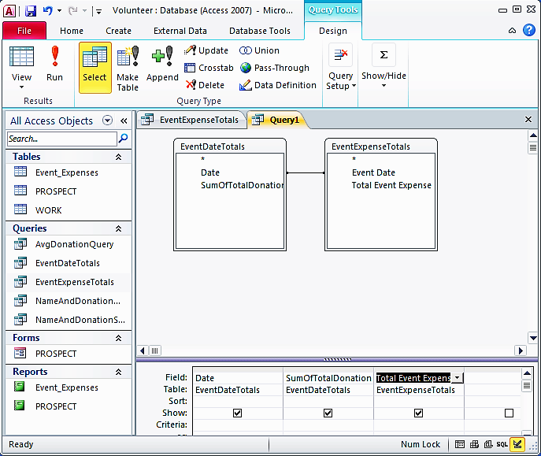
Query with Columns Added

Slide 57
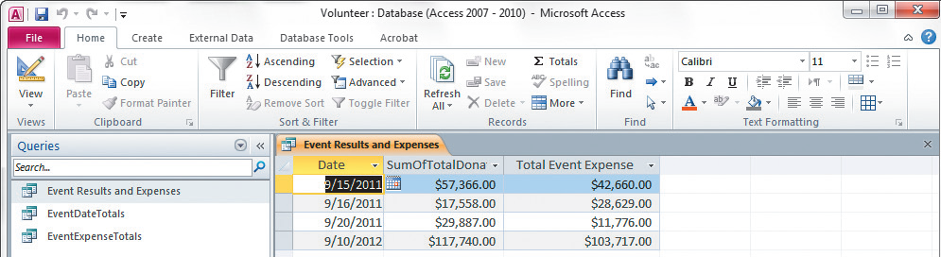
Result of Query

Slide 58
Import Events Results and Expenses into Excel
Select Access database with query, and select Event Results and Expenses
Open Excel workbook and import Event Results and Expenses query
Click Data From Access in Get External Data section of ribbon

Slide 59
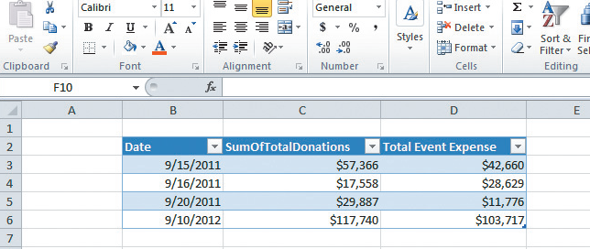
Query Imported into Excel

Slide 60
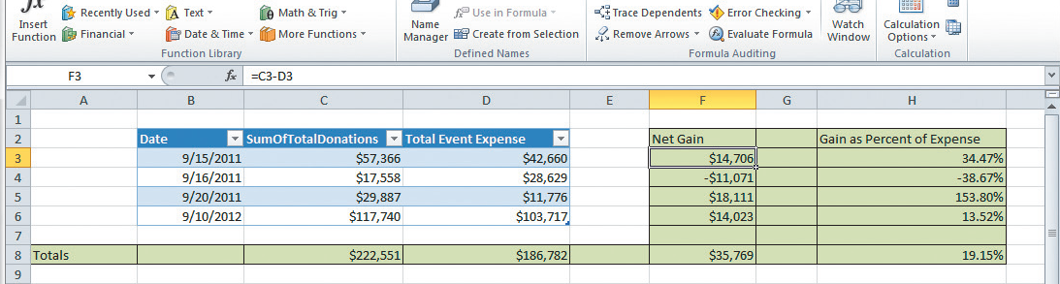
Imported into Excel
Notes:
Expense data began as Excel data in Fund Raising Expense worksheet, then imported into Access, where it was summed. Results of Total Event Expense query were then imported back to Excel.
Here, the user computed the Net Gain, Net Gain as a Percent of Expense, and Totals for donations and expenses.

Slide 61
Reflect on What Has Been Done with This Data
Total Donation data originated in Access and summed using an Access query
Expense data from Excel worksheet Fund Raising Expense imported into Access, and summed in a query
Results of Total Event Expense query imported back to Excel, and analyzed.

Slide 62
Active Review
Q1: Why use Excel and Access together?
Q2: What is import/export?
Q3: How can you create charts with Excel?
Q4: How can you create group totals in Access?
Q5: How can you use Excel to graph Access data?
Q6: How can you use Access to report Excel data?
Q7: How can you combine Excel and Access to analyze data?

Slide 63


