Slide 1
Chapter Extension 5
Using Microsoft Access 2010

Slide 2
Study Questions
Q1: How do you create tables?
Q2: How do you create relationships?
Q3: How do you create a data entry form?
Q4: How do you create queries using the query design tool?
Q5: How do you create a report?
Notes:
This chapter extension discusses fundamental techniques for creating a database and a database application with Microsoft Access 2010.

Slide 3
Q1: How Do I Create Tables?
Create tables from data model
  PROSPECT (ProspectID, Name, Street, City, State, Zip, Email Address)
  WORK (ProspectID, Date, Hour, NumCalls, TotalDonations)
Link tables
  Select primary keys
  Select foreign keys
Notes:
Note the ambiguity in name PROSPECT. Before someone has become a volunteer, he is a prospect, and the term is fine. However, once that person has actually done work, he is no longer merely a prospect. This ambiguity occurs because the database is used both for finding volunteers and for recording their experiences once they have joined.

Slide 4
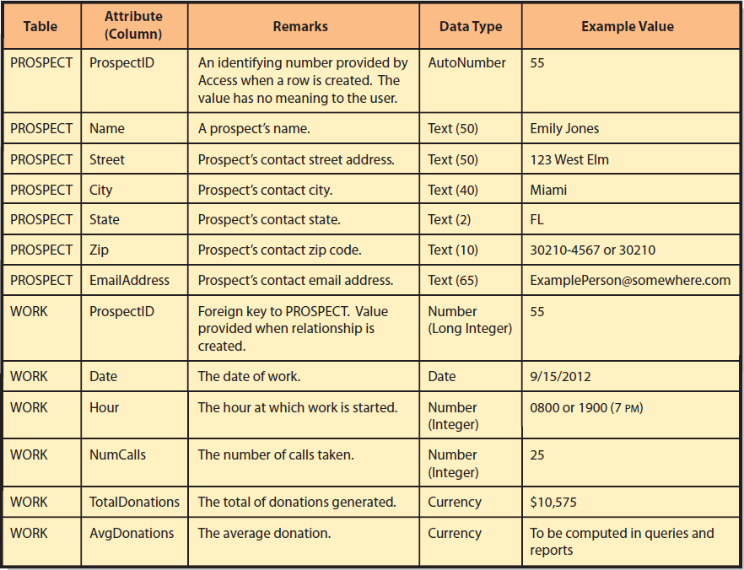
Attributes of the Database
Notes:
This figure further documents the attributes of the design. Sample data for this table are shown in Figure CE5-2.

Slide 5
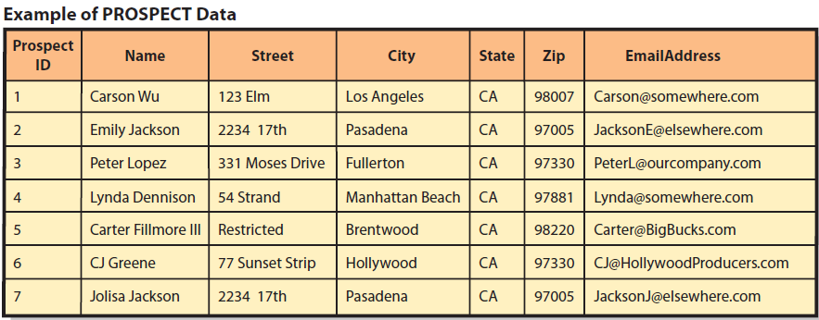
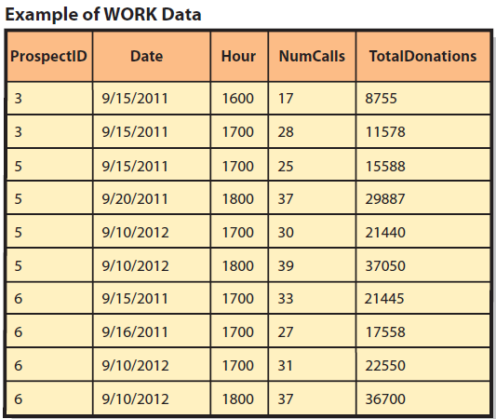
Sample Data

Slide 6
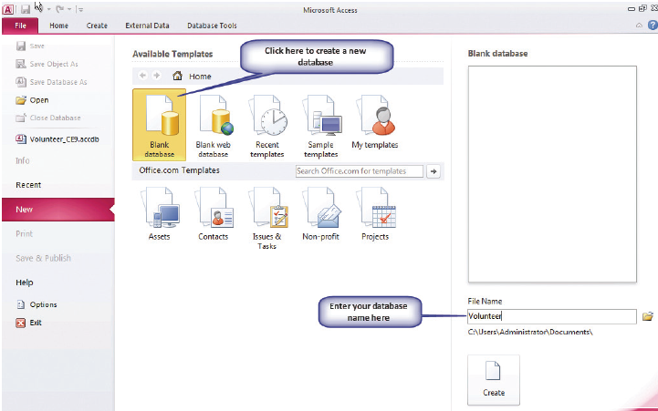
Opening Access 2010
Notes:
If you use another version of Access, your screen will appear differently, but the essentials will be the same.

Slide 7
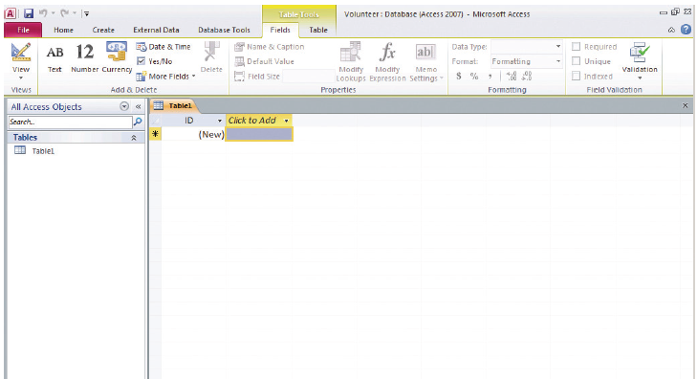
Creates Default Table Named Table1
Notes:
Access opens the new database by creating a default table named Table1. We want to modify the design of this table, so in the upper left-hand corner, where you see a pencil and a right angle square, click View and select Design View.

Slide 8
Review: Sequence of Steps for Creating a Database with Access 2010
Click on folder icon to browse to a folder to save database
Click on Blank database
Blank table opens
Click on Create
Enter file name in lower right-hand corner box
Notes:
Use this figure to review the steps presented in previous slides.

Slide 9
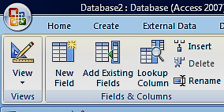
Creating a Database with Access 2010 (cont’d)
Click View icon
Select Design View in drop-down list
Enter table name in pop-up box
Window changes to Design View
Notes:
Explain Access View modes

Slide 10
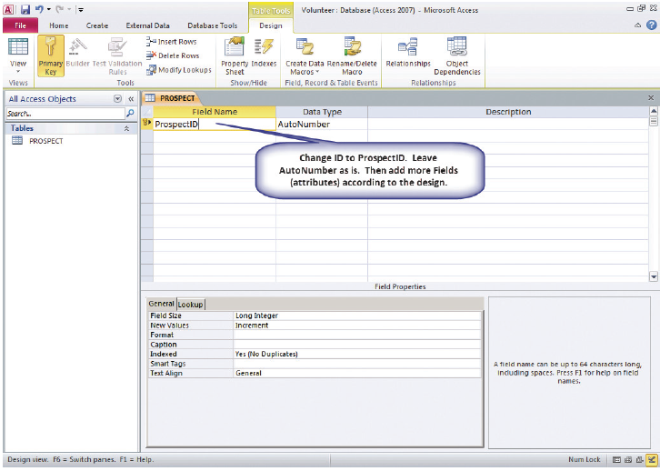
Creating Tables in Access - Step 1: Declaring Field Names and Data Types
  Upper part
    Enter name of each attribute (Fields)
    Enter Data Type
    Enter Description
  Bottom part
    Declare field properties

Slide 11
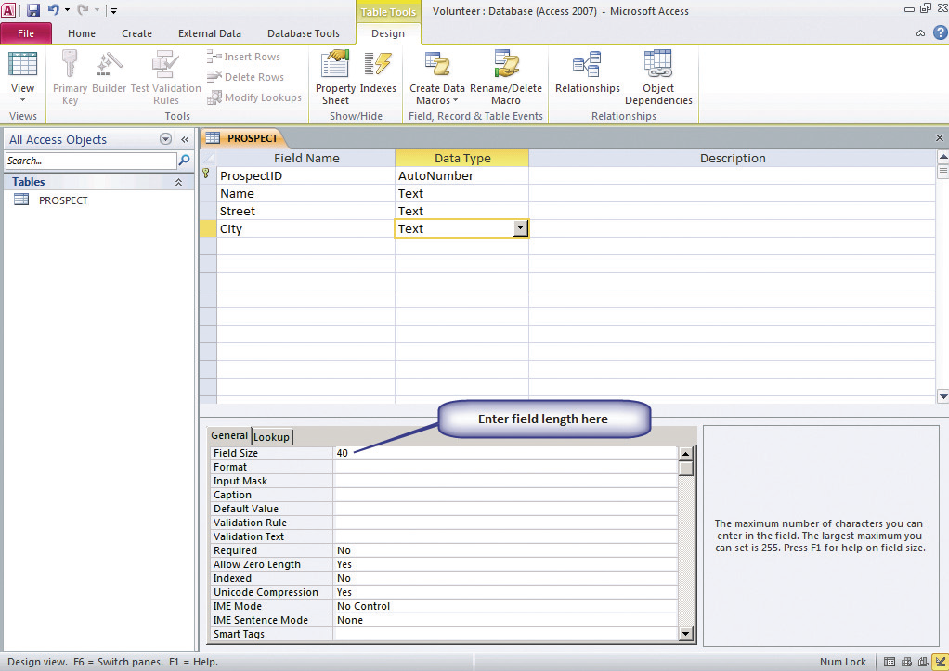
Creating Tables in Access - Step 2:
Declaring Field Properties
Setting length of a Text Data Type
Notes:
Figure shows how to set the length of a Text Data Type.

Slide 12
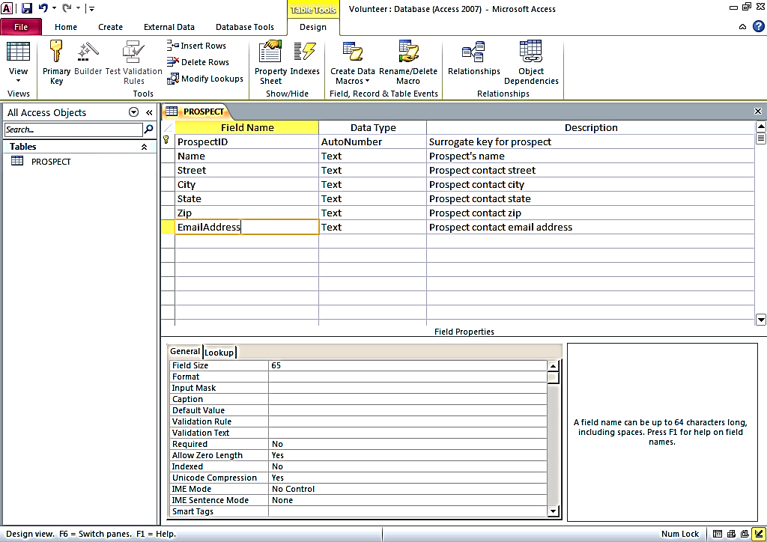
Complete Sample PROSPECT Table
Notes:
ProspectID is the primary key of this table, and the little key icon next to the ProspectID Field Name means Access has already made it so. If we wanted to make another field the primary key, we would highlight that field and then click the Primary Key icon in the left-hand portion of the Design ribbon.

Slide 13
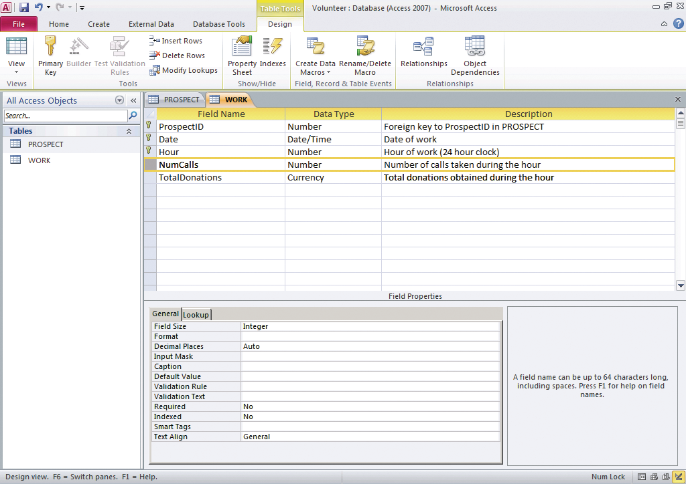
Finished WORK Table

Slide 14
Overview of Steps in Creating Tables
Enter Field Names
Enter Data Types
Declare Field Properties
Select Primary Key
Save table

Slide 15
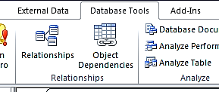
Q2: How Do I Create Relationships? Step 1
Go to Database Tools
Select Relationships
Show Table dialog box opens
Double-click on names of tables
Tables added to Relationships window
Close Show Table dialog box

Slide 16
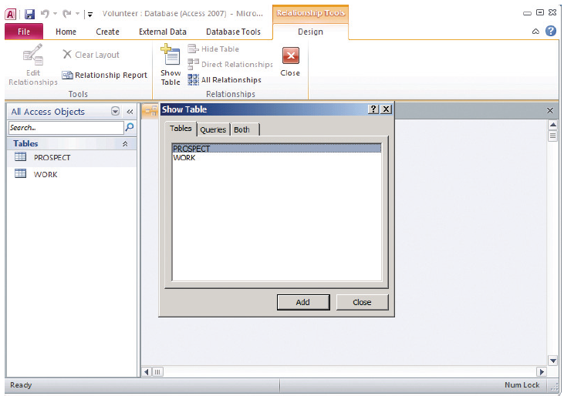
Show Table Dialog Box in Access
Notes:
Click the Database Tools tab in the ribbon and then click the Relationships icon near the left-hand side of that ribbon. The Relationships window will open and the Show Table dialog box will be displayed.

Slide 17
Creating a Relationship Between Two Tables: Step 2
Click Cascade Update Related Fields
Click on attribute in one table
Dialog box appears
Close Relationships window
Drag it to attribute in second table
Click Enforce Referential Integrity
Click Cascade Delete Related Fields
Save changes

Slide 18
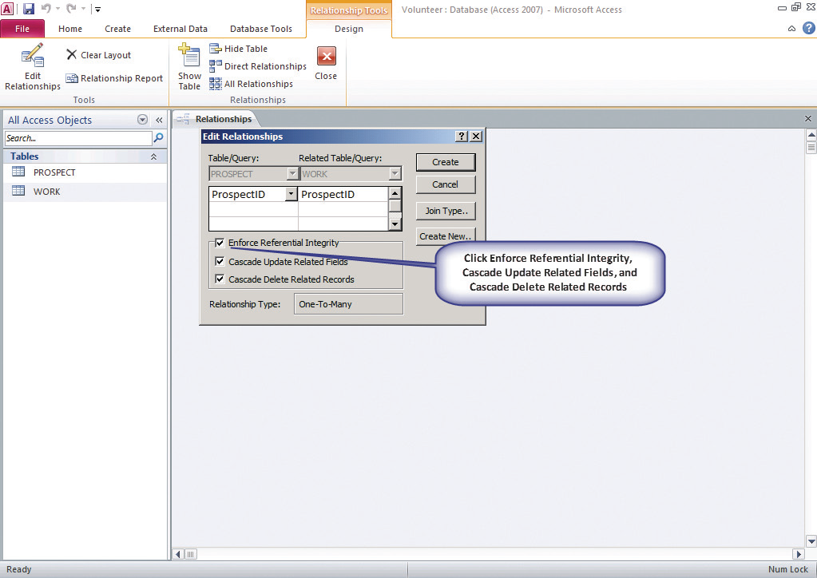
Creating a Relationship Between Two Tables: Step 2 (cont’d)
Notes:
Click Enforce Referential Integrity, click Cascade Update Related Fields, and then click Cascade Delete Related Records. The specifics of these actions are beyond the scope of our discussion. Just understand that clicking these options will cause Access to make sure that ProspectID values in WORK also exist in PROSPECT.

Slide 19
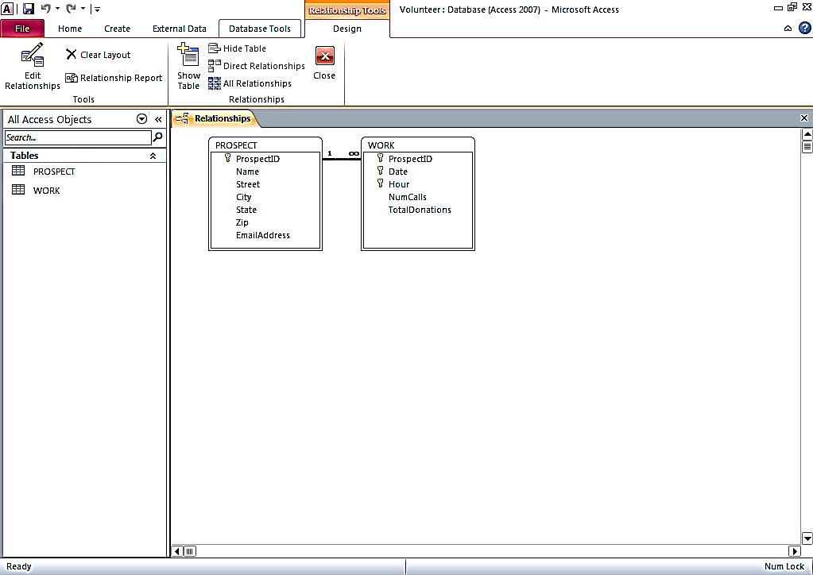
Completed Relationship Between PROSPECT and WORK Tables
∞ means one PROSPECT row can be related to an unlimited number of rows in WORK

Slide 20
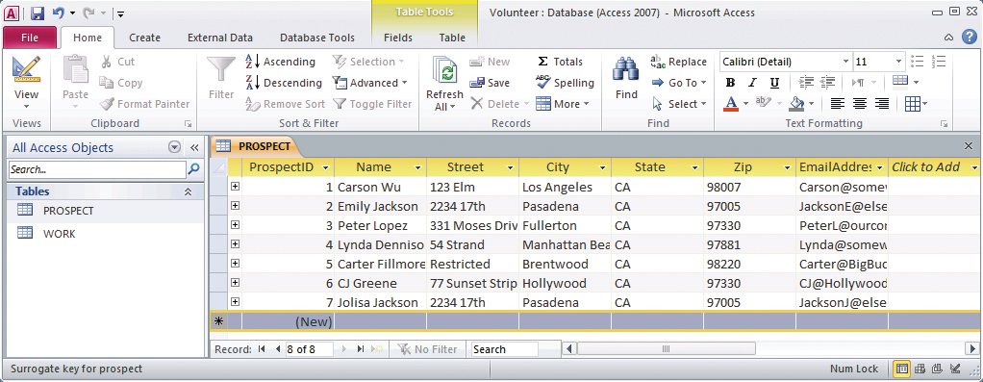
PROSPECT Table with Data Entered

Slide 21
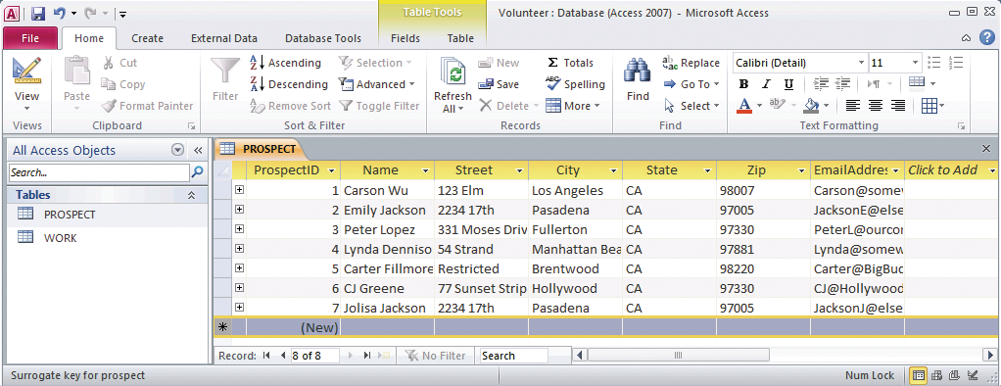
WORK Table with Data Entered

Slide 22
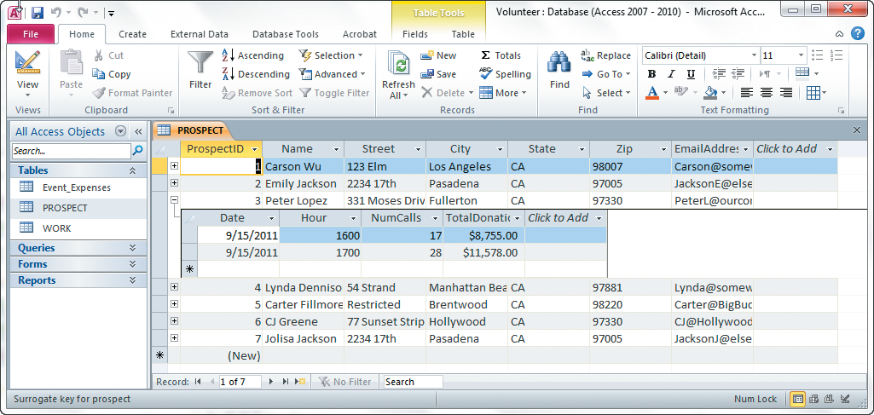
Q3: How Do I Create a Data Entry Form?
Use default table display
Notes:
Table display, although convenient, is limited in capability. It also does not provide a very pleasing user interface. For more generality and better design, you can use the Access form generator.

Slide 23
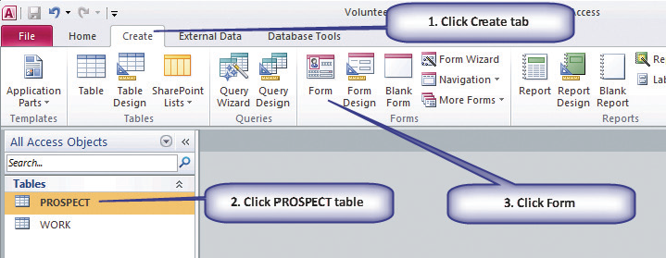
Form Generator
Starting the Form Generator

Slide 24
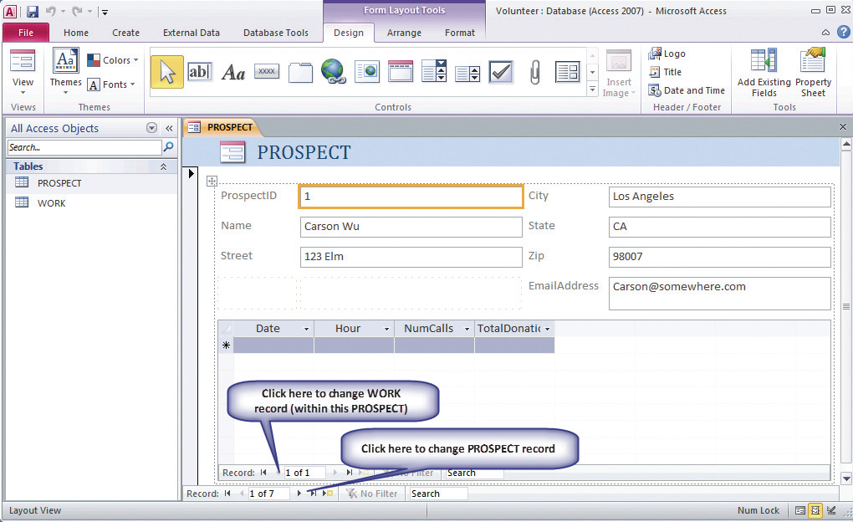
Resulting Data Entry Form
Notes:
Access uses metadata about the tables and their relationship to create the data entry form in Figure CE5-15.

Slide 25
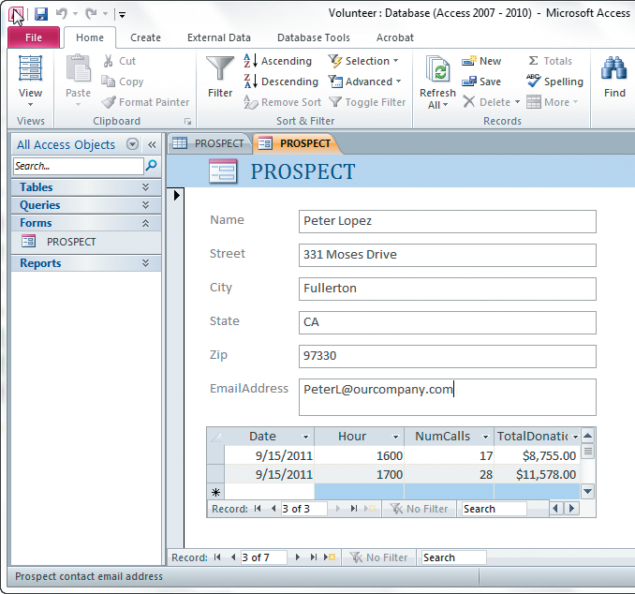
Reformatted Data Entry Form

Slide 26
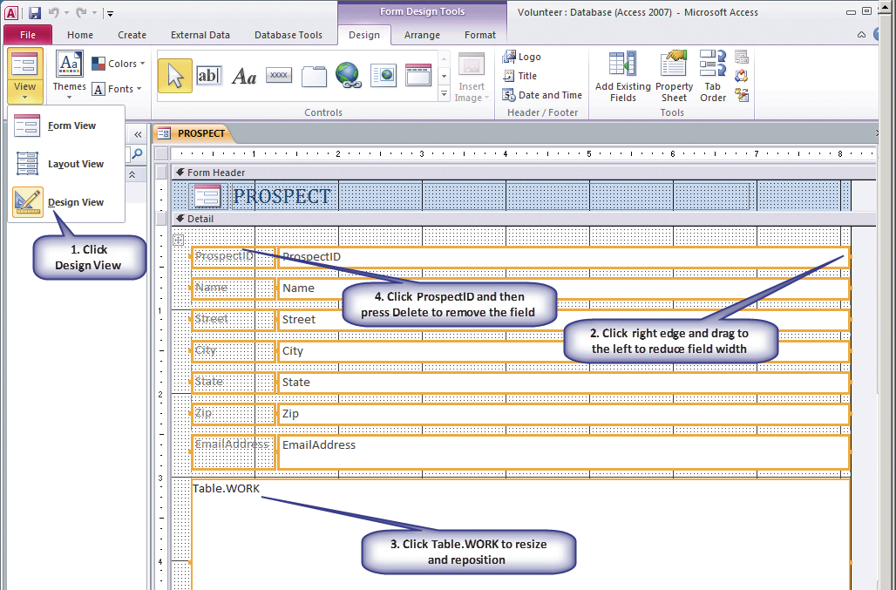
Process for Reformatting Data Entry Form

Slide 27
Q4: How Do You Create Queries Using the Query Design Tool?
Use SQL query language
Use graphical interface to create queries
Click Queries
Click Query Design
Show Table, Add
Query Design form
Run !
Notes:
Like all modern DBMS products, Access can process the SQL query language.

Slide 28
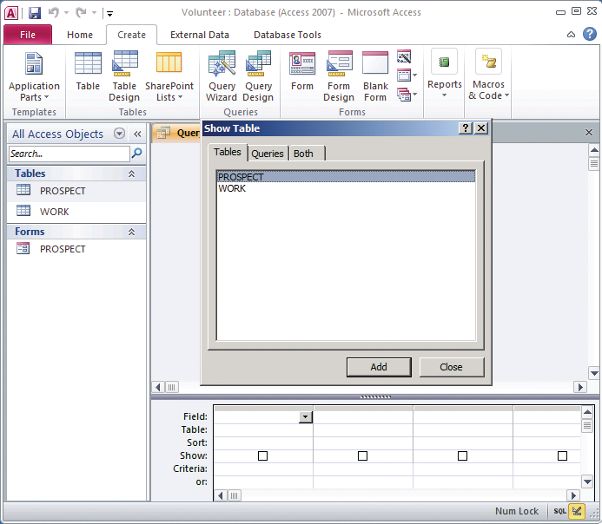
Creating a Query: Step 1 (Select and Add Tables)

Slide 29
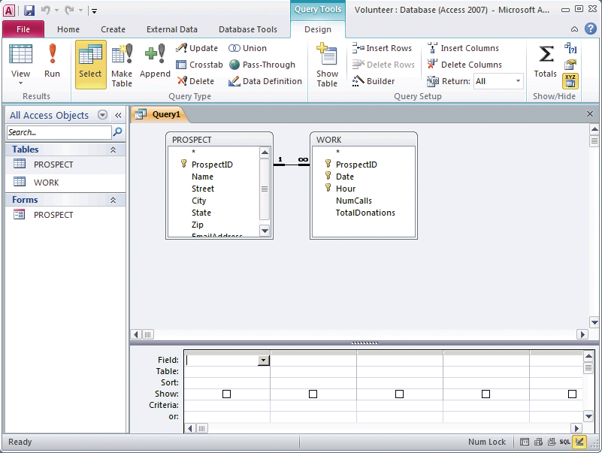
Step 2: Query Design Form
Notes:
Notice that Access shows the relationship between the two tables.

Slide 30
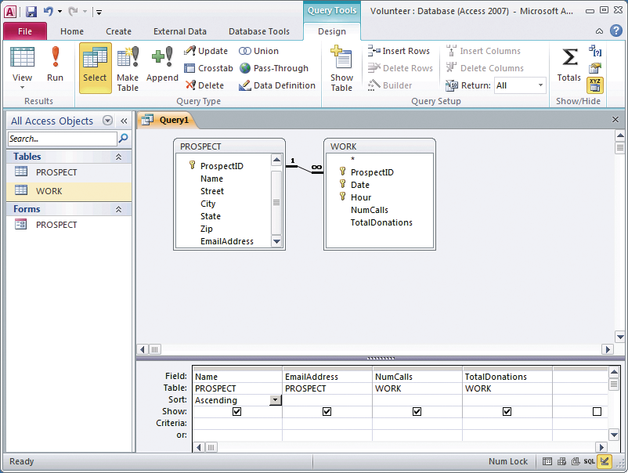
Creating a Query: Step 3
Notes:
Note that the Ascending keyword has been selected for the Name column.
Click the red exclamation point labeled Run in the Results section of the ribbon.

Slide 31
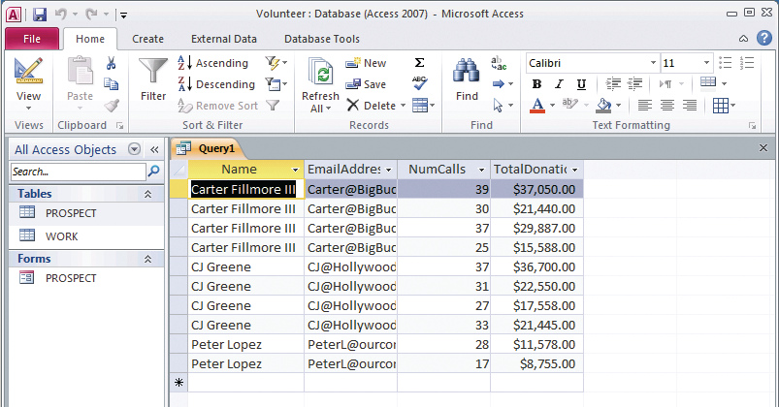
Results of TotalDonations Query

Slide 32
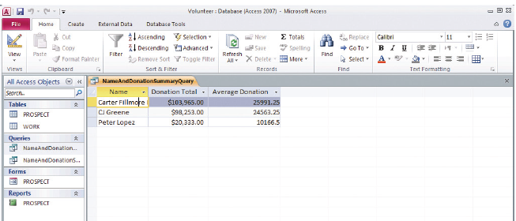
Results of More Advanced Query

Slide 33
Q5: How Do I Create a Report?
Select table, add fields
Click Create
Table/ Queries
Click >
Select Report Wizard
Highlight table and fields
Add fields
Click Finish

Slide 34
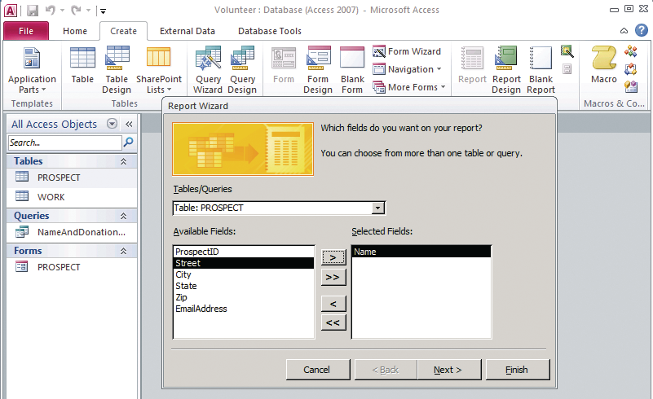
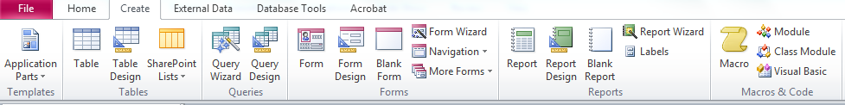
Selecting Data to Show in a Report
Notes:
This figure shows the Report Wizard. To create a report with data from two or more tables, we must use the Report Wizard.
Click the Create tab, and then in the Reports section click Report Wizard.

Slide 35
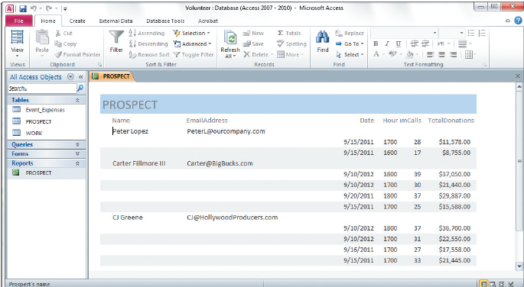
Report on Donations by Prospect

Slide 36
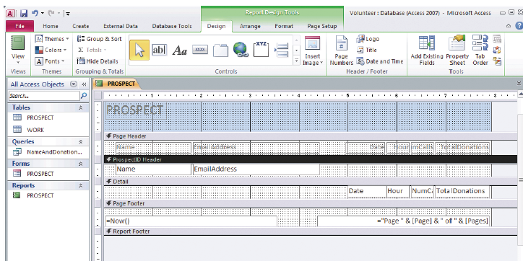
Report Design View

Slide 37
Grouping and Totaling
Click Group & Sort in Grouping & Totals
Click down arrow to “with no totals”
See result next slide
Click More
Click Report icon in View

Slide 38
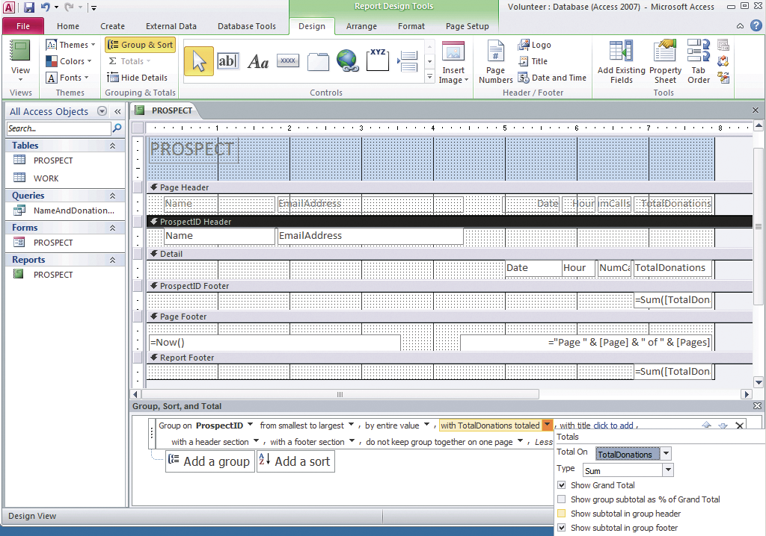
Creating a Sum of TotalDonations for Each Prospect
Notes:
In the ribbon, click Group and Sort in the Grouping & Totals section. In the bottom of the form, click More, and then click the down arrow next to the phrase “with no totals.” Next, select TotalDonations from the TotalOn box, and then check Show Grand Total and Show subtotal in group footer.

Slide 39
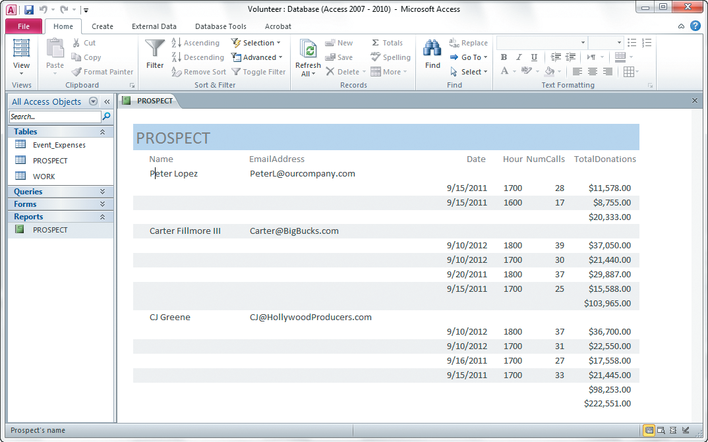
Report with Sum of TotalDonations
Notes:
The only remaining problem is that label NumCalls is cut off. We need to expand the box that contains this value. To do so, select Layout View from View in the ribbon, click Date, and then slide it slightly to the left. Do the same with Hour. Then expand NumCalls until you can see all of the label.

Slide 40
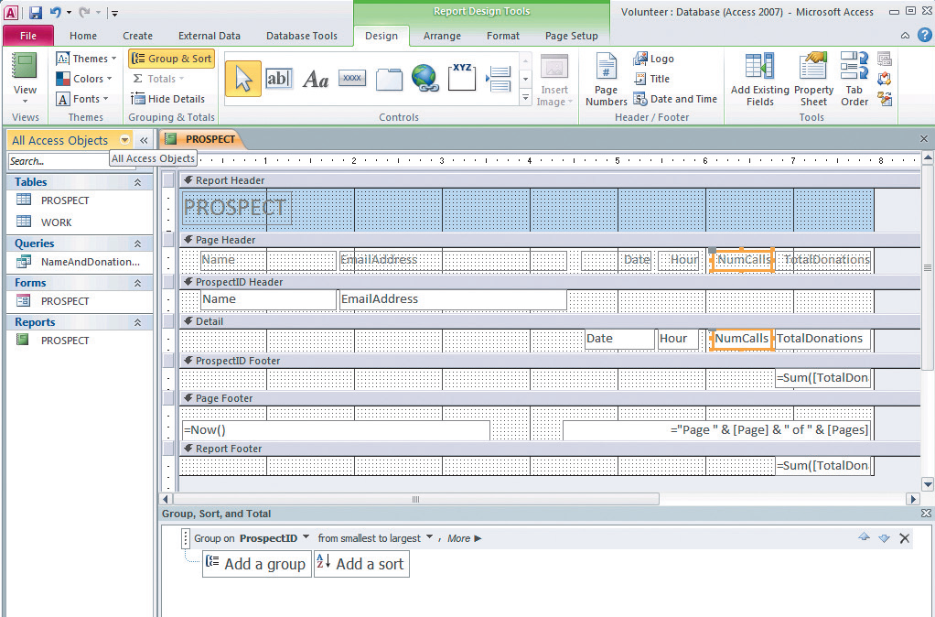
Increasing Size of Fields
Select Layout View from View in the ribbon, click Date. Slide it slightly to left. Do same with Hour. Expand NumCalls.

Slide 41
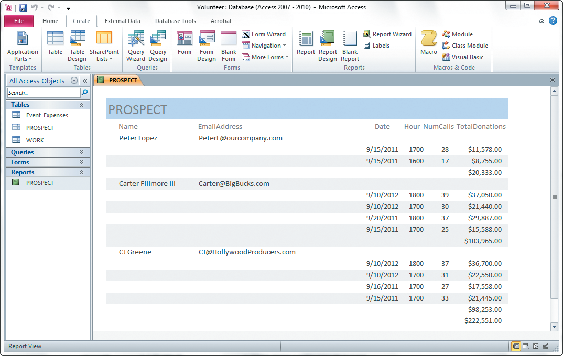
Final Version of Report

Slide 42
Active Review
Q1: How do you create tables?
Q2: How do you create relationships?
Q3: How do you create a data entry form?
Q4: How do you create queries using the query design tool?
Q5: How do you create a report?

Slide 43


