Slide 1
Chapter Extension 4
Database Design
Notes:
Chapter 5 provides the background for this Extension

Slide 2
Study Questions
Q1: Who will volunteer?
Q2: How are database application systems developed?
Q3: What are the components of the entity relationship data model?
Q4: How is a data model transformed into a database design?
Q5: What is the users’ role?
Q6: Who will volunteer? (continued)
Notes:
This chapter discusses how database application systems are developed, components of the entity-relationship data model, how a data model is transformed into a database design, and and the users’ role in database development.

Slide 3
Q1: Who Will Volunteer?
Challenge:
Secure 60 volunteers for six-night televised fund raiser
Problems:
Need to contact previous volunteers.
Need to know their years of experience, effectiveness, willingness to work multiple nights.
Need a usable database format.
Need to know how to proceed to create such a database?

Slide 4
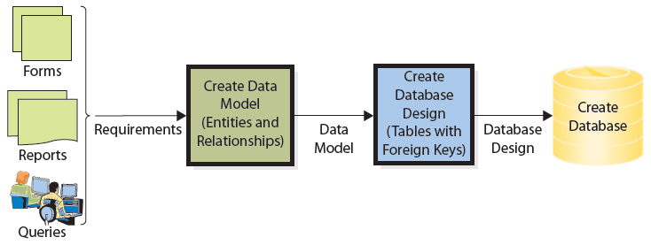
Q2: How Are Database Application Systems Developed?
Notes:
This figure summarizes the database application system development process.

Slide 5
Q2: How Are Database Application Systems Developed? (cont’d)
Build database
Interview users to identify and develop requirements for applications
Users approve data model
Analyze existing forms, reports, queries, other user activities
Summarize requirements and themes in a data model
Users review and validate data model

Slide 6
Q3: What Are the Components of the
Entity-Relationship Data Model?
Entities
  Something users want to track
  Order, customer, salesperson, item, volunteer, donation
Attributes
  Describe characteristics of an entity
  OrderNumber, CustomerNumber, VolunteerName, PhoneNumber
Identifier
  Uniquely identifies one entity instance from other instances
  Student_ID_Number

Slide 7
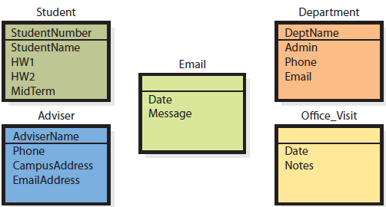
Student Data Model Entities
Notes:
Notice entities Email and Office_Visit do not have an identifier (primary key). Unlike Student or Adviser, the users do not have an attribute that identifies a particular email or office visit.
Database designer will deal with missing identifiers by adding columns, possibly using hidden identifiers, to implement the users’ view.

Slide 8
Example of Department, Adviser, and Student Entities and Relationships
A department may have many advisers
An adviser works in one department
An adviser advises many students
A student may have one or more advisers
1:N relationships
N:M relationships

Slide 9
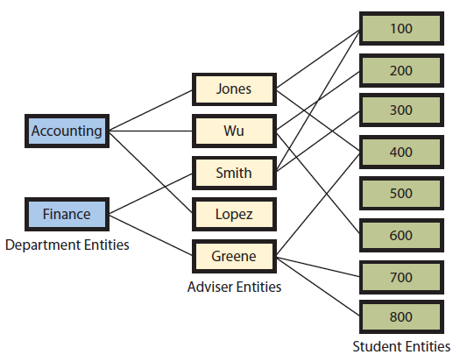
Example of Department, Adviser, and Student Entities and Relationships
N:M
1:N

Slide 10
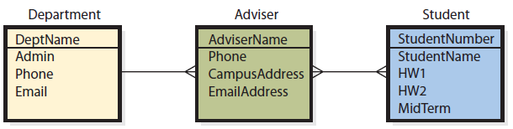
Example of Relationships Showing Maximum Cardinalities―Version 1
Crow’s Feet
1:N
N:M
1:N
One department can have many advisers, but an adviser is in only one department
N:M
An Adviser can have many students, and one student can many advisers

Slide 11
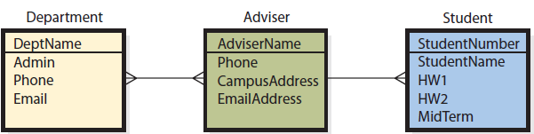
Example of Relationships Showing Maximum Cardinalities─Version 2
“Crow’s Foot”
N:M
A department has many advisors, and an advisor may advise for more than one department
1:N
A student has only one advisor, but an adviser may advise many students

Slide 12
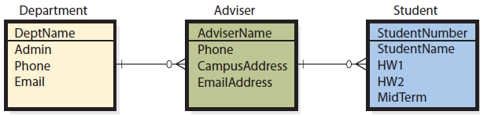
Crow’s-Foot Diagram Version
Maximum cardinality─maximum number of entities involved in a relationship. Vertical bar on a line means that at least one entity is required.
Minimum cardinality—minimum number of entities in a relationship. Small oval means entity is optional; relationship need not have an entity of that type.
Notes:
Example of relationships showing both maximum and minimum cardinalities.

Slide 13
Q4: How Is a Data Model Transformed into a Database Design?
Normalization
  Converting poorly structured tables into two or more well-structured tables
  Goal
    Construct tables with data about a single theme or entity
  Purpose
    To minimize data integrity problems

Slide 14
Data Integrity Problems
Data integrity problems produce incorrect and inconsistent information, users lose confidence in information, and the system gets a poor reputation
Can only occur if data are duplicated

Slide 15
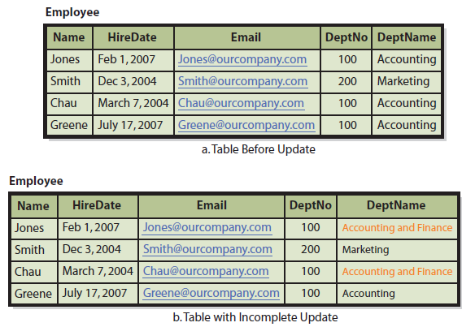
Poorly Designed Employee Table Causes Data Integrity Problem
Notes:
In the bottom figure, some rows show Dept. 100 is “Accounting and Finance,” others show Dept. 100 is “Accounting.” Which is correct?
The problem with the table is that it has two independent themes: Employee and Department.

Slide 16
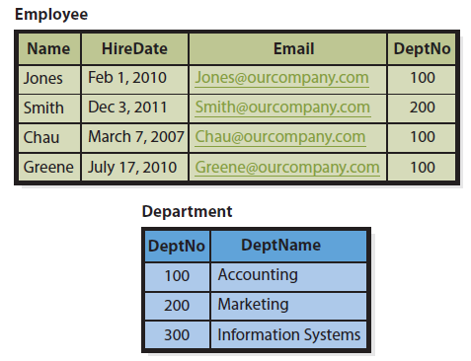
Two Normalized Tables
Single Themes
Notes:
By transforming the table into two tables, as here, the name of the department is stored just once, therefore no data inconsistencies can occur.

Slide 17
Normalization Cautions
Normalization is just one criterion for evaluating database designs
Normalized designs can be slower to process
Designers sometimes choose to accept non-normalized tables
Best design depends on users’ requirements

Slide 18
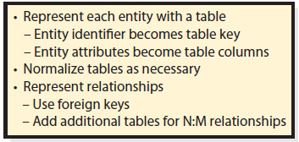
Transforming a Data Model into a Database Design
Transforming a table into a normal form to remove duplicated data and other problems

Slide 19
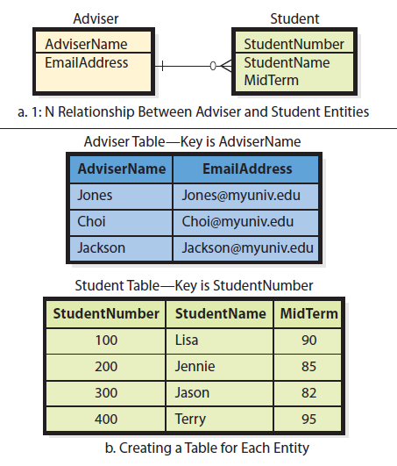
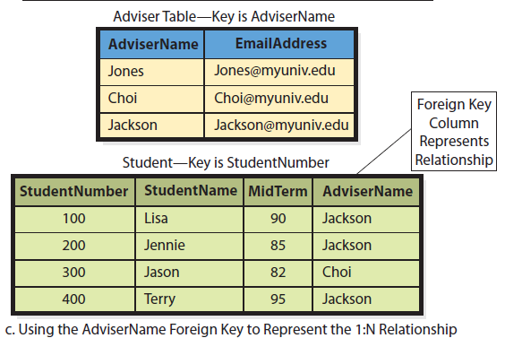
Representing 1:N Relationships
Notes:
To represent an N:M relationship, a third table is created, as shown in two tables on the right. The top table has two columns, AdviserName and EmailAddress. The AdvisorName field in the lower right table is a foreign key that links the records of the top table to those of the lower table by matching AdvisorName values.

Slide 20
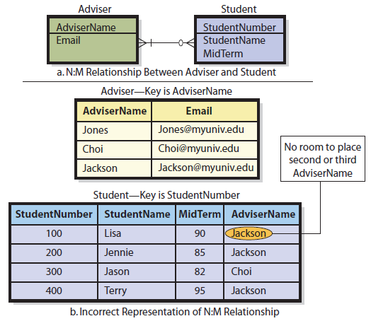
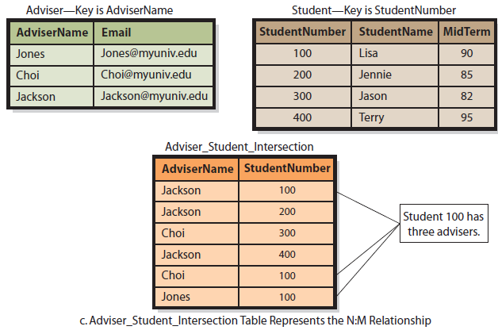
Representing an N:M Relationship: Strategy for Foreign Keys

Slide 21
Q5: What Is the Users’ Role?
Users are the final judges of:
    What data database should contain
    How tables should be related
Users review data model to ensure it accurately reflects users’ view of the business
            Mistakes will come back to haunt them

Slide 22
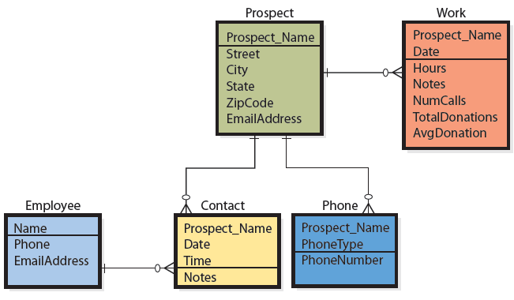
Q6: Who Will Volunteer?
Data Model for Volunteer Database
Notes:
This data model has an entity for Prospect, an entity for Employee, and three additional entities for Contact, Phone, and Work

Slide 23
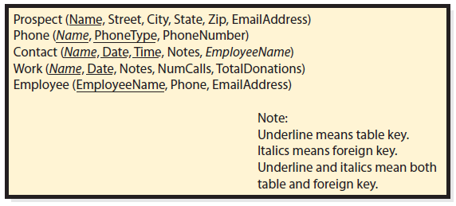
Q6: Who Will Volunteer? (cont’d)
First Table Design

Slide 24
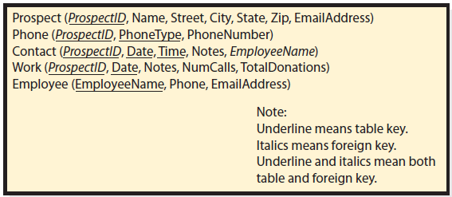
Q6: Who Will Volunteer? (cont’d)
Second Table Design
Notes:
Values of ProspectID will have no meaning to the users, but it will be used to ensure each prospect obtains a unique record in the Volunteer database. Because this ID has no meaning to the users, the consultant will hide it on forms and reports that users see.

Slide 25
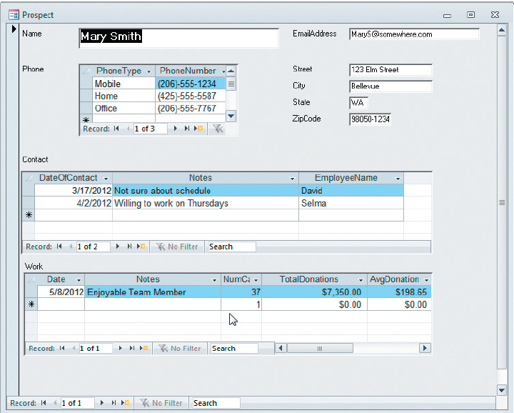
Volunteer Prospect Data Entry Form
Notes:
Once tables are designed, the consultant creates a Microsoft Access 2007 database by defining the tables, creating relationships among the tables, and constructing forms and reports.

Slide 26
Active Review
Q1: Who will volunteer?
Q2: How are database application systems developed?
Q3: What are the components of the entity relationship data model?
Q4: How is a data model transformed into a database design?
Q5: What is the users’ role?
Q6: Who will volunteer? (continued)

Slide 27


