Slide 1
Chapter Extension 3
Introduction to Microsoft
Excel 2010

Slide 2
Study Questions
Q1: What is a spreadsheet?
Q2: How do you get started with Excel?
Q3: How can you enter data?
Q4: How can you insert and delete rows and columns and change their size?
Q5: How can you format data?
Q6: How can you create a (simple) formula?
Q7: How can you print results?
Notes:
This chapter extension teaches basic skills with Microsoft Excel, a product for creating and processing spreadsheets. If you already know how to use Excel, use this chapter extension for review.

Slide 3
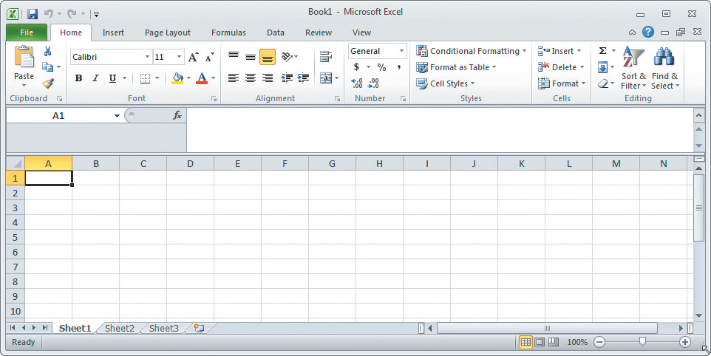
Q1: What Is a Spreadsheet?
Excel Spreadsheet Showing Rows and Columns
Notes:
Excel spreadsheets have rows and columns. The rows are identified by numbers, and the columns are identified by letters.

Slide 4
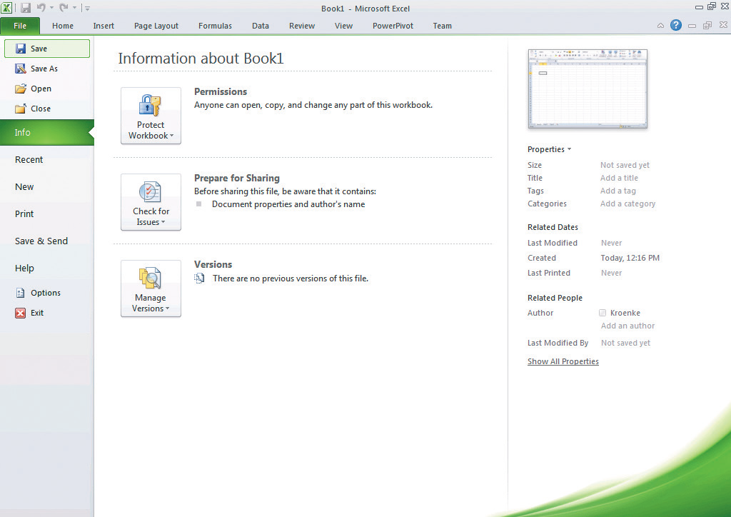
Q2: How Do You Get Started with Excel?
Save by clicking File, then Save or Save As

Slide 5
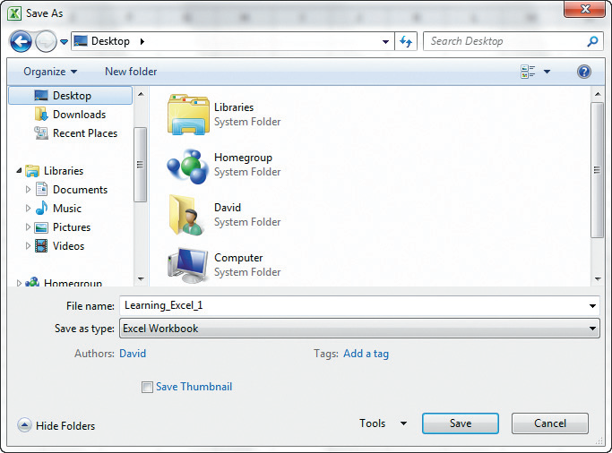
Entering a File Name in Excel

Slide 6
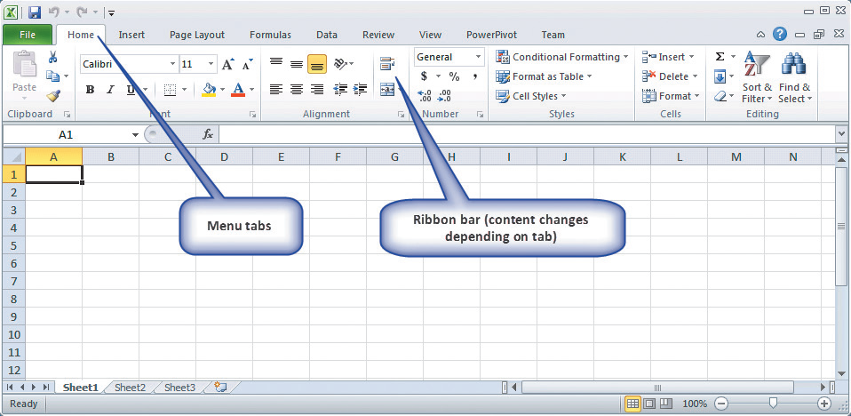
Excel Menu Tabs and Ribbon Bar

Slide 7
Ribbon with Home Tab Selected
Notes:
Home tab for general work, the tools and selection are the most useful
Insert tab for pictures, graphs, hyperlinks, or other items into your spreadsheet
Page Layout tab to format your page, often for printing
Formulas tab to create more complex formulas
Data tab for filtering and sorting data in your spreadsheet
Review tab for tracking changes and making comments
View tab for configuring the appearance of Excel
Add-Ins tab for using nonstandard features that have been added to Excel, such as PowerPivot and Team shown

Slide 8
Q3: How Can You Enter Data?
Three general methods
  Key in the data
  Let Excel add data based on a pattern
  Import from another file or program

Slide 9
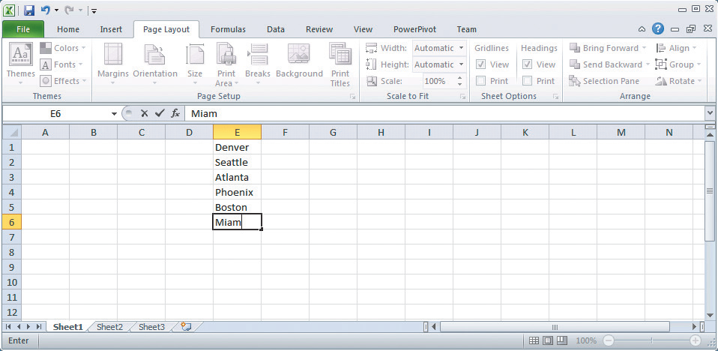
Key in the Data: Entering City Names in Column E
Use F2 key to make corrections without retyping the whole entry.
Notes:
The user has keyed names of cities into column E and is in the process of adding Miami.

Slide 10
Let Excel Add Data Using a Pattern
Automatically repeat items already entered
Use fill handle to fill data
Fill data into adjacent cells
Fill formulas into adjacent cells
Fill in a series of numbers, dates, or other built-in series items
Fill data by using a custom fill series

Slide 11
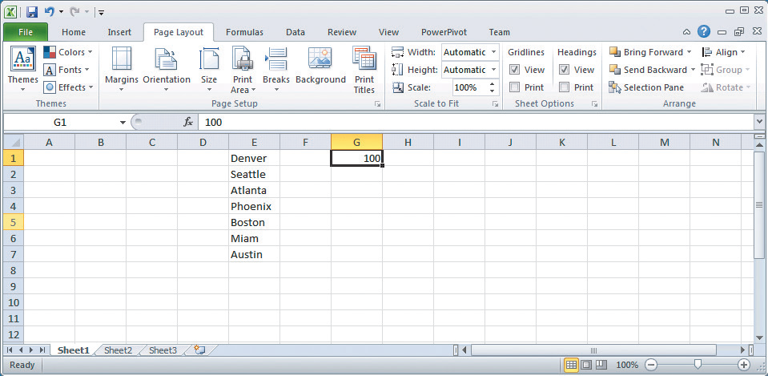
Entering Identical Data in Multiple Cells: Step 1
Little black box in lower right-hand corner.

Slide 12
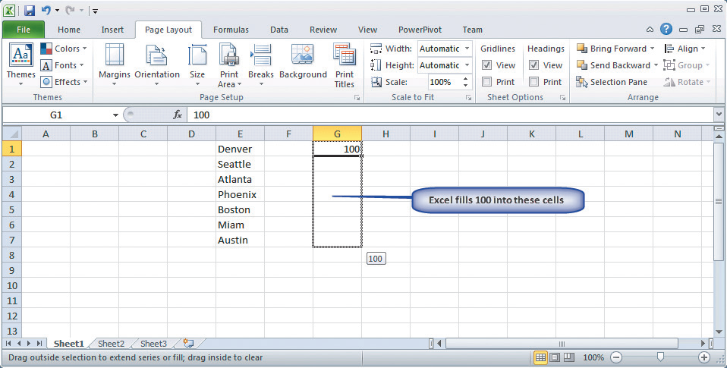
Entering Identical Data In Multiple Cells: Step 2
Click left mouse button on little black box and drag cursor to cell G7

Slide 13
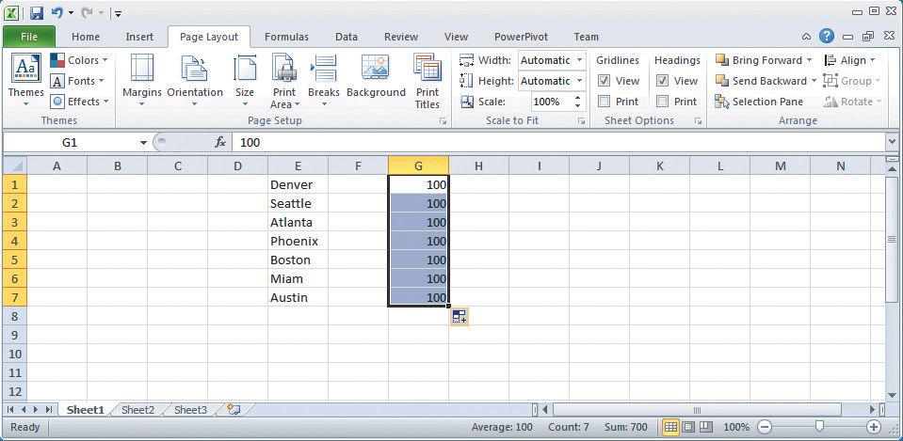
Entering Identical Data In Multiple Cells: Step 3
Release mouse button

Slide 14
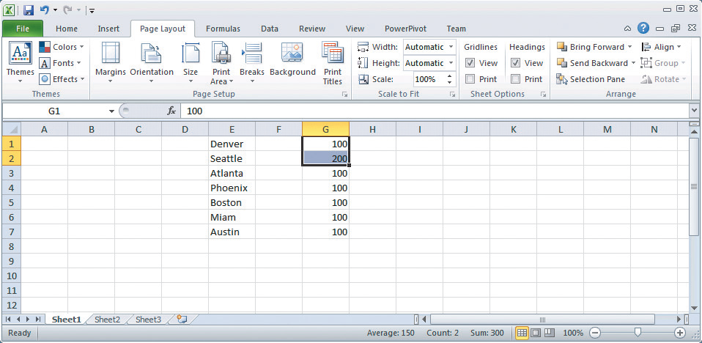
Entering Patterned Data in Multiple Cells
Select pattern: 100, 200

Slide 15
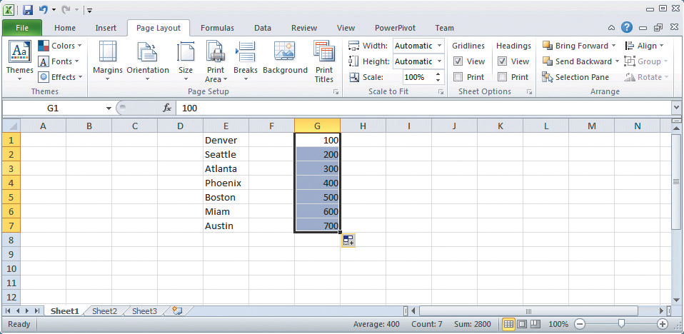
Patterned Data Entered in Multiple Cells
Click, drag, drop pattern to G7

Slide 16
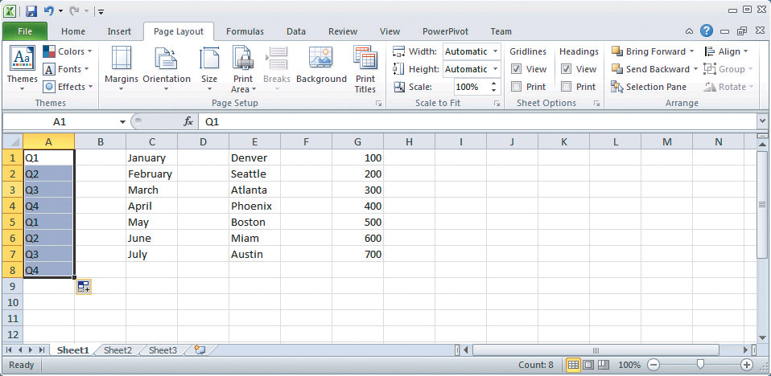
Sophisticated Entry of Patterned Data in Multiple Cells
Select cells for pattern in columns A and B
Notes:
If you key January and February into cells C1 and C2 and then select both cells and drag down, Excel will fill in with March, April, May, and so on. Or, if in column A you key in the sequence Q1, Q2, Q3, and Q4, Excel will repeat pattern.

Slide 17
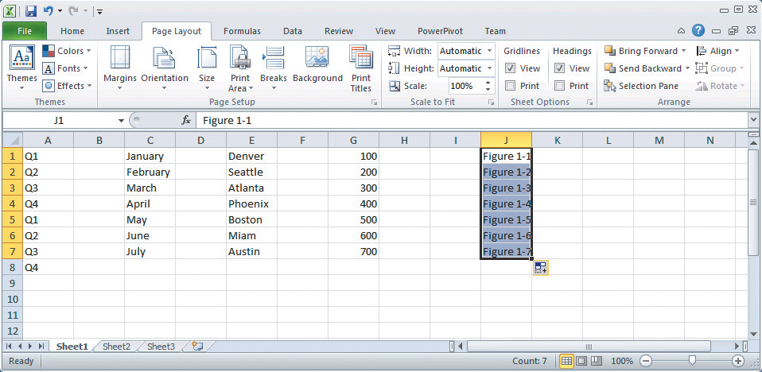
Find Patterns Within Text Values
Selecting and dragging cells J1 and J2 produces sequence

Slide 18
Q4: How Can You Insert and Delete Rows and Columns and Change Their Size?
Insert rows
    Left click in row number above where new row(s) to be inserted
    Right click, select Insert from menu
Delete rows - Delete key
Change row size
    Click and hold on bottom of row number (cursor changes to vertical bar)
    Drag mouse to desired row height

Slide 19
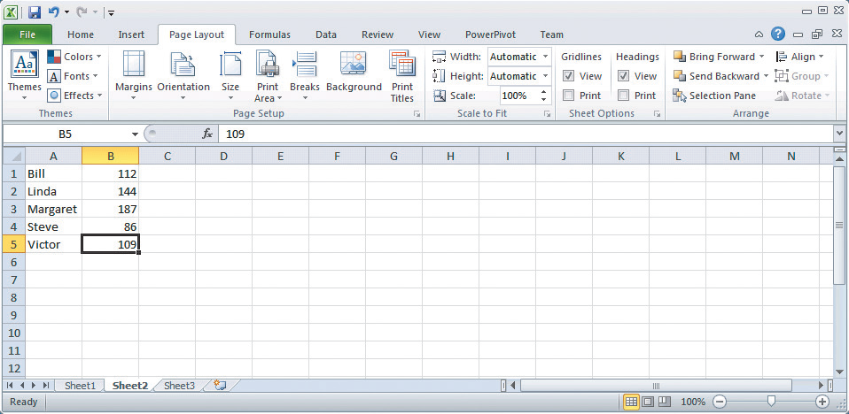
Adding New Rows for Column Headings
Insert two new rows

Slide 20
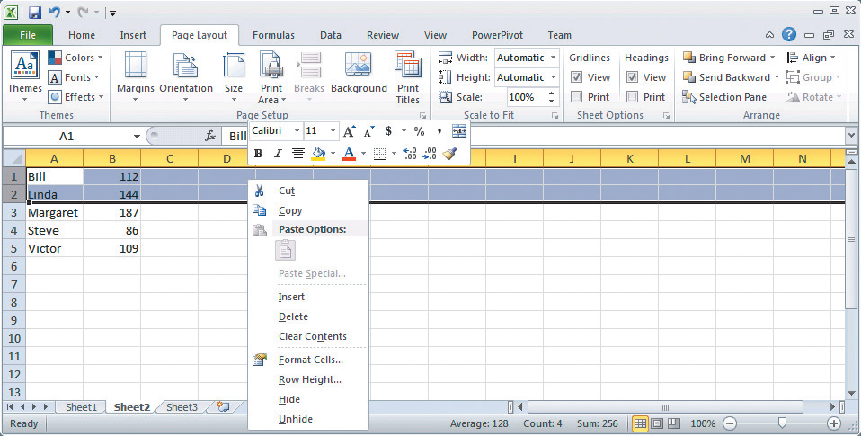
Adding Inserts Such as New Rows
Click row 1 and select two rows. Using right mouse button, click selection and menu box appears. Left-click on Insert .

Slide 21
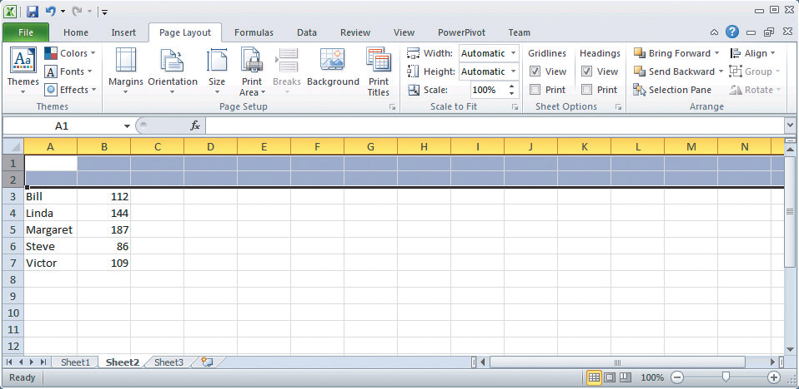
User Has Added New Rows for Column Headings
Two new rows added

Slide 22
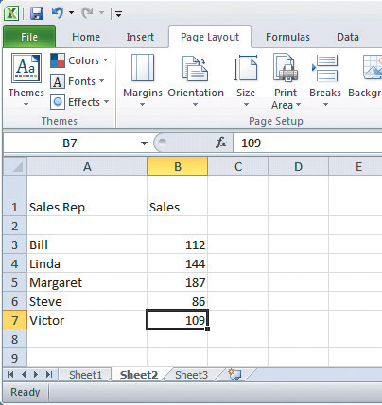

Changing Cursor to a Vertical Bar to Change Column Widths
Click line between A and B. Cursor changes to a vertical bar with an arrow on each side. Move cursor to right to increase size and to left to decrease.

Slide 23
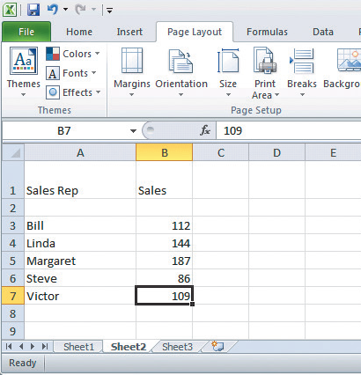
Rows Added and Sizes of Columns Changed
Column A width changed

Slide 24
Q5: How Can You Format Data?
Ribbon options
    Alignment (left, center, right) within cell
    Font size, style, color
    Number style – currency, comma, percentage, number of decimal places
    Cell lines and borders

Slide 25
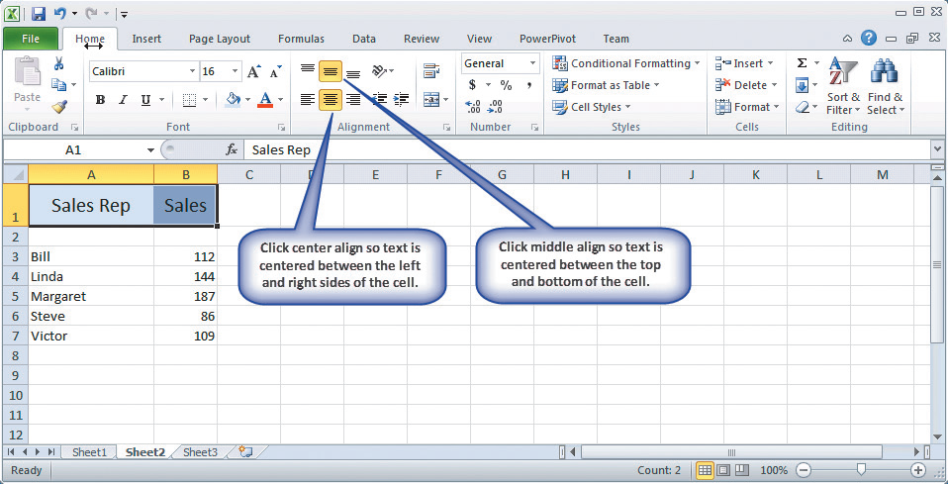
Centering Labels in Cells

Slide 26
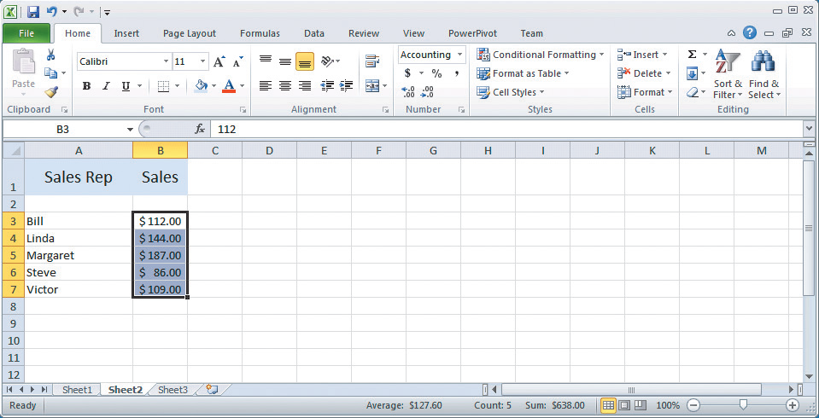
Adding Dollar Signs In Cells

Slide 27
Q6: How Can You Create a (Simple)
Formula?
Formula
    Key in: =C3+D3+E3
    Copy and paste formula to other cells
    Using built-in function such as SUM

Slide 28
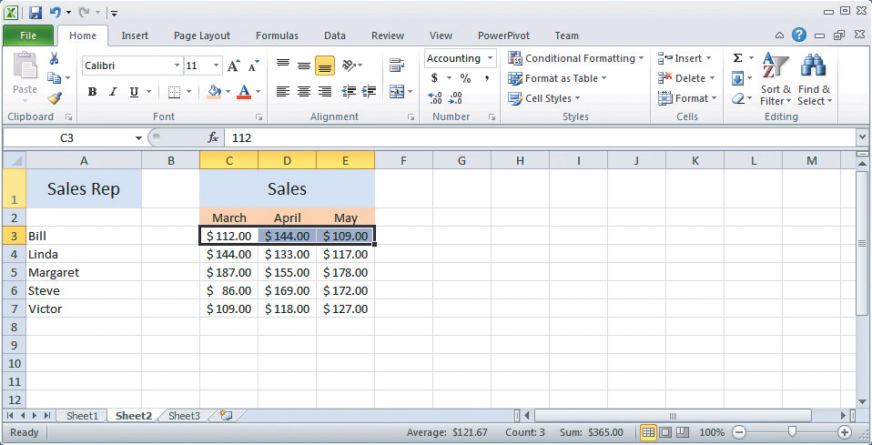
Selecting Cells to Be Summed
Click cell G3 and enter expression
= C3 + D3 + E3
Press F2 to highlight cells involved in calculation.

Slide 29
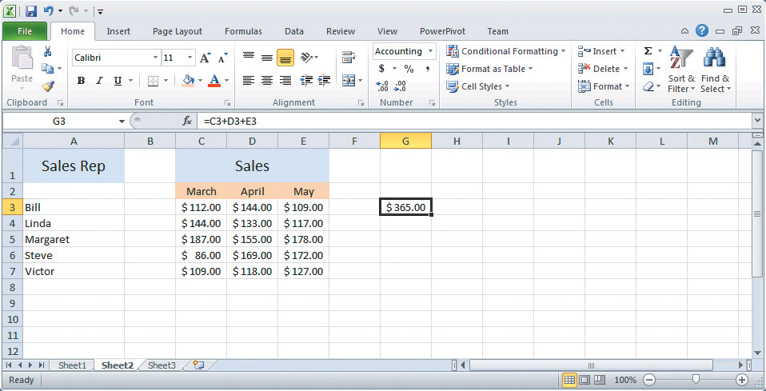
Result of Applying a Formula That Summed Cells C3, D3, and E3
Formula
Result

Slide 30
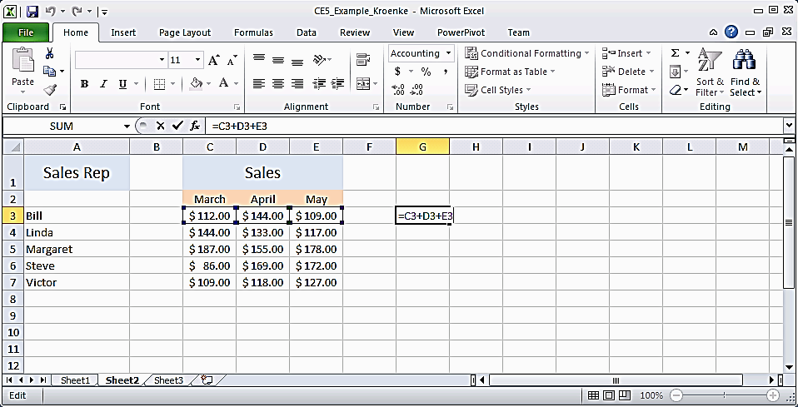
Using F2 Function Key to Show Color Coding of Cells Involved in a Calculation

Slide 31
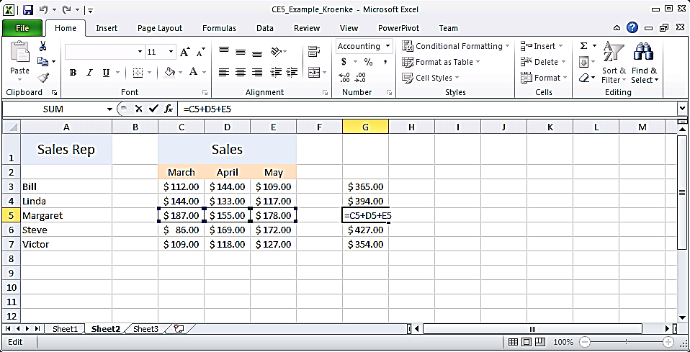
Using F2 Function Key to Confirm a Formula Was Correctly Copied into Multiple Cells
Select cell G3 and select Copy. Next, highlight cells G4 through G7, right-click, and select Paste.
Excel adjusted row numbers when it copied the formula!

Slide 32
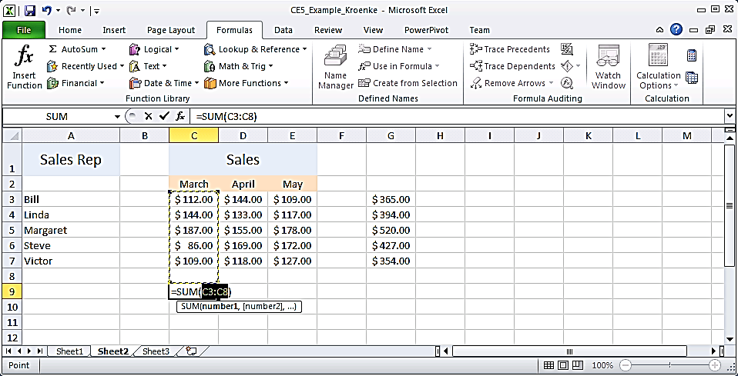
Summing Sales by Month Using AutoSum Function
Select cell C9. Then select Formulas tab at top of ribbon. At top of tab, click AutoSum (∑). Press Enter

Slide 33
Q7: How Can You Print Results?
Print Preview
  Use to save paper and ink
Page layout tab
  Sheet Options
    View and print with gridlines
    Headings
    Orientation: Landscape or Portrait
Print area
  Specify a portion of worksheet to print

Slide 34
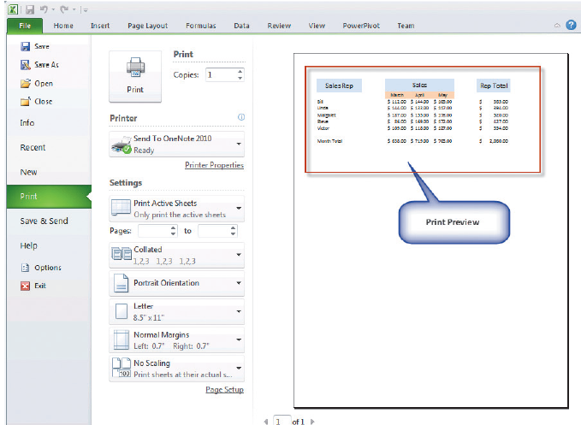
Print Preview Screen In Excel

Slide 35
Active Review
Q1: What is a spreadsheet?
Q2: How do you get started with Excel?
Q3: How can you enter data?
Q4: How can you insert and delete rows and columns and change their size?
Q5: How can you format data?
Q6: How can you create a (simple) formula?
Q7: How can you print results?

Slide 36


