Slide 1
Chapter Extension 2
Collaborative Information Systems for Student Projects

Slide 2
Study Questions
Q1: What are the IS requirements for student project collaborations?
Q2: How can you use collaboration tools for team communication?
Q3: How can you use collaboration tools to share content?
Q4: How can you use collaboration tools for project planning and management?
Q5: Which collaboration IS is right for your team?
Notes:
Most of this chapter extension focuses on collaboration tools, the software component of an information system.
It will be your content as well as your meta-data for project management and for demonstrating that your team practiced iteration and feedback.

Slide 3
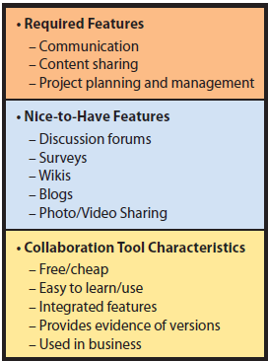
Q1: What Are the IS Requirements for Student Project Collaborations?
Notes:
Face-to-face meetings are difficult to schedule and invariably someone can’t be on campus, or is stuck in traffic, or misses the bus, or whatever.

Slide 4
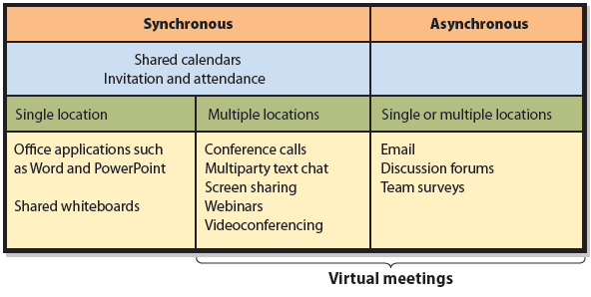
Q2: How Can You Use Collaboration Tools For Team Communication?

Slide 5
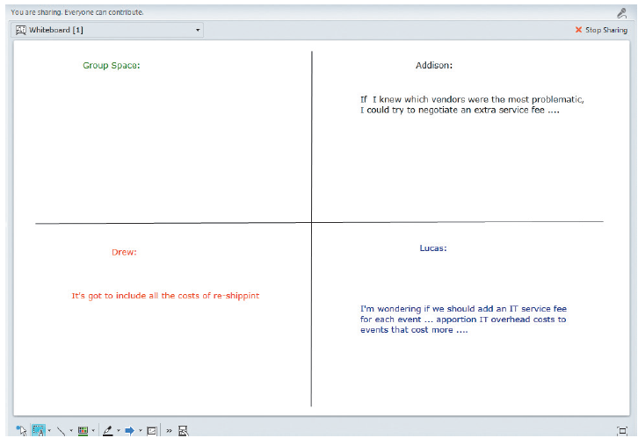
Office 365 Lync Whiteboard Showing Simultaneous Contributions

Slide 6

Videoconferencing
Notes:
Google Talk, NetMeeting, Skype

Slide 7
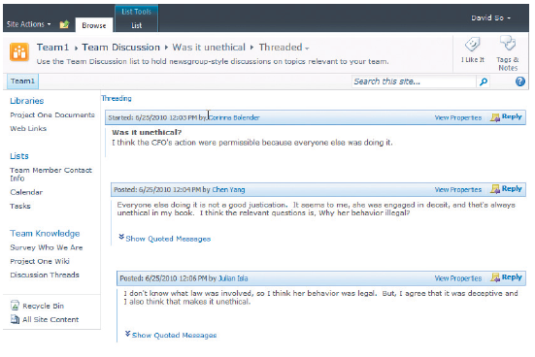
Discussion Forums

Slide 8
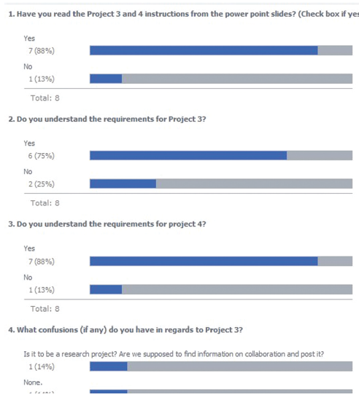
Team Surveys
Notes:
SurveyMonkey (www.surveymonkey.com) is one common survey application program. You can find others on the Internet. Microsoft SharePoint has a built-in survey capability, as discussed in Q5.

Slide 9
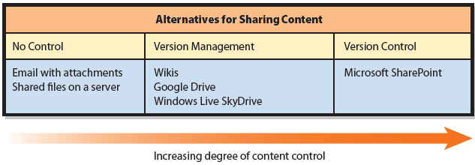
Q3: How Can You Use Collaboration
Tools to Share Content?
Collaboration Tools for Sharing Content
Notes:
No Control
FTP provides access to shared files on servers (discussed in Chapter 6).
Storing documents on servers is better than using email attachments because documents have a single storage location. They are not scattered in different team members’ email boxes, and team members have a known location for finding documents.
Team will need to develop manual procedures to prevent two people from working on the same document at the same time, or will need to use a tool that supports version management.

Slide 10
Shared Content with Version Management
Version management
Wikis
    Shared knowledge management
    Repository of team knowledge
    Tracks who created entry, date of creation, modified entry, date of change and other pertinent data

Slide 11
Shared Content with Version Management (cont’d)
Google Docs & Spreadsheets
    Free
    Save, edit files on Google server
    Users can access files at same time
    Google merges changes into single document
    Keeps pre-change versions
    Records who made changes and when
    Tracks revisions with summary of changes
    Documents saved as Word, Excel, other common formats
    Automatically notifies Google group members by email that documents exist with hyperlink to group account

Slide 12
Google Drive
Free service provides a virtual drive in the cloud
Create folders and store files, including documents, spreadsheets, presentations, drawings, and other types of data
Establish Google account using Hotmail, university, or other email service

Slide 13
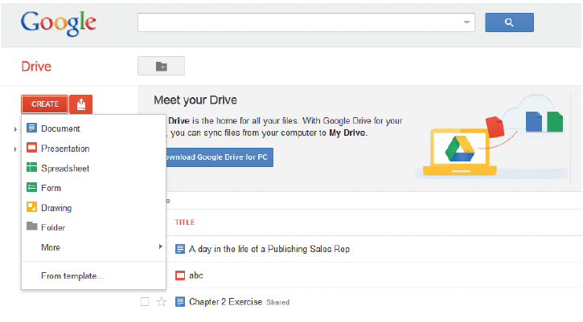

Google Drive Creation Options
Notes:
Create a Google document, go to http://drive.google.com

Slide 14
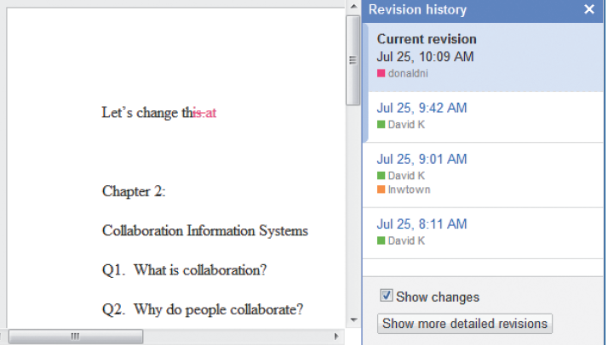
Example of Sharing a Revised Document on Google Drive
Notes:
Documents are stored on a Google server. Users can access the documents from Google and simultaneously see and edit documents. In the background, Google merges the users’ activities into a single document.
Refresh document to see latest changes. Google tracks document revisions, with brief summaries of changes made.

Slide 15
Windows Live SkyDrive
Store and share Office documents and other files
25 GB of free storage
Share folders with others by entering their Windows Live IDs or email address
License-free Office Web Apps versions of Word, Excel, PowerPoint, OneNote
Open and save documents directly from and to SkyDrive from Microsoft Office products
Notes:
To set up a SkyDrive account, you need a Windows Live ID. If you have either a Hotmail or an MSN email account, that account is your Windows Live ID. If you do not have a Hotmail or an MSN email account, you can create a Windows Live ID with some other email account, or you can create a new Hotmail account, which is free.

Slide 16
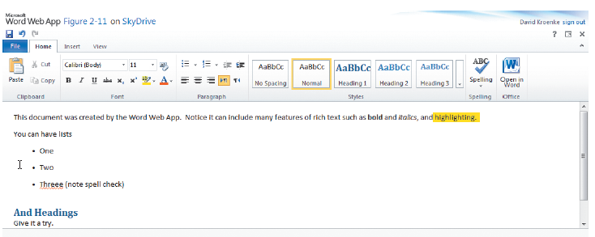
Example Use of Word Web App

Slide 17
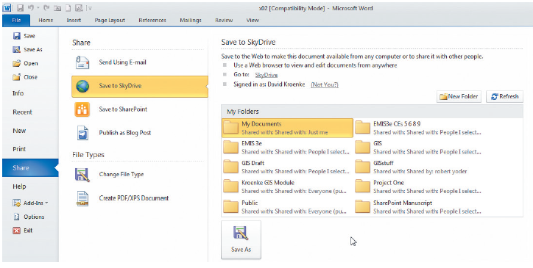
Saving a Word 2010 Document in a SkyDrive Account

Slide 18
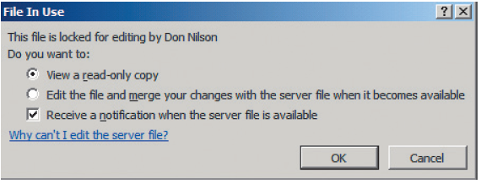
Opening a Document Locked by Another User in Word Web App

Slide 19
Shared Content with Version Control
Permission-Limited Activity
Each team member given account with set of permissions
      Read only
      Read and edit
      Read, edit, delete
      No permission to view
Document Checkout
Workflow Control
Notes:
Checking out documents prevents others from editing it while checked out.
Workflow control manages activities in a pre-defined process.

Slide 20
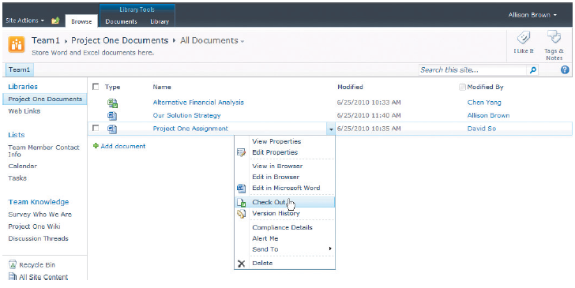
Checking Out a Document

Slide 21
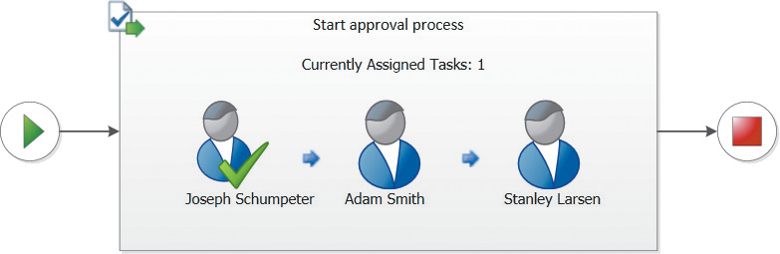
Example Workflow
Notes:
SharePoint is most popular document control system. Others include MasterControl (www.mastercontrol.com) and Document Locator (www.documentlocator.com). Software development teams use applications such as CVS (www.nongnu.org/cvs) or Subversion (http://subversion.tigris.org) to control versions of software code, test plans, and product documentation.

Slide 22
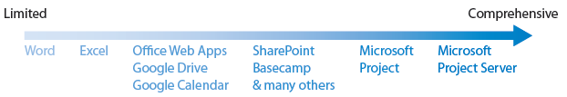
Q4: How Can You Use Collaboration Tools for Project Planning and Management?
Continuum of Task Tracking/Project Management Tools

Slide 23
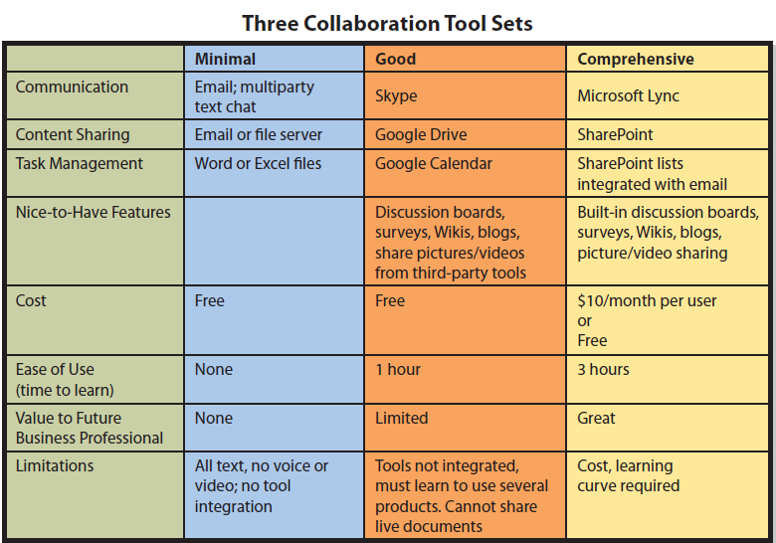
Q5: Which Collaboration IS Is Right for Your Team?

Slide 24
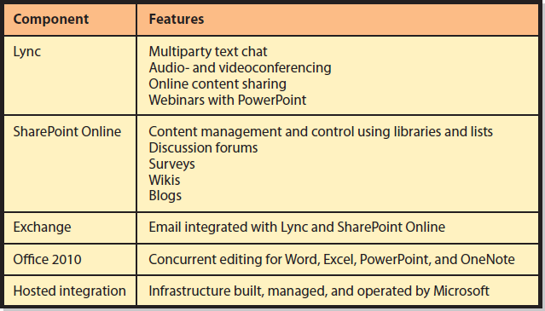
Office 365 Components and Features
Notes:
Office 365 is provided as a cloud-based service over the Internet. (See Chapter 6 for the meaning of the term cloud-based.) Figure CE2-17 summarizes Office 365 features.
You can click on users’ names in emails or in SharePoint, and Office 365 will automatically start a Lync text, audio, or video conversation with that user if he or she is currently available. All text messages that you send via Lync are automatically recorded and stored in your email folder.

Slide 25
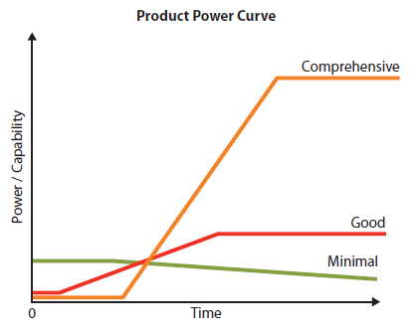
Choosing the Set for Your Team
Notes:
Graph that shows the relationship of the power (the utility that one gains from a software product) as a function of the time using that product. A flat line means you are investing time without any increase in power. The ideal power curve starts at some value at time zero and has no flat spots.

Slide 26
Don’t Forget Procedures and People!
Hardware hosted on cloud
Meta-data for project management, team iteration and feedback
Think about procedure and people components
  Agree on tools and usage
  Training
  Identify special job or roles needed

Slide 27
Active Review
Q1: What are the IS requirements for student project collaborations?
Q2: How can you use collaboration tools for team communication?
Q3: How can you use collaboration tools to share content?
Q4: How can you use collaboration tools for project planning and management?
Q5: Which collaboration IS is right for your team?

Slide 28
